Slide 1
Docker Compose
Multiple Containers with UI, Service and database(mongo db)

Slide 2
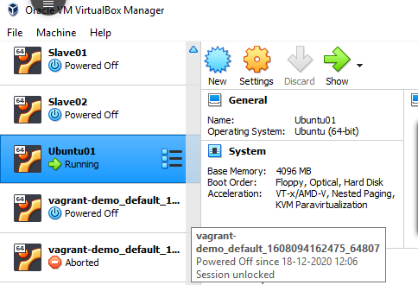
Connect to node from virtual box
Start ubuntu01 node

Slide 3
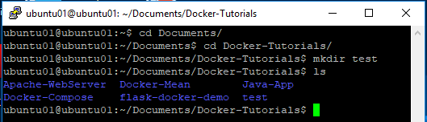
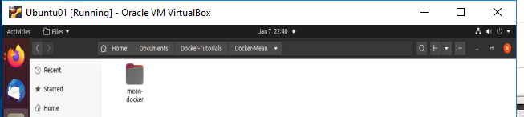
CREATE Project Folder
There are two ways to create folder
Connect putty through WinScp through route to location intend to create project folder using mkdir command
Another way directly login through server
Here mean-docker is project folder

Slide 4
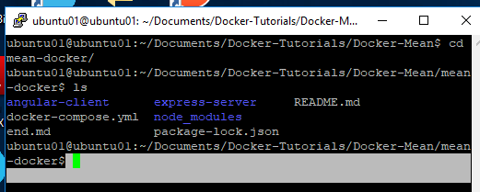
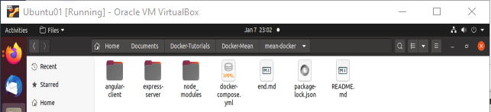
Create containers
We have to create 3 folders in project folder location, to facilitate criteria of UI, Service and database layers.
Below images shows the structure of folders
These folders will become containers in docker

Slide 5
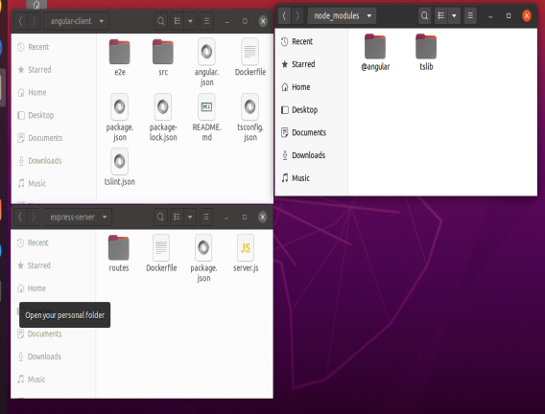
Container files
Each container their respective files like docker, routes, src, angular etc..

Slide 6
Create docker yaml file
Create docker yaml file like below to call containers and install required software's
version: '2' # specify docker-compose version
# Define the services/containers to be run
services:
angular: # name of the first service
build: angular-client # specify the directory of the Dockerfile ports: - "4200:4200" # specify port forewarding
express: #name of the second service
build: express-server # specify the directory of the Dockerfile ports: - "3000:3000" #specify ports forewarding
links: - database
database: # name of the third service
image: mongo # specify image to build container from
ports: - "27018:27018" # specify port forewarding
Above script calling 3 docker containers to up and run

Slide 7
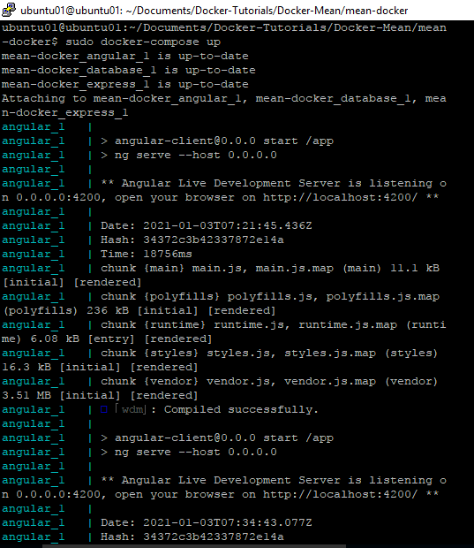
Run docker compose to run project
Run below command to execute container specified in docker yaml file
$docker-compose up
Can see below screen with execution of all containers

Slide 8
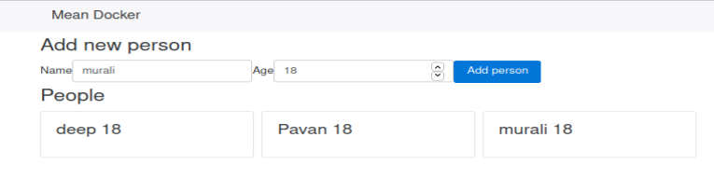
CREATE Project Folder
Final output is like below:
http://localhost:4200
Above screen saves name and age data to mongo db through service layer using angular js at UI, express js at service and backend as mongo db.
Below is service layer url.
http://localhost:3000

Slide 9
Thank you ☺

