Slide 1
405 BBLAB Summer Course
2023/08/09

Slide 2
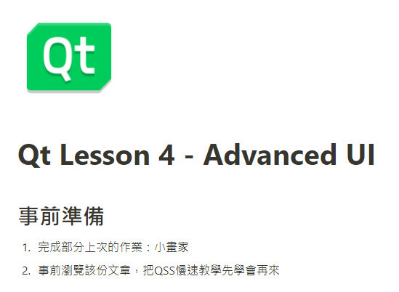
Qt – Advanced UI
https://www.notion.so/wesleych3n/Qt-Lesson-4-Advanced-UI-ed0cd9f1ea594d6bab7872d52b17b113

Slide 3
調用圖片路徑
圖片和exe放同一個目錄下，程式中直接用相對路徑
<img src="./images/test.png"> 目前的目錄下的檔案
<img src="../test/images/test.png"> 上一層目錄下的圖片檔案
絕對路徑
C:/Desktop/test/images/test.png
https://blog.csdn.net/weixin_52068490/article/details/123253449

Slide 4
自適應介面
void painterEvent(QPaintEvent *ev);
void Widget::paintEvent(QPaintEvent *event){
QPainter p(this); //指定當前視窗為繪圖設備(畫布)
p.drawPixmap(0,0,width(),height(),QPixmap("圖片路徑"));
}
https://juejin.cn/post/7030813126190694414

Slide 5
HW2 - Painter
https://github.com/bblabNTU/LabHW_112_Undergraduate/tree/main/HW2
畫筆粗細
畫出幾何圖形
顏色選擇(可使用點選，用下拉式選單更好)
橡皮擦
全部清除
選單(開新檔案、開啟舊檔、另存新檔)
美化介面(美化畫布以外的地方or按鈕樣式)
(Extra)進階功能:回復上一步(Stack資料結構)

Slide 6
打包exe
Qt (Release) -> 發佈程式 -> 程式打包
EzDeploy
https://github.com/bblabNTU/LabHW_112_Undergraduate/tree/main/HW2/EzDeploy(Qt打包)/EzDeploy
Windeployqt + Enigma Virtual Box
https://blog.51cto.com/u_14114084/3652819

Slide 7
405 BBLAB Master Course
2023/08/09

Slide 8
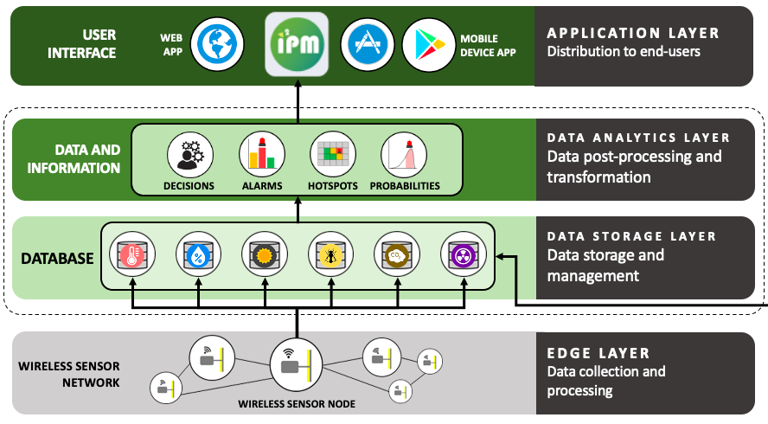
Exercise: Insect Pest Management (IPM)

Slide 9
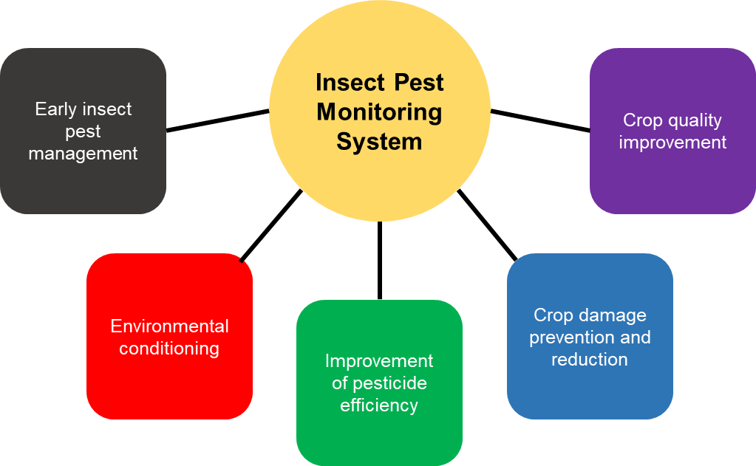
Exercise: Insect Pest Management (IPM)

Slide 10












WSN
Android
Sticky paper camera
Mobile APPs
Server
iOS
Plant disease camera
API
Tainan DARES
Website
Other sources
TARI
Frontend
Backend

Slide 11
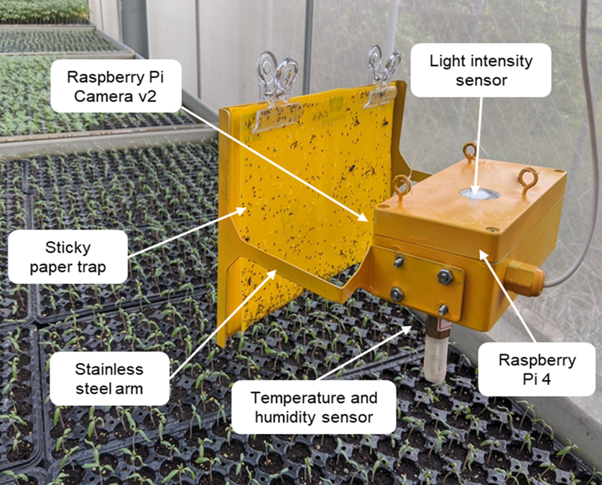
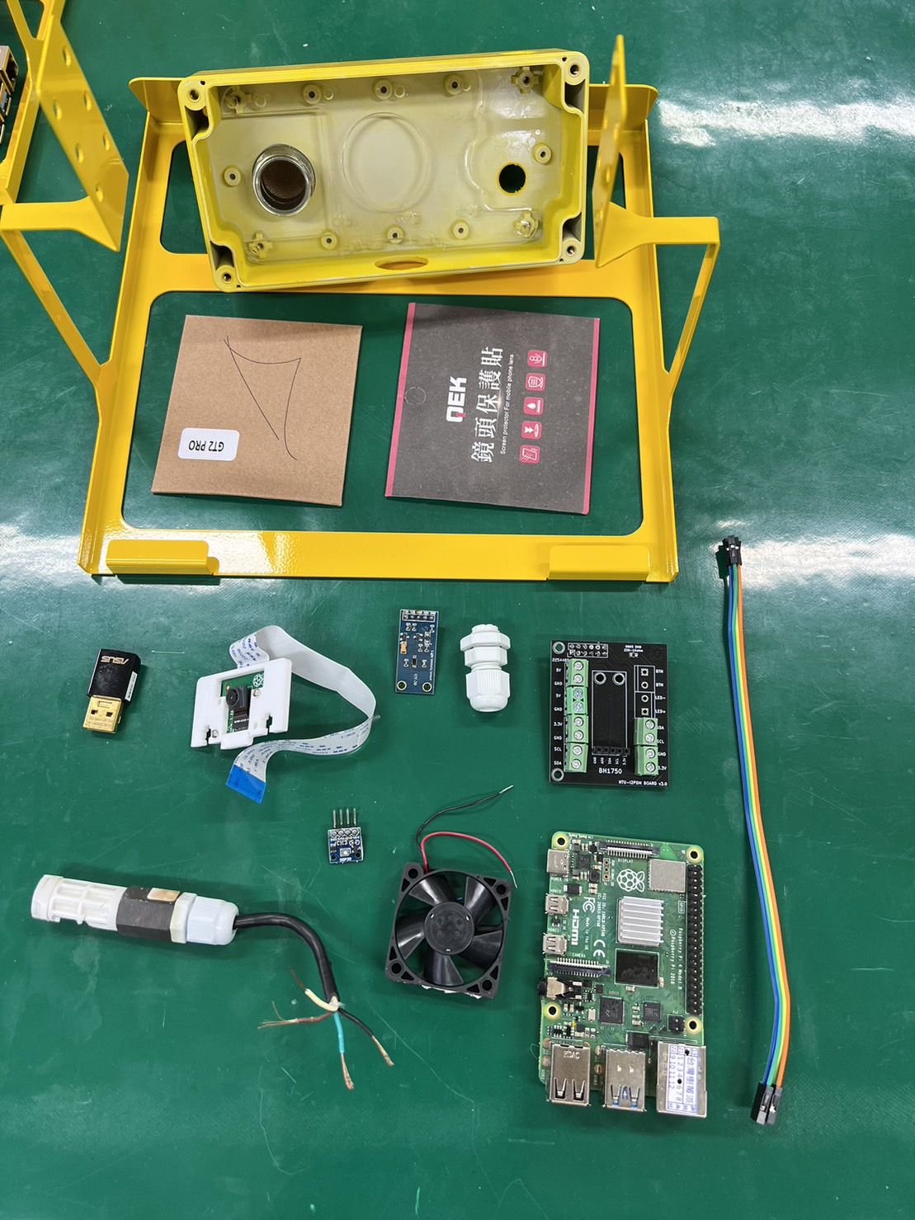
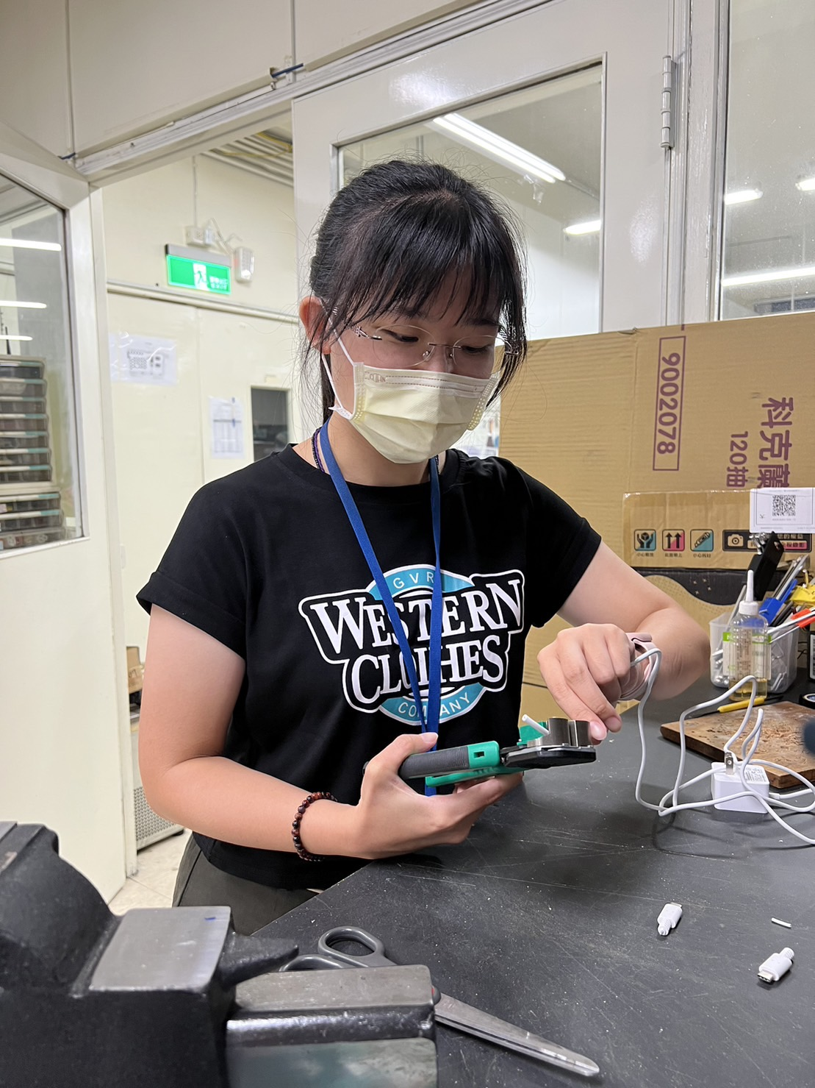
Materials
SHT20
SGP30(杜邦線)
GY30
Pi Camera
Fan
Dongle
PCB
Rpi
Glass(30/40)
防水接頭
Power Supply

Slide 12
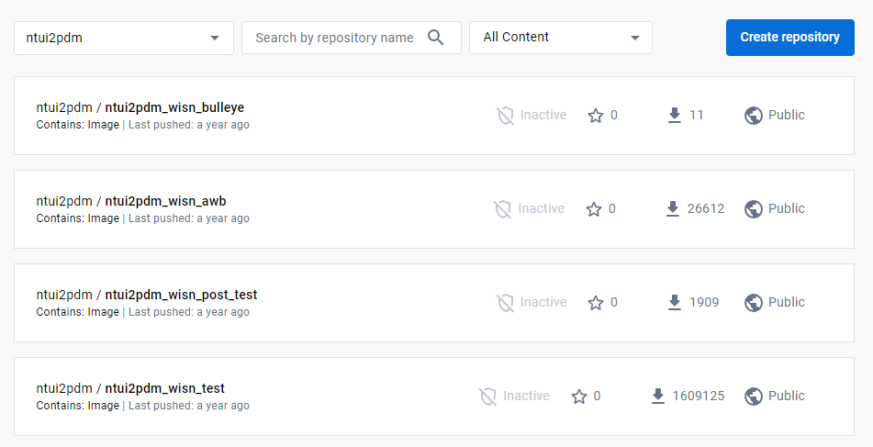
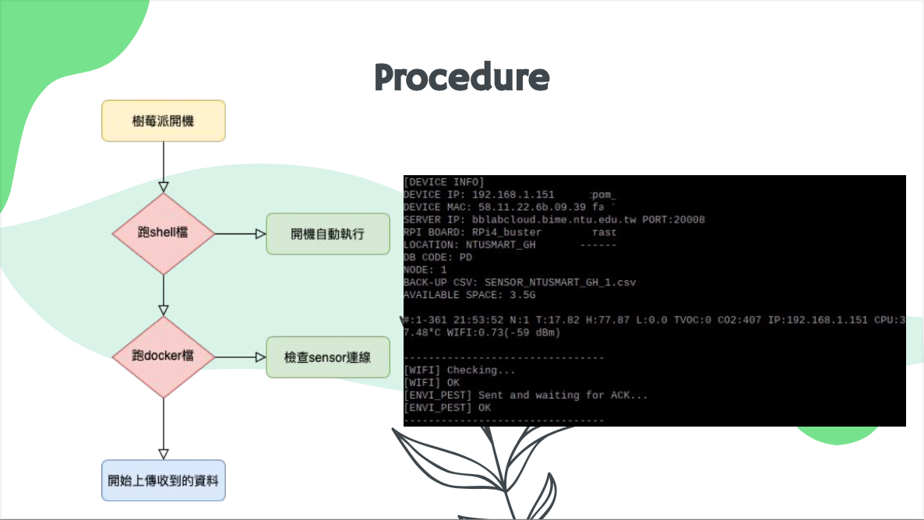
Software

Slide 13
Thanks for listening

