Slide 1
Effects of the Parameters in Monte Carlo Approach to its Reliability
Zhejun Li
Zhejun.li@durham.ac.uk

Slide 2
Outline
1. Theory bases
2. Procedure of Monte Carlo Approach
3. Parameters that matters
4. Analysis criterion
5. Results and analysis
6. Further analysis

Slide 3
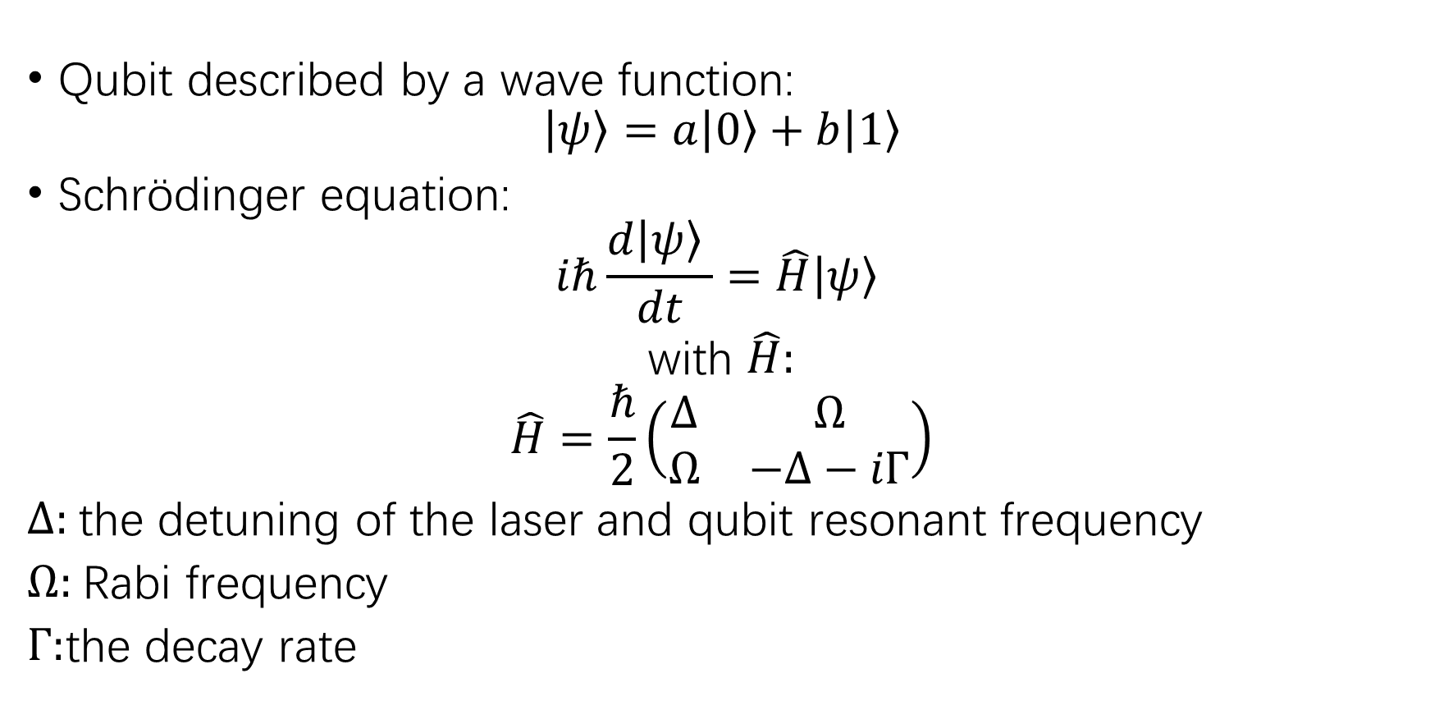
1. Theory bases
Qubit described by a wave function:
$$\left|\left.ψ\right\rangle =a\right.\left|\left.0\right\rangle +b\right.\left|\left.1\right\rangle \right.$$
Schrödinger equation:
$$iℏ\frac{d\left|\left.ψ\right\rangle \right.}{dt}=\hat{H}\left|\left.ψ\right\rangle \right.$$
with $\hat{H}:$
$$\hat{H}=\frac{ℏ}{2}\left(\begin{matrix}∆ & Ω \\ Ω & −Δ−iΓ\end{matrix}\right)$$
$Δ:$the detuning of the laser and qubit resonant frequency
$Ω:$Rabi frequency
$Γ:$the decay rate

Slide 4
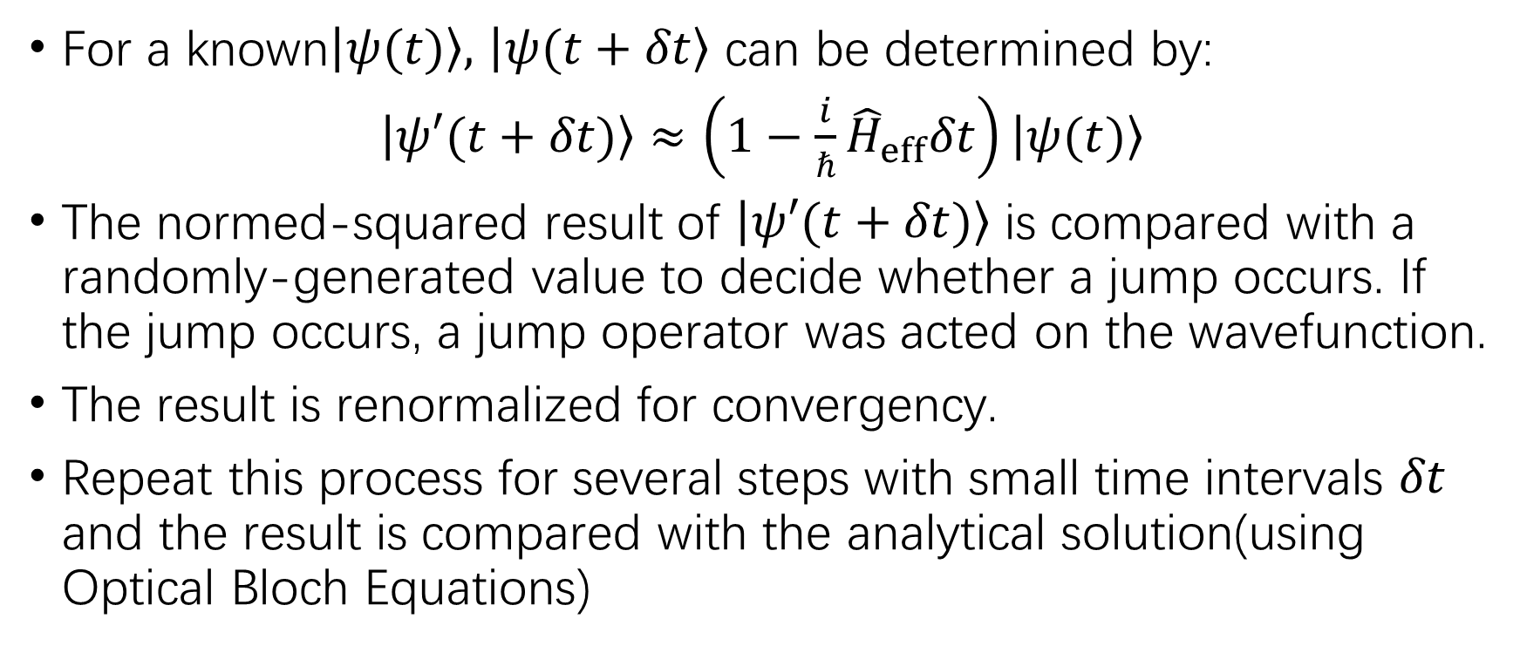
2. Procedure of Monte Carlo Approach
For a known$\left|\left.ψ(t)\right\rangle \right.,$ $\left|\left.ψ(t+δt\right\rangle \right.$ can be determined by:
$\left|\left.ψ′(t+δt)\right\rangle \right.$ $≈\left(1−\frac{i}{ℏ}{\hat{H}}_{eff}δt\right)\left|\left.ψ(t)\right\rangle \right.$
The normed-squared result of $\left|\left.ψ′(t+δt)\right\rangle \right.$ is compared with a randomly-generated value to decide whether a jump occurs. If the jump occurs, a jump operator was acted on the wavefunction.
The result is renormalized for convergency.
Repeat this process for several steps with small time intervals $δt$ and the result is compared with the analytical solution(using Optical Bloch Equations)

Slide 5
3. Parameters that matters
Detuning
Rabi frequency
Number of iterations
Time steps
Number of particles

Slide 6
4. Analysis criterion

Slide 7
5. Results and analysis

Slide 8
6. Further analysis

Slide 9
Reference:

