Slide 1
Effects of the Parameters in Monte Carlo Approach to its Reliability
Zhejun Li
Zhejun.li@durham.ac.uk
github: https://github.com/bblike/Quantum_Computing

Slide 2
Outline
1. Theory bases
2. Procedure of Monte Carlo Approach
3. Parameters
4. Analysis criterion
5. Results and analysis
6. Further analysis

Slide 3
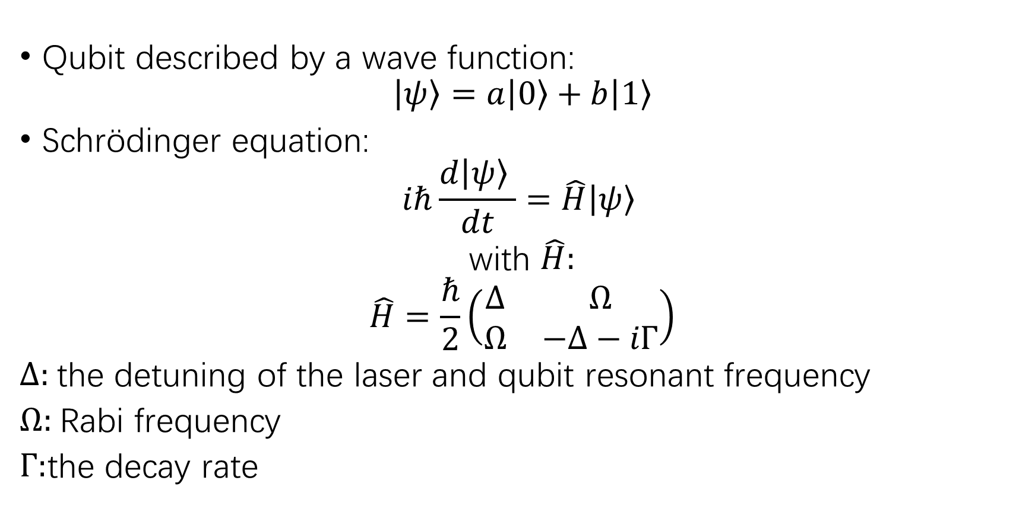
1. Theory bases
Qubit described by a wave function:
$$\left|\left.ψ\right\rangle =a\right.\left|\left.0\right\rangle +b\right.\left|\left.1\right\rangle \right.$$
Schrödinger equation:
$$iℏ\frac{d\left|\left.ψ\right\rangle \right.}{dt}=\hat{H}\left|\left.ψ\right\rangle \right.$$
with $\hat{H}:$
$$\hat{H}=\frac{ℏ}{2}\left(\begin{matrix}∆ & Ω \\ Ω & −Δ−iΓ\end{matrix}\right)$$
$Δ:$the detuning of the laser and qubit resonant frequency
$Ω:$Rabi frequency
$Γ:$the decay rate

Slide 4
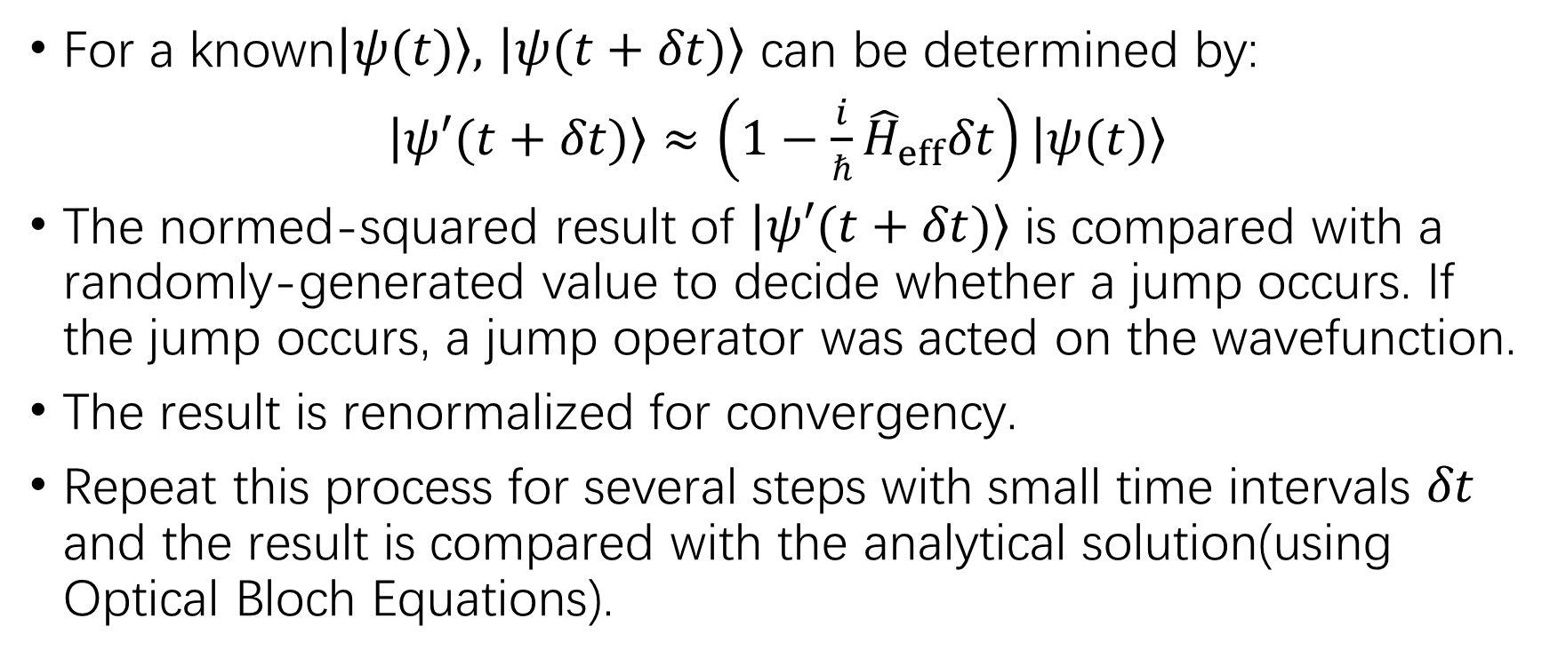
2. Procedure of Monte Carlo Approach
For a known$\left|\left.ψ(t)\right\rangle \right.,$ $\left|\left.ψ(t+δt)\right\rangle \right.$ can be determined by:
$\left|\left.ψ′(t+δt)\right\rangle \right.$ $≈\left(1−\frac{i}{ℏ}{\hat{H}}_{eff}δt\right)\left|\left.ψ(t)\right\rangle \right.$
The normed-squared result of $\left|\left.ψ′(t+δt)\right\rangle \right.$ is compared with a randomly-generated value to decide whether a jump occurs. If the jump occurs, a jump operator was acted on the wavefunction.
The result is renormalized for convergency.
Repeat this process for several steps with small time intervals $δt$ and the result is compared with the analytical solution(using Optical Bloch Equations).

Slide 5
3. Parameters
Parameters with graphical meanings:
Detuning
Rabi frequency
Decay rate
Parameters without graphical meanings:
Number of particles
Number of iterations, time steps and total time

Slide 6
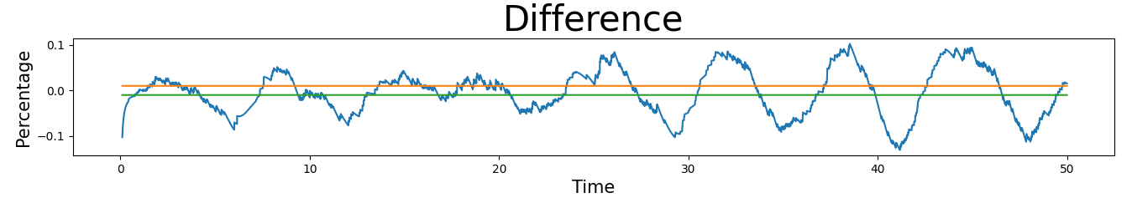
4. Analysis Criterion
For parameters with graphical meanings:
Compare the change on the graph directly.
For parameters without graphical meanings:
The difference compared to the analytical solution is recorded.
Set accepted region of 1%, 5%, 10% to the analytical value.
Compared the change on concentration due to parameters.

Slide 7
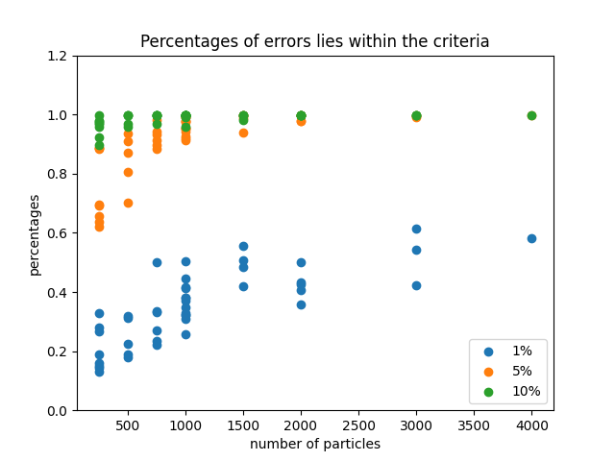
5. Results and Analysis-Number of Particles

Slide 8
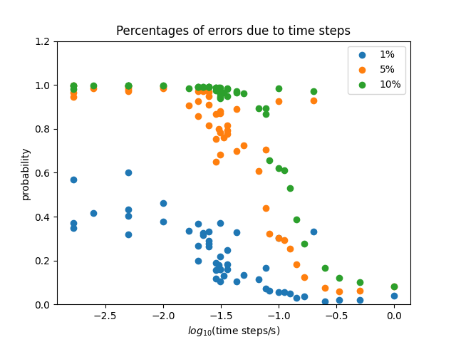
5. Results and Analysis-Time Steps

Slide 9
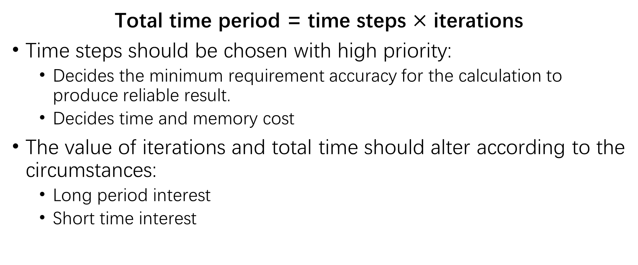
5. Results and Analysis- Time Steps, Iterations and Total Time
Total time period = time steps $×$ iterations
Time steps should be chosen with high priority:
Decides the minimum requirement accuracy for the calculation to produce reliable result.
Decides time and memory cost
The value of iterations and total time should alter according to the circumstances:
Long period interest
Short time interest

Slide 10
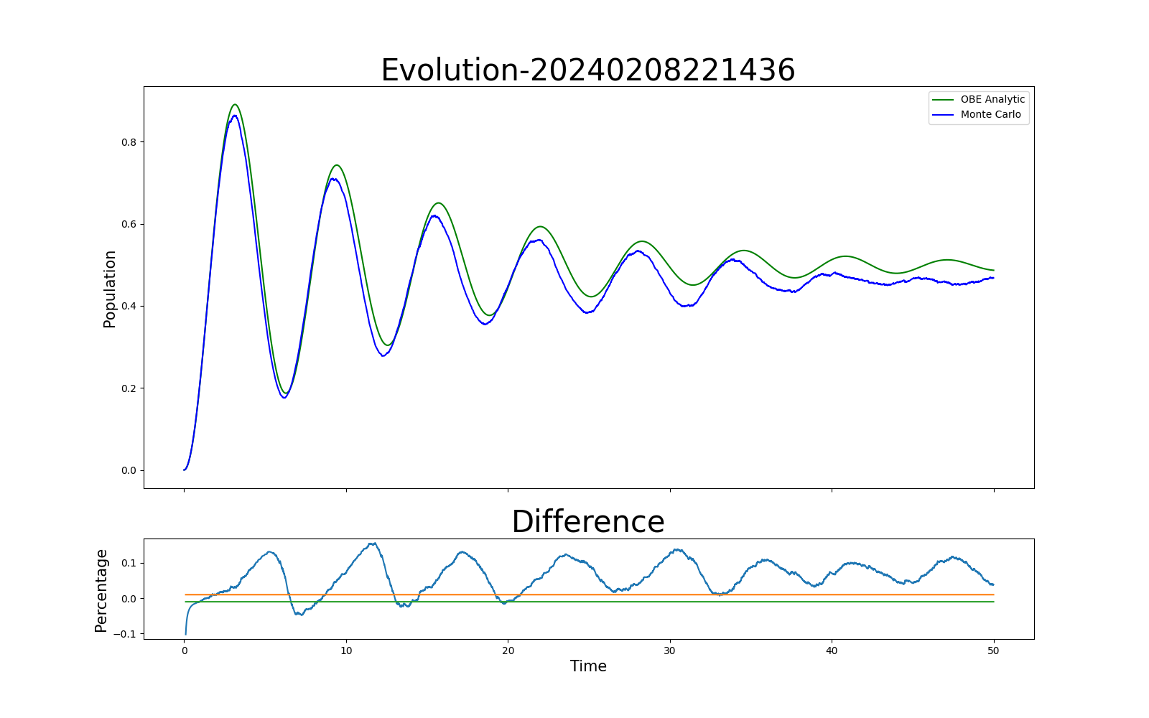
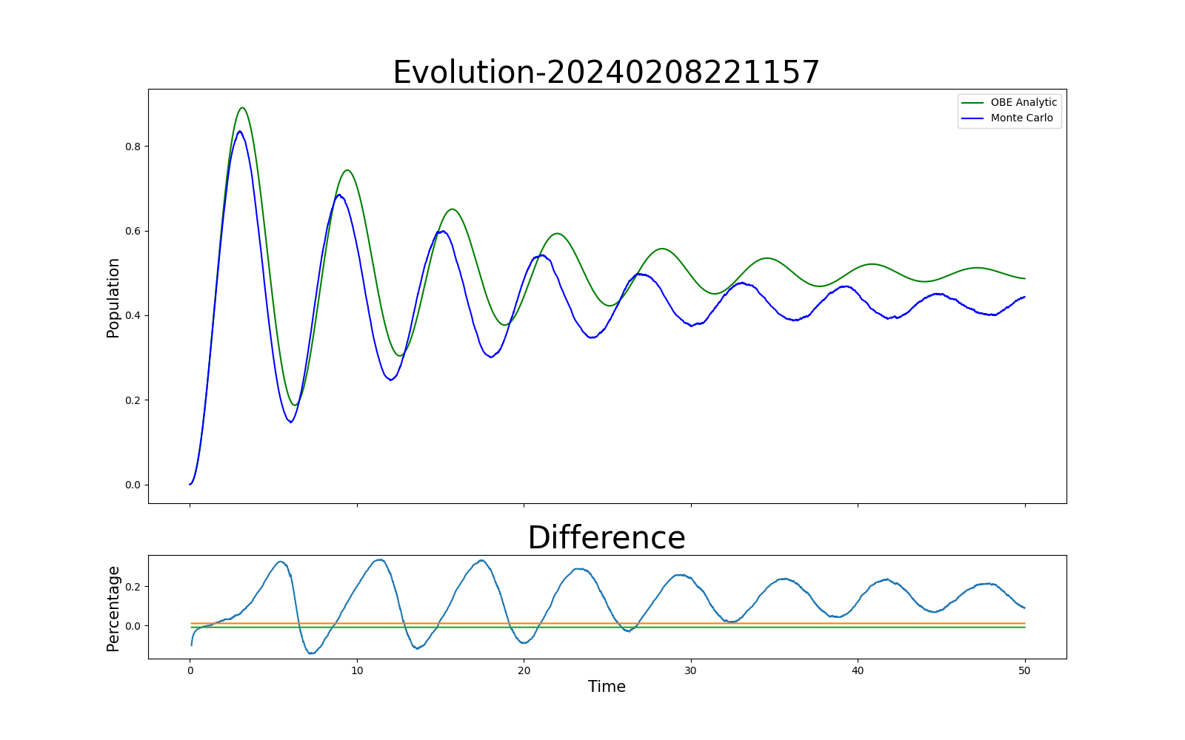
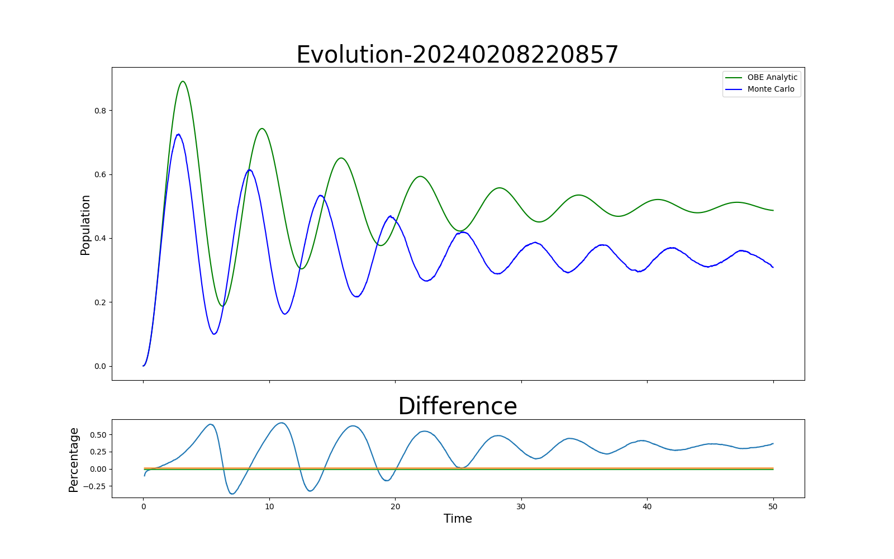
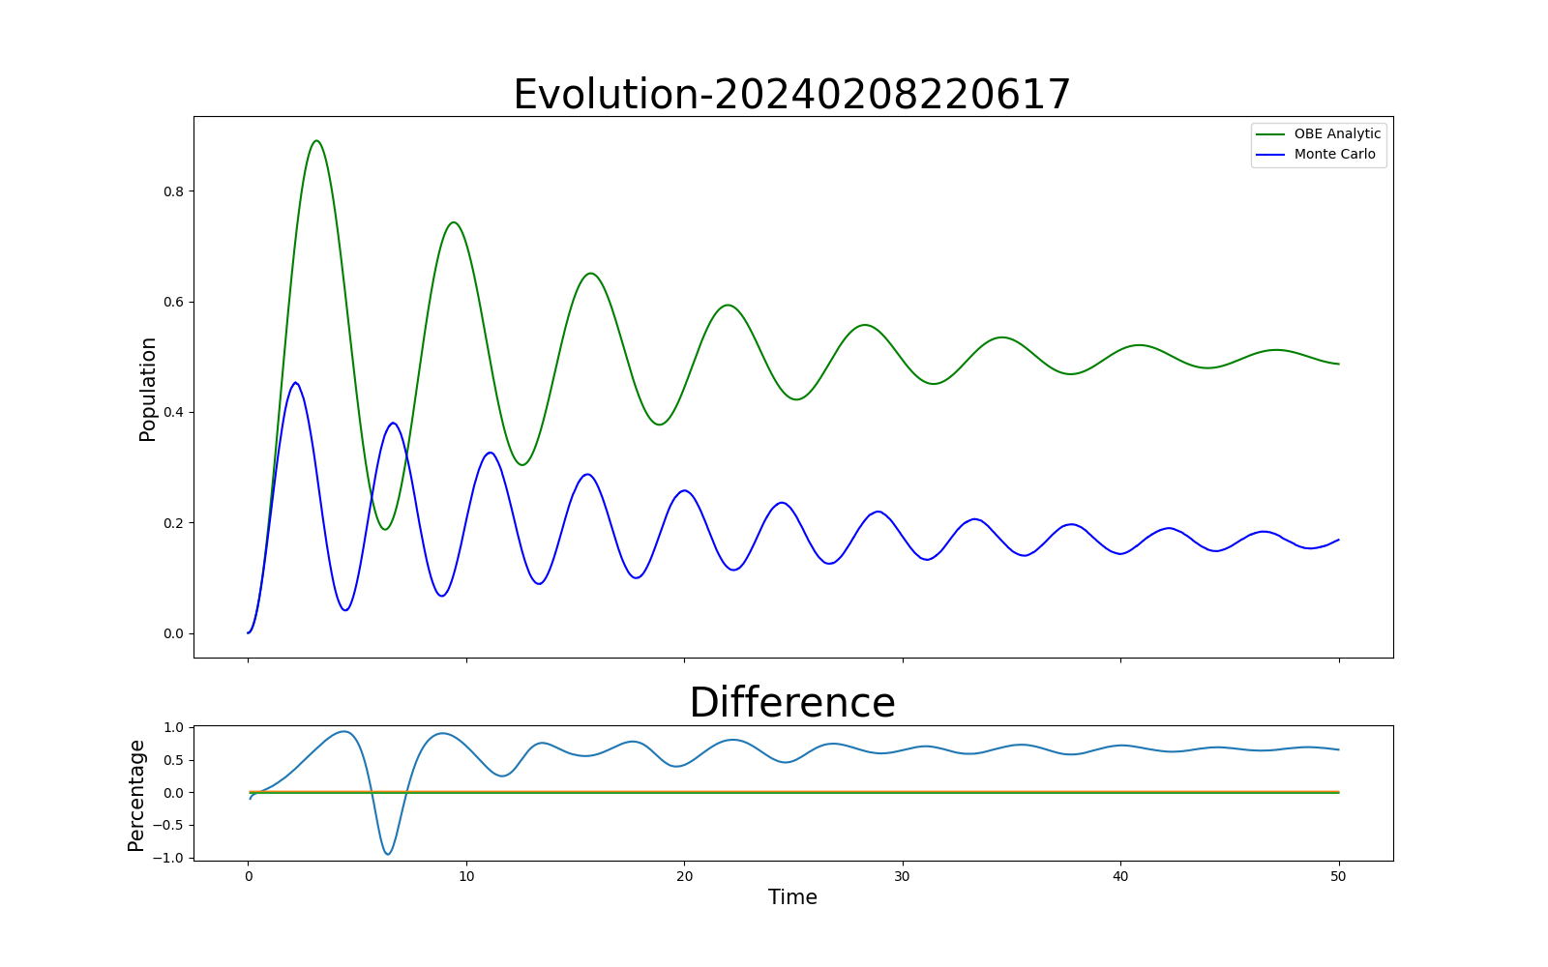
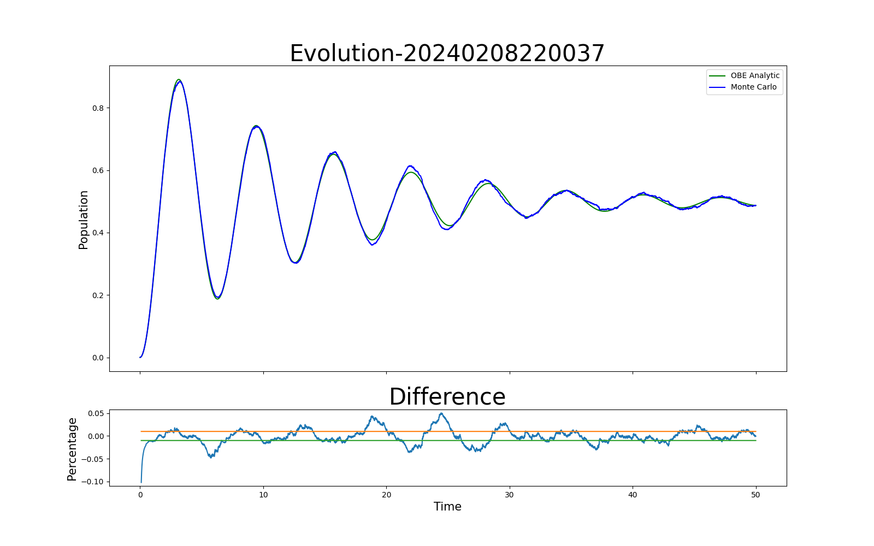
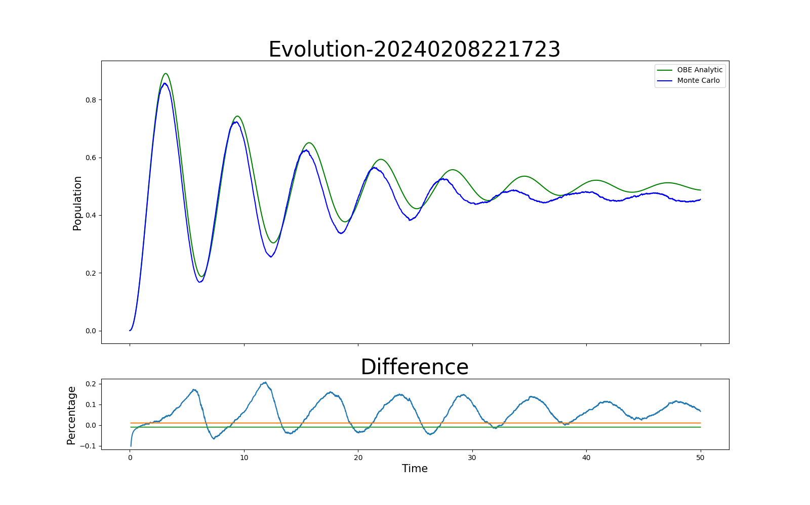
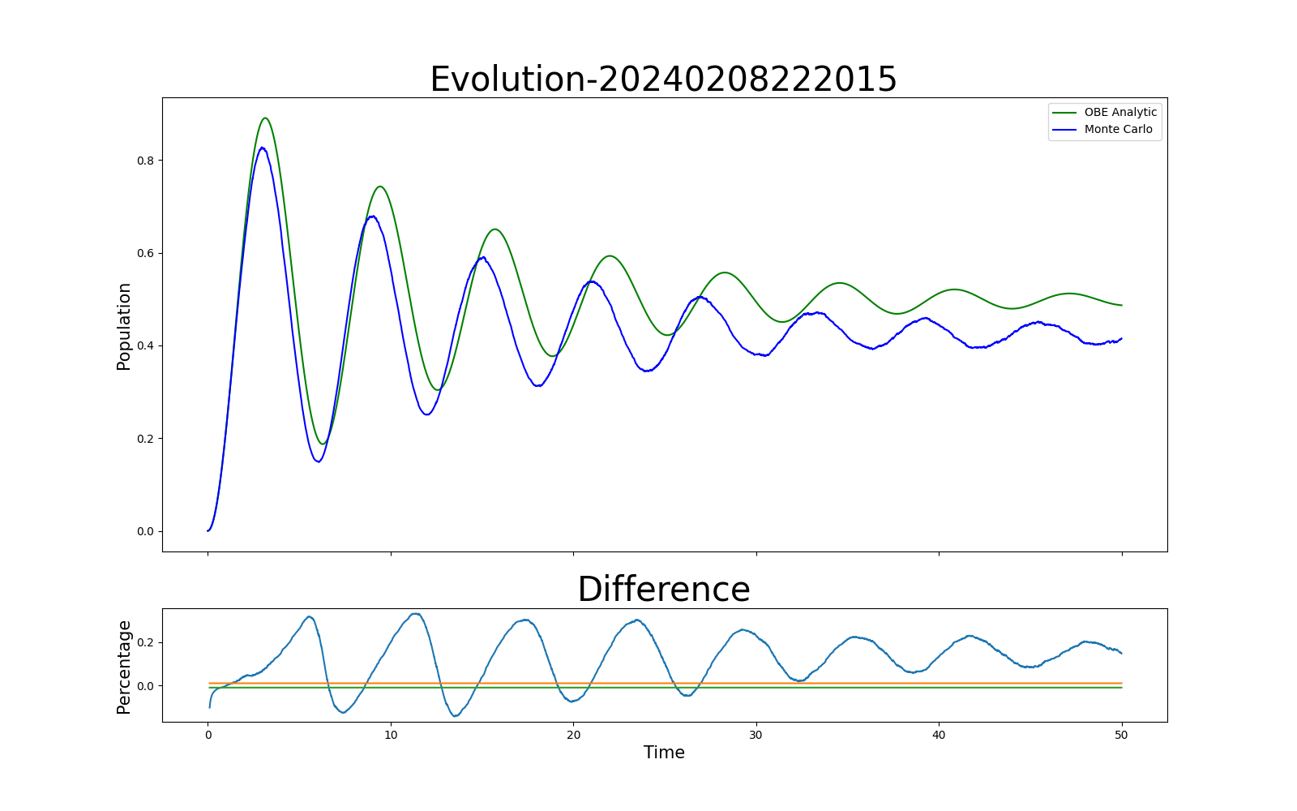
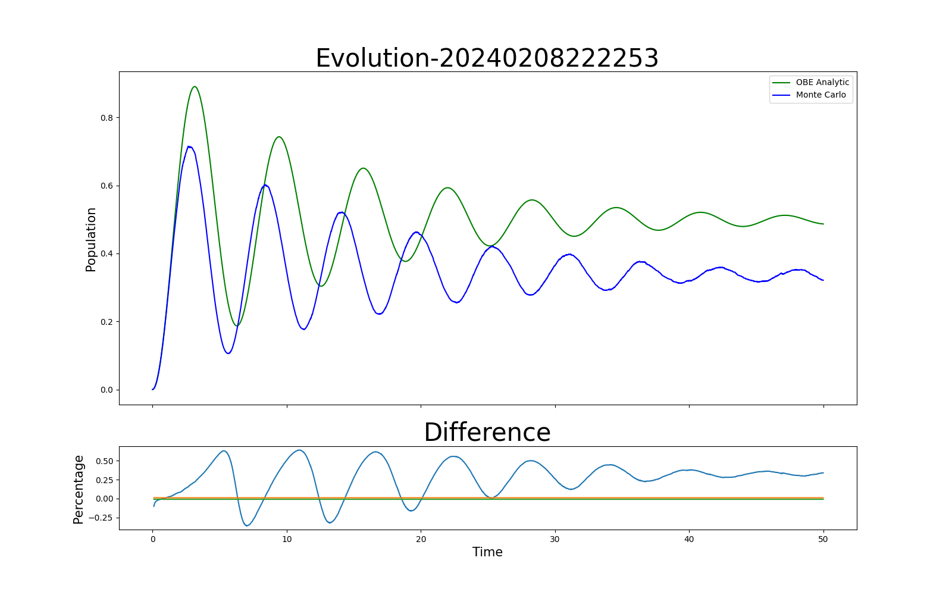
5. Results and Analysis-Detuning
Detuning = 0.2
Detuning = 0.3
Detuning = 0.5
Detuning = 0
Detuning = 1
Detuning = -0.2
Detuning = -0.3
Detuning = -0.5

Slide 11

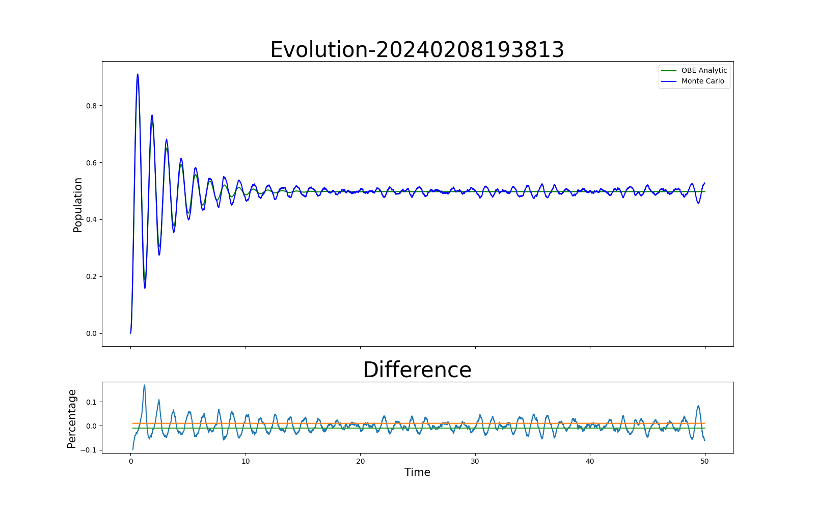
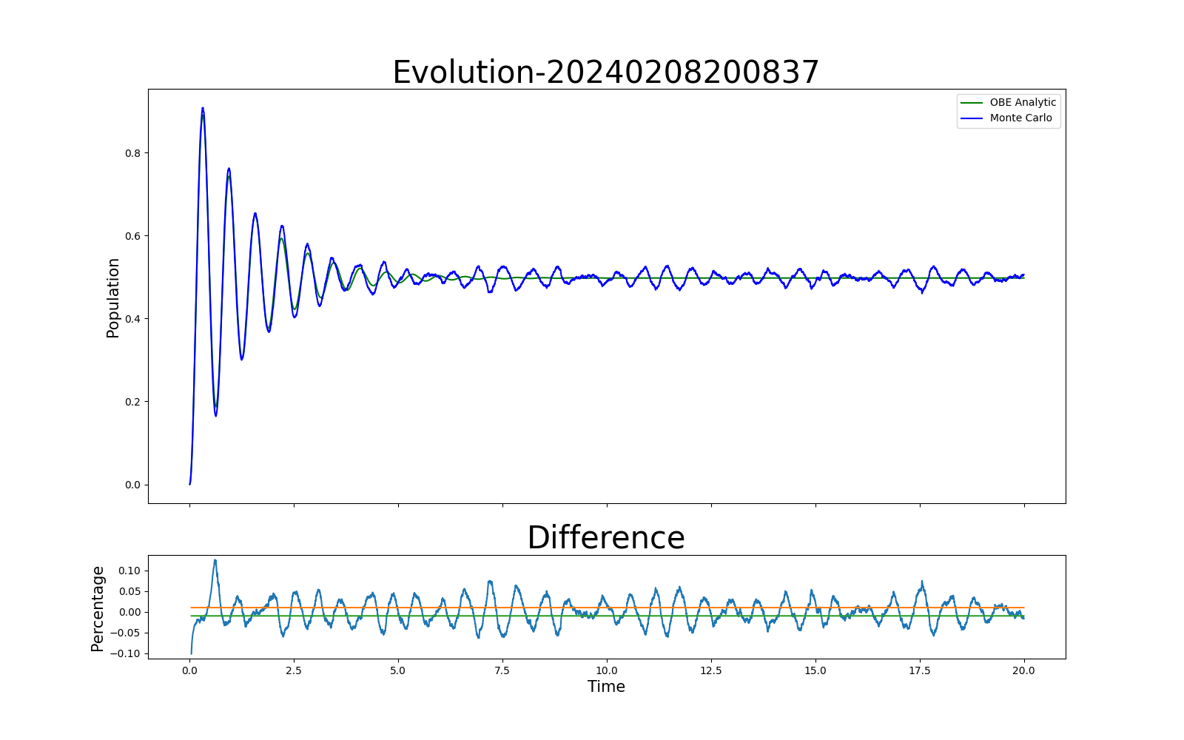
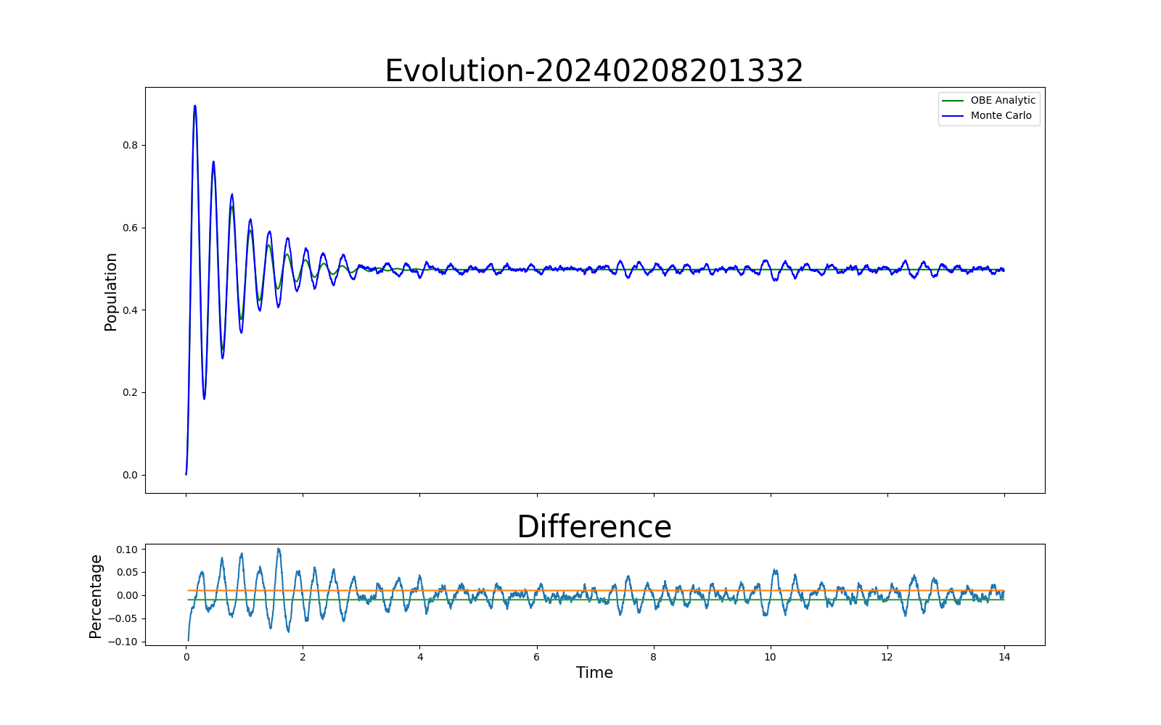
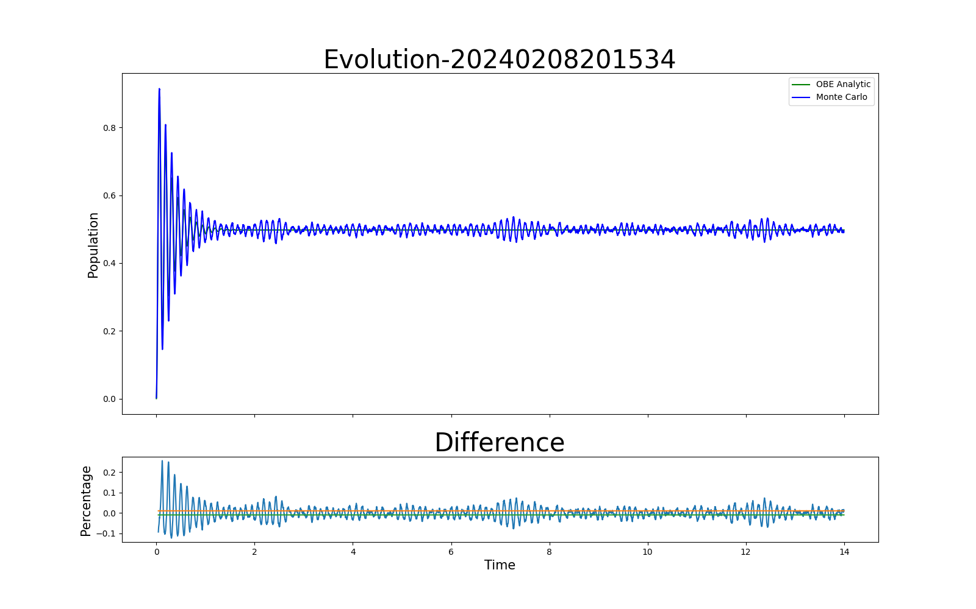
5. Results and analysis-Rabi Frequency (same x axis scale)
Rabi frequency = 5
Rabi frequency = 10
Rabi frequency = 1
Rabi frequency = 20
Rabi frequency = 50

Slide 12
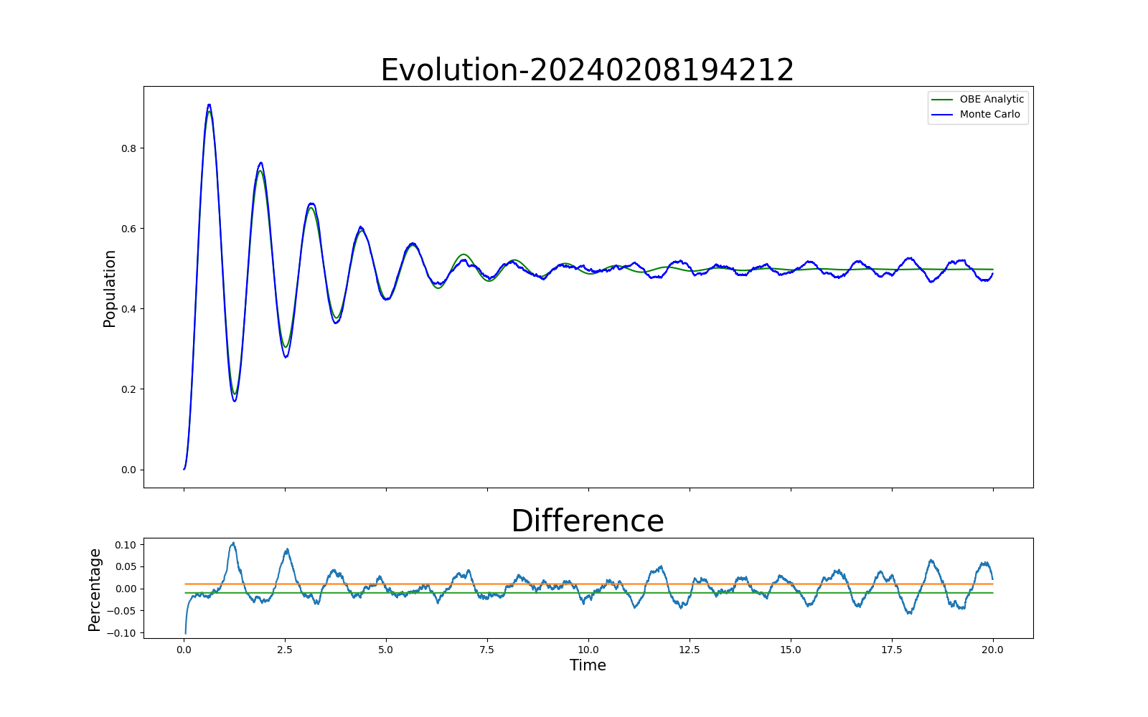
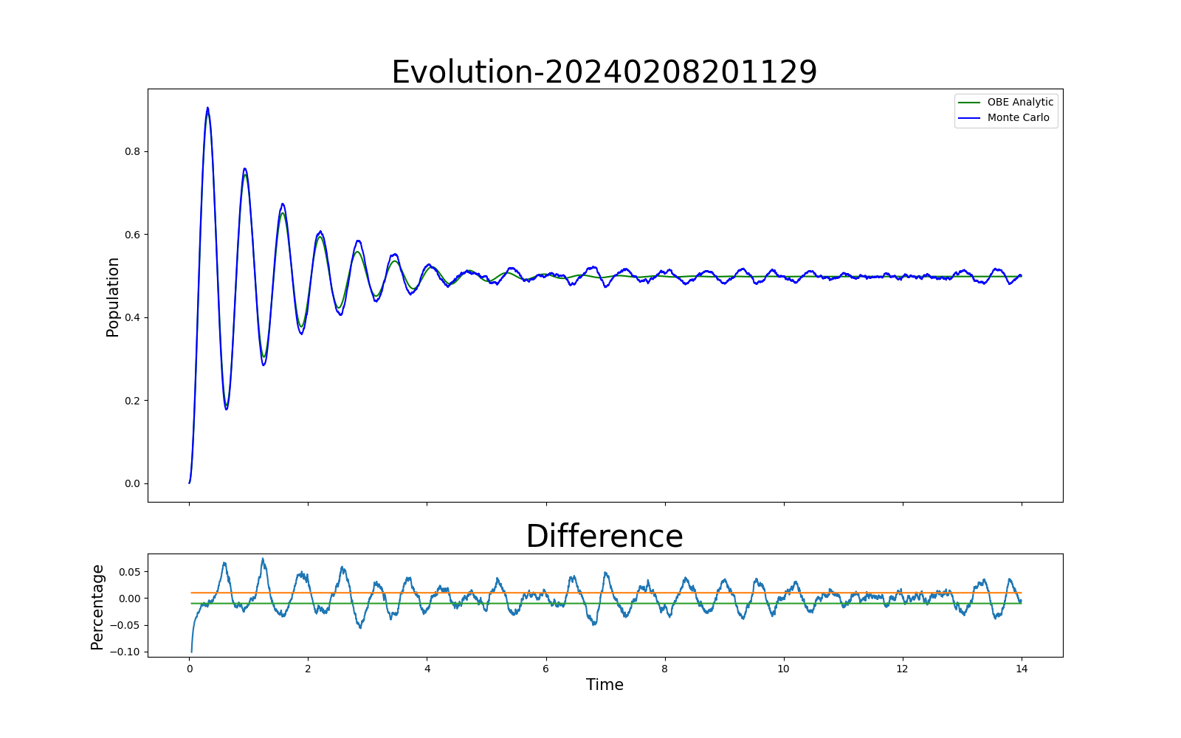

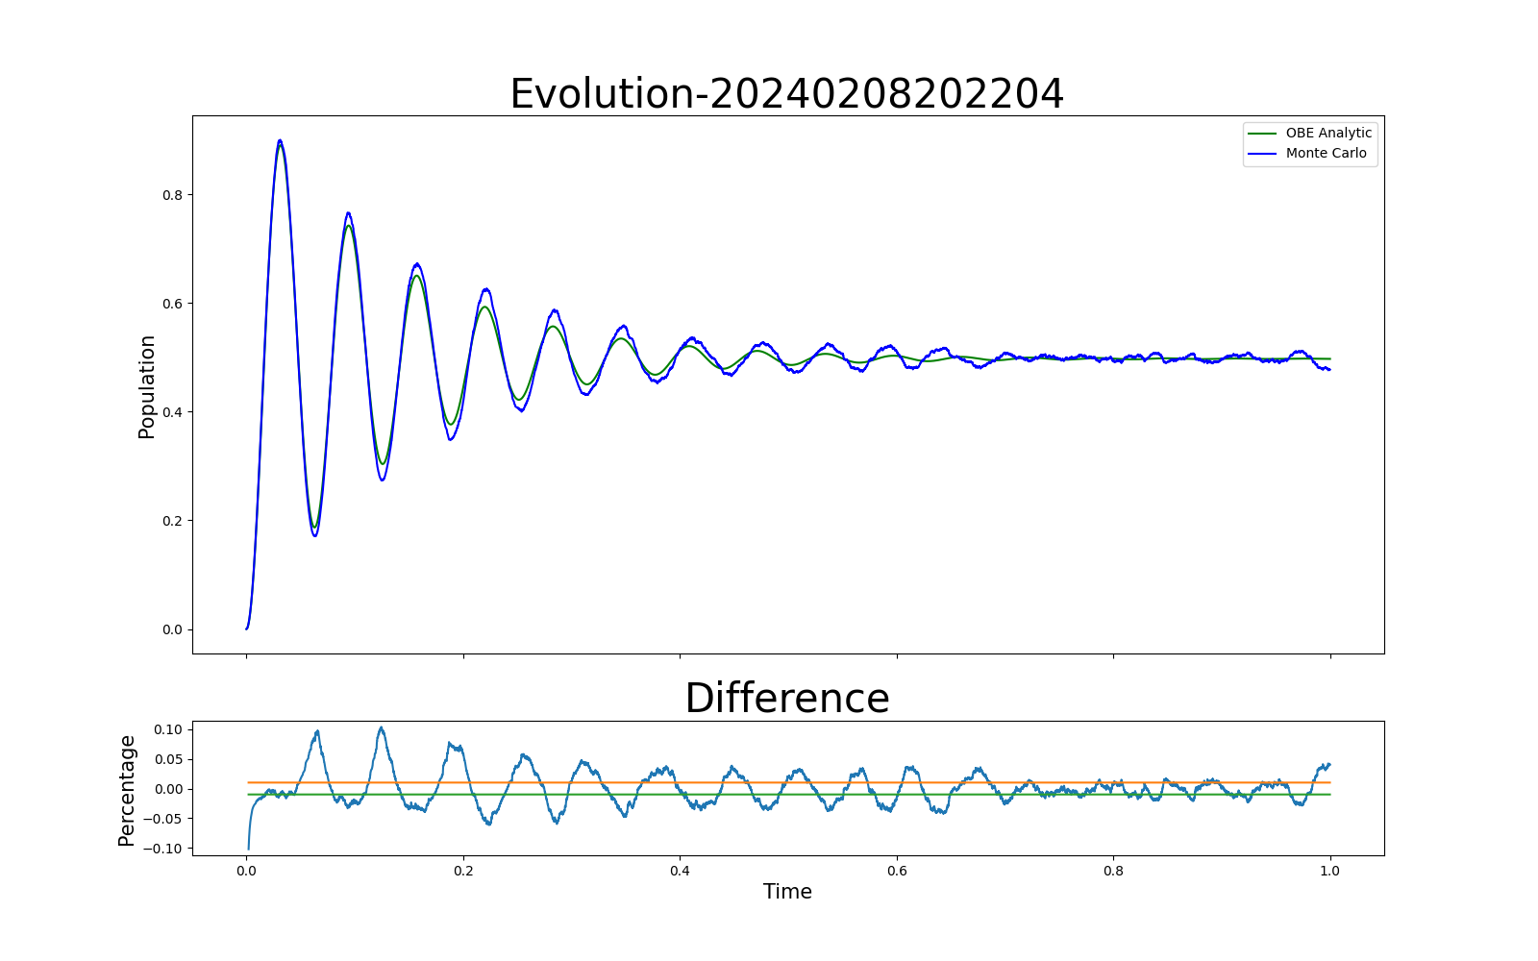
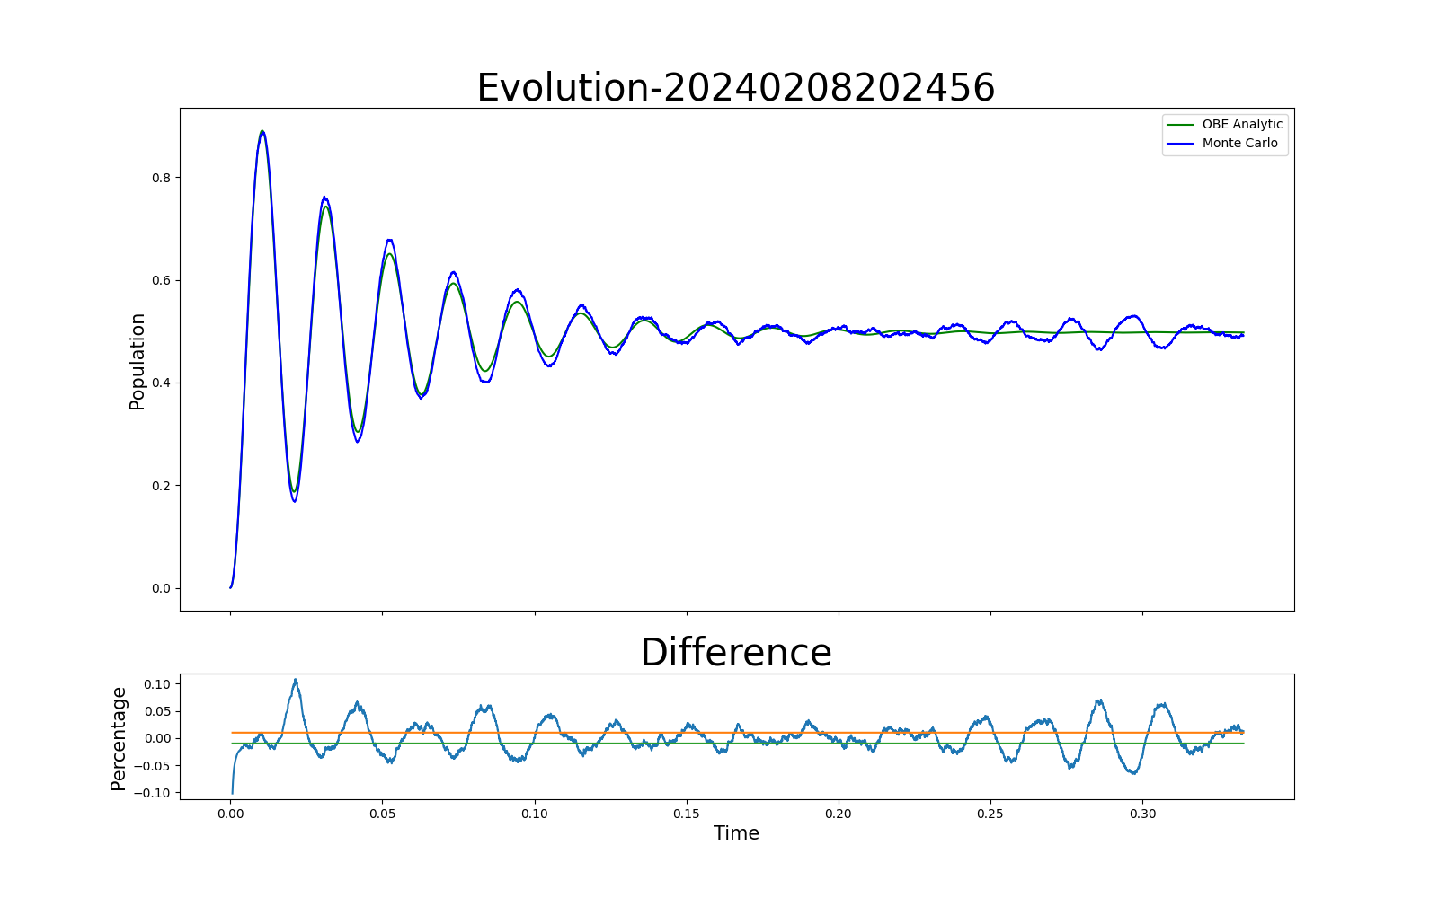
5. Results and analysis-Rabi Frequency (same iteration)
Rabi frequency = 1
Rabi frequency = 5
Rabi frequency = 10
Rabi frequency = 50
Rabi frequency = 100
Rabi frequency = 300

Slide 13
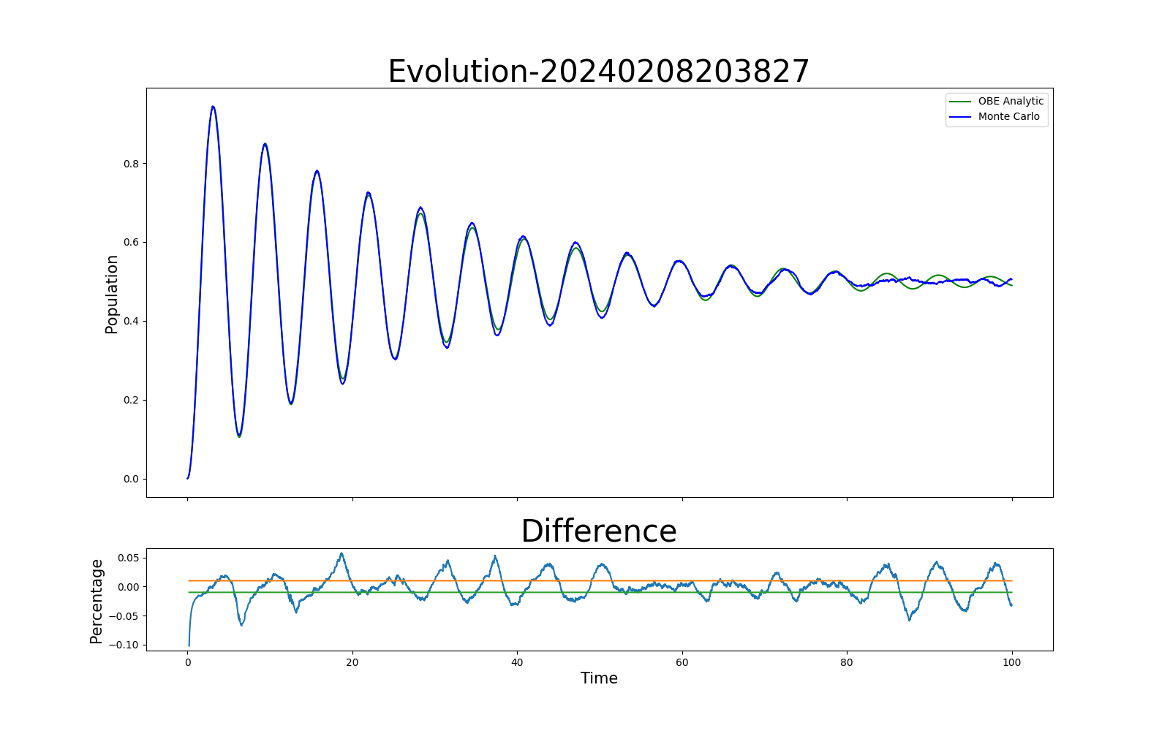
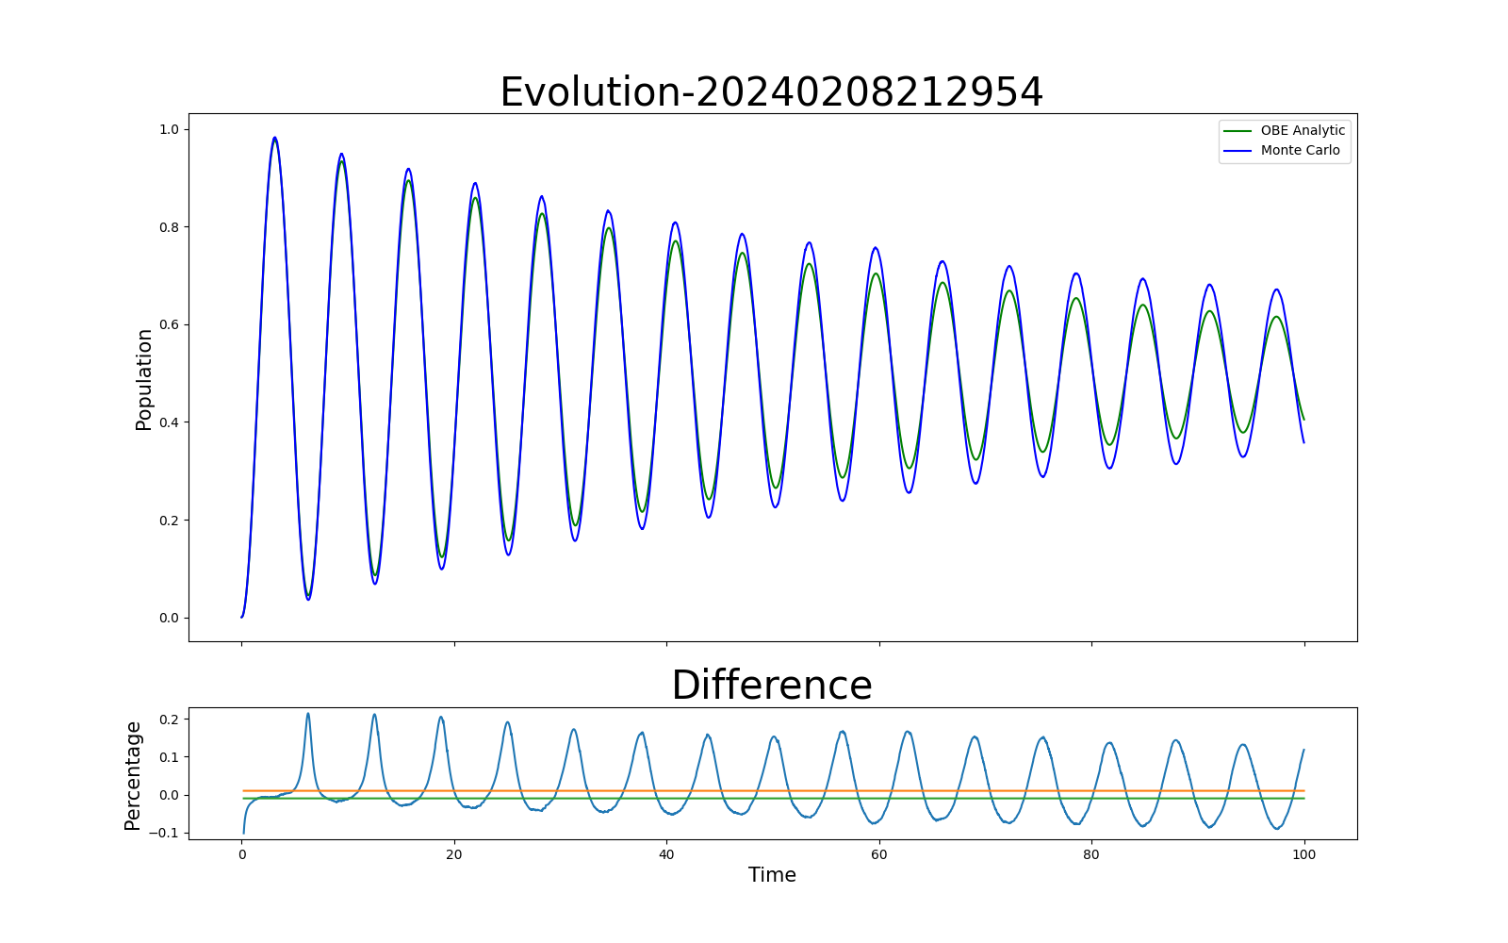
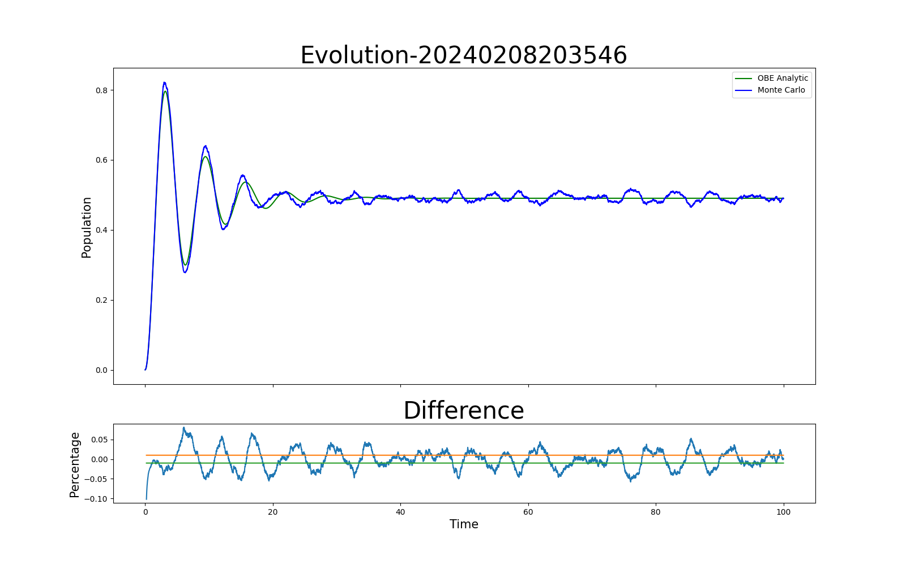
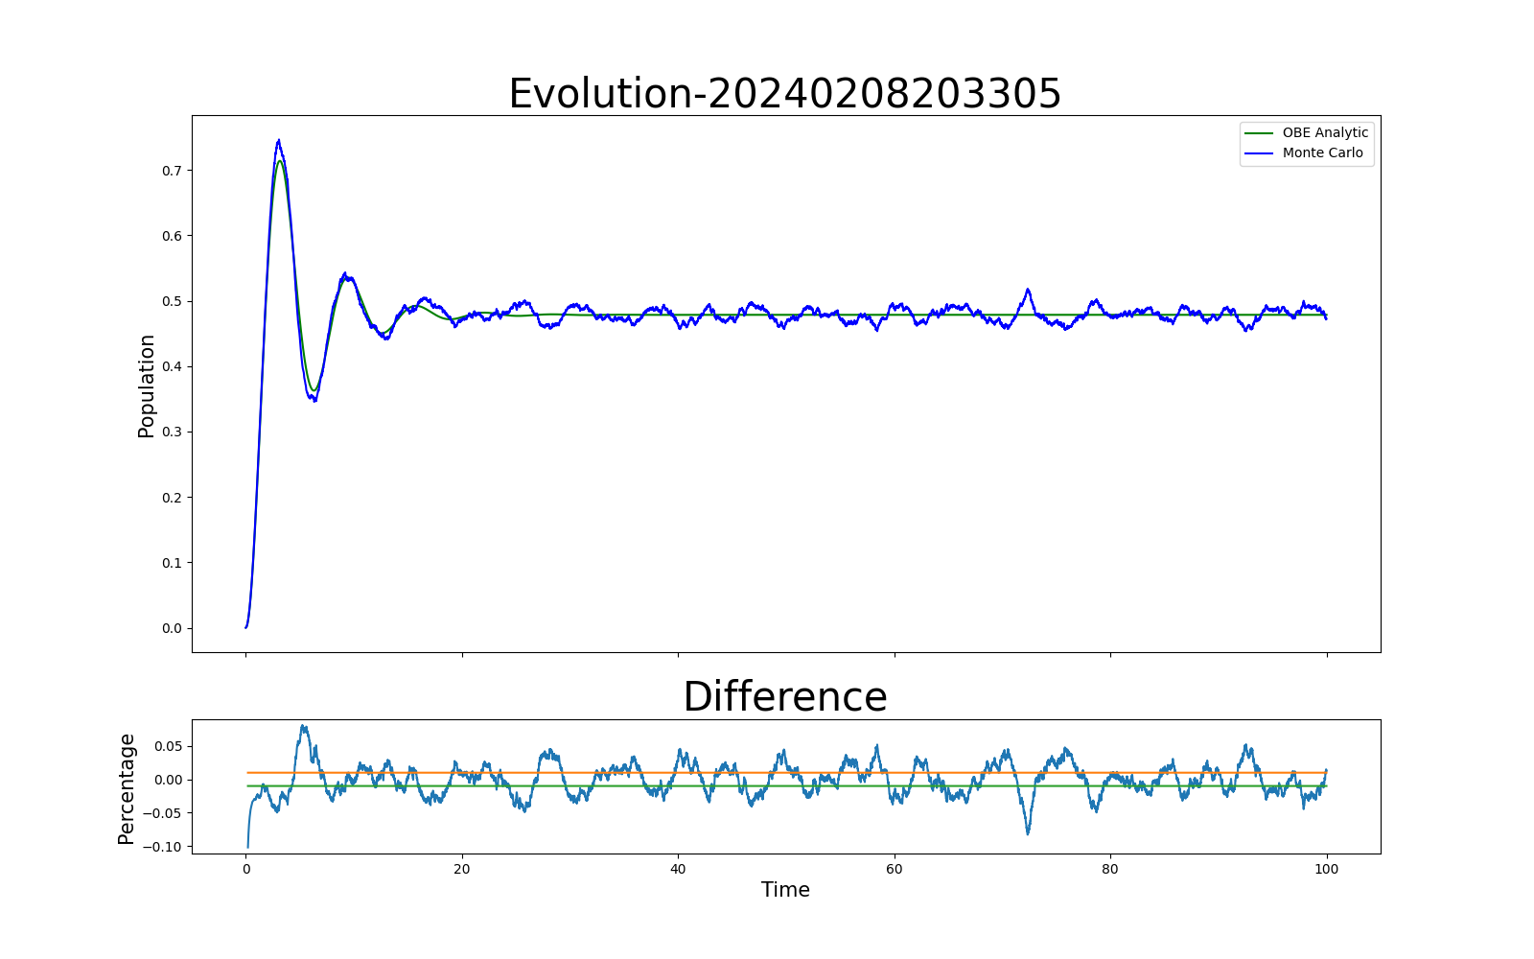
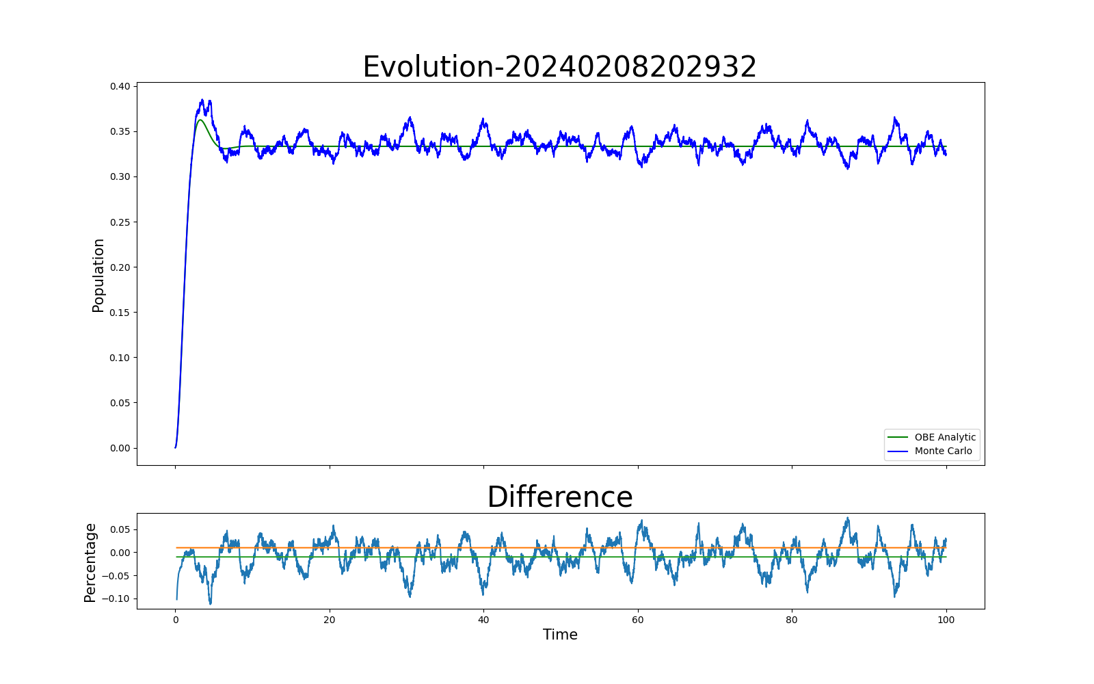
5. Results and Analysis-Decay rate
Rate = 0.1
Rate = 0.05
Rate = 0.02
Rate = 0.2
Rate = 0.3
Rate = 1

Slide 14
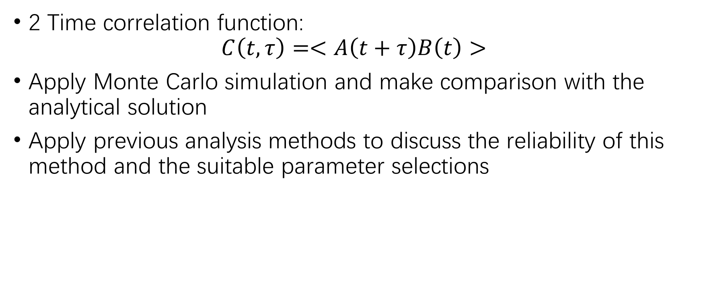
6. Further analysis
2 Time correlation function:
$$C\left(t, τ\right)=<A\left(t+τ\right)B\left(t\right)>$$
Apply Monte Carlo simulation and make comparison with the analytical solution
Apply previous analysis methods to discuss the reliability of this method and the suitable parameter selections

Slide 15
Reference:
Klaus Mølmer, Yvan Castin, Jean Dalibard, Monte Carlo wave-function method in quantum optics, Published in: J.Opt.Soc.Am.B 10 (1993) 3, 524-538, doi: 10.1364/JOSAB.10.000524
Liu, Y., Zhao, Q., Li, MH. et al. Device-independent quantum random-number generation. Nature 562, 548–551 (2018). https://doi.org/10.1038/s41586-018-0559-3

Slide 16
Thanks for listening

