Slide 1

Household finance
David Laibson
May 6, 2022

Slide 2
Nine claims about household finance
Households:
Have low levels of financial literacy
Have very few liquid assets (live hand to mouth)
Have substantial illiquid wealth
Have a high MPC out of liquid wealth and liquidity
Have a low MPC out of illiquid/portfolio wealth
Don’t choose optimal financial service products
Barely change their behavior after financial education interventions
Have misaligned financial intentions and financial actions
Make financial (and health) choices that are seemingly easy to manipulate (see Doug Bernheim’s lecture)

Slide 3
Nine claims about household finance
Households:
Have low levels of financial literacy
Have very few liquid assets (live hand to mouth)
Have substantial illiquid wealth
Have a high MPC out of liquid wealth and liquidity
Have a low MPC out of illiquid/portfolio wealth
Don’t choose optimal financial service products
Barely change their behavior after financial education interventions
Have misaligned financial intentions and financial actions
Make financial (and health) choices that are seemingly easy to manipulate

Slide 4
Assessing Literacy: Numeracy
Compound Interest
“Suppose you had $100 in a savings account and the interest rate was 2% per year. After 5 years, how much do you think you would have in the account if you left the money to grow?”
i) More than $102;
ii) Exactly $102;
iii) Less than $102;
iv) Don’t know (DK);
v) Refuse to answer.
See Lusardi and Mitchell (2014)

Slide 5
Assessing Literacy: Inflation
Inflation
“Imagine that the interest rate on your savings account was 1% per year and inflation was 2% per year. After 1 year, would you be able to buy with the money in this account:”
i) More than today;
ii) Exactly the same;
iii) Less than today;
iv) DK;
v) Refuse to answer.

Slide 6
Assessing Literacy: Risk Diversification
Risk Diversification
“Do you think the following statement is true or false? Buying a single company stock usually provides a safer return than a stock mutual fund.”
i) True;
ii) False;
iii) DK;
iv) Refuse to answer.

Slide 7
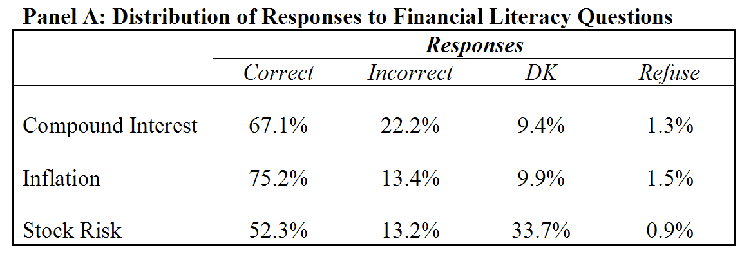
How much do older people (ages 50+) know?
34% correctly answer all 3 questions

Slide 8
Correct responses: By Gender

Slide 9
Financial Literacy and Age

Slide 10
Financial Literacy and Education
Percent answering risk diversification correctly
Source: Health and Retirement Study, 2004

Slide 11
Financial Literacy among the Young (23-27). NLSY: Percentage of correct responses
Interest rate: 79.2%
Inflation: 53.9%
Risk diversification: 46.6%

Slide 12
Two Takeway Points
Financial literacy should not be taken for granted
Illiteracy is widespread
Financial literacy varies a lot among demographic groups

Slide 13
Financial literacy matters
Financial literacy affects financial decisions: Those with low literacy:
are less likely to calculate how much they need for retirement
are less likely to participate in the stock market
are more likely to have difficulties paying off debt

Slide 14
More on the power of interest compounding (TNS)
Suppose you owe $1,000 on your credit card and the interest rate you are charged is 20% per year compounded annually. If you didn’t pay anything off, at this interest rate, how many years would it take for the amount you owe to double?
2 years
Under 5 years
5 to 10 years
More than 10 years
Do not know
Prefer not to answer

Slide 15
Payment options: Loaning money to the retailer (TNS)
You purchase an appliance which costs $1,000. To pay for this appliance, you are given the following two options: a) Pay 12 monthly installments of $100 each; b) Borrow at a 20% annual interest rate and pay back $1,200 a year from now. Which is the more advantageous offer?
Option (a)
Option (b)
They are the same
Do not know
Prefer not to answer

Slide 16
Who has lower debt literacy? Differences between men and women
Percent answering credit card question correctly or “do not know” by gender
Notes:
16

Slide 17
People who make errors have “difficulties paying off debt.”
Grossly underestimate compounding
Gives free loan to retailer
35%
30%
25%
20%
Percentage with "too much debt"
15%
10%
5%
0%
Option a
Option b
Choose two payment options

Slide 18
Lusardi and Mitchell (2010)
‘I understand the stock market reasonably well’
‘An employee of a company with publicly traded stock should have a lot of his retirement savings in the company’s stock’
‘It is best to avoid stock of foreign companies’
‘If the interest rate falls, bond prices will rise’
Sophisticated/correct answer to all questions: 5.8%

Slide 19
Lusardi and Mitchell (2010)
(30% agree): ‘I understand the stock market reasonably well’
(52% disagree) ‘An employee of a company with publicly traded stock should have a lot of his retirement savings in the company’s stock’
(51% disagree): ‘It is best to avoid stock of foreign companies’
(40% agree) : ‘If the interest rate falls, bond prices will rise’
Sophisticated/correct answer to all questions: 5.8%

Slide 20
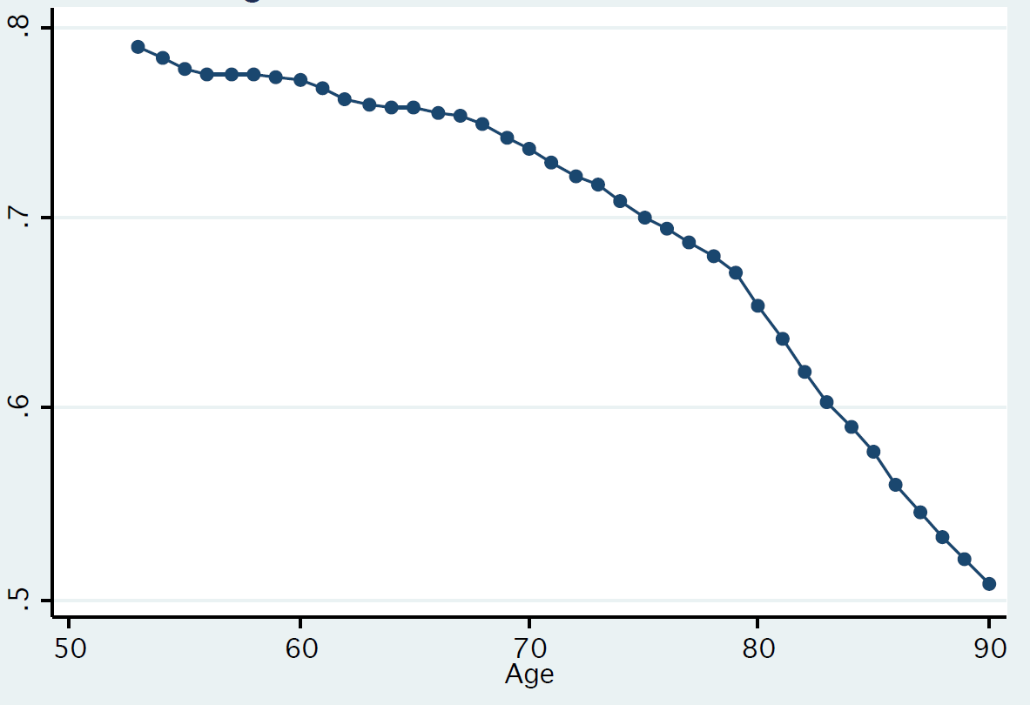
“If the chance of getting a disease is 10 percent, how many people out of 1,000 would be expected to get the disease?”
Fraction of people who answer “100”
Source: HRS; Agarwal, Driscoll, Gabaix, Laibson (2009)

Slide 21
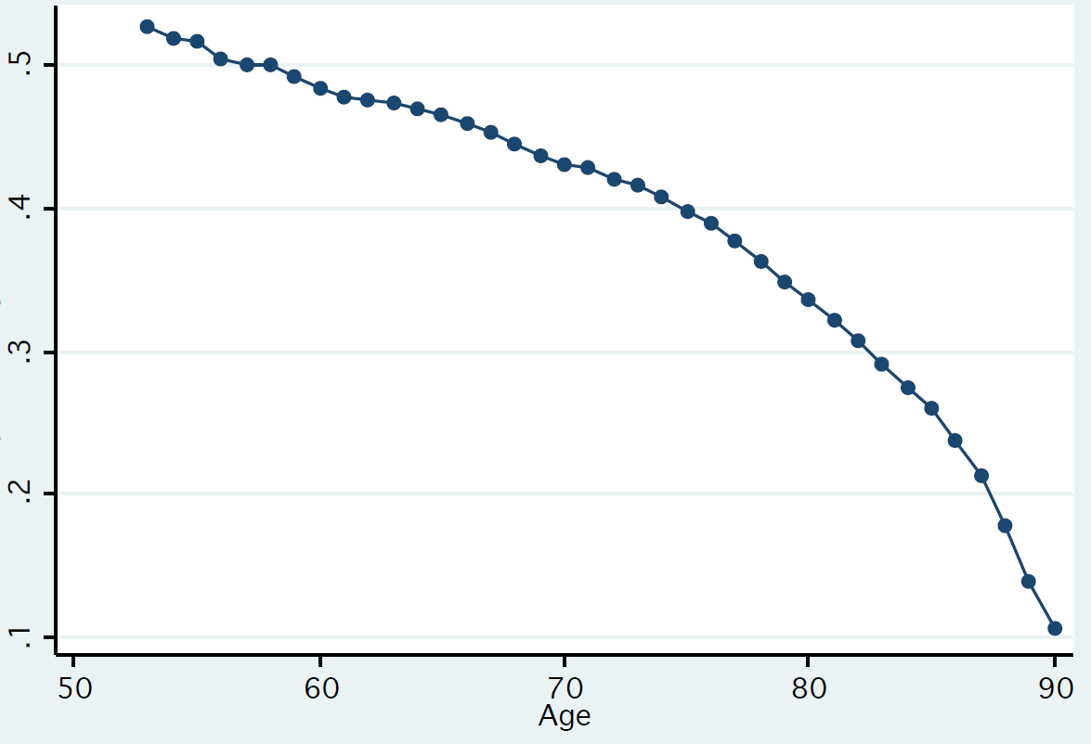
“If 5 people all have the winning numbers in the lottery and the prize is two million dollars, how much will each of them get?”
Fraction of people who answer “400,000”
Source: HRS; Agarwal, Driscoll, Gabaix, Laibson (2009)

Slide 22
Nine claims about household finance
Households:
Have low levels of financial literacy
Have very few liquid assets (live hand to mouth)
Have substantial illiquid wealth
Have a high MPC out of liquid wealth and liquidity
Have a low MPC out of illiquid/portfolio wealth
Don’t choose optimal financial service products
Barely change their behavior after financial education interventions
Have misaligned financial intentions and financial actions
Make financial choices that are seemingly easy to manipulate

Slide 23
Households live hand to mouth Lusardi and Tufano (2009)
How confident are you that you could come up with $2,000 if an unexpected need arose within the next month?
I am certain…I could
I could probably…
I probably could not…
I am certain…I could not
Do not know.
47%
53%

Slide 24
Households live hand to mouth (Board of Governors of the Federal Reserve System 2016)
Forty-six percent of U.S. adults report that they either could not come up with $400 to cover an emergency expense, or would have to borrow or sell something to do so.

Slide 25
SCF (age 65-74): In 2007, the median holding of
financial assets is $68,100
HRS (age 65-69): In 2008, the median holding of
financial assets is $12,500
among 1-person households
HRS (age 65-69): In 2008, the median holding of
financial assets is $111,600
among 2-person households

Slide 26
65-74 year old households
Survey of Consumer Finances
In 2007, the median holding of
financial assets
including personal retirement accounts
is $68,100

Slide 27
(Poterba, Venti, and Wise 2013; HRS 2008 wave)

Slide 28
2013 Survey of Consumer Finances (Beshears et al 2018)
(excluding social security)

Slide 30
Decomposition of household wealth, age 60-69, +/- 5 percentile points from median
Survey of Consumer Finances, 2013

Slide 31
Decomposition of household wealth, age 50-59, +/- 5 percentile points from median
Survey of Consumer Finances, 2013

Slide 32
Decomposition of household wealth, age 30-39, +/- 5 percentile points from median
Survey of Consumer Finances, 2013

Slide 33
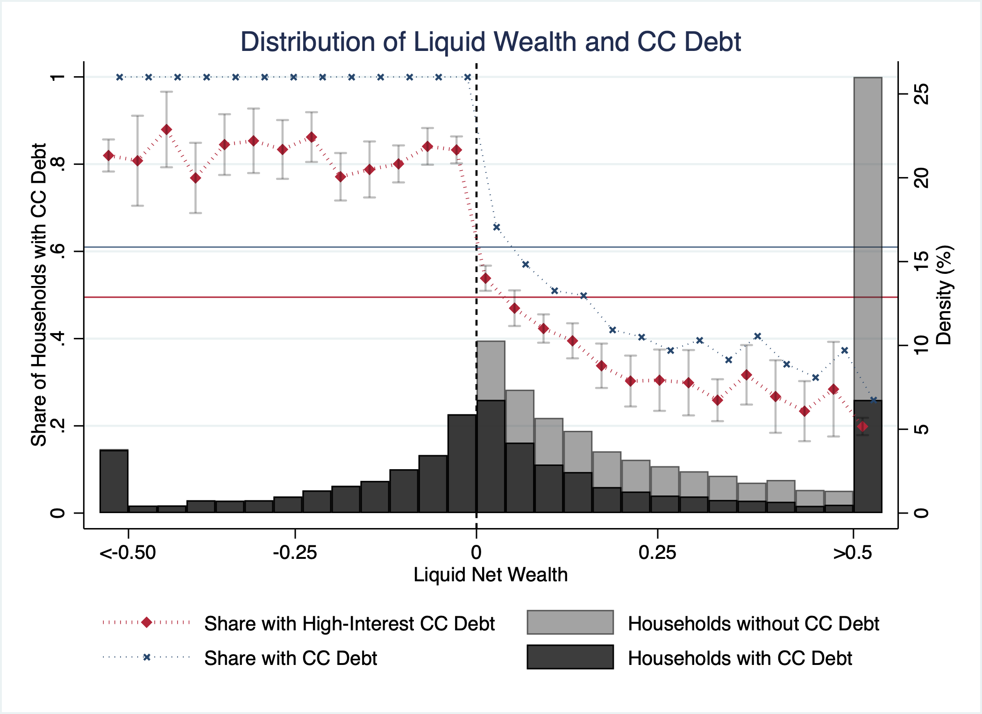
SCF data from 2013, 2016, 2019 (source: Laibson, Lee, Maxted 2022)

Slide 34
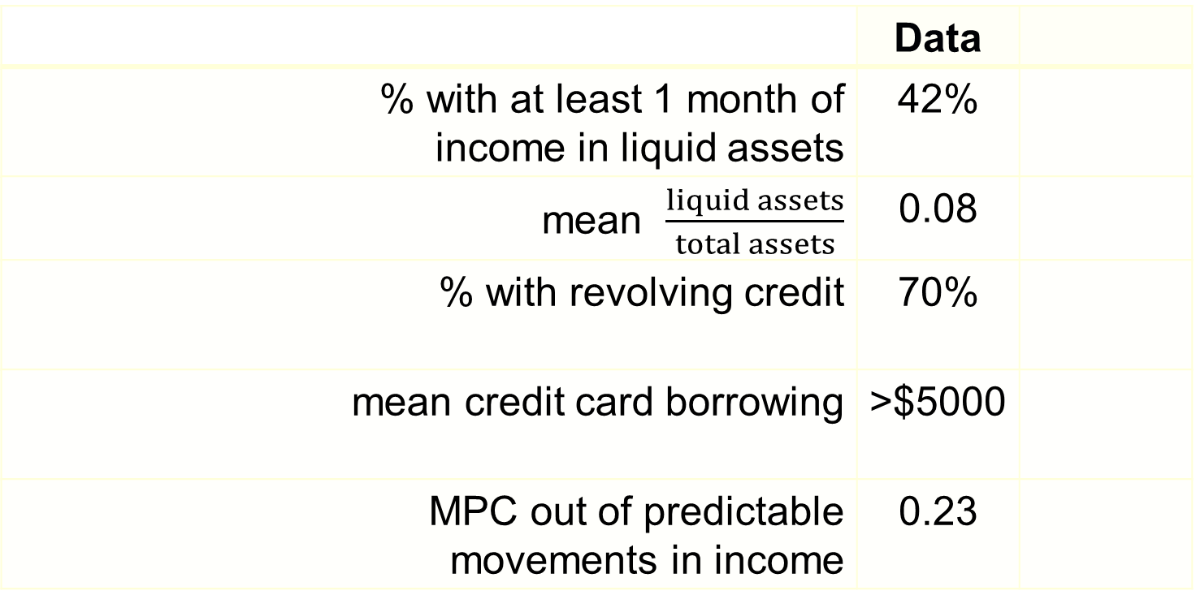
High School education
 | Data
% with at least 1 month of income in liquid assets | 42%
mean $\frac{liquid assets}{total assets}$ | 0.08
% with revolving credit | 70%
mean credit card borrowing | >$5000
MPC out of predictable movements in income | 0.23

Slide 35
High Marginal Propensity to Consume from Liquidity
Shapiro (2005): food stamps and monthly caloric cycle (calories drop 10-15% over the month)
Parker (2014): study of 2008 Economic Stimulus Payments using Nielsen data generating a within-year MPX of 60%
Ganong and Noel (2016): when unemployment insurance runs out (a predictable event), household consumption drops by 11%.
Fagereng, Holm, and Natvik (2020): lottery winner MPX’s; “Low-liquidity winners of the smallest prizes (around $1,500) are estimated to spend all within the year of winning. The corresponding estimate for high-liquidity winners of large prizes ($8,300-150,000) is slightly below one half.”
Gerard and Naritomi (2021): “displaced workers eligible for both UI and SP increase consumption at layoff by 35% despite experiencing a 17% consumption loss after they stop receiving any benefits”
Also see, Shea (1995), Mastrobuoni and Weinberg (2009), Hastings and Washington (2010), Olafsson and Pagel (2018), Stephens and Toohey (2018)

Slide 36
Havranek and Sokolova (2020)
Reviews 246 estimates of the MPC for nondurables
Mean MPC is 0.29
Median MPC is 0.25
Mean standard error is 0.19
Median standard error is 0.13
To get marginal propensity for expenditure, multiply by 3X (see Laibson, Maxted, and Moll 2022).

Slide 37
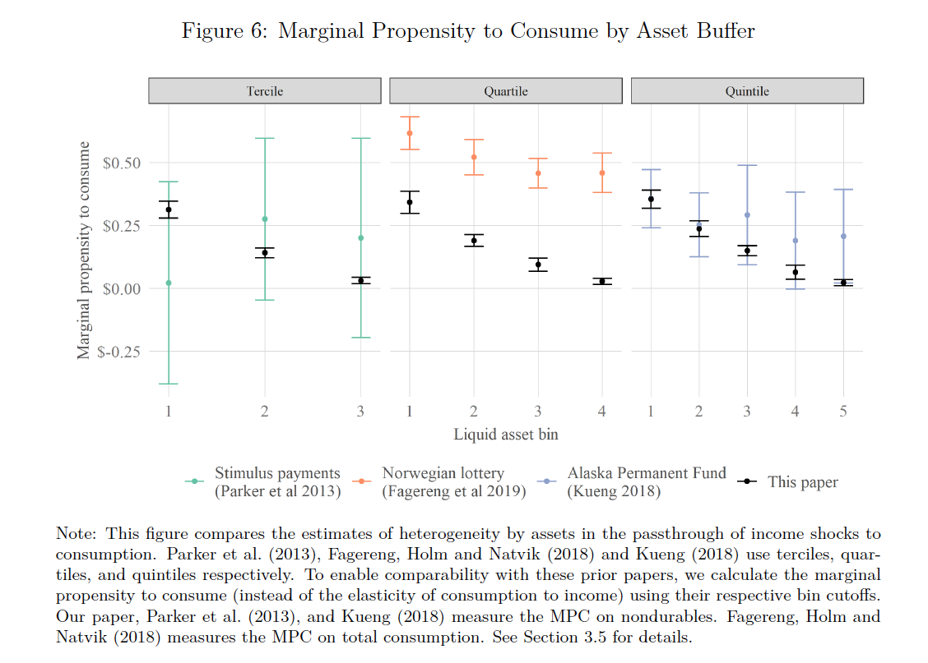

MPC’s (Ganong, Jones, Noel, Greig, Farrell, and Wheat 2020); $×$3 for MPX
Aggregate (non-durable) MPC = $0.22

Slide 38
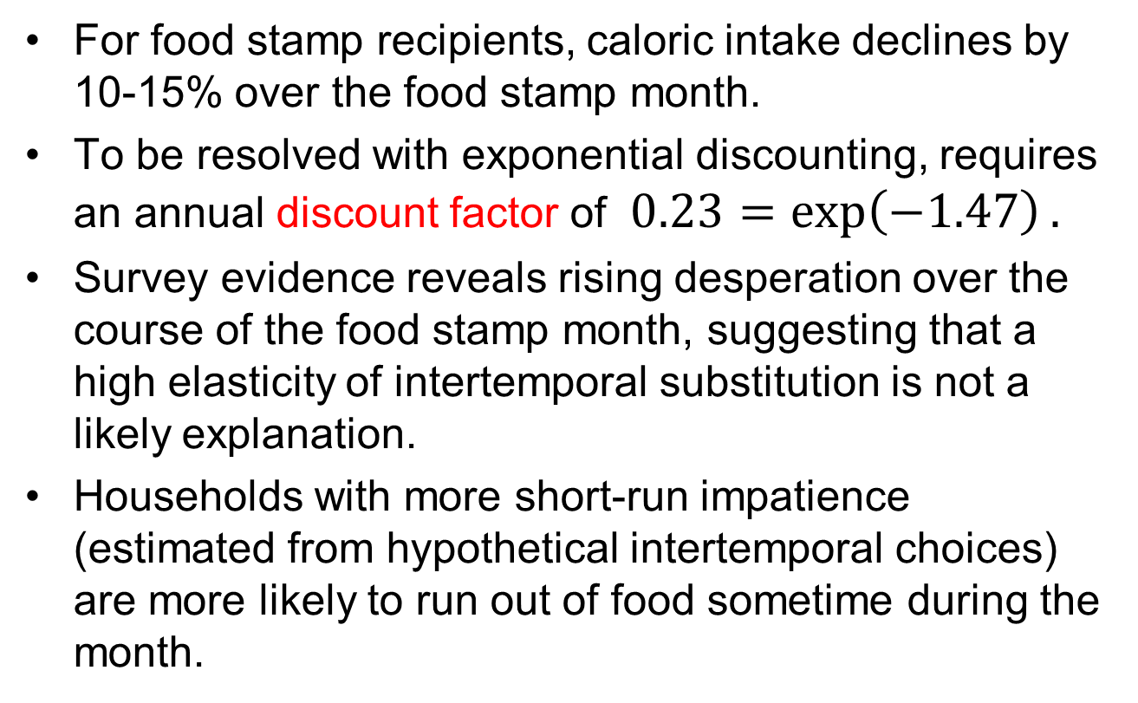
High MPC’s out of liquid wealth Shapiro (2005)
For food stamp recipients, caloric intake declines by 10-15% over the food stamp month.
To be resolved with exponential discounting, requires an annual discount factor of $0.23=\exp\left(−1.47\right).$
Survey evidence reveals rising desperation over the course of the food stamp month, suggesting that a high elasticity of intertemporal substitution is not a likely explanation.
Households with more short-run impatience (estimated from hypothetical intertemporal choices) are more likely to run out of food sometime during the month.

Slide 39
The data can reject a number of alternative hypotheses.
Households that shop for food more frequently do not display a smaller decline in intake over the month, casting doubt on depreciation stories.
Individuals in single-person households experience no less of a decline in caloric intake over the month than individuals in multi-person households.
Survey respondents are not more likely to eat in another person’s home toward the end of the month.
The data show no evidence of learning over time

Slide 40
High MPC’s out of Social security Mastrobuoni and Weinberg (2009)
Individuals with substantial savings smooth consumption over the monthly pay cycle
Individuals without savings consume 25 percent fewer calories the week before they receive SS checks relative to the week after

Slide 41
Lifecycle simulations (Angeletos et al 2001)
Mortality
Dependents
Retirement/Social Security
Three educational groups: NHS, HS, COLL
Stochastic labor income
Credit limit: (.30)(permanent income)
3 state variables: liquid and illiquid wealth, income.
2 choice variables: liquid and illiquid wealth investment

Slide 42
Preferences
Constant relative risk aversion = 2
For exponential discounting economy:
β=1
δ=0.94 (match median ‘W/Y’ of 3.9 ages 50-59)
For quasi-hyperbolic discounting economy:
β=0.7
δ=0.96 (match median ‘W/Y’ of 3.9 ages 50-59)

Slide 43
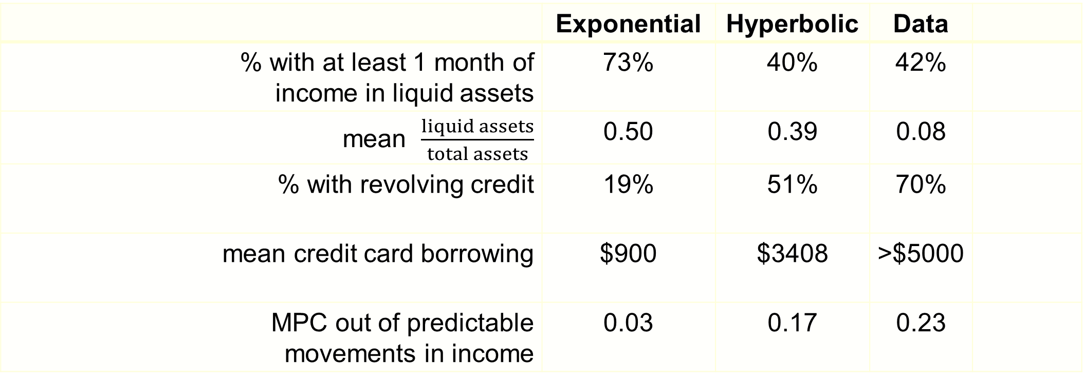
Predictions (HS education)
 | Exponential | Hyperbolic | Data
% with at least 1 month of income in liquid assets | 73% | 40% | 42%
mean $\frac{liquid assets}{total assets}$ | 0.50 | 0.39 | 0.08
% with revolving credit | 19% | 51% | 70%
mean credit card borrowing | $900 | $3408 | >$5000
MPC out of predictable movements in income | 0.03 | 0.17 | 0.23

Slide 44
LRT Simulation Model
Stochastic Income
Lifecycle variation in labor supply (e.g. retirement)
Social Security system
Life-cycle variation in household dependents
Bequests
Illiquid asset
Liquid asset
Credit card debt
Numerical solution (backwards induction) of 90 period lifecycle problem.

Slide 45
Laibson, Repetto, and Tobacman (2012)
Use MSM to estimate discounting parameters:
Substantial voluntarily accumulated illiquid wealth: W/Y = 3.9.
Extensive credit card borrowing:
68% didn’t pay their credit card in full last month
Average credit card interest rate is 14%
Credit card debt averages 13% of annual income
Consumption-income comovement:
Marginal Propensity to Consume = 0.23
(i.e. consumption tracks income)

Slide 46
LRT Results:
U_{t} = u_{t} + β [δu_{t+1} + δ²u_{t+2} + δ³u_{t+3} + ...]
β = 0.70 (s.e. 0.11)
δ = 0.96 (s.e. 0.01)
Null hypothesis of β = 1 rejected (t-stat of 3).
Specification test accepted.

Slide 47
Households have a low MPC out of illiquid/portfolio wealth
Skinner (1989)
Thaler (1990)
Choi, Laibson, Madrian, Metrick (2009)
Di Maggio, Kermani, and Majlesi (2020)
Kolsrud, Landais, Reck, and Spinnewijn (2021)

Slide 48
Nine claims about household finance
Households:
Have low levels of financial literacy
Have very few liquid assets (live hand to mouth)
Have substantial illiquid wealth
Have a high MPC out of liquid wealth and liquidity
Have a low MPC out of illiquid/portfolio wealth
Don’t choose optimal financial service products
Barely change their behavior after financial education interventions
Have misaligned financial intentions and financial actions
Make financial choices that are seemingly easy to manipulate

Slide 49
Financial illiteracy in mutual fund choice Choi, Laibson, Madrian (2011)
Subjects allocate $10,000 among four funds
Randomly choose two subjects to receive any positive portfolio return during the subsequent year
Eliminate variation in pre-fee returns
Choose among S&P 500 index funds
Unbundle services from returns
Experimenters pay out portfolio returns, so no access to investment company services

Slide 50
One year of index fund fees on a $10,000 investment

Slide 51
Experimental conditions
Control
Subjects receive only four prospectuses
Prospectuses are often the only information investors receive from companies
Fees transparency treatment
Eliminate search costs by also distributing fee summary sheet (repeats information in prospectus)
Returns treatment
Highlight extraneous information by distributing summary of funds’ annualized returns since inception (repeats information in prospectus)

Slide 52
Fees paid by control groups (prospectus only)
Maximum
Possible
Fee
$443: average fee with random fund allocation
Minimum
Possible
Fee
N = 83
N = 30
6% of MBA Controls put all funds in minimum-fee fund
0% of College Controls put all funds in minimum-fee fund
t-test: p=0.5086

Slide 53
Ranking of factor importance
MBA controls
Fees
1-year performance
Performance since inception
Investment objectives
Desire to diversify among funds
Brand recognition
Performance over different horizon
Past experience with fund companies
Quality of prospectus
Customer service of fund
Minimum opening balance
College controls
1-year performance
Performance since inception
Desire to diversify among funds
Investment objectives
Quality of prospectus
Performance over different horizon
Brand recognition
Fees
Customer service of fund
Minimum opening balance
Past experience with fund companies

Slide 54
Effect of fee treatment (prospectus plus 1-page sheet highlighting fees)
**
N = 83
N = 85
N = 30
N = 29
19% of MBA treatment put all funds in minimum-fee fund
10% of College treatment put all funds in minimum-fee fund
t-tests:
MBA: p=0.0000
College: p=0.1451

Slide 55
Ranking of factor importance
MBA fee treatment
Fees
1-year performance
Performance since inception
MBA controls
Fees
1-year performance
Performance since inception
College fee treatment
Fees
1-year performance
Performance since inception
College controls
1-year performance
Performance since inception
Desire to diversify among funds

Slide 56
Returns treatment effect on average returns since inception
**
**
N = 83
N = 84
N = 30
N = 28
t-tests
MBA: p=0.0055
College: p=0.0000

Slide 57
Returns treatment effect on fees
**
N = 83
N = 84
N = 30
N = 28
t-tests
MBA: p=0.0813
College: p=0.0008

Slide 58
Ranking of factor importance
MBA return treatment
1-year performance
Performance since inception
Fees
MBA controls
Fees
1-year performance
Performance since inception
College return treatment
Performance since inception
1-year performance
Desire to diversify among funds
College controls
1-year performance
Performance since inception
Desire to diversify among funds

Slide 59
Lack of confidence and fees (all revealed preferences are not created equal)
*
N = 64
N = 136
N = 50
N = 46
N = 36
N = 5
t-tests: MBA 1 vs. 2, p=0.2013; MBA 1 vs. 3, p=0.0479;
College 1 vs. 2, p=0.2864; College 1 vs. 3, p=0.3335

Slide 60
Financial illiteracy in mutual fund choice Choi, Laibson, Madrian (2011)
Subjects allocate $10,000 among four funds
No variation in underlying returns (excluding fees)
Choose among S&P 500 index funds
Unbundle services from returns
Experimenters pay out portfolio returns, so no access to investment company services

Slide 61
We conducted one version with Harvard staff as subjects
400 subjects (administrators, faculty assistants, technical personal, but not faculty)
We give every one of our subjects $10,000 and rewarded them with any gains on their investment
$4,000,000 short position in stock market

Slide 62
Data from Harvard Staff
Control Treatment
$518
Fees from
random
allocation
$431
3% of Harvard staff
in Control Treatment
put all $$$
in low-cost fund

Slide 63
Data from Harvard Staff
Control Treatment
Fee Treatment
$518
Fees from
random
allocation
$431
$494
3% of Harvard staff
in Control Treatment
put all $$$
in low-cost fund
9% of Harvard staff
in Fee Treatment
put all $$$
in low-cost fund

Slide 64
$100 bills on the sidewalk Choi, Laibson, Madrian (2009)
Employer match is an instantaneous, riskless return on investment
Particularly appealing if you are over 59½ years old
Have the most experience, so should be savvy
Retirement is close, so should be thinking about saving
Can withdraw money from 401(k) without penalty
We study seven companies and find that on average, half of employees over 59½ years old are not fully exploiting their employer match
Average loss is 1.6% of salary per year
Educational intervention has no effect

Slide 65
Financial education Choi, Laibson, Madrian, Metrick (2004)
Seminars presented by professional financial advisors
Curriculum: Setting savings goals, asset allocation, managing credit and debt, insurance against financial risks
Seminars offered throughout 2000
Linked data on individual employees’ seminar attendance to administrative data on actual savings behavior before and after seminar

Slide 66
Effect of education is positive but small
 | Seminar attendees |  | Non-attendees
 | % planning to make change | % actually made change | % actually made change
Those not in 401(k)
Enroll in 401(k) Plan | 100% | 14% | 7%
Those already in 401(k)
Increase contribution rate | 28% | 8% | 5%
Change fund selection | 47% | 15% | 10%
Change asset allocation | 36% | 10% | 6%

Slide 67
Effect of education is positive but small
 | Seminar attendees |  | Non-attendees
 | % planning to make change | % actually made change | % actually made change
Those not in 401(k)
Enroll in 401(k) Plan | 100% | 14% | 7%
Those already in 401(k)
Increase contribution rate | 28% | 8% | 5%
Change fund selection | 47% | 15% | 10%
Change asset allocation | 36% | 10% | 6%

Slide 68
Effect of education is positive but small
 | Seminar attendees |  | Non-attendees
 | % planning to make change | % actually made change | % actually made change
Those not in 401(k)
Enroll in 401(k) Plan | 100% | 14% | 7%
Those already in 401(k)
Increase contribution rate | 28% | 8% | 5%
Change fund selection | 47% | 15% | 10%
Change asset allocation | 36% | 10% | 6%

Slide 69
Financial education effects are small
Seminar attendees have good intentions to change their 401(k) savings behavior, but most do not follow through
Financial education alone will not dramatically improve the quality of 401(k) savings outcomes
Choi et al (2005) study the effect of the Enron, Worldcom, and Global Crossing scandals on employer stock holding
No net sales of employer stock in reaction to these news stories
These scandals did not affect the asset allocation decisions of new hires.
These hires did not affect the asset allocation decisions of new hires at other Houston firms.

Slide 70
Information and disclosure generally don’t do much on their own
Example
New York City calorie disclosure
(Elbel et al 2009)
Calories from
fast food purchases
 | Before | After
NYC (intervention city) | 825 | 846
Newark (control city) | 823 | 826

Slide 71
Social marketing and peer effects Beshears, Choi, Laibson, Madrian, Milkman (2014)
How does information about your peers affect savings behavior?

Slide 72
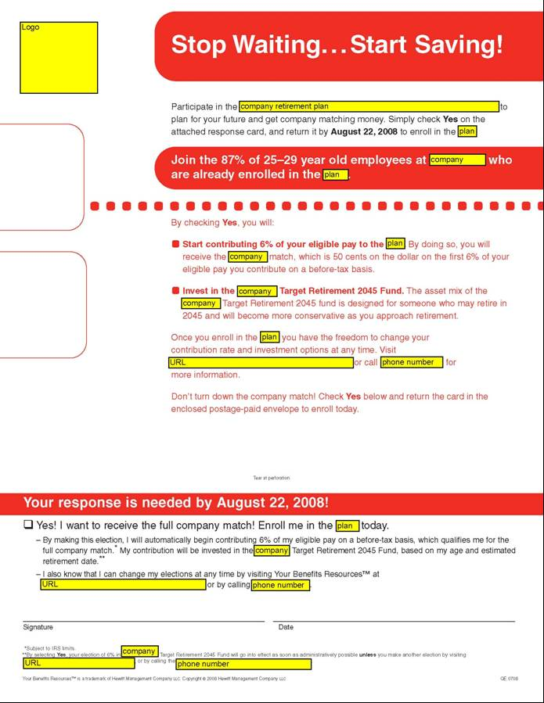
Notes:
72

Slide 73
Variation in peer information has no net impact on savings behavior
Small perverse effects for unionized workers
Small positive effect for non-unionized workers
Sources of variation of peer information:
Exclusion vs. inclusion of peer information
Variation in peer success (due to variation in comparison group)
All sources of variation generate consistent findings.

Slide 74
Nine claims about household finance
Households:
Have low levels of financial literacy
Have very few liquid assets (live hand to mouth)
Have substantial illiquid wealth
Have a high MPC out of liquid wealth and liquidity
Have a low MPC out of illiquid/portfolio wealth
Don’t choose optimal financial service products
Barely change their behavior after financial education interventions
Have misaligned financial intentions and financial actions
Make financial choices that are seemingly easy to manipulate

Slide 75
Procrastination in retirement savings Choi, Laibson, Madrian, Metrick (2002)
Survey
Mailed to 590 employees (random sample)
195 usable responses
Matched to administrative data on actual savings behavior

Slide 76
Typical breakdown among 100 employees
Out of every 100 surveyed employees
68 self-report saving too little
24 plan to raise savings rate in next 2 months
3 actually follow through

Slide 77
Credit card pay down Kuchler and Pagel (2021)
Data from on-line financial management service ReadyForZero, which gives users help in managing their debt.
Median credit card debt at sign-up: $10,669.
When users sign up for the site, they plan to reduce their debt significantly.
Median plan over first 90 days: $1,947
Most users reduce their debt levels by very little
Median pay down over first 90 days: $234.

Slide 78
Estimating discount functions with consumption choices over the lifecycle Laibson, Lee, Maxted, Repetto, Tobacman (2022)
Demographics:
mortality, child dependents, adult dependents, three educational groups, stochastic labor income with life-course variation
Dynamic Budget Constraint
credit cards with credit limit, liquid and partially illiquid assets
State variables:
liquid wealth, illiquid wealth, autocorrelated labor income
Preferences:
Present bias (naïve case) and constant relative risk aversion

Slide 79
Methodology
Method of simulated moments.
Solve for the preference parameters (discounting and risk aversion) that minimize the weighted squared difference between 16 simulated and empirical balance sheet moments.
Main population: US households with a high school education and not a college education

Slide 80
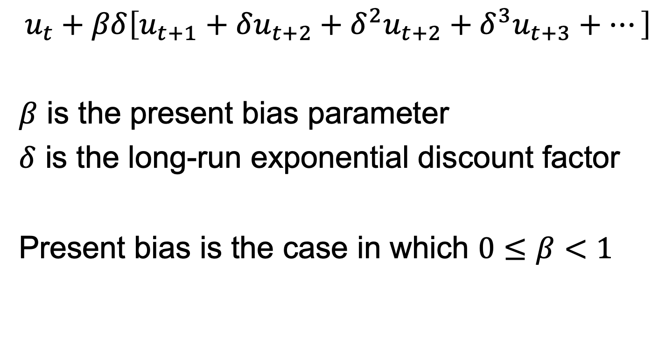
Discount function admits present bias
$$u_{t}+βδ\left[u_{t+1}+δu_{t+2}+δ^{2}u_{t+2}+δ^{3}u_{t+3}+…\right]$$
$β$ is the present bias parameter
$δ$ is the long-run exponential discount factor
Present bias is the case in which $0≤β<1$

Slide 81
 |  |  |  | β | β=1
(short run discount factor) β |  |  |  | 0.50 | 1.00
(long-run, exponential discount factor) δ |  |  |  | 0.99 | 0.96
relative risk aversion |  |  |  | 1.32 | 1.42
 |  |  |  | Simulated Moments |  |  | Moments |  | Age buckets
 | % households with credit card debt |  |  | 0.58 | 0.28 |  | 0.81 |  | 21-30
 |  |  |  | 0.59 | 0.24 |  | 0.78 |  | 31-40
 |  |  |  | 0.57 | 0.26 |  | 0.75 |  | 41-50
 |  |  |  | 0.55 | 0.26 |  | 0.66 |  | 51-60
 |  |  |  | 0.11 | 0.03 |  | 0.14 |  | 21-30
 |  |  |  | 0.14 | 0.03 |  | 0.14 |  | 31-40
 |  |  |  | 0.17 | 0.04 |  | 0.19 |  | 41-50
 |  |  |  | 0.20 | 0.05 |  | 0.20 |  | 51-60
 |  |  |  | 1.11 | 0.96 |  | 1.19 |  | 21-30
 |  |  |  | 1.48 | 0.98 |  | 1.78 |  | 31-40
 |  |  |  | 2.45 | 2.02 |  | 2.94 |  | 41-50
 |  |  |  | 4.34 | 4.14 |  | 4.24 |  | 51-60
 |  |  |  | 1.96 | 1.94 |  | 1.91 |  | 21-30
 |  |  |  | 3.04 | 2.88 |  | 2.66 |  | 31-40
 |  |  |  | 4.56 | 4.24 |  | 4.89 |  | 41-50
 |  |  |  | 7.45 | 6.28 |  | 8.10 |  | 51-60
$$\frac{\text{average} \text{credit} \text{card} \text{debt}}{\text{average} \text{income}}$$
households with
credit card debt:
$$\frac{\text{average} net worth}{\text{average} \text{income}}$$
households w/o
credit card debt:
$$\frac{\text{average} net worth}{\text{average} \text{income}}$$

Slide 82
 |  |  |  | β flexible | β=1
(short run discount factor) β |  |  |  | 0.50 | 1.00
(long-run, exponential discount factor) δ |  |  |  | 0.99 | 0.96
relative risk aversion |  |  |  | 1.32 | 1.42
 |  |  |  | Simulated Moments |  |  | Moments |  | Age buckets
 | % households with credit card debt |  |  | 0.58 | 0.28 |  | 0.81 |  | 21-30
 |  |  |  | 0.59 | 0.24 |  | 0.78 |  | 31-40
 |  |  |  | 0.57 | 0.26 |  | 0.75 |  | 41-50
 |  |  |  | 0.55 | 0.26 |  | 0.66 |  | 51-60
 |  |  |  | 0.11 | 0.03 |  | 0.14 |  | 21-30
 |  |  |  | 0.14 | 0.03 |  | 0.14 |  | 31-40
 |  |  |  | 0.17 | 0.04 |  | 0.19 |  | 41-50
 |  |  |  | 0.20 | 0.05 |  | 0.20 |  | 51-60
 |  |  |  | 1.11 | 0.96 |  | 1.19 |  | 21-30
 |  |  |  | 1.48 | 0.98 |  | 1.78 |  | 31-40
 |  |  |  | 2.45 | 2.02 |  | 2.94 |  | 41-50
 |  |  |  | 4.34 | 4.14 |  | 4.24 |  | 51-60
 |  |  |  | 1.96 | 1.94 |  | 1.91 |  | 21-30
 |  |  |  | 3.04 | 2.88 |  | 2.66 |  | 31-40
 |  |  |  | 4.56 | 4.24 |  | 4.89 |  | 41-50
 |  |  |  | 7.45 | 6.28 |  | 8.10 |  | 51-60
$$\frac{\text{average} \text{credit} \text{card} \text{debt}}{\text{average} \text{income}}$$
households with
credit card debt:
$$\frac{\text{average} net worth}{\text{average} \text{income}}$$
households w/o
credit card debt:
$$\frac{\text{average} net worth}{\text{average} \text{income}}$$

Slide 83
 |  |  |  | β flexible | β=1
(short run discount factor) β |  |  |  | 0.50 | 1.00
(long-run, exponential discount factor) δ |  |  |  | 0.99 | 0.96
relative risk aversion |  |  |  | 1.32 | 1.42
 |  |  |  | Simulated Moments |  |  | Moments |  | Age buckets
 | % households with credit card debt |  |  | 0.58 | 0.28 |  | 0.81 |  | 21-30
 |  |  |  | 0.59 | 0.24 |  | 0.78 |  | 31-40
 |  |  |  | 0.57 | 0.26 |  | 0.75 |  | 41-50
 |  |  |  | 0.55 | 0.26 |  | 0.66 |  | 51-60
 |  |  |  | 0.11 | 0.03 |  | 0.14 |  | 21-30
 |  |  |  | 0.14 | 0.03 |  | 0.14 |  | 31-40
 |  |  |  | 0.17 | 0.04 |  | 0.19 |  | 41-50
 |  |  |  | 0.20 | 0.05 |  | 0.20 |  | 51-60
 |  |  |  | 1.11 | 0.96 |  | 1.19 |  | 21-30
 |  |  |  | 1.48 | 0.98 |  | 1.78 |  | 31-40
 |  |  |  | 2.45 | 2.02 |  | 2.94 |  | 41-50
 |  |  |  | 4.34 | 4.14 |  | 4.24 |  | 51-60
 |  |  |  | 1.96 | 1.94 |  | 1.91 |  | 21-30
 |  |  |  | 3.04 | 2.88 |  | 2.66 |  | 31-40
 |  |  |  | 4.56 | 4.24 |  | 4.89 |  | 41-50
 |  |  |  | 7.45 | 6.28 |  | 8.10 |  | 51-60
$$\frac{\text{average} \text{credit} \text{card} \text{debt}}{\text{average} \text{income}}$$
households with
credit card debt:
$$\frac{\text{average} net worth}{\text{average} \text{income}}$$
households w/o
credit card debt:
$$\frac{\text{average} net worth}{\text{average} \text{income}}$$

Slide 84
 |  |  |  | β flexible | β=1
(short run discount factor) β |  |  |  | 0.50 | 1.00
(long-run, exponential discount factor) δ |  |  |  | 0.99 | 0.96
relative risk aversion |  |  |  | 1.32 | 1.42
 |  |  |  | Simulated Moments |  |  | Moments |  | Age buckets
 | % households with credit card debt |  |  | 0.58 | 0.28 |  | 0.81 |  | 21-30
 |  |  |  | 0.59 | 0.24 |  | 0.78 |  | 31-40
 |  |  |  | 0.57 | 0.26 |  | 0.75 |  | 41-50
 |  |  |  | 0.55 | 0.26 |  | 0.66 |  | 51-60
 |  |  |  | 0.11 | 0.03 |  | 0.14 |  | 21-30
 |  |  |  | 0.14 | 0.03 |  | 0.14 |  | 31-40
 |  |  |  | 0.17 | 0.04 |  | 0.19 |  | 41-50
 |  |  |  | 0.20 | 0.05 |  | 0.20 |  | 51-60
 |  |  |  | 1.11 | 0.96 |  | 1.19 |  | 21-30
 |  |  |  | 1.48 | 0.98 |  | 1.78 |  | 31-40
 |  |  |  | 2.45 | 2.02 |  | 2.94 |  | 41-50
 |  |  |  | 4.34 | 4.14 |  | 4.24 |  | 51-60
 |  |  |  | 1.96 | 1.94 |  | 1.91 |  | 21-30
 |  |  |  | 3.04 | 2.88 |  | 2.66 |  | 31-40
 |  |  |  | 4.56 | 4.24 |  | 4.89 |  | 41-50
 |  |  |  | 7.45 | 6.28 |  | 8.10 |  | 51-60
$$\frac{\text{average} \text{credit} \text{card} \text{debt}}{\text{average} \text{income}}$$
households with
credit card debt:
$$\frac{\text{average} net worth}{\text{average} \text{income}}$$
households w/o
credit card debt:
$$\frac{\text{average} net worth}{\text{average} \text{income}}$$

Slide 85
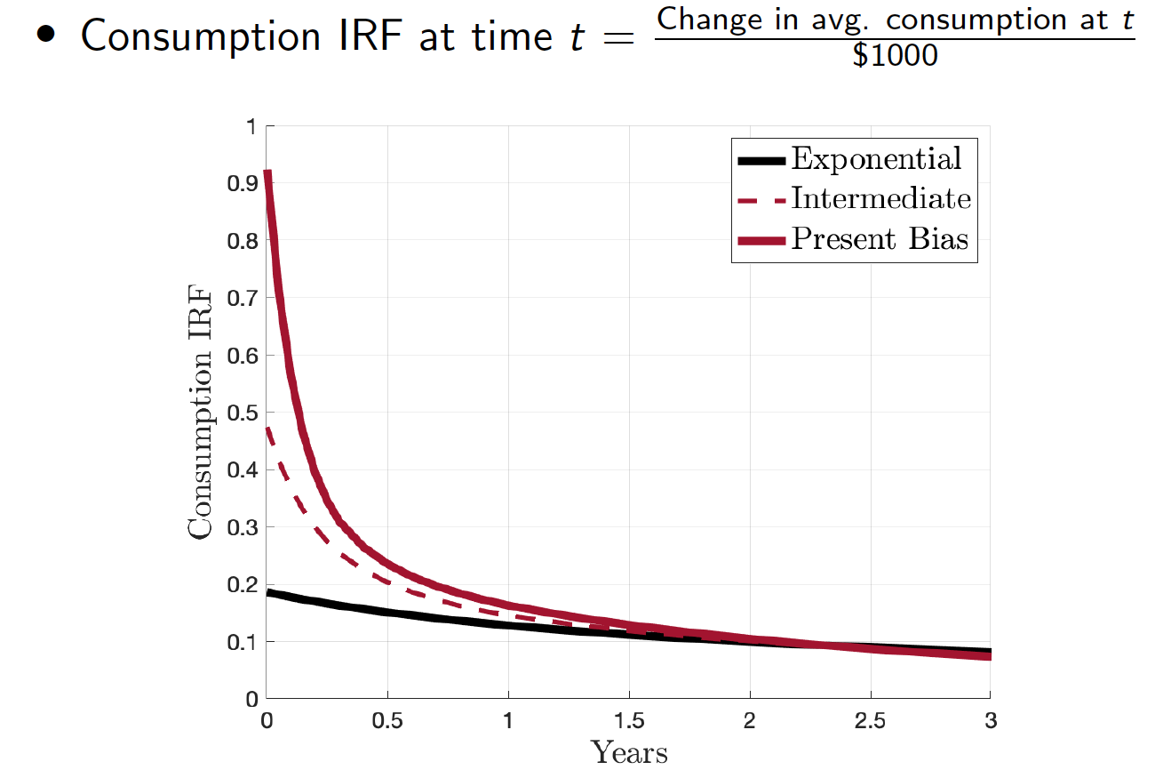
Laibson, Maxted, Moll (2022) 1-year MPC (28% w/ present bias; 15% w/ exponential)

Slide 86
Other structural models that incorporate present bias to explain household finance facts
Laibson, Repetto, and Tobacman (1998)
Shapiro (2005)
Dellavigna and Malmendier (2005, 2006)
Ganong and Noel (2019)
Gerard and Naritomi (2021)
Allcott, Kim, Taubinsky & Zinman (2021)

Slide 87
Nine claims about household finance
Households:
Have low levels of financial literacy
Have very few liquid assets (live hand to mouth)
Have substantial illiquid wealth
Have a high MPC out of liquid wealth and liquidity
Have a low MPC out of illiquid wealth
Don’t choose optimal financial service products
Barely change their behavior after financial education interventions
Have misaligned financial intentions and financial actions
Make financial choices that are seemingly easy to manipulate (Doug Bernheim’s lecture)

