Slide 1
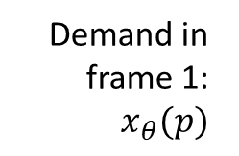
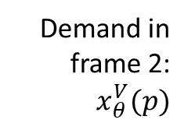
Demand in frame 1: $x_{θ}(p)$
Demand in frame 2: $x_{θ}^{V}(p)$
Price
Quantity

Slide 2
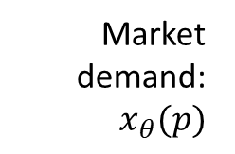

Market demand: $x_{θ}(p)$
Welfare-relevant demand: $x_{θ}^{V}(p)$
Price
Quantity

Slide 3
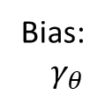
Market demand: $x_{θ}(p)$
Welfare-relevant demand: $x_{θ}^{V}(p)$
Bias:$γ_{θ}$
Price
Quantity

Slide 4
Market demand: $x_{θ}(p)$
Welfare-relevant demand: $x_{θ}^{V}(p)$
Marginal cost
Price
Quantity

Slide 5

Market demand: $x_{θ}(p)$
Welfare-relevant demand: $x_{θ}^{V}(p)$
Tax-inclusive price
$$t$$
Marginal cost
Price
Quantity

Slide 6


Market demand: $x_{θ}(p)$
Welfare-relevant demand: $x_{θ}^{V}(p)$
$$\frac{dx_{θ}}{dt}dt$$
Tax-inclusive price
$$dt$$
$$t$$
Marginal cost
Price
Quantity

Slide 7
Market demand: $x_{θ}(p)$
Welfare-relevant demand: $x_{θ}^{V}(p)$
$$\frac{dx_{θ}}{dt}dt$$
Fiscal externality
Tax-inclusive price
$$dt$$
$$t$$
Marginal cost
Price
Quantity

Slide 8
Market demand: $x_{θ}(p)$
Welfare-relevant demand: $x_{θ}^{V}(p)$
Tax-inclusive price
$$dt$$
Mechanical effect
Price
Quantity

Slide 9
Market demand: $x_{θ}(p)$
Welfare-relevant demand: $x_{θ}^{V}(p)$
$$\frac{dx_{θ}}{dt}dt$$
Tax-inclusive price
$$dt$$
Bias:$γ_{θ}$
Bias correction
Price
Quantity

Slide 10
Market demand: $x_{θ}(p)$
Welfare-relevant demand: $x_{θ}^{V}(p)$
$$\frac{dx_{θ}}{dt}dt$$
Fiscal externality
Tax-inclusive price
$$dt$$
Mechanical effect
Bias:$γ_{θ}$
Marginal cost
Bias correction
Price
Quantity

Slide 11
Market demand: $x_{θ}(p)$
Welfare-relevant demand: $x_{θ}^{V}(p)$
Consumption explained by bias
Tax-inclusive price
Bias:$γ_{θ}$
Price
Quantity

