Slide 1
What Test Should I Run?
Improving Concurrency Tests using State Space Estimation
Ben Blum
Jiří Šimša, Garth Gibson
Parallel Data Laboratory
Carnegie Mellon University

Slide 2
Outline
Systematic Testing
  Introduction and motivation
  State space estimation
Using State Space Estimates
  Improving estimation quality
  Automatic input refinement for small tests
Conclusion

Slide 3
Example
int thread_fork()
{
thread_t *child = spawn_new_thread();
add_to_runqueue(child);
return child->tid;
}

Slide 4
Example
  On exit, child's state is freed
  Forking thread does use-after-free
  Might return garbage instead of thread ID
int thread_fork()
{
thread_t *child = spawn_new_thread();
add_to_runqueue(child);
return child->tid;
}
“child” gets freed!

Slide 5
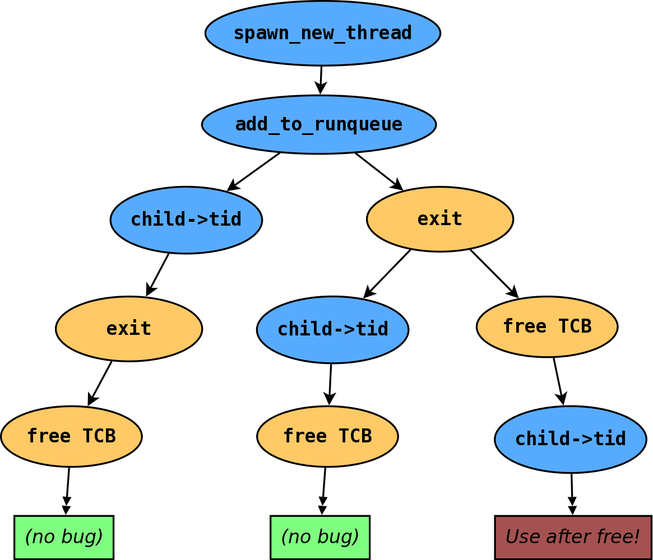
The Execution Tree
- Thread 1
- Thread 2

Slide 6
Systematic Testing
Systematic (exploratory) testing [Godefroid '97]
  Exhaustive search of a concurrent test's state space
  State space defined by “decision points”
  dBug [Simsa '11], Landslide (for kernels) [Blum '12]

Slide 7
Systematic Testing
Systematic (exploratory) testing [Godefroid '97]
  Exhaustive search of a concurrent test's state space
  State space defined by “decision points”
  dBug [Simsa '11], Landslide (for kernels) [Blum '12]
Problem: Many state spaces are too large to test feasibly.
  Exponential trade-off: thoroughness versus time
  Reduction techniques help (somewhat) [Flanagan '05]
Can we approach this trade-off automatically?

Slide 8
State Space Estimation
On-line estimation can guess total exploration time.
  Enables resource allocation for scheduling many
  tests to maximize completion [Simsa '12]
  As exploration progresses, estimate updates to
  reflect new knowledge about the state space.
    Assumes similar structure across state space.
    However, pruning interferes with estimation.

Slide 9
State Space Estimation
Why is state space estimation difficult?
  Estimation varies as time progresses
  Estimation varies across exploration orderings

Slide 10
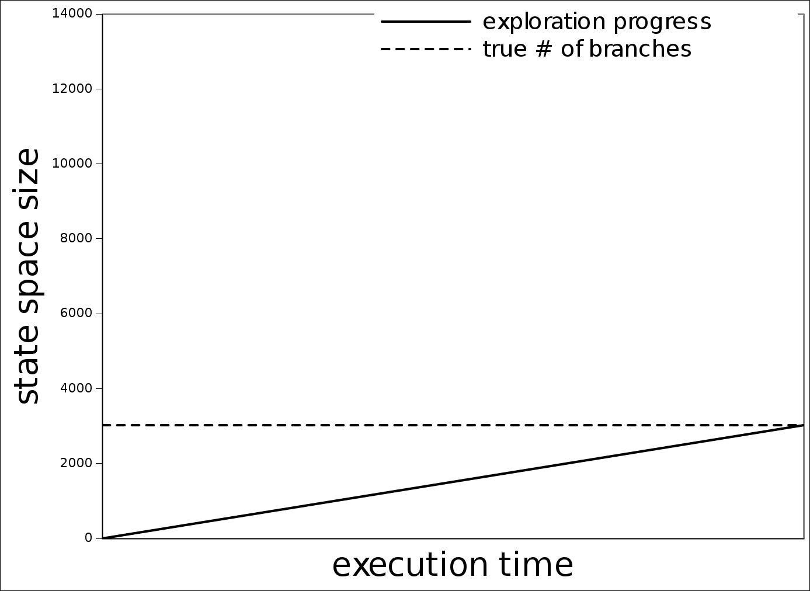
State Space Estimation
Why is state space estimation difficult?
  Estimation varies as time progresses
  Estimation varies across exploration orderings

Slide 11
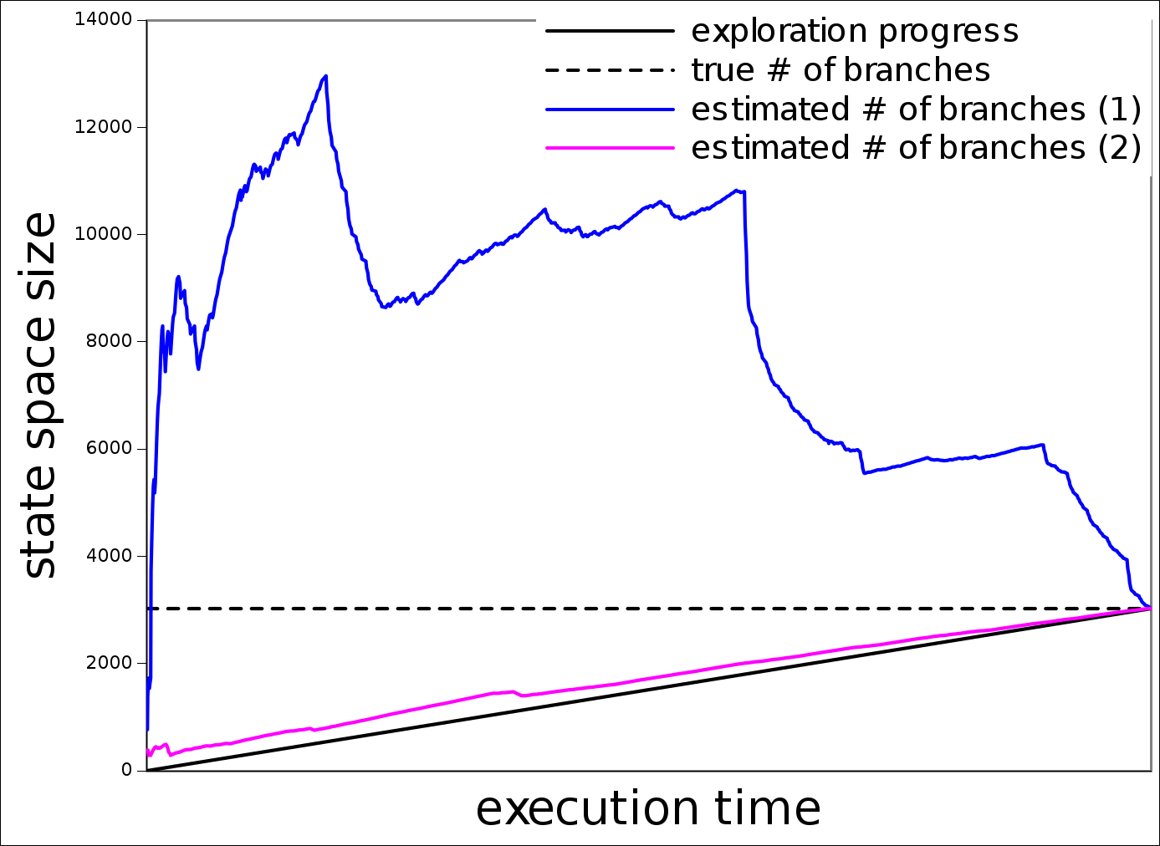
State Space Estimation
Why is state space estimation difficult?
  Estimation varies as time progresses
  Estimation varies across exploration orderings

Slide 12
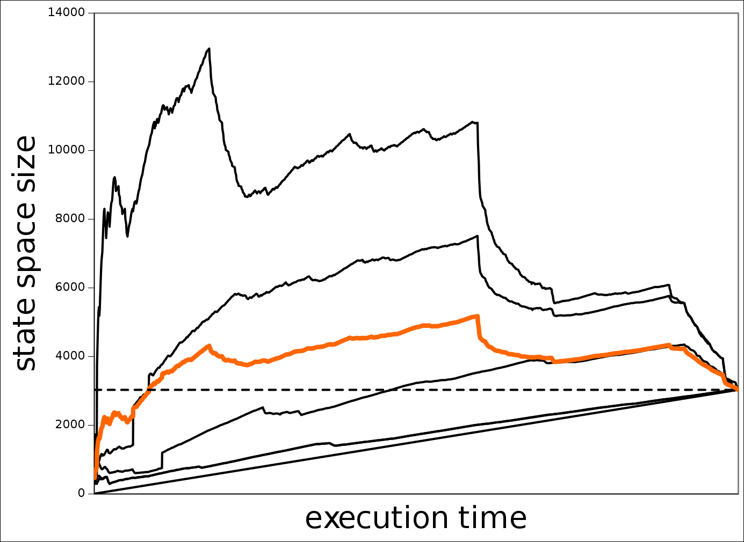
Improving Estimation Quality
Sample estimates from many parts of the tree at once.
  Try different, random exploration orderings in parallel.
  Average of all estimates tends to be most accurate.

Slide 13
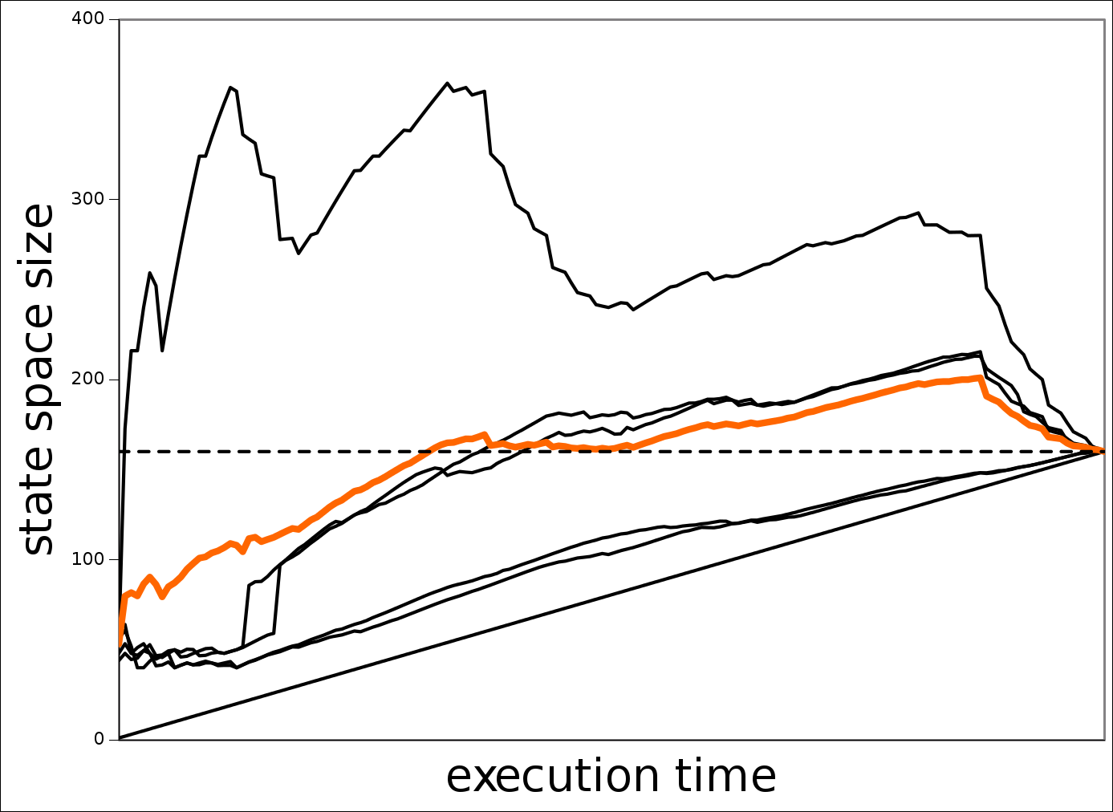
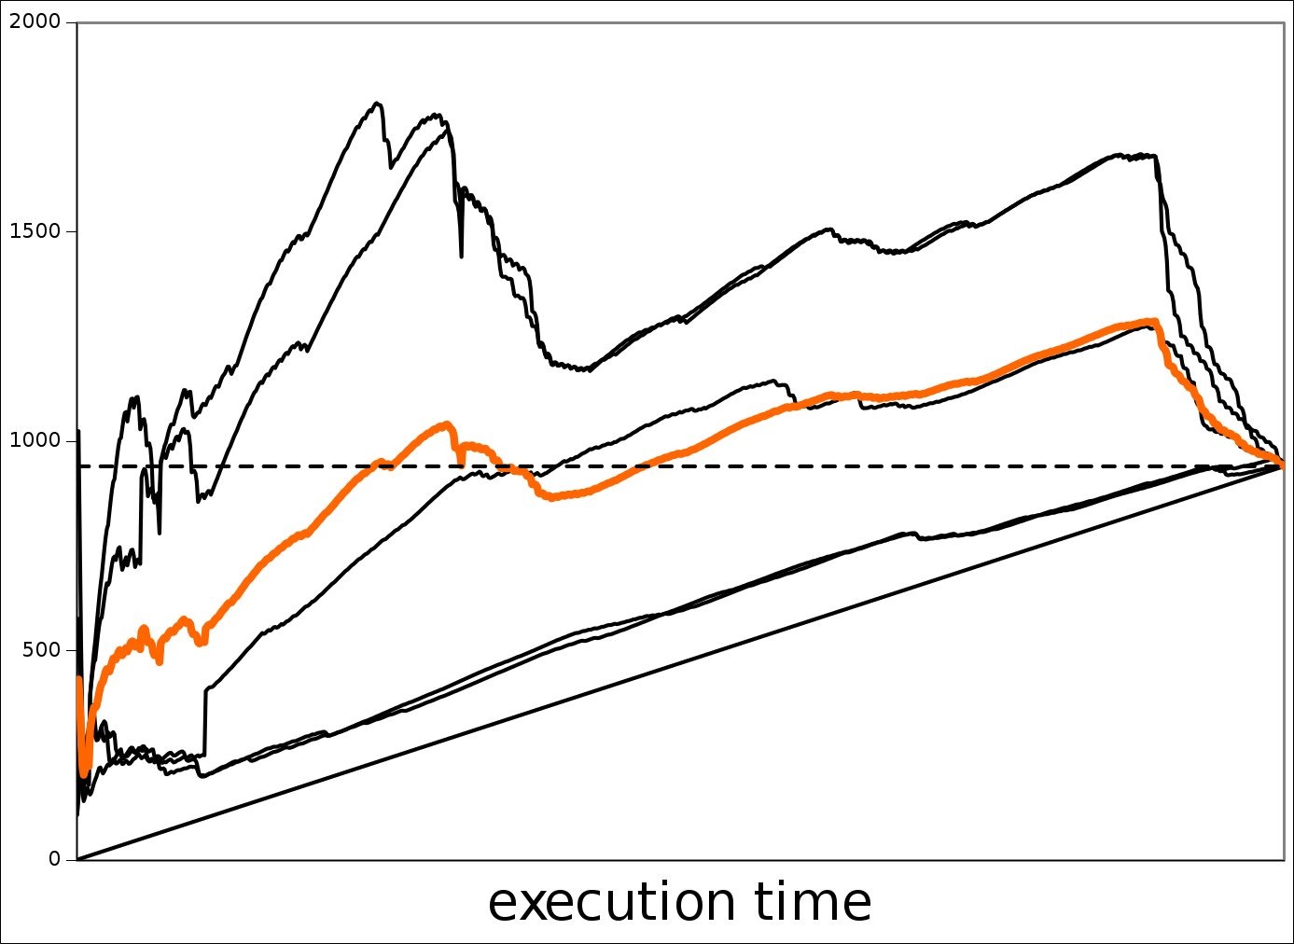
Improving Estimation Quality
Sample estimates from many parts of the tree at once.
  Try different, random exploration orderings in parallel.
  Average of all estimates tends to be most accurate.

Slide 14
Improving Estimation Quality
How to get the best estimate with a given CPU budget?
  Use value of estimate after exploring N branches.
  Exploring M ways in parallel requires lowering N.
What is a good heuristic for N versus M?

Slide 15
Test Case Refinement
How can we create a test with a reasonable state space?
  User studies with 15-410 (operating systems)
    Students worked best with an iterative process
    “Start small, then add more decision points”

Slide 16
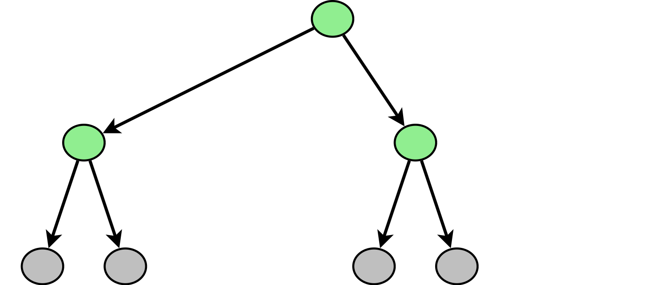
Test Case Refinement
How can we create a test with a reasonable state space?
  User studies with 15-410 (operating systems)
    Students worked best with an iterative process
    “Start small, then add more decision points”

Slide 17
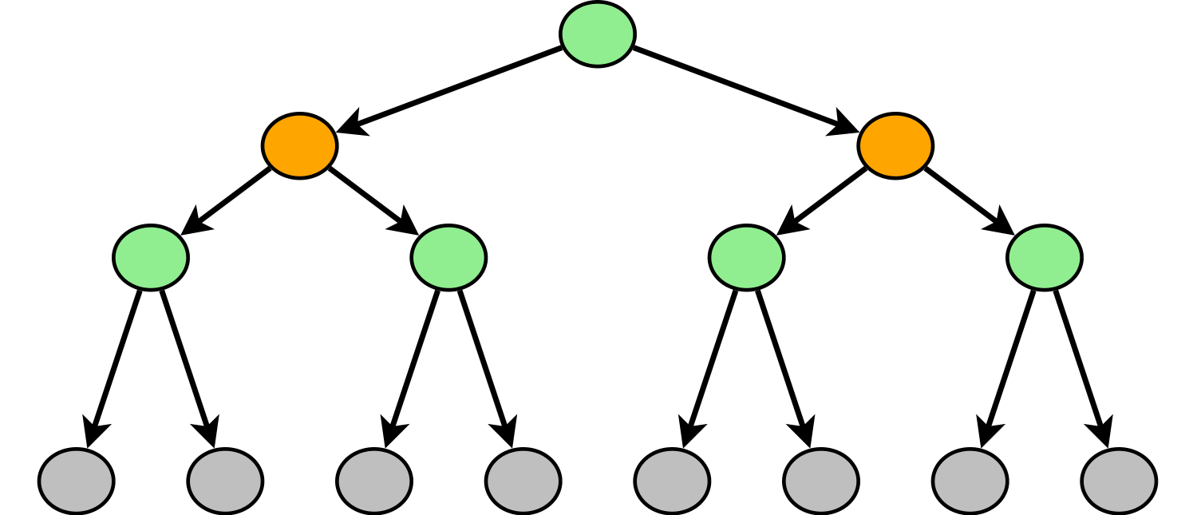
Test Case Refinement
How can we create a test with a reasonable state space?
  User studies with 15-410 (operating systems)
    Students worked best with an iterative process
    “Start small, then add more decision points”

Slide 18
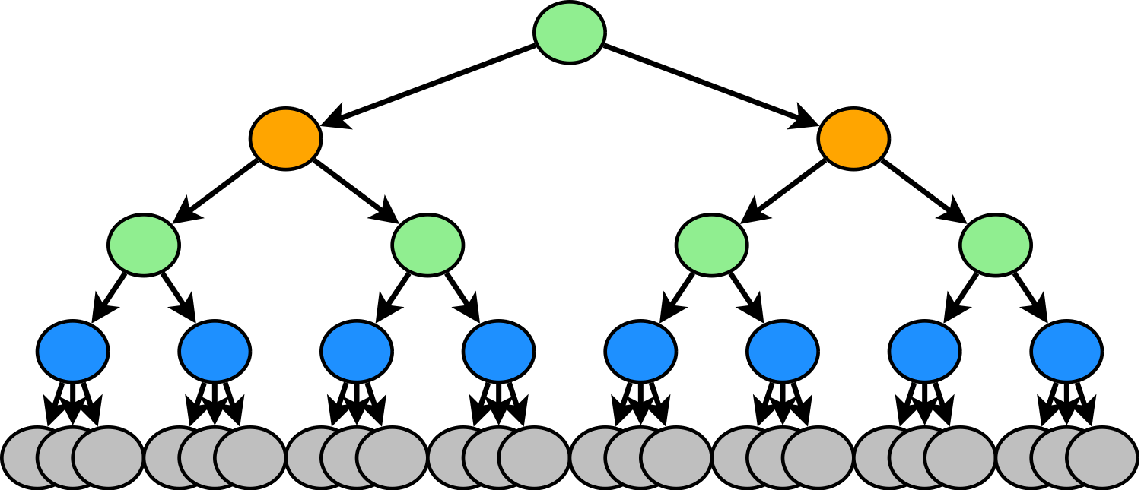
Test Case Refinement
How can we create a test with a reasonable state space?
  User studies with 15-410 (operating systems)
    Students worked best with an iterative process
    “Start small, then add more decision points”

Slide 19
Test Case Refinement
How can we create a test with a reasonable state space?
  User studies with 15-410 (operating systems)
    Students worked best with an iterative process
    “Start small, then add more decision points”
Can we automate this process?

Slide 20
“Iterative Deepening”
Goal: Heuristically add as many decision points as
possible for a given CPU time budget.
  Challenge: decision points should be meaningful.
    Lock/unlock calls (worked well with 15-410)
    Analyze memory accesses to find data races
  Estimates let us judge state spaces as “too big”.
    Test framework can test increasingly large
    sets of decision points until time runs out.

Slide 21
Conclusion
On-line estimation for concurrency tests is hard.
  Estimates vary dramatically with test configuration
  Can improve estimation quality with heuristic averages
Accurate estimates are important.
  With a large test suite, allows us to decide which tests are best to run
  With a single test, allows us to iteratively refine the test configuration until resources are exhausted

Slide 22
References
[Godefroid '97]
  Patrice Godefroid. VeriSoft: A Tool for the Automatic Analysis of Concurrent Reactive Software. CAV 1997.
[Flanagan '05]
  Cormac Flanagan and Patrice Godefroid. Dynamic partial-order reduction for model checking software. POPL 2005.
[Simsa '11]
  Jirí Simsa, Randy Bryant, Garth A. Gibson: dBug: Systematic Testing of Unmodified Distributed and Multi-threaded Systems. SPIN 2011.
[Blum '12]
  Ben Blum. Landslide: Systematic Dynamic Race Detection in Kernel Space. CMU-CS-12-118. May 2012.
[Simsa '12]
  Jiri Simsa. Runtime Estimation and Resource Allocation for Concurrency Testing. CMU-PDL-12-113. December 2012.

Slide 23
Related Work
Systematic testing
  MaceMC (NSDI '07) – liveness, random walking
  CHESS (PLDI '07) – iterative context bounding
  MoDist (NSDI '09) – network/disk model checking
  dBug (SSV '10) – dynamic partial order reduction
  SimTester (VEE '12) – interrupt injection, drivers
Data race detection
  Eraser (TOCS '97) – lock-set tracking, annotations
  DataCollider (OSDI '10) – random sampling, kernel
  RacePro (SOSP '11) – inter-process races

