Slide 1
Concurrency Testing with
Data-Race Preemption Points
Ben Blum
Garth Gibson
PDL Retreat 2015
Parallel Data Laboratory
Carnegie Mellon University

Slide 2
Outline
What is Systematic Testing?
  Motivation
  Role of preemption points
  Challenges
Iterative Deepening
  Data race detection
  State space estimation
  Implementation in Landslide & Quicksand
Evaluation
  Finding bugs in CMU OS student projects
Conclusion

Slide 3
Background: What is Systematic Testing?

Slide 4
Example
int thread_fork()
{
thread_t *child = spawn_new_thread();
add_to_runqueue(child);
return child->tid;
}

Slide 5
Example
  On exit, child's state is freed
  Forking thread does use-after-free
  Might return garbage instead of thread ID
int thread_fork()
{
thread_t *child = spawn_new_thread();
add_to_runqueue(child);
return child->tid;
}
“child” gets freed!

Slide 6
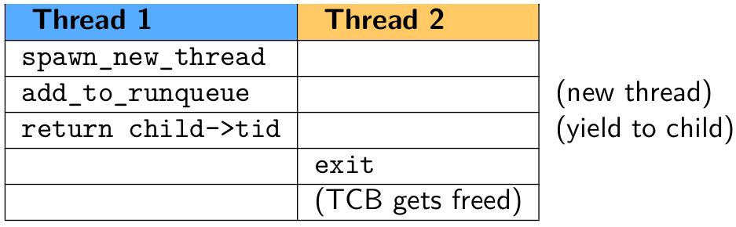
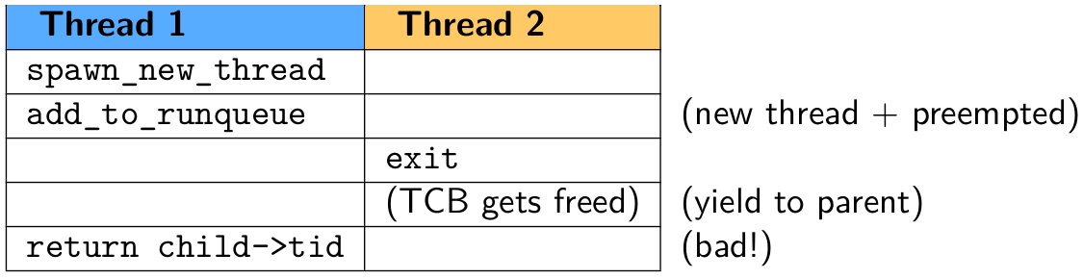
Example

Slide 7
Systematic Testing
Stress testing
  Common approach to finding concurrency bugs
  Relies on randomly-occurring context switches
  User-friendly but unpredictable/unbounded

Slide 8
Systematic Testing
Stress testing
  Common approach to finding concurrency bugs
  Relies on randomly-occurring context switches
  User-friendly but unpredictable/unbounded
Systematic testing [Godefroid '97]
  Thread scheduling controlled by test framework
  Each iteration, test a different thread interleaving
  Goal: Exhaustively search “all possible” interleavings

Slide 9
Systematic Testing
Stress testing
  Common approach to finding concurrency bugs
  Relies on randomly-occurring context switches
  User-friendly but unpredictable/unbounded
Systematic testing [Godefroid '97]
  Thread scheduling controlled by test framework
  Each iteration, test a different thread interleaving
  Goal: Exhaustively search “all possible” interleavings
    Wait... what?
    In practice, interleavings are of coarse granularity.

Slide 10
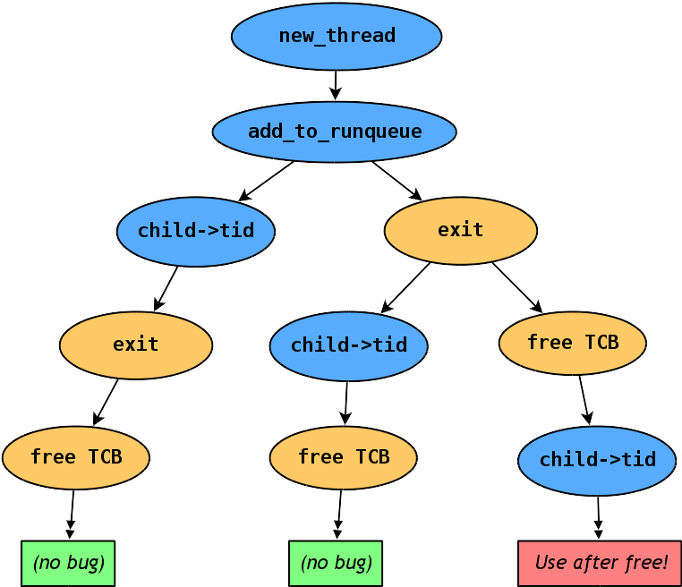
Example - State Space
- Thread 1
- Thread 2

Slide 11
Preemption Points
The burning question of systematic testing: “Which preemption points (PPs) are important?”
State space of interleavings is parameterized by PPs.
  Preemption points everywhere: completion infeasible
  Too few preemption points: won't find bugs
Prior work implementations hard-code a fixed set of PPs.
  dBug [Simsa '11]: pthread library calls
  Landslide [Blum '12]: kernel or user mutex lock/unlock

Slide 12
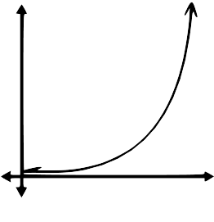
Challenges
Parameters of systematic tests must be kept small.
  Test program length / number of threads
  Number of preemption points used
state space size
# of preemption points

Slide 13
Coping with Exponential Explosion
Some prior work focuses on improving coverage with...
  Reduction techniques (identifying equivalences)
    [Flanagan '05, Guo '11, Huang '15]
  Determinizing runtimes [Cui '13]
Other prior systems give up on 100% completion...
  Random distribution of PPs [Fonseca '14]
  Heuristic exploration ordering (ICB) [Musuvathi '08]

Slide 14
Coping with Exponential Explosion
Current systematic testing model not user-friendly.
  Test framework: “I want to use these PPs, but can't predict how long until completion.”
  User: “I have 16 CPUs and 24h to test my program.”
Stress testing offers this... can we offer it too?

Slide 15
Our Technique: Iterative Deepening

Slide 16
Iterative Deepening
Goal: Run the best tests for a given CPU budget.
  User studies with 15-410 (operating systems)
    Students worked best with an iterative process
    “Start small, then add more preemption points”

Slide 17
Iterative Deepening
Goal: Run the best tests for a given CPU budget.
  User studies with 15-410 (operating systems)
    Students worked best with an iterative process
    “Start small, then add more preemption points”
Named after analogous technique in chess AI.
  Chess search is DFS limited by max # of moves (ply).
  Chess AIs repeat DFS, increasing ply, until timeout.

Slide 18
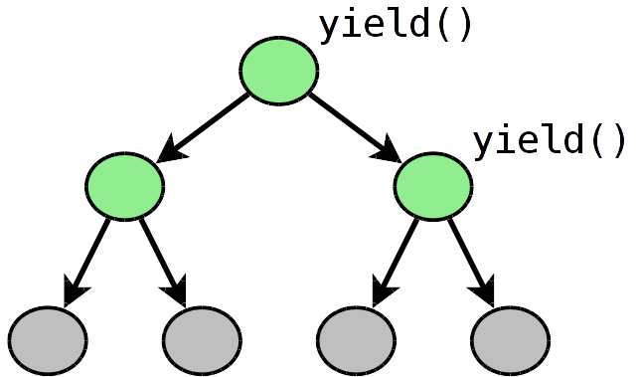
Iterative Deepening
“Minimal” state space == mandatory thread switches only
  yield()
  cond_wait()

Slide 19
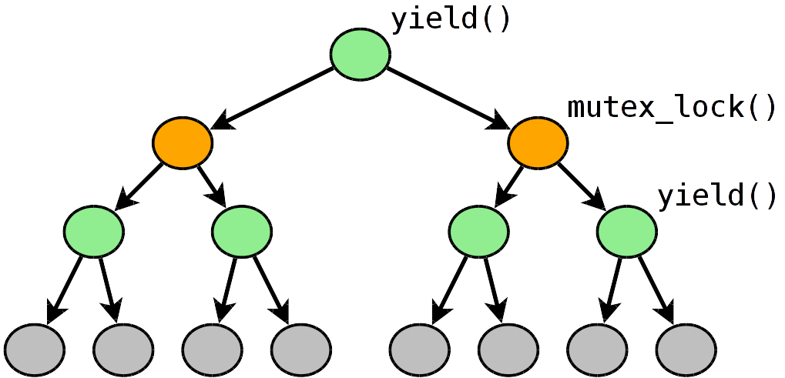
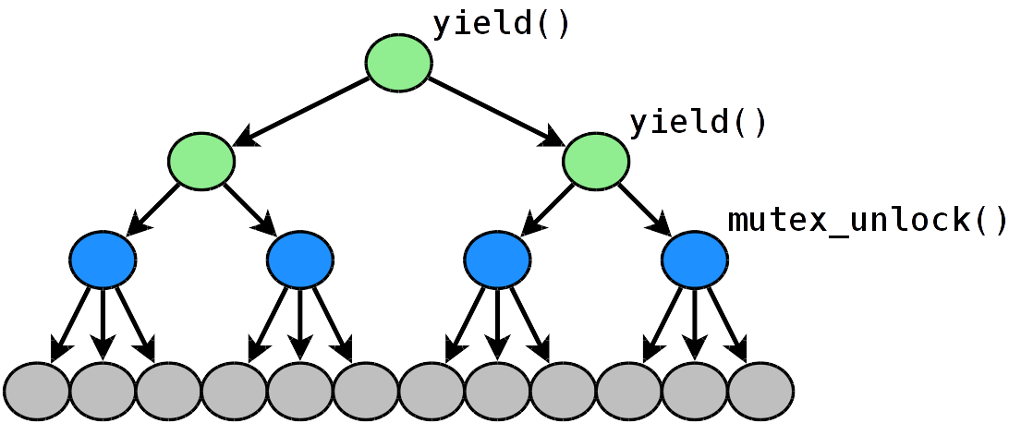
Iterative Deepening
Different PPs can produce state spaces of different sizes.
Testing them in parallel hedges our bets.

Slide 20
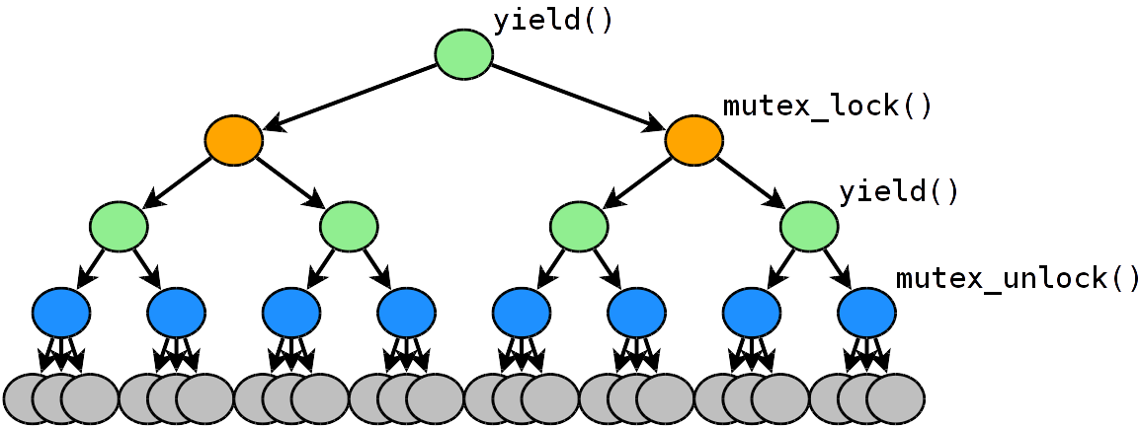
Iterative Deepening
If time allows, we combine PPs to produce larger tests.
All PPs enabled = “maximal” state space
  Prior work tools explore this state space only.

Slide 21
Choosing Preemption Points
How do we choose good preemption points?
  Start with “hardcoded” PPs as candidates
  Dynamic analysis during run can find new candidates:
    Ad-hoc yield or busy loops
      Avoid cyclic state spaces
    Data races [Savage '97]
      Including atomic operations enables testing locks, lock-free queues, etc.
Our main
contribution

Slide 22
Data-Race Preemption Points
Data race: 2 threads access the same memory, and:
  At least one access is a write
  Sets of locks held by each thread do not overlap
  No sync-enforced ordering (e.g. cond_signal())
Let's preempt threads during these accesses!
  Preempting only on API boundaries can miss bugs
  1-pass data-race analysis has false positive problem
    Using data races as PPs automatically verifies or refutes each data race candidate.

Slide 23
Landslide
Landslide [Blum '12]: simulator-based tester
  Originally built to test 15-410 Pebbles kernels
    (a landslide tests the stability of pebbles)
  Wind River Simics: Full-system x86 simulator
    Supports instruction/memory tracing, backtracking
    No additional overhead for data race analysis
Landslide's features
  DPOR [Flanagan '05] prunes equivalences
  State space estimation guesses total time [Simsa '12]
  Bug detection: heap checking, deadlock, infinite loop...

Slide 24
Landslide & Quicksand
Quicksand: wrapper program for Iterative Deepening
  Manages work queue of jobs with different PP configs
  Each job is a new state space for Landslide to explore
  Prioritizes which jobs are important / likely to finish
    Based on nature of PPs (data races? mutexes?)
    Based on estimated completion time
Only required argument is user's CPU budget

Slide 25
Evaluation

Slide 26
PLDI Evaluation Plan
Comparing to single-state-space (SSS) testing
  Finding bugs faster, while SSS times out
  Finding new bugs with data-race PPs
Comparing to 1-pass data-race analysis
  No details now, happy to explain at poster session
Testing OS projects from CMU, Berkeley, and U Chicago
  CMU: 79 “P2” thread libraries
  Berkeley & U Chicago: 79 “Pintos” kernels
  Under construction, feedback much appreciated!

Slide 27
Test Suite
15-410 – Undergrad Operating Systems at CMU
  P2: pthread-like userspace thread library
    Sync primitives: mutexes, cvars, sems, rwlocks
    Thread API: thr_create, thr_join, thr_exit
  6 test cases (50 LOC average):
    thr_exit_join, broadcast_test, paraguay, rwlock_test, paradise_lost
      Test of everything built on top of mutexes
    mutex_test
      Test of low-level lock implementation

Slide 28
mutex_test is special...
Normally, we give a lock's internal accesses a “free pass”.
  This enables productive data-race analysis elsewhere.
while (xchg(&lock->held,1)==1)
yield(lock->owner);
lock->owner = gettid();
// in critical section...
// access protected data...
lock->owner = -1;
lock->held = 0;
lock()
All accesses in this range are considered protected by the lock.
unlock()

Slide 29
mutex_test is special...
In mutex_test, we wish to verify the implicit assumption that other tests make that the locks are correct.
while (xchg(&lock->held,1)==1)
yield(lock->owner);
lock->owner = gettid();
// in critical section...
// access protected data...
lock->owner = -1;
lock->held = 0;
lock()
All accesses in this range are considered protected by the lock.
unlock()

Slide 30
Experimental Setup
79 P2s × 6 test cases × 10 CPU-hours ≈ 200 CPU-days
  18 12-core (HT) 3.2 GHz Xeon machines, 12 GB RAM
Compare to a “control” experiment, also given 10 CPU-hours
  1 state space, all “fixed” PPs enabled
    mutex_lock()
    mutex_unlock()
    yield()
    (cond_wait(), etc, have mutex_lock() PPs inside)

Slide 31
Results
Do we find the same bugs faster?
Control experiment with fixed PPs
  70 nondeterministic bugs
  90 timeouts
Quicksand with iterative deepening
  Found 68 of those 70
    Maximal state space's ETA was too high
  Found 2 more (no DR PPs needed) in control time-outs
    Found much faster in subset state spaces

Slide 32
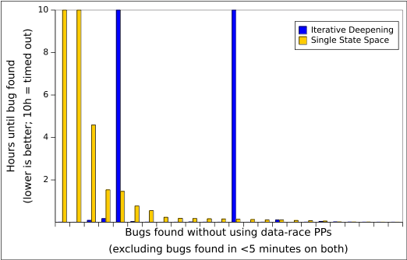
Results
Do we find the same bugs faster?

Slide 33
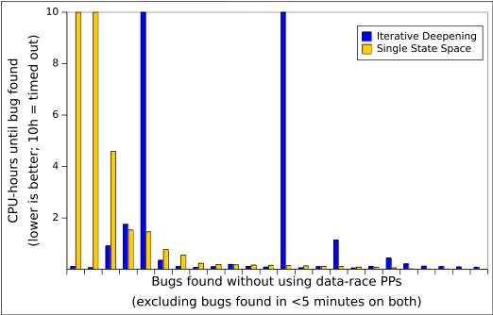
Results
Do we find the same bugs faster?

Slide 34
Results
Do we find new bugs with data-race PPs?
Quicksand with iterative deepening
  107 nondeterministic bugs in total
  33 required data-race PPs to expose!
    10 where control timed-out
    23 where control completed w/ no bug found
  mutex_test
    12 bugs (to control's 1)
    All 12 others found with data-race PPs

Slide 35
Conclusion

Slide 36
Future Work
Immediate future
  Ongoing user study with 15-410 students
    Evaluate effectiveness for education/grading
  Finish PLDI evaluation plan, obviously
    Have any experiment design ideas to share?
More uncertain future
  Smarter policies for too-large state spaces (ICB)
  Incorporate parallel DPOR to saturate CPUs better
  Applying to production, not student, code

Slide 37
Conclusion
Systematic Testing
  Controls scheduling rather than rely on randomness
  More reliable bug-finding than stress testing
  State space depends on preemption points (PPs)
  Completion time is exponential and unpredictable
Iterative deepening with Landslide & Quicksand
  Automatically searches for optimal set of PPs to use
  User need only supply CPU time budget
  Data race PPs uncover 50% more bugs
  PLDI submission soon; want evaluation feedback

Slide 38
References
[Godefroid '97]
  Patrice Godefroid. VeriSoft: A Tool for the Automatic Analysis of Concurrent Reactive Software. CAV 1997.
[Savage '97]
  Stefan Savage et al. Eraser: A Dynamic Data Race Detector for Multithreaded Programs. ACM TOCS 1997.
[Flanagan '05]
  Cormac Flanagan and Patrice Godefroid. Dynamic partial-order reduction for model checking software. POPL 2005.
[Musuvathi '08]
  Madanlal Musuvathi et al. Finding and Reproducing Heisenbugs in Concurrent Programs. (a.k.a. the CHESS paper.) OSDI 2008.
[Simsa '11]
  Jirí Simsa, Randy Bryant, Garth A. Gibson: dBug: Systematic Testing of Unmodified Distributed and Multi-threaded Systems. SPIN 2011.

Slide 39
References
[Guo '11]
  Huayang Guo et al. Practical Software Model Checking via Dynamic Interface Reduction. SOSP 2011.
[Blum '12]
  Ben Blum. Landslide: Systematic Dynamic Race Detection in Kernel Space. CMU-CS-12-118. May 2012.
[Simsa '12]
  Jiri Simsa. Runtime Estimation and Resource Allocation for Concurrency Testing. CMU-PDL-12-113. December 2012.
[Cui '13]
  Heming Cui et al. Parrot: A Practical Runtime for Deterministic, Stable, and Reliable Threads. SOSP 2013.
[Fonseca '14]
  Pedro Fonseca et al. SKI: Exposing Kernel Concurrency Bugs through Systematic Schedule Exploration. OSDI 2014.

Slide 40
Related Work
Systematic testing
  MaceMC (NSDI '07) – liveness, random walking
  CHESS (PLDI '07) – iterative context bounding (ICB)
  MoDist (NSDI '09) – network/disk model checking
  dBug (SSV '10/SPIN '11) – dynamic partial order reduction
  SimTester (VEE '12) – interrupt injection, drivers
  Parrot (SOSP '13) – dBug + deterministic userspace scheduler
  SKI (OSDI '14) – randomly-chosen PPs for testing Linux
  SAMC (OSDI '14) – annotated sync primitives, better reduction
Data race detection
  Eraser (TOCS '97) – lock-set tracking, annotations
  DataCollider (OSDI '10) – random sampling, kernel
  RacePro (SOSP '11) – inter-process races
  Portend (ASPLOS '12) – alternate interleavings, symbolic execution

Slide 41
Bonus Slides

Slide 42
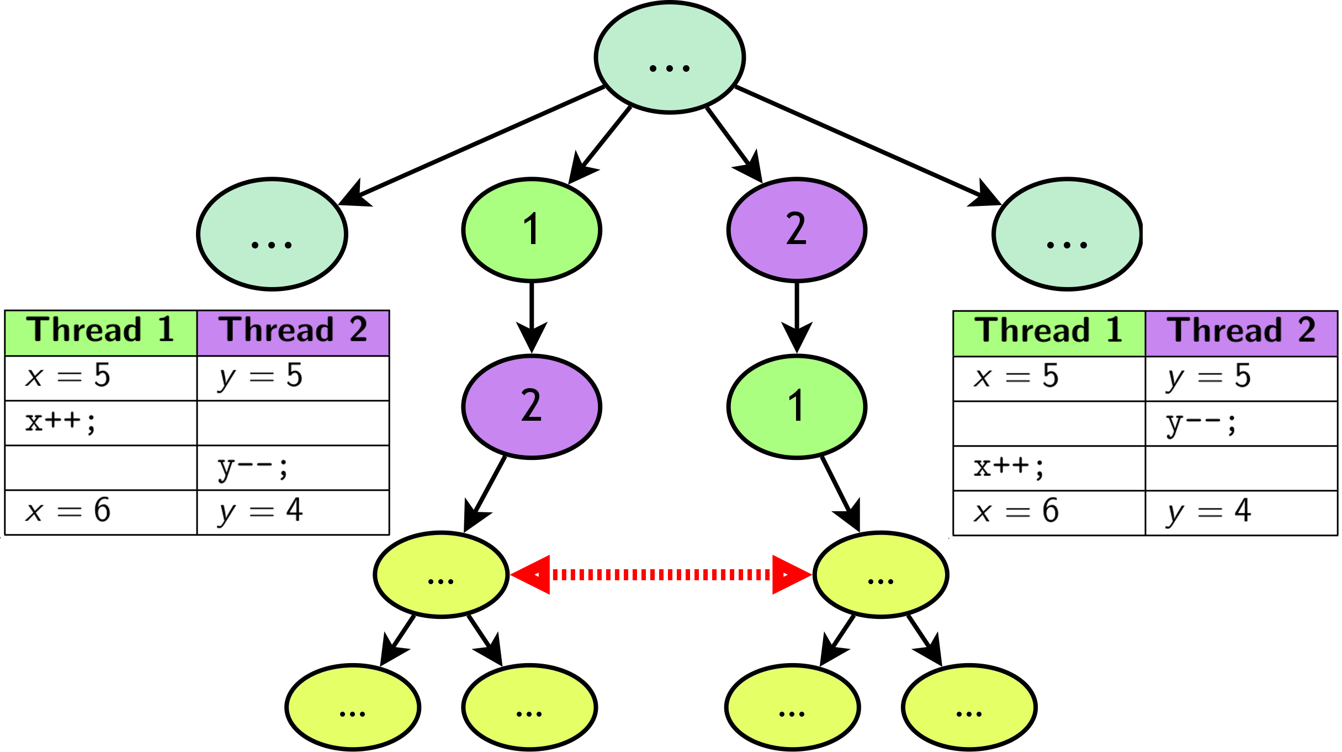
Dynamic Partial Order Reduction

Slide 43
Results
Among 474 total tests (P2+unit test pairs)...
  23 deterministic bugs (e.g. use-after-free); fixed by hand
Control experiment with fixed PPs
  70 nondeterministic bugs
  90 timeouts
Quicksand with iterative deepening
  107 nondeterministic bugs
    37 requiring data-race PPs to expose
    mutex_test: 13 bugs, 12 requiring data-race PPs
  2 bugs found without data-race PPs (control timeout)
  2 bugs missed that control found (explain why)

