Slide 1
Landslide:
Systematic Testing for Kernel Space Race Detection
Ben Blum
Jiří Šimša, Garth Gibson
Parallel Data Laboratory
Carnegie Mellon University

Slide 2
Outline
Motivation: Concurrency debugging
  Systematic testing versus stress testing
  State space explosion
  Challenges of kernel-space
Tool: Landslide
  Design and interface
  Addressing challenges
Evaluation: Finding Races
  Student user study
  Case study
Future Work and Conclusion

Slide 3
Motivation – Example
int thread_fork()
{
thread_t *child = spawn_new_thread();
add_to_runqueue(child);
return child->tid;
}

Slide 4
Motivation – Example
  On exit, child's state is freed
  Forking thread does use-after-free
  Might return garbage instead of thread ID
int thread_fork()
{
thread_t *child = spawn_new_thread();
add_to_runqueue(child);
return child->tid;
}
“child” gets freed!

Slide 5
Motivation – Testing Techniques
Stress Testing: Common testing approach
  Trying to exercise as many interleavings as possible
  Exposes race conditions at random
    “If a preemption occurs at just the right time...”
  Cryptic panic messages or machine reboots
Systematic Testing [Godefroid '97]
  Make educated guesses about when to preempt
  Run every single interleaving
  Provide better debugging information, reproducibility

Slide 6
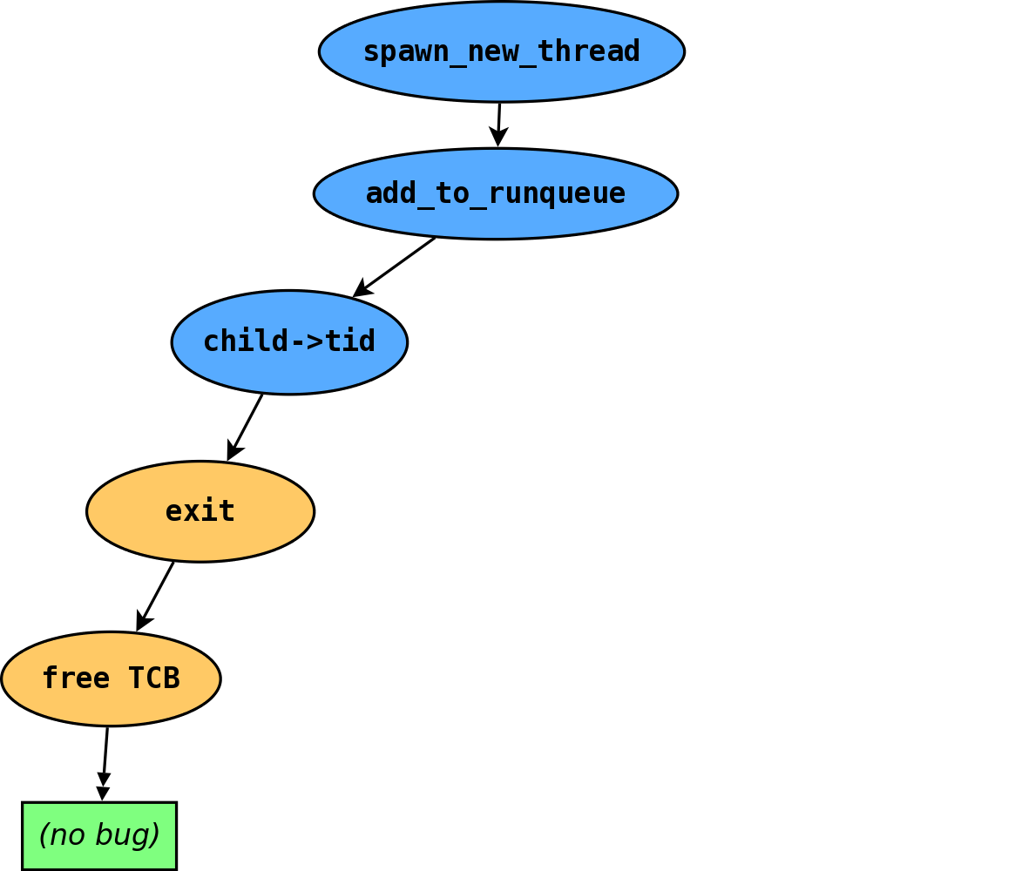
The Execution Tree
- Thread 1
- Thread 2

Slide 7

The Execution Tree
- Thread 1
- Thread 2

Slide 8
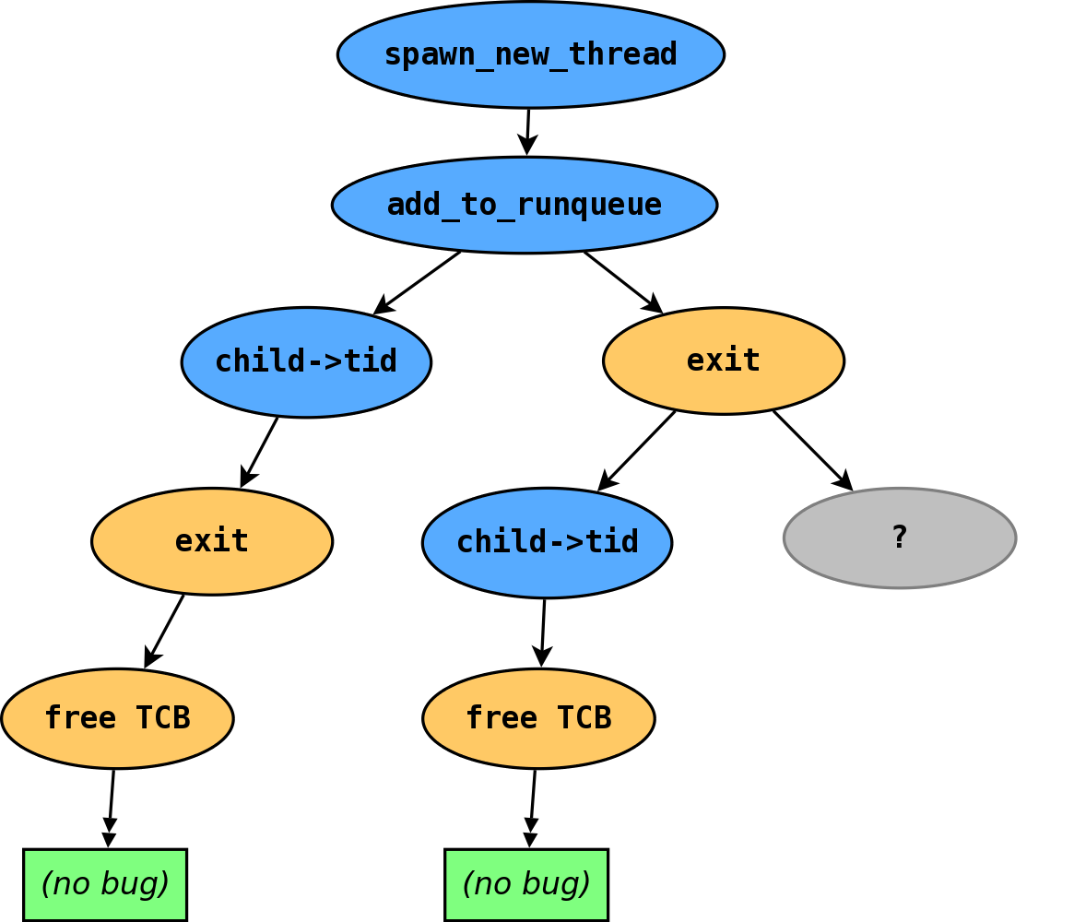
The Execution Tree
- Thread 1
- Thread 2

Slide 9
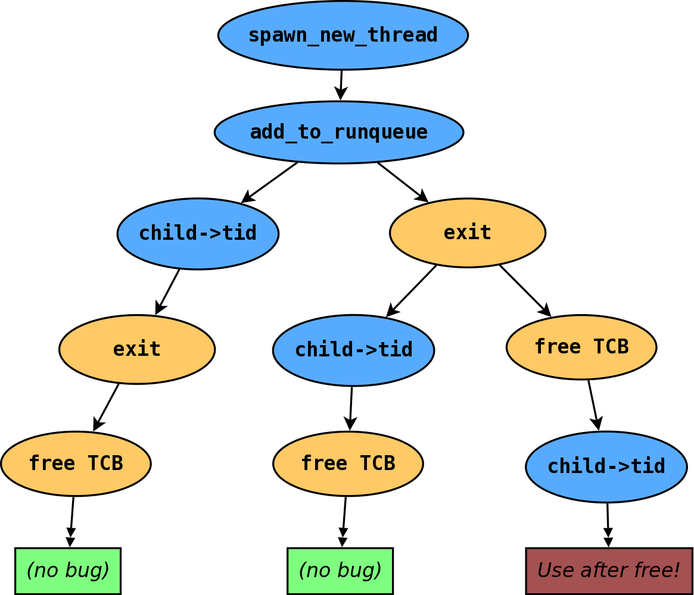
The Execution Tree
- Thread 1
- Thread 2

Slide 10
Decision Points
Decision points: where being preempted causes different
behaviour.
What does “all possible interleavings” mean?
  One extreme: Decide at every instruction
    Impossibly large test runtime
  Other extreme: No decision points
    Makes “no race found” a weak claim
  Sweet spot: Intuit where preemptions “might matter”
    Joint effort between programmer and tool

Slide 11
Decision Points
In userspace, pthread library calls. [Simsa '11]
In kernels, we need to tell the story from scratch.

Slide 12
Challenge 1: Causes of Concurrency
Kernels contain their own concurrency implementation.
  Context switching
    Nondeterministic timer-driven thread scheduling
  Runqueue tracking
    Which threads are runnable?
  Thread lifecycle tracking
    When are threads created/destroyed?

Slide 13
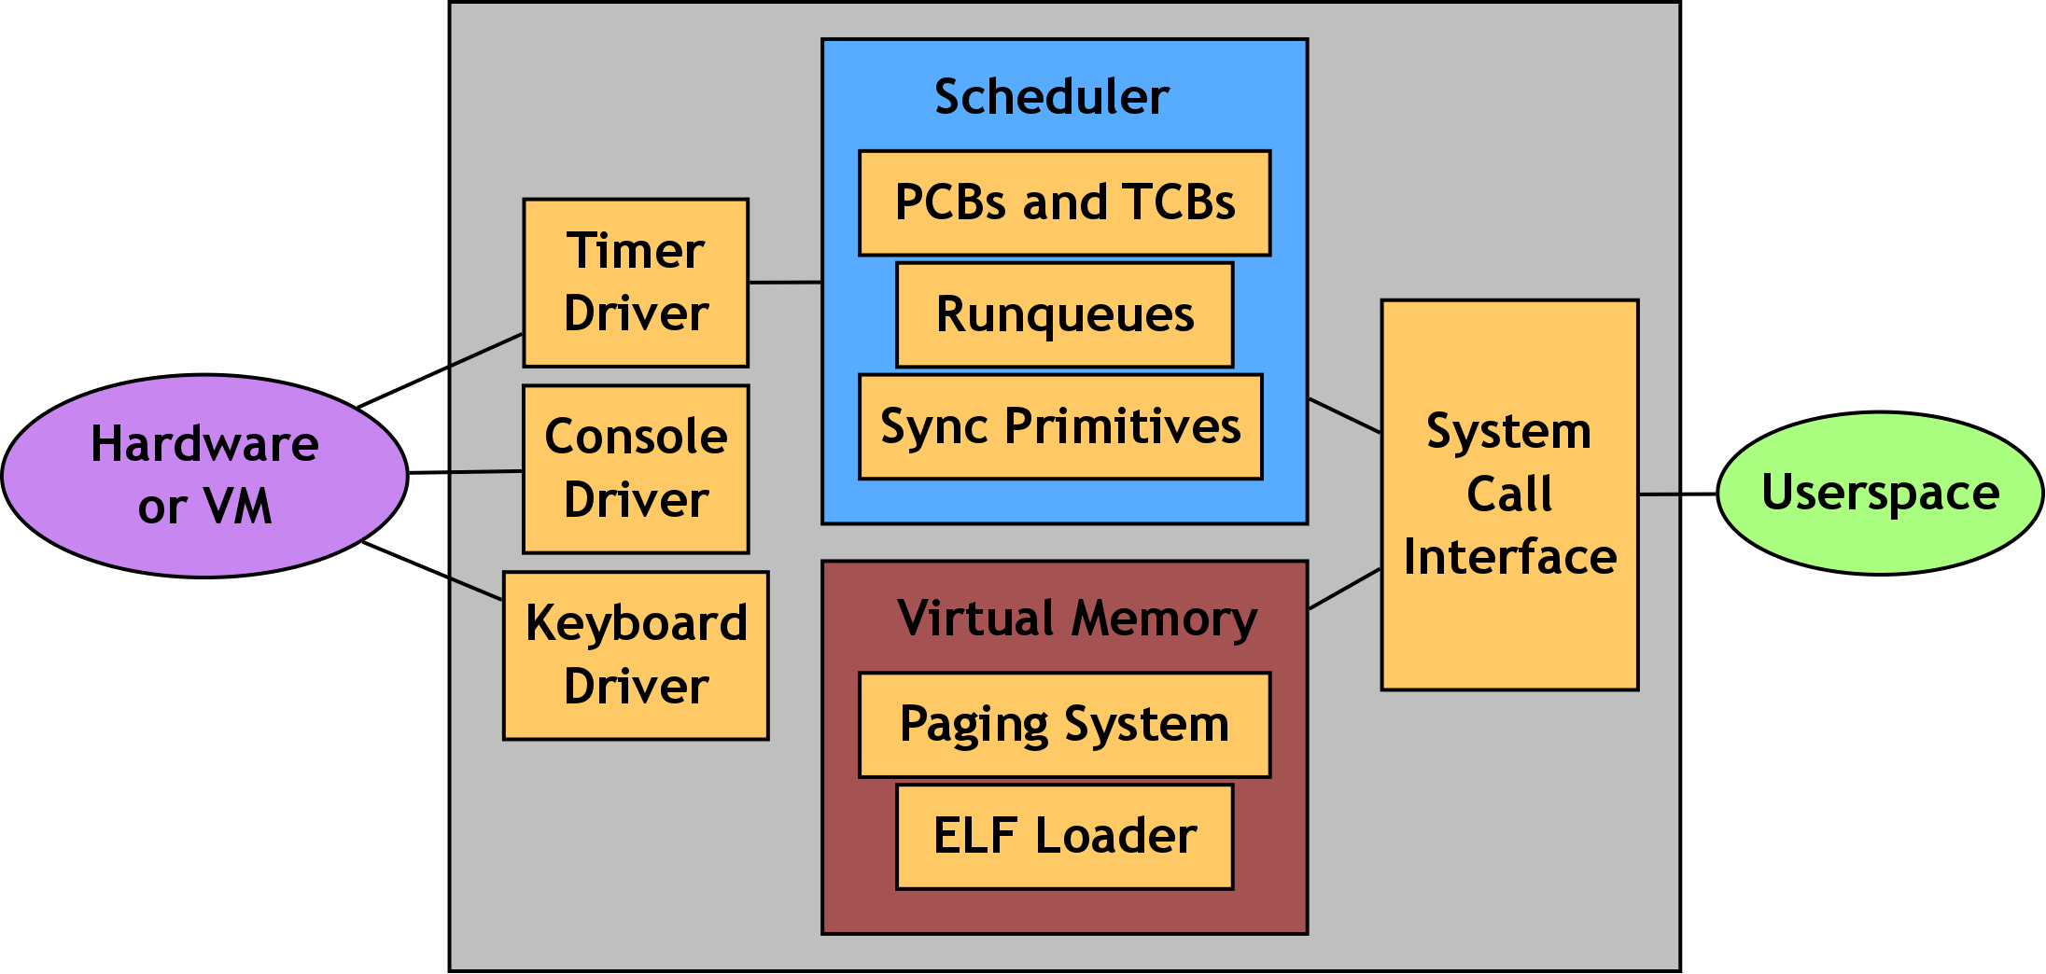
Challenge 2: The Kernel as One Program
“Everything interleaves with everything else”?

Slide 14
Contribution
Systematic testing is a tool for testing concurrent
systems.
  How can it be applied in kernel-space?
  What simple things can the user provide to help?

Slide 15
Outline
Motivation: Concurrency debugging
  Systematic testing versus stress testing
  State space explosion
  Challenges of kernel-space
Tool: Landslide
  Design and interface
  Addressing challenges
Evaluation: Finding Races
  Student user study
  Case study
Future Work and Conclusion

Slide 16
Execution Environment
Simics: a full-system x86 simulator
  Landslide runs as a Simics module.
    Can see kernel instructions, memory accesses
Controlling system nondeterminism
  Injecting timer interrupts triggers thread scheduling
  Future work may use device interrupts (disk, network)
Backtracking
  After each test execution, can rewind system state
  using Simics “bookmarks”

Slide 17
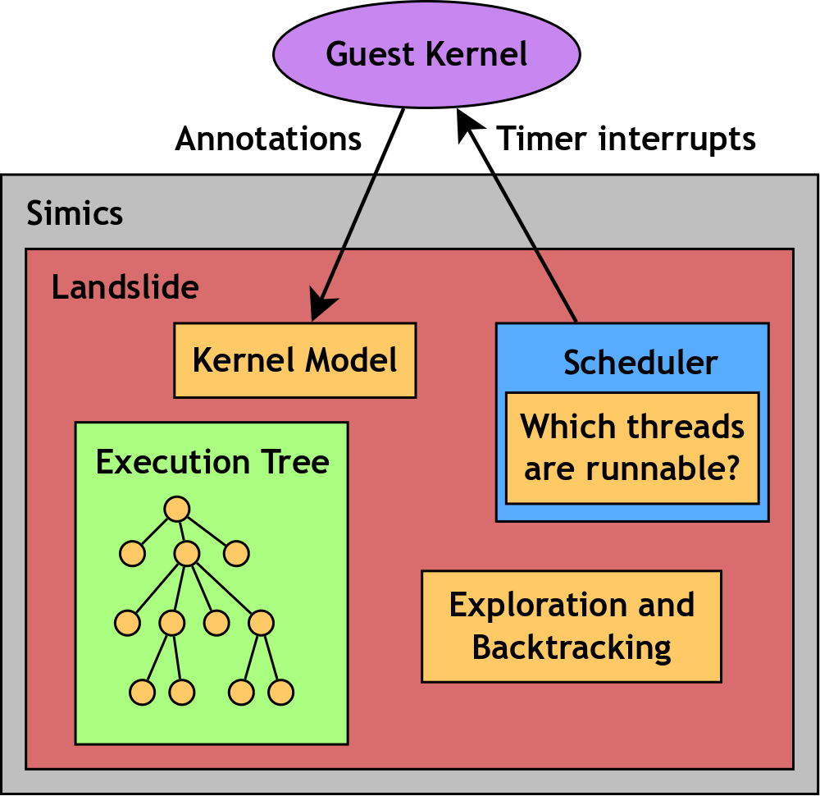
Anatomy of Landslide

Slide 18
Interface
User must tell Landslide when certain events happen:
  When do threads become runnable / descheduled?
  When does the scheduler switch threads?
Can also configure optional additional decision points
int thread_fork()
{
thread_t *child = spawn_new_thread();
tell_landslide_forking();
add_to_runqueue(child);
tell_landslide_decide(); /* Interrupt me here! */
return child->tid;
}

Slide 19
Decision Trace
USE AFTER FREE - read from 0x0015a8f0 at PC 0x00104209
[0x15a8f0 | 4136] was allocated by TID3 at (...)
and freed by TID4 at (...)
**** A bug was found! ****
**** Decision trace follows. ****
1: 1347079 instructions, old TID 3, new TID 4
TID3 at 0x00105a10 in context_switch,
0x001041f4 in thread_fork,
0x0010362b in thread_fork_wrapper
2: 1350725 instructions, old TID 4, new TID 3
TID4 at 0x00105a10 in context_switch,
0x00104681 in yield,
0x00104570 in exit,
0x00103708 in exit_wrapper
Stack: TID3 at 0x00104209 in thread_fork,
0x0010362b in thread_fork_wrapper
Total decision points 24, total backtracks 5

Slide 20
State Space Reduction
State spaces grow exponentially.
  Fortunately, some sequences cause identical states.
  Dynamic Partial Order Reduction [Flanagan '05]
    Can even be parallelized [Simsa '12]
    Requires “memory independence relation”
    between transitions

Slide 21
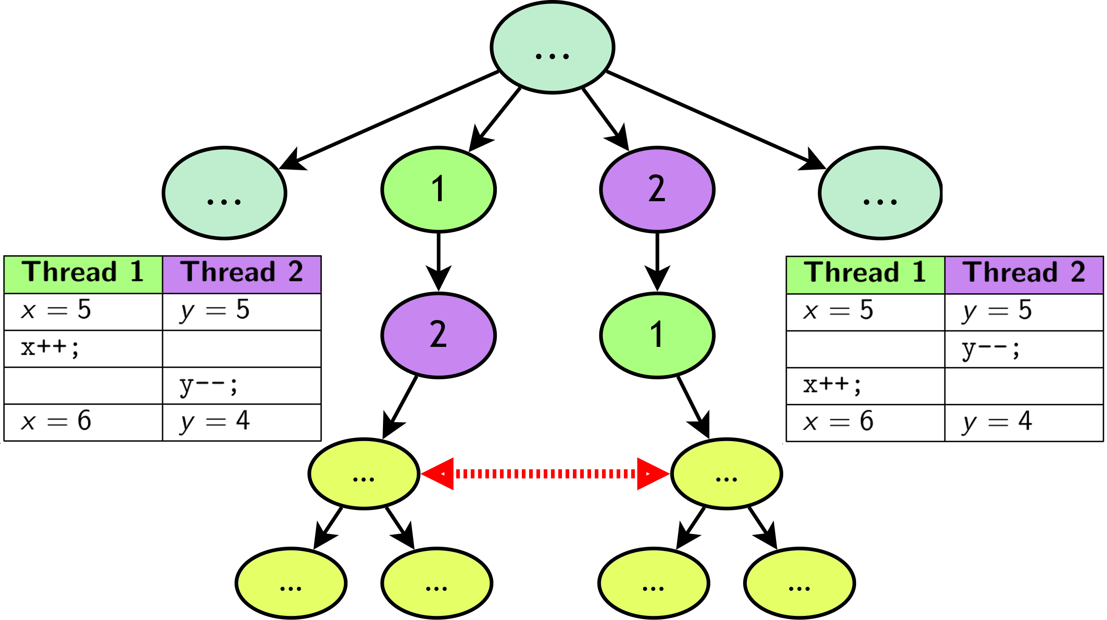
State Space Explosion

Slide 22
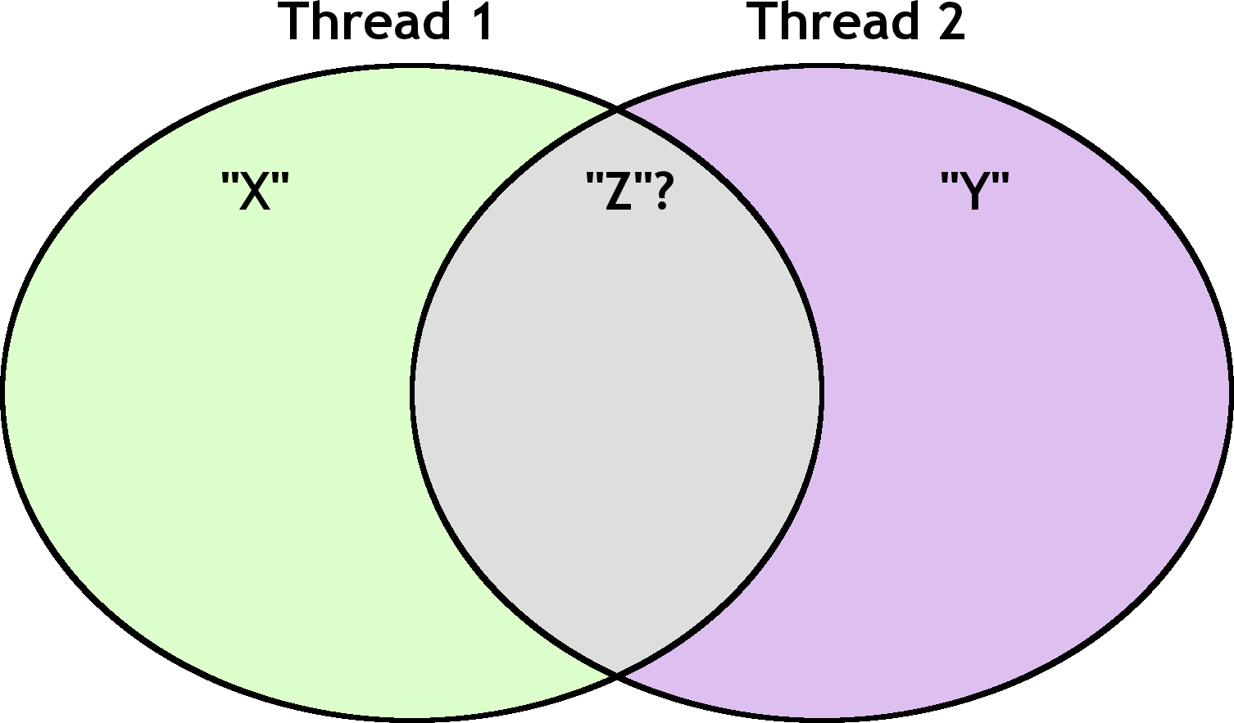
Shared Memory Conflicts

Slide 23
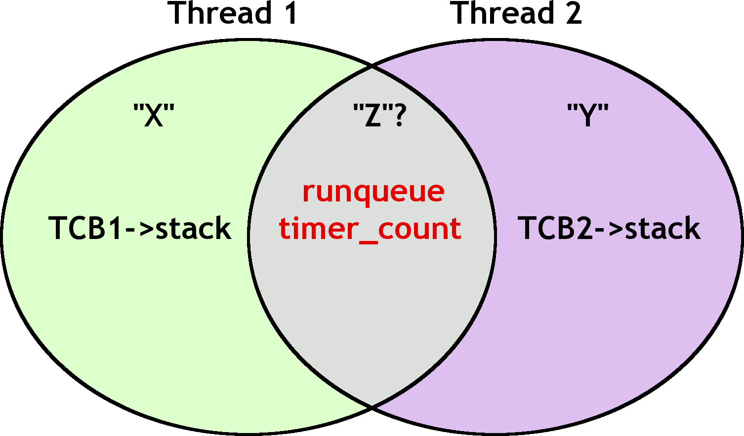
Shared Memory Conflicts

Slide 24
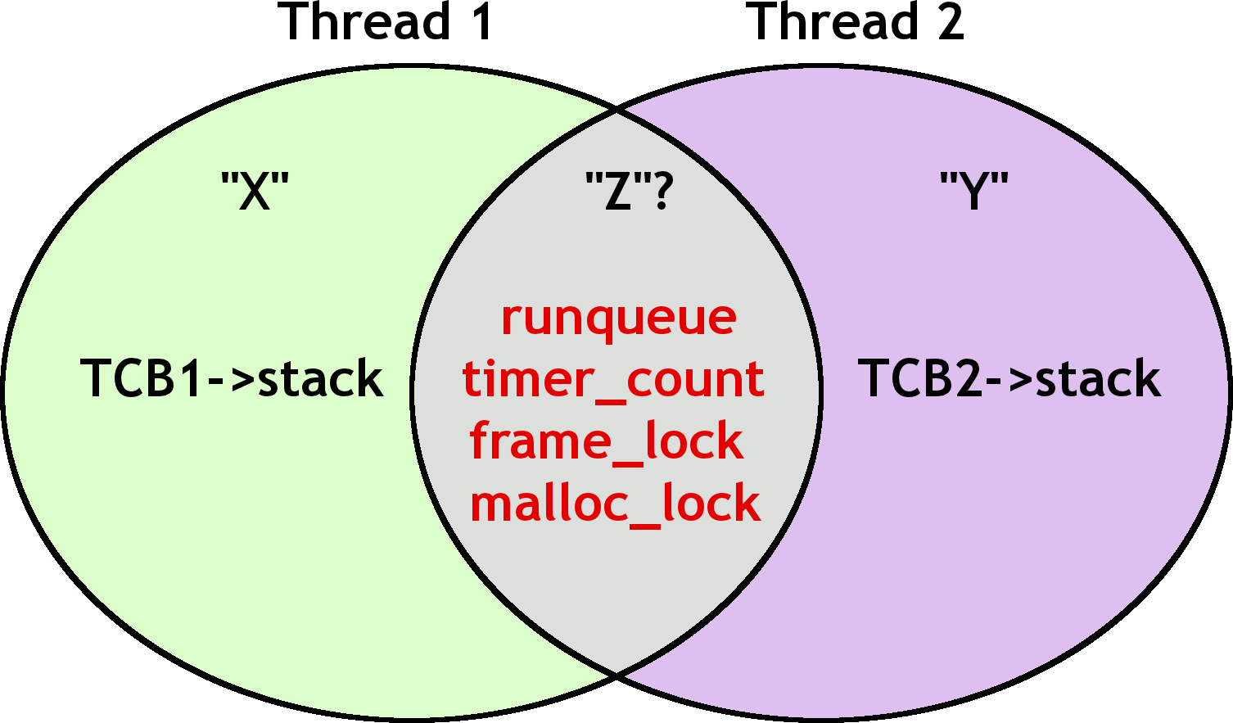
Shared Memory Conflicts

Slide 25
Shared Memory Conflicts
Solution: Only consider “relevant” memory conflicts.
  Ignore scheduler, global objects assumed to be
  correct.
    Sacrifice ability to test these to efficiently test
    everything else.
  User must specify what to ignore.

Slide 26
Focusing the Search Space
Recommended decision points: mutex_lock(), mutex_unlock()
Problem: Kernel uses mutexes everywhere.
  Good: exit() calls mutex_lock()
  Bad: destroy_address_space() calls it too
Solution: User specifies which modules to pay attention to.
  within_function exit
  without_function destroy_address_space

Slide 27
Identifying Bugs
How do we know we've found a bug?
Definite bugs
  Kernel panics / assertion failures
  Use-after-free
  Deadlock
Probable bugs
  Infinite loop
    Use structure of execution
    tree to judge progress.

Slide 28
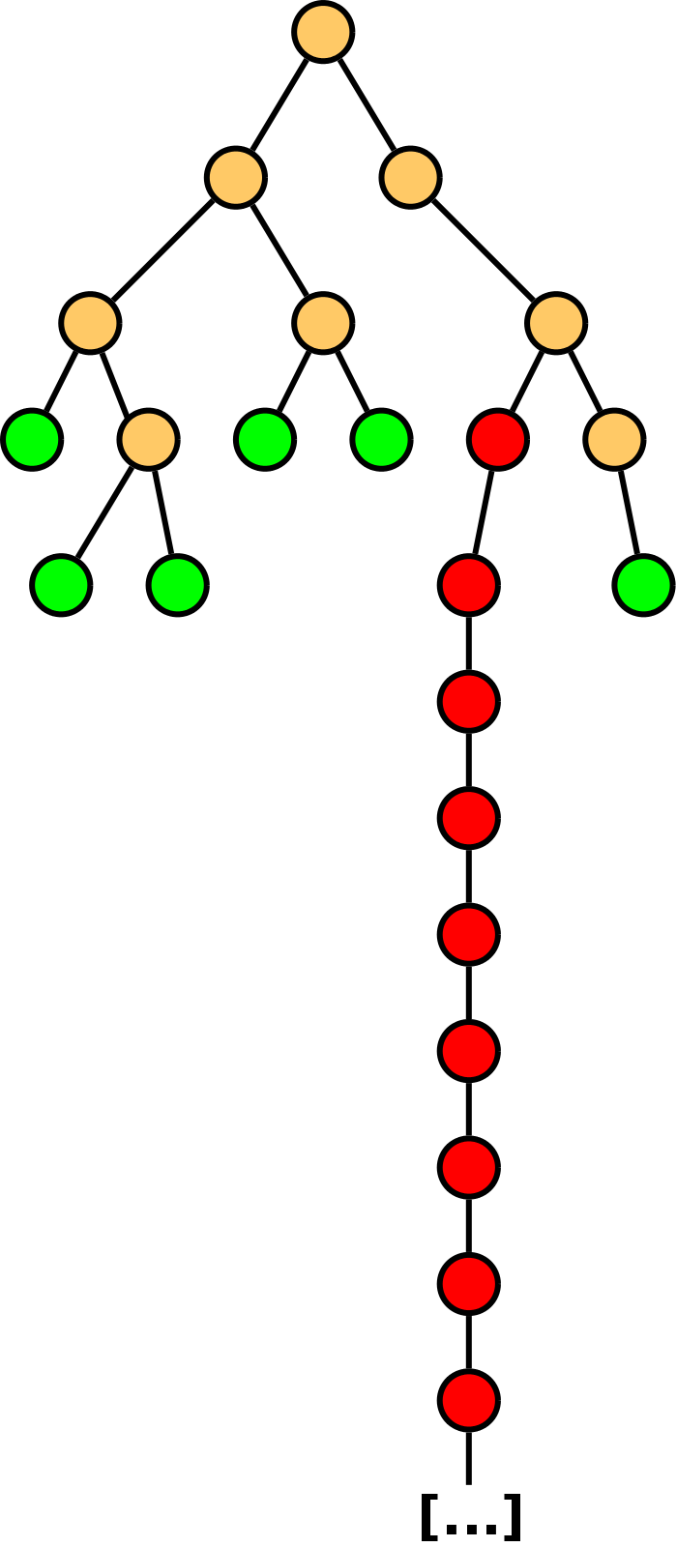
Identifying Bugs
How do we know we've found a bug?
Definite bugs
  Kernel panics / assertion failures
  Use-after-free
  Deadlock
Probable bugs
  Infinite loop
    Use structure of execution
    tree to judge progress.

Slide 29
Outline
Motivation: Concurrency debugging
  Systematic testing versus stress testing
  State space explosion
  Challenges of kernel-space
Tool: Landslide
  Design and interface
  Addressing challenges
Evaluation: Finding Races
  Student user study
  Case study
Future Work and Conclusion

Slide 30
Working with Students
15-410: Operating System Design and Implementation
  Students implement a small kernel in 6 weeks
  “Pebbles”, a UNIX-like system call specification
  On average 4000 lines of code
Solicited students to use Landslide on their kernels.
  Can Landslide find bugs “in the wild”?
  How much time does manual instrumentation take?
Five groups participated; four got it to work.
  Average instrumentation time 100 minutes (55-158)
  All four groups found bugs; two were nondeterministic

Slide 31
Studying Bugs In-Depth
Tested two Pebbles kernels: my own, and one I graded
  Confirmed several of the most subtle races I had
  found in the kernel I graded
    Parent and child exit simultaneously
  Found a previously unknown bug in my kernel
    Missed by TA's manual inspection, stress tests

Slide 32
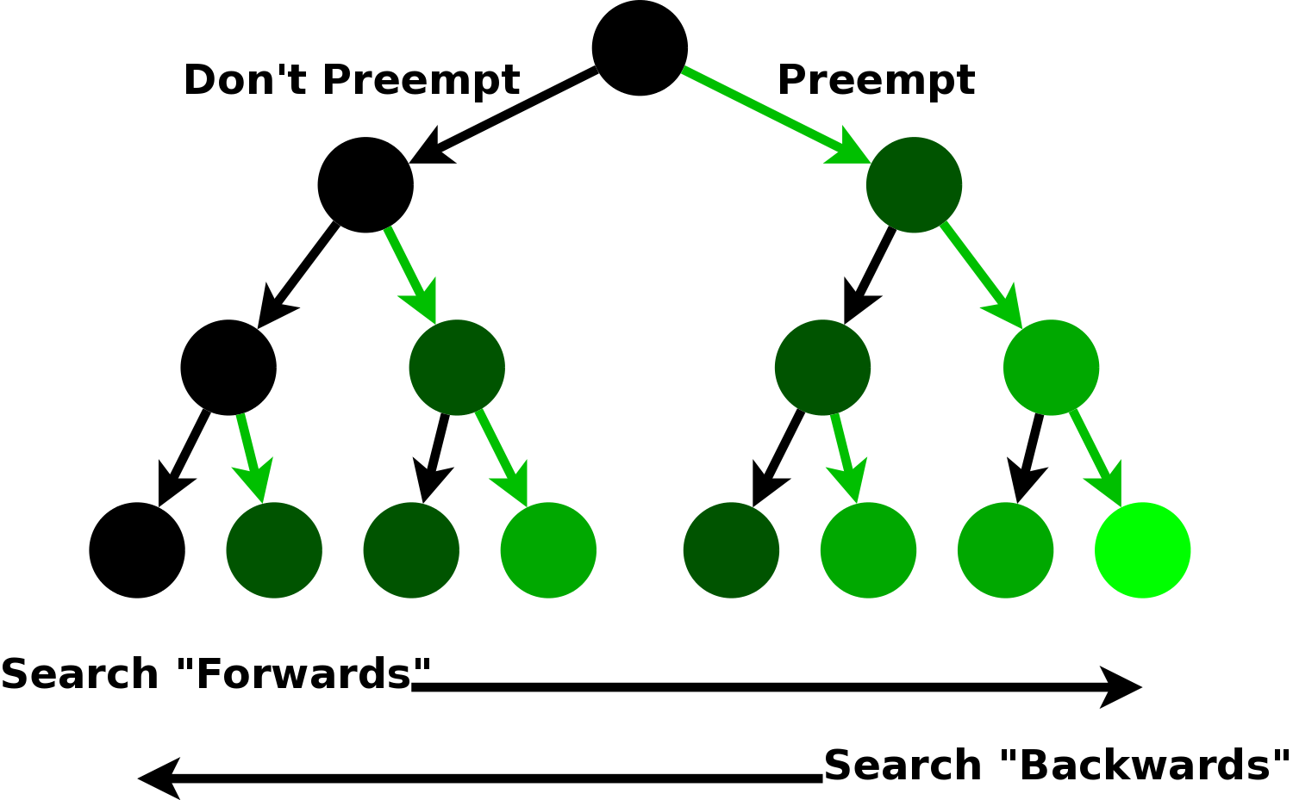
Studying Bugs In-Depth
Exploration ordering: Search branches with more or
fewer preemptions first?

Slide 33
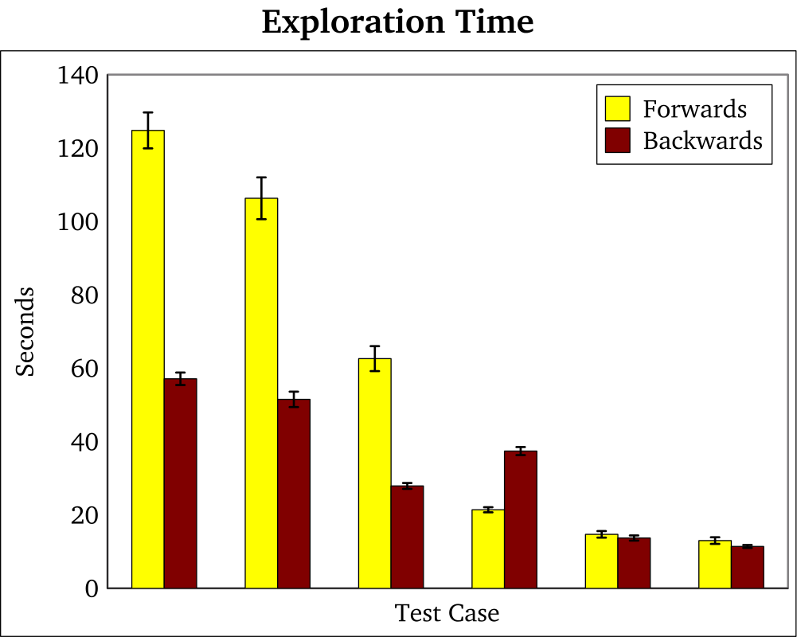
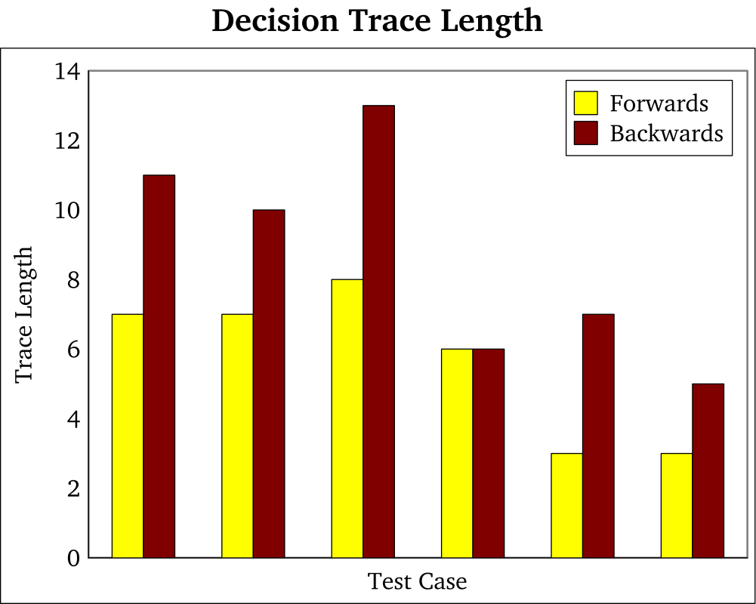
Studying Bugs In-Depth
Exploration ordering
  “Backwards” exploration found bugs sooner
  “Forwards” exploration found shorter decision traces

Slide 34
Outline
Motivation: Concurrency debugging
  Systematic testing versus stress testing
  State space explosion
  Challenges of kernel-space
Tool: Landslide
  Design and interface
  Addressing challenges
Evaluation: Finding Races
  Student user study
  Case study
Future Work and Conclusion

Slide 35
Future Work
Performance
  Virtualization – less control, compared to Simics
Generalizing the concurrency model
  Device driver input as new source of nondeterminism
  Multicore execution
  Better model more complex kernels
    e.g. educational (Pintos) or production (Linux)
Emphasis on “steering” test by changing parameters
  Start with coarse granularity, iteratively refine
  Perhaps we can automate this steering?

Slide 36
Conclusion
Systematic testing
  Make educated guesses about when to preempt.
  Find many types of races; provide debugging info.
Systematic testing in kernel-space
  Use internal kernel abstractions to understand concurrency behaviour.
  Relying on user's knowledge makes testing easier.
Landslide
  A first step towards sophisticated kernel debugging techniques.

Slide 37
Related Work
Systematic testing
  MaceMC (NSDI '07) – liveness, random walking
  CHESS (PLDI '07) – iterative context bounding
  MoDist (NSDI '09) – network/disk model checking
  dBug (SSV '10) – dynamic partial order reduction
  SimTester (VEE '12) – interrupt injection, drivers
Data race detection
  Eraser (TOCS '97) – lock-set tracking, annotations
  DataCollider (OSDI '10) – random sampling, kernel
  RacePro (SOSP '11) – inter-process races

Slide 38
References
[Godefroid '97]
  Patrice Godefroid. VeriSoft: A Tool for the Automatic Analysis of Concurrent Reactive Software. CAV 1997.
[Flanagan '05]
  Cormac Flanagan and Patrice Godefroid. Dynamic partial-order reduction for model checking software. POPL 2005.
[Simsa '11]
  Jirí Simsa, Randy Bryant, Garth A. Gibson: dBug: Systematic Testing of Unmodified Distributed and Multi-threaded Systems. SPIN 2011.
[Simsa '12]
  Jiri Simsa. Scalable Dynamic Partial Order Reduction. Talk at PDL Retreat 2012.

