Slide 1
Concurrency Testing with
Data-Race Preemption Points
Ben Blum
Garth Gibson
PDL Retreat 2016
Parallel Data Laboratory
Carnegie Mellon University

Slide 2
Outline
Concurrency Testing Techniques
  Systematic testing
  Data-race analysis
  Challenges
Iterative Deepening
  Choosing new preemption points
  State space estimation for large tests
  Verification for small tests
  Implementation in Landslide & Quicksand
Evaluation
  Bug-finding/verification speed vs ICB

Slide 3
Background: What is Systematic Testing?

Slide 4
Example
Initially x = 0;
Thread 1
mutex_lock(m);
x++;
mutex_unlock(m);
assert(x >= 1);
Thread 2
atomic_xadd(&x, 1);
yield();
atomic_xadd(&x, 1);
assert(x >= 2);

Slide 5
Example
Initially x = 0;
Thread 1
mutex_lock(m);
int tmp = x;
x = tmp + 1;
mutex_unlock(m);
assert(x >= 1);
Thread 2
atomic_xadd(&x, 1);
yield();
atomic_xadd(&x, 1);
assert(x >= 2);

Slide 6
Systematic Testing
Stress testing
  Common approach to finding concurrency bugs
  Relies on randomly-occurring context switches
  User-friendly but unpredictable/unbounded

Slide 7
Systematic Testing
Stress testing
  Common approach to finding concurrency bugs
  Relies on randomly-occurring context switches
  User-friendly but unpredictable/unbounded
Systematic testing [Godefroid '97]
  Thread scheduling controlled by test framework
  Each iteration, test a different thread interleaving
  Goal: Exhaustively search “all possible” behaviors

Slide 8
Systematic Testing
Stress testing
  Common approach to finding concurrency bugs
  Relies on randomly-occurring context switches
  User-friendly but unpredictable/unbounded
Systematic testing [Godefroid '97]
  Thread scheduling controlled by test framework
  Each iteration, test a different thread interleaving
  Goal: Exhaustively search “all possible” behaviors
    Wait... what?
    In practice, interleavings are of coarse granularity.

Slide 9
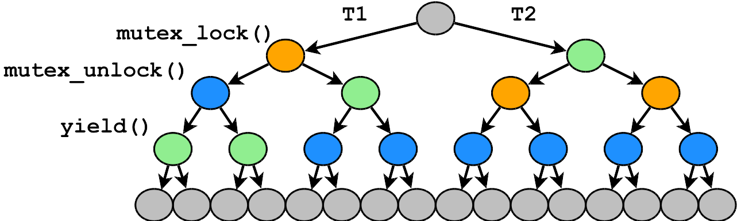
Example - State Space
Possible interleavings represented as a tree
  Node: Intermediate execution state
  Edge: State transition from executing a thread

Slide 10
Preemption Points
The burning question of systematic testing: "Which preemption points (PPs) are important?"
State space of interleavings is parameterized by PPs.
  Preemption points everywhere: completion infeasible
  Too few preemption points: won't find bugs
Prior work implementations hard-code a fixed set of PPs.
  dBug [Simsa '11]: pthread library calls
  Landslide [Blum '12]: kernel or user mutex lock/unlock

Slide 11
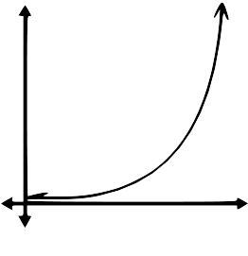
Challenges
Parameters of systematic tests must be kept small.
  Test program length / number of threads
  Number of preemption points used
state space size
# of preemption points

Slide 12
Challenges
Parameters of systematic tests must be kept small.
  Test program length / number of threads
  Number of preemption points used
Given fixed PPs, testing time is unpredictable.
  Even small code changes can have drastic impact
  Fixing PPs in advance leaves many tests infeasible!
Problem: Make trade-off decision automatically.

Slide 13
Data-Race Analysis
Data race: 2 threads access the same memory, and:
  At least one access is a write
  Threads do not hold the same lock
  No Happens-Before relation between threads
Variants of Happens-Before (HB)
  Pure HB: Any synchronization events [Lamport '78]
  Limited HB: Synchronization (e.g. cond_wait()) enforces one ordering [O'Callahan '03]

Slide 14
Happens-Before Example
Thread 1
x++;
mutex_lock(m);
// unrelated
mutex_unlock(m);
Thread 2
mutex_lock(m);
// unrelated
mutex_unlock(m);
x++;
No race under Pure HB; true potential race under Limited HB.

Slide 15
Happens-Before Example
Thread 1
x++;
mutex_lock(m);
y = true;
mutex_unlock(m);
Thread 2
mutex_lock(m);
bool tmp = y;
mutex_unlock(m);
if (tmp) x++;
No race under Pure HB; false positive under Limited HB.

Slide 16
Races, Bugs, What's the Difference?
Not all data-races cause failures.
  C++ spec: All data-races are undefined behaviour
  Many prior tools: User attention is valuable, report only failing races [Engler '03, Kasicki '12]
Systematic tests search for concrete, observable failures
  Assertion failures
  Memory errors (segfault, use-after-free)
  Infinite loops (heuristically)
Problem: Classify data races as failing or benign.

Slide 17
Example - State Space
None of these branches contain the necessary preemption!
A data-race preemption point is required to find the bug.

Slide 18
Contribution
Algorithm: Iterative Deepening
  Seed systematic test with synchronization APIs;
  Dynamically detect new data-race candidates;
  Add data-race preemption points as discovered;
  Iteratively advance to state spaces with new PPs;
  Prioritize them with dynamic state space estimates;
  ...until specified CPU budget is exhausted.

Slide 19
Iterative Deepening
Goal: Run the best tests for a given CPU budget.
  User studies with 15-410 (operating systems)
    Students worked best with an iterative process
    "Start small, then add more preemption points"
    Guide search with heuristic state space estimator

Slide 20
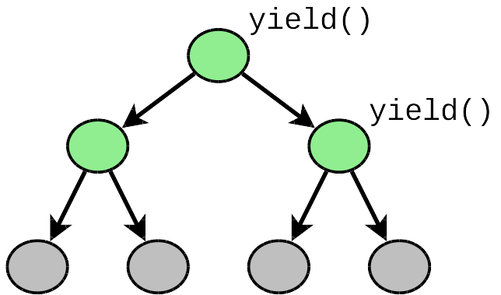
Iterative Deepening
"Minimal" state space == mandatory thread switches only
  yield()
  cond_wait()

Slide 21
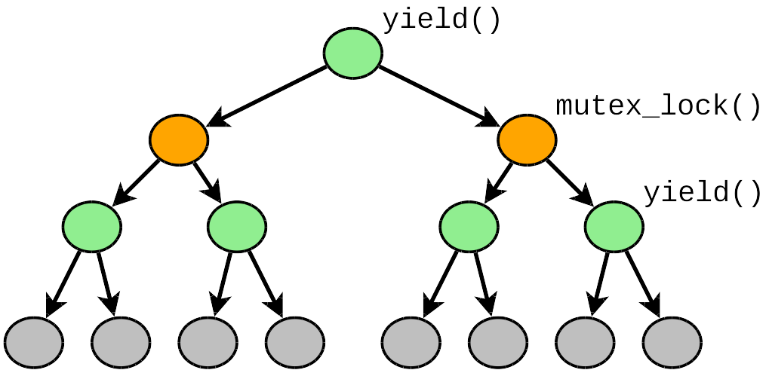
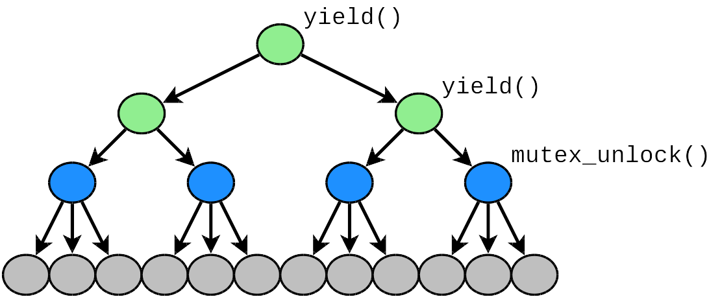
Iterative Deepening
Different PPs can produce state spaces of different sizes.
Testing them in parallel hedges our bets.

Slide 22
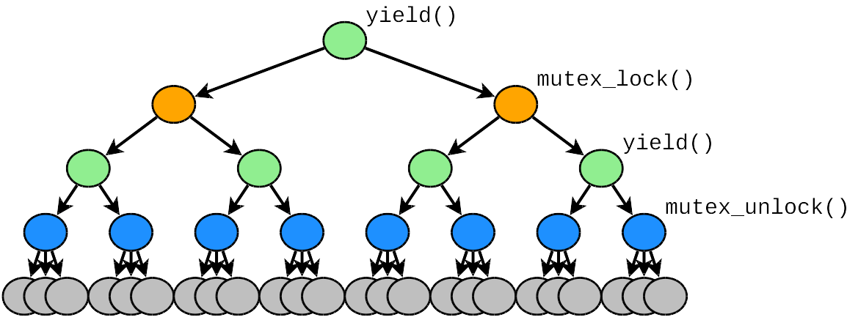
Iterative Deepening
If time allows, we combine PPs to produce larger tests.
All PPs enabled = "maximal" state space
  Prior work tools explore this state space only.

Slide 23
Landslide
Landslide [Blum '12]: simulator-based tester
  Originally built to test 15-410 Pebbles kernels
    (a landslide tests the stability of pebbles)
  Also supports Pintos (Berkeley, U. of Chicago, etc)
  Wind River Simics: Full-system x86 simulator
    Provides instruction/memory tracing, backtracking
    Low overhead for data race analysis
Features
  DPOR [Flanagan '05] prunes equivalences
  State space estimation guesses total time [Simsa '12]
  Iterative Context Bounding [Musuvathi '07]

Slide 24
Quicksand
Quicksand: wrapper program for Iterative Deepening
  Manages work queue of jobs with different PP configs
  Each job is a new state space for Landslide to explore
  Prioritizes which jobs are important / likely to finish
    Based on nature of PPs (data races? mutexes?)
    Based on estimated completion time

Slide 25
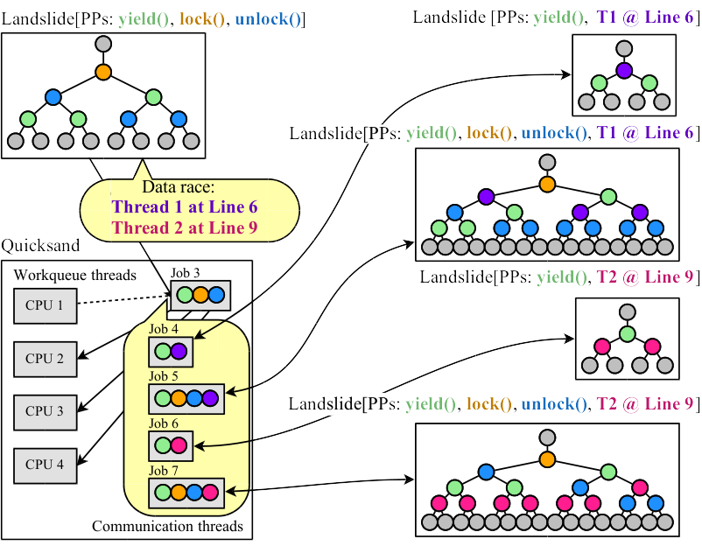
System Architecture

Slide 26
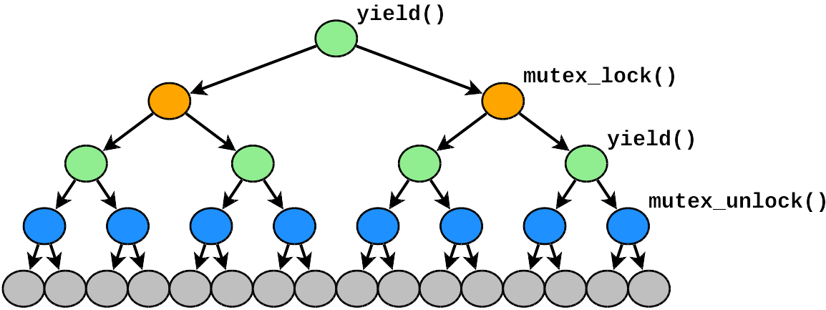
Iterative Deepening Reductions
If one job is a subset of another, testing either might let us skip the other.

Slide 27
Iterative Deepening Reductions
If one job is a subset of another, testing either might let us skip the other.
Estimate: 999 years

Slide 28
Iterative Deepening Reductions
If one job is a subset of another, testing either might let us skip the other.
Complete!

Slide 29
Total Verification
Convergence theorem: Testing maximal state space after detecting all data races ≡ preempting everywhere!
  Insight: ∀ arbitrary buggy interleaving, ∃ equivalent interleaving using only sync/data-race PPs.
  (see paper for full proof)
Hence, Iterative Deepening provides "best of both worlds"
  Provides total safety guarantee for small tests
  Finds bugs quickly for large tests when completion is infeasible

Slide 30
Evaluation

Slide 31
Evaluation Questions
Comparing to single-state-space (SSS) testing
  Do we find bugs faster, while SSS times out?
  Do we provide more total verifications?
  ...whether or not SSS chooses PPs on synchronization only, or "everywhere"?
Testing OS projects from CMU, Berkeley, and U. Chicago
  CMU: 79 "P2" thread libraries
  Berkeley & U Chicago: 78 "Pintos" kernels

Slide 32
Experimental Setup
6 test cases for each P2; 3 for each Pintos
  629 unique tests in total (P2/Pintos + test pair)
  10 CPU-hours for each test
Experimental trials:
  Quicksand with Limited HB
  Quicksand with Pure HB
  SSS Landslide with ICB, mutex/yield PPs only
  SSS Landslide with ICB & "Preempt Everywhere"
629 tests * 10 CPU-hours * 4 trials ≈ 1000 CPU-days

Slide 33
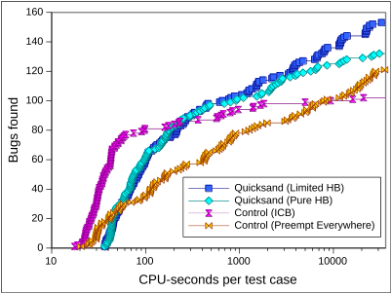
Results (Bug-finding, CPU time)

Slide 34
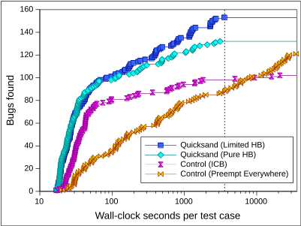
Results (Bug-finding, wall-clock time)

Slide 35
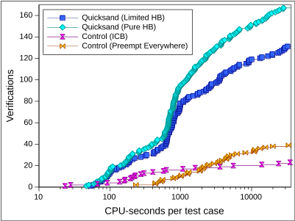
Results (Verification)
Do we find the same bugs faster?

Slide 36
Takeaway
Quicksand outperforms SSS after 10 CPU-hours in all cases.
  125% as many bugs found (using Limited HB)
  428% as many verifications provided (using Pure HB)
  For CPU budgets < 200 seconds, suffers startup overhead
"Preempt Everywhere" finds bugs best for SSS in long tests, but overhead of PPs significantly impacts completion time.
Pure HB reaches the end of tests faster, when possible;
Limited HB finds more bugs, at expense of completion time.

Slide 37
Conclusion

Slide 38
Future Work
Ongoing study for educational effectiveness
  Offering to 15-410 students for testing, TAs for grading
  Planning to offer for Pintos OS classes
Upcoming features
  Smarter policies for too-large state spaces (ICB)
  Incorporate parallel DPOR to saturate CPUs better
  Supporting Hardware Transactional Memory in concurrency model

Slide 39
Conclusion
Systematic Testing
  Controls scheduling rather than rely on randomness
  More reliable bug-finding than stress testing
  State space depends on preemption points (PPs)
  Completion time is exponential and unpredictable
Iterative deepening with Landslide & Quicksand
  Automatically searches for optimal set of PPs to use
  User need only supply CPU time budget
  Data race PPs uncover 125% as many bugs and provides 429% as many verifications than SSS.

Slide 40
References
[Godefroid '97]
  Patrice Godefroid. VeriSoft: A Tool for the Automatic Analysis of Concurrent Reactive Software. CAV 1997.
[Savage '97]
  Stefan Savage et al. Eraser: A Dynamic Data Race Detector for Multithreaded Programs. ACM TOCS 1997.
[Flanagan '05]
  Cormac Flanagan and Patrice Godefroid. Dynamic partial-order reduction for model checking software. POPL 2005.
[Musuvathi '08]
  Madanlal Musuvathi et al. Finding and Reproducing Heisenbugs in Concurrent Programs. (a.k.a. the CHESS paper.) OSDI 2008.
[Simsa '11]
  Jirí Simsa, Randy Bryant, Garth A. Gibson: dBug: Systematic Testing of Unmodified Distributed and Multi-threaded Systems. SPIN 2011.
[Liu '11]
  Tongping Liu et al. DThreads: Efficient Deterministic Multithreading. SOSP 2011.

Slide 41
References
[Guo '11]
  Huayang Guo et al. Practical Software Model Checking via Dynamic Interface Reduction. SOSP 2011.
[Blum '12]
  Ben Blum. Landslide: Systematic Dynamic Race Detection in Kernel Space. CMU-CS-12-118. May 2012.
[Simsa '12]
  Jiri Simsa. Runtime Estimation and Resource Allocation for Concurrency Testing. CMU-PDL-12-113. December 2012.
[Cui '13]
  Heming Cui et al. Parrot: A Practical Runtime for Deterministic, Stable, and Reliable Threads. SOSP 2013.
[Fonseca '14]
  Pedro Fonseca et al. SKI: Exposing Kernel Concurrency Bugs through Systematic Schedule Exploration. OSDI 2014.

Slide 42
Related Work
Systematic testing
  MaceMC (NSDI '07) – liveness, random walking
  CHESS (PLDI '07) – iterative context bounding (ICB)
  MoDist (NSDI '09) – network/disk model checking
  dBug (SSV '10/SPIN '11) – dynamic partial order reduction
  SimTester (VEE '12) – interrupt injection, drivers
  Parrot (SOSP '13) – dBug + deterministic userspace scheduler
  SKI (OSDI '14) – randomly-chosen PPs for testing Linux
  SAMC (OSDI '14) – annotated sync primitives, better reduction
Data race detection
  Eraser (TOCS '97) – lock-set tracking, annotations
  DataCollider (OSDI '10) – random sampling, kernel
  RacePro (SOSP '11) – inter-process races
  Portend (ASPLOS '12) – alternate interleavings, symbolic execution

Slide 43
Bonus Slides

Slide 44
Results
Do we find new bugs with data-race PPs?
Quicksand with iterative deepening
  107 nondeterministic bugs in total
  33 required data-race PPs to expose!
    10 where control timed-out
    23 where control completed w/ no bug found
  mutex_test
    12 bugs (to control's 1)
    All 12 others found with data-race PPs

Slide 45
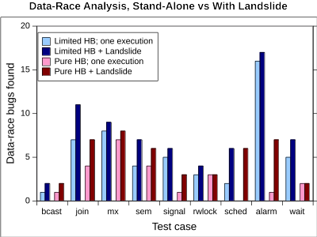
Results (Data Race study)

Slide 46
Test Suite
15-410 – Undergrad Operating Systems at CMU
  P2: pthread-like userspace thread library
    Sync primitives: mutexes, cvars, sems, rwlocks
    Thread API: thr_create, thr_join, thr_exit
  6 test cases (50 LOC average):
    thr_exit_join, broadcast_test, paraguay, rwlock_test, paradise_lost
      Test of everything built on top of mutexes
    mutex_test
      Test of low-level lock implementation

Slide 47
mutex_test is special...
Normally, we give a lock's internal accesses a “free pass”.
  This enables productive data-race analysis elsewhere.
while (xchg(&lock->held,1)==1)
yield(lock->owner);
lock->owner = gettid();
// in critical section...
// access protected data...
lock->owner = -1;
lock->held = 0;
lock()
All accesses in this range are considered protected by the lock.
unlock()

Slide 48
mutex_test is special...
In mutex_test, we wish to verify the implicit assumption that other tests make that the locks are correct.
while (xchg(&lock->held,1)==1)
yield(lock->owner);
lock->owner = gettid();
// in critical section...
// access protected data...
lock->owner = -1;
lock->held = 0;
lock()
All accesses in this range are considered protected by the lock.
unlock()

Slide 49
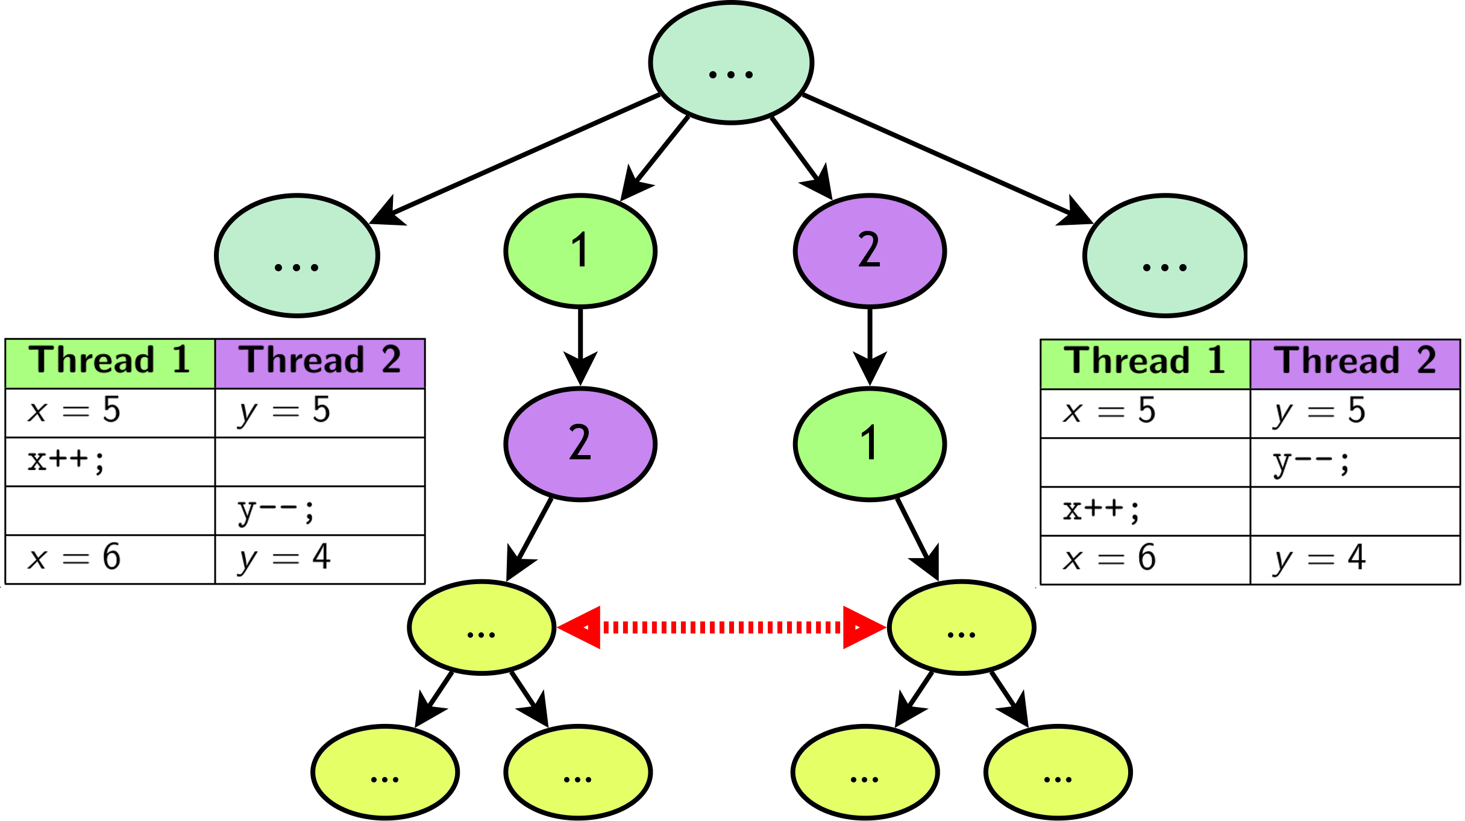
Dynamic Partial Order Reduction

Slide 50
Results
Among 474 total tests (P2+unit test pairs)...
  23 deterministic bugs (e.g. use-after-free); fixed by hand
Control experiment with fixed PPs
  70 nondeterministic bugs
  90 timeouts
Quicksand with iterative deepening
  107 nondeterministic bugs
    37 requiring data-race PPs to expose
    mutex_test: 13 bugs, 12 requiring data-race PPs
  2 bugs found without data-race PPs (control timeout)
  2 bugs missed that control found (explain why)

Slide 51
Coping with Exponential Explosion
Some prior work focuses on improving coverage with...
  Reduction techniques (identifying equivalences)
    [Flanagan '05, Guo '11, Huang '15]
  Determinizing runtimes [Liu '11, Cui '13]
Other prior systems give up on 100% completion...
  Random distribution of PPs [Fonseca '14]
  Heuristic exploration ordering (ICB) [Musuvathi '08]
Problem: Make trade-off decision automatically.

Slide 52
Coping with Exponential Explosion
Current systematic testing model not user-friendly.
  Test framework: "I want to use these PPs, but can't predict how long until completion."
  User: "I have 16 CPUs and 24h to test my program."
Stress testing offers this... can we offer it too?

Slide 53
Iterative Deepening
Goal: Run the best tests for a given CPU budget.
  User studies with 15-410 (operating systems)
    Students worked best with an iterative process
    "Start small, then add more preemption points"
    Guide search with heuristic state space estimator
Named after analogous technique in chess AI.
  Chess search is DFS limited by max # of moves (ply).
  Chess AIs repeat DFS, increasing ply, until timeout.

