Slide 1
Testing Concurrent Transactional Programs
Ben Blum
Garth Gibson
PDL Retreat 2017
Parallel Data Laboratory
Carnegie Mellon University

Slide 2
Hardware Transactional Memory (HTM)
  Intel: Transactional Synchronization Extensions
    new x86 instructions (above: GCC intrinsics)
    Documented in 2012, released 2013-14
  Lock-free atomic regions guaranteed by hardware
    Existing cache coherence logic detect conflicts
  Avoid overhead of traditional locking
  Except...
xbegin();
count++;
xend();

Slide 3
Transactional Aborts
if (xbegin() == TXN_STARTED) {
count++;
xend();
} else {
/* conflict detected,
* transaction aborted */
... user-specified
fall-back algorithm ...
}

Slide 4
Transactional Aborts
  If txn failure is rare, backup path may be slow
  ...but must still be correct (not deadlock, race, etc)!
if (xbegin() == TXN_STARTED) {
count++;
xend();
} else {
mutex_lock(&count_lock);
count++;
mutex_unlock(&count_lock);
}

Slide 5
Transactional Aborts
Reasons for transaction failure
  Memory conflict with another CPU
  Programmer invoked xabort()
  Factors beyond programmer control
    Timer or other system interrupt
    CPU runs out of cache space needed to track pending transactional memory accesses

Slide 6
Transactional Races
Thread 1
xbegin() == ABORTED
mutex_lock()
count++;
mutex_unlock()
thread_join()
assert(count == 2) // XXX
Thread 2
xbegin() == STARTED
count++;
xend()

Slide 7
Handling Transactional Aborts
if (xbegin() == TXN_STARTED) {
if (mutex_held(&count_lock)) {
xabort();
}
count++;
xend();
} else {
mutex_lock(&count_lock);
count++;
mutex_unlock(&count_lock);
}

Slide 8
Systematic Concurrency Testing
Stress testing alternative for finding concurrency bugs
  Test harness controls nondeterministic system inputs
  Force every possible thread interleaving to execute
  Number of interleavings is exponential in program size
Landslide, our systematic tester
  Has a bunch of cool features which don't fit in this talk
  Nondeterministic inputs: thread scheduling only
Goal: develop a concurrency model for transactional execution semantics

Slide 9
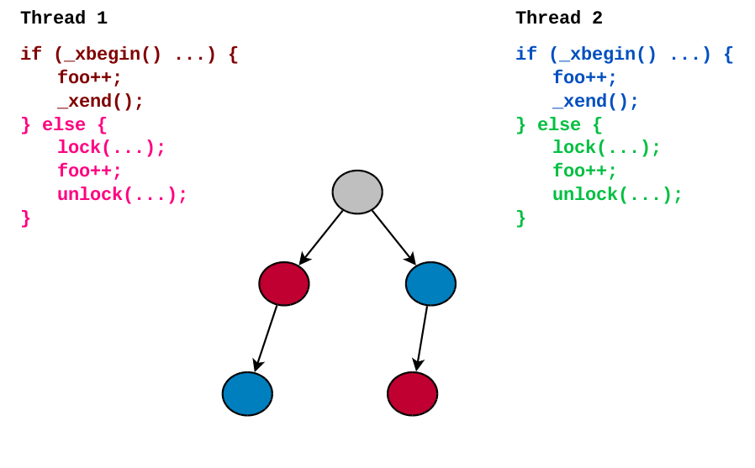
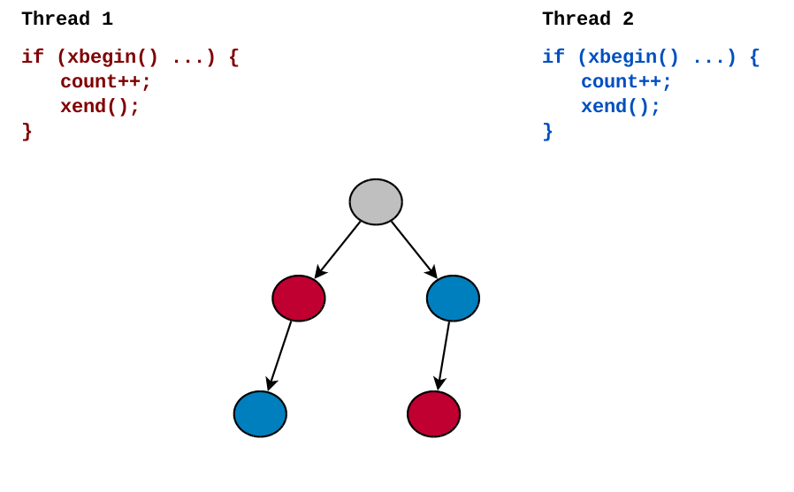
Sources of Nondeterminism
(execution begins)
"Run Thread 1
"Run Thread 2
...then run Thread 2"
...then run Thread 1"
(execution ends)

Slide 10
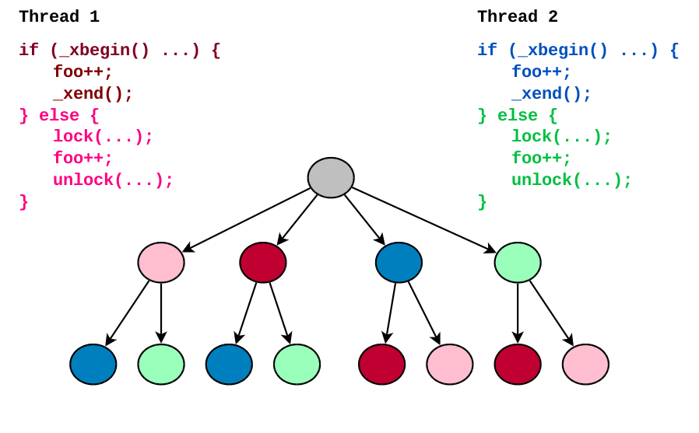
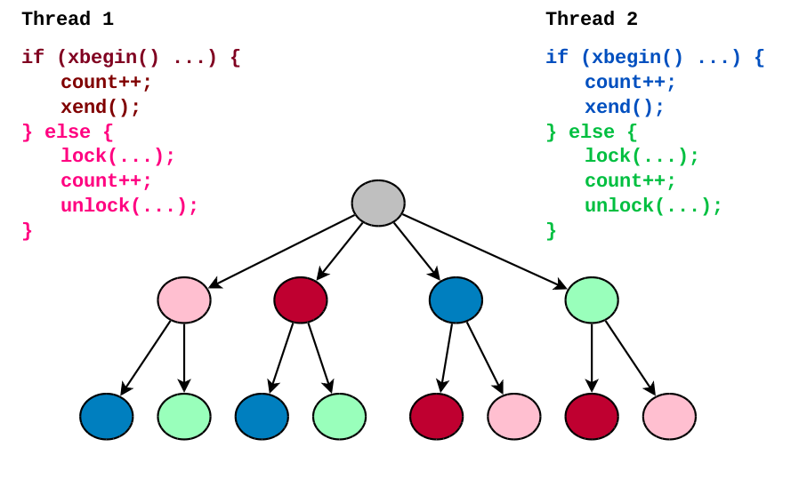
Sources of Nondeterminism
"Inject a failure
in Thread 1s
transaction..."
"Inject a failure
in Thread 2s
transaction..."

Slide 11
Concurrency Model for TSX
Thread 1
xbegin() == STARTED
count++;
// hardware detects
// memory conflict;
// "count++" reverted
xbegin() == ABORTED
mutex_lock()
...
"What about interleaving the transactions with each other with finer granularity?"
Thread 2
xbegin() == STARTED
count++;
xend()

Slide 12
Concurrency Model for TSX
Thread 1
xbegin() == ABORTED
mutex_lock()
...
"What about interleaving the transactions with each other with finer granularity?"
Thread 2
xbegin() == STARTED
count++;
xend()

Slide 13
Concurrency Model for TSX
"What about interleaving the transactions with each other with finer granularity?"
Claim: Simulating transaction failure at every xbegin() suffices to expose all observable executions caused by any interleaving within transactions
  No need to simulate hardware roll-back semantics

Slide 14
Project Status
Done:
  Implemented new concurrency model in Landslide
  Added support for different xabort() codes
  Several unit tests, including the example bug here

Slide 15
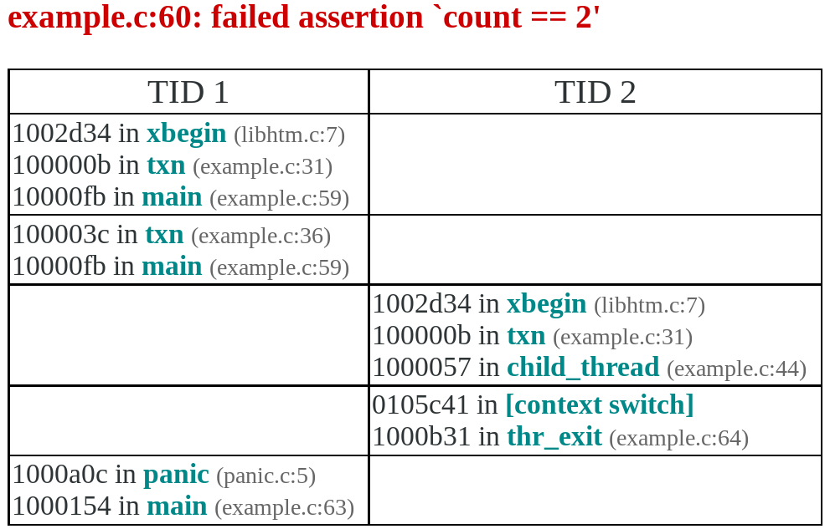
(BTW, Landslide finds this bug in 40 seconds)
(note: this line is the count++ data
race in the transaction failure path)
(after fixing the bug, verifies correctness in 12 CPU-minutes)

Slide 16
Project Status
Done:
  Implemented new concurrency model in Landslide
  Added support for different xabort() codes
  Several unit tests, including the example bug here
TODO:
  Prove correctness of equivalence claim
  Cope with state space explosion :)
  Check real-world transactional benchmarks/algorithms
    Got any to share with me??

