Slide 1
This is not a title:
This is not a subtitle
Ben Blum
Jiří Šimša, Garth Gibson
Parallel Data Laboratory
Carnegie Mellon University

Slide 2
Outline
Systematic Testing
  Introduction
  State space estimation
  Improving estimation quality
Using State Space Estimates
  Resource allocation for too large tests
  Automatic “iterative deepening” for too small tests
Conclusion

Slide 3
Systematic Testing
Systematic (exploratory) testing = exhaustive search of a concurrent program's state space.
  State space defined by “decision points”, exponential in size
  Reduction techniques (DPOR) help make exploration feasible.
  dBug for userspace programs [cite], Landslide for kernels [cite]
On-line estimation lets us guess how long exploration will take [cite]
  DPOR prunes the state space, interfering with estimation.

Slide 4
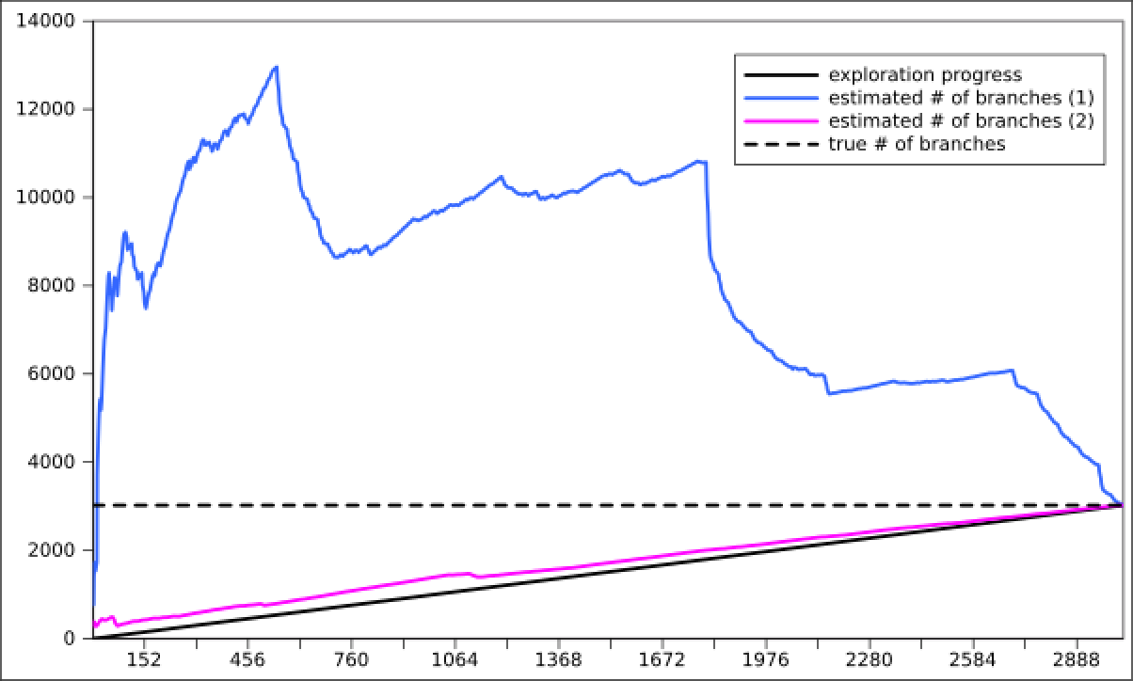
State Space Estimation
Why is state space estimation difficult?
  Estimation varies as time progresses
  Estimation varies across different exploration orderings

Slide 5
Improving Estimation Quality
Exploring different parts of the tree at once improves estimates.
  Run multiple explorations in parallel, use average of estimates
[graph of averages]

Slide 6
Improving Estimation Quality
Exploring different parts of the tree at once improves estimates.
  Run multiple explorations in parallel, use average of estimates
How can we get the best estimate with a given # of CPU seconds?
  Use value of estimate after exploring N branches of the tree
  Running M explorations in parallel requires a lower value for N.
    [maybe have a picture here?]
  What is a good heuristic for N versus M?

Slide 7
Use Case: Test Suite Scheduling
todo
  todo
todo
  todo

Slide 8
Use Case: Test Case Refinement
How can we create a test with a reasonable state space?
  Landslide user studies with 15-410 (operating systems)
    Students worked best with an iterative process
    “Start small, add more decision points and try again”

Slide 9
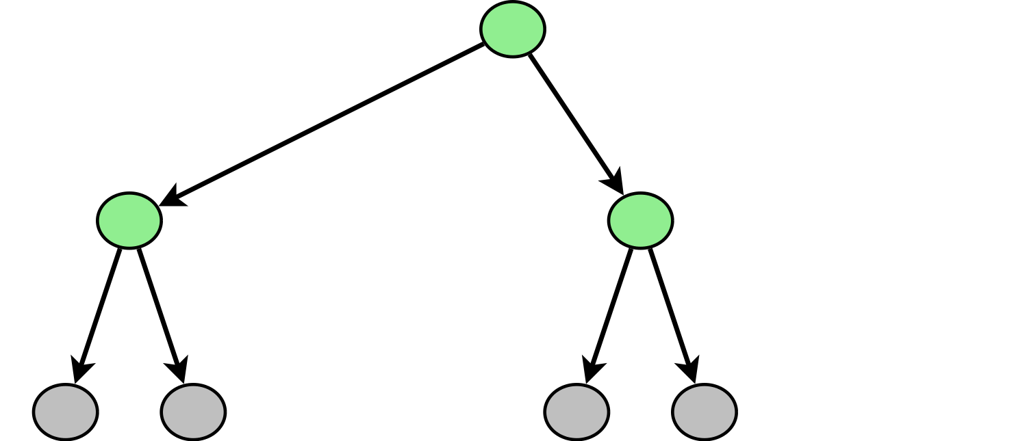
Use Case: Test Case Refinement
How can we create a test with a reasonable state space?
  Landslide user studies with 15-410 (operating systems)
    Students worked best with an iterative process
    “Start small, add more decision points and try again”

Slide 10
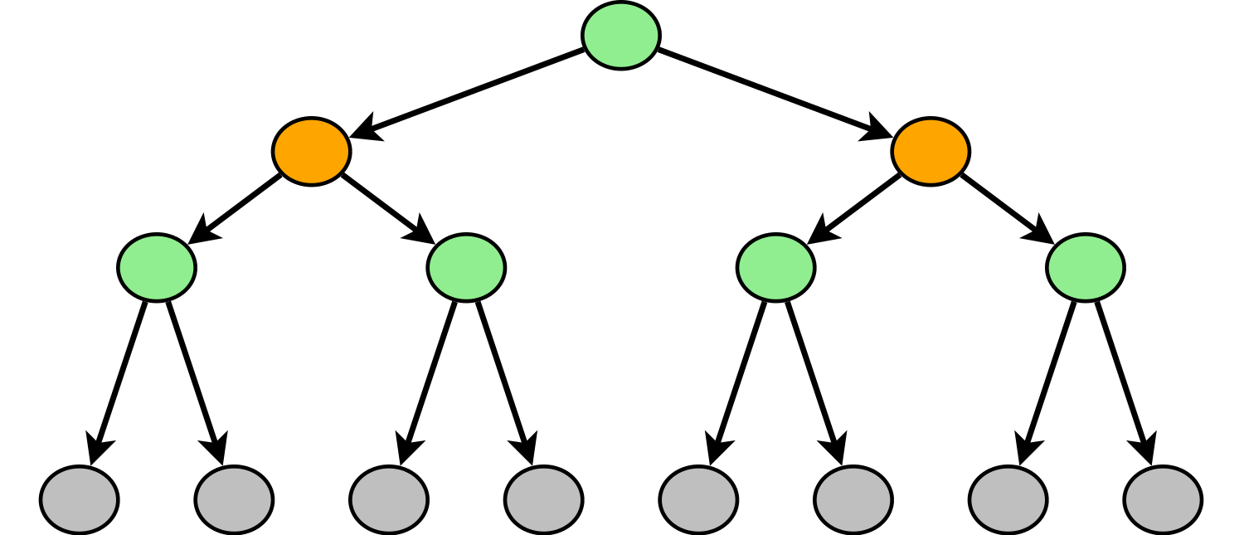
Use Case: Test Case Refinement
How can we create a test with a reasonable state space?
  Landslide user studies with 15-410 (operating systems)
    Students worked best with an iterative process
    “Start small, add more decision points and try again”

Slide 11
Use Case: Test Case Refinement
How can we create a test with a reasonable state space?
  Landslide user studies with 15-410 (operating systems)
    Students worked best with an iterative process
    “Start small, add more decision points and try again”

Slide 12
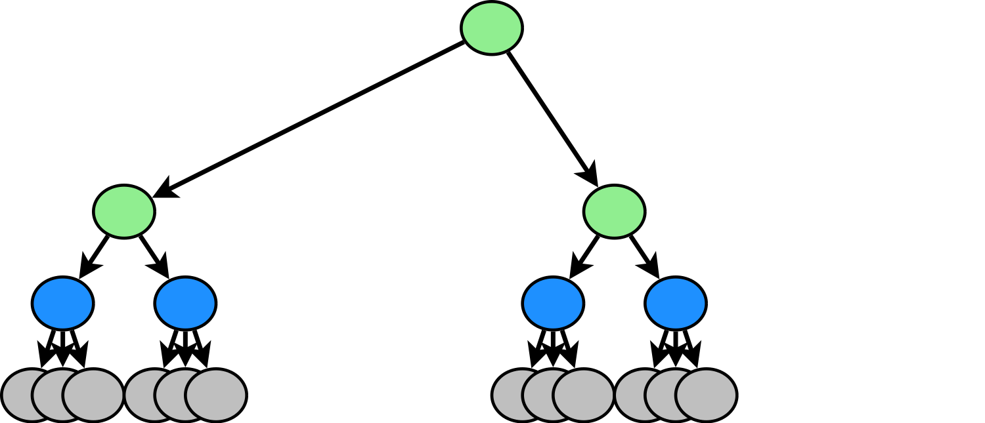
Use Case: Test Case Refinement
How can we create a test with a reasonable state space?
  Landslide user studies with 15-410 (operating systems)
    Students worked best with an iterative process
    “Start small, add more decision points and try again”

Slide 13
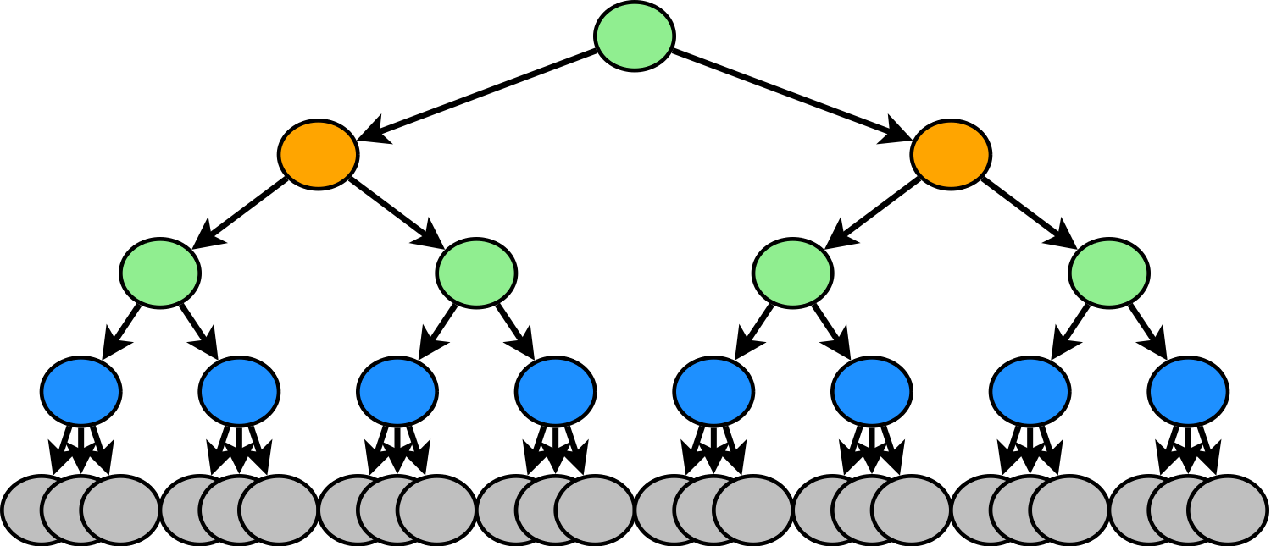
Use Case: Test Case Refinement
How can we create a test with a reasonable state space?
  Landslide user studies with 15-410 (operating systems)
    Students worked best with an iterative process
    “Start small, add more decision points and try again”

Slide 14
Use Case: Test Case Refinement
How can we create a test with a reasonable state space?
  Landslide user studies with 15-410 (operating systems)
    Students worked best with an iterative process
    “Start small, add more decision points and try again”
Can we automate this process?

Slide 15
Use Case: Test Case Refinement
Goal: A test framework that heuristically adds as many decision points as it can handle given a certain CPU time budget.
  Automatically-inserted decision points should be meaningful.
    Lock, semaphore operations (worked well with 15-410)
    Analyze memory accesses to find data races
  Estimates allow us to judge state spaces as “too big”.
    Framework can test increasing combinations of decision points until time runs out.

Slide 16
Conclusion
On-line state space estimation for concurrency tests is hard.
  Estimates vary dramatically with test configuration
  Can improve estimation quality with averages and heuristics
Accurate estimates are important.
  With a large test suite, decide which tests are best to run
  With a single test, allows us to iteratively refine the test configuration until resources are exhausted

Slide 18
Related Work
Systematic testing
  MaceMC (NSDI '07) – liveness, random walking
  CHESS (PLDI '07) – iterative context bounding
  MoDist (NSDI '09) – network/disk model checking
  dBug (SSV '10) – dynamic partial order reduction
  SimTester (VEE '12) – interrupt injection, drivers
Data race detection
  Eraser (TOCS '97) – lock-set tracking, annotations
  DataCollider (OSDI '10) – random sampling, kernel
  RacePro (SOSP '11) – inter-process races

Slide 19
References
[Godefroid '97]
  Patrice Godefroid. VeriSoft: A Tool for the Automatic Analysis of Concurrent Reactive Software. CAV 1997.
[Flanagan '05]
  Cormac Flanagan and Patrice Godefroid. Dynamic partial-order reduction for model checking software. POPL 2005.
[Simsa '11]
  Jirí Simsa, Randy Bryant, Garth A. Gibson: dBug: Systematic Testing of Unmodified Distributed and Multi-threaded Systems. SPIN 2011.
[Simsa '12]
  Jiri Simsa. Scalable Dynamic Partial Order Reduction. Talk at PDL Retreat 2012.

