Slide 1
Working Title
Clever Working Subtitle
Ben Blum
Garth Gibson
Parallel Data Laboratory
Carnegie Mellon University

Slide 2
Outline
What is Systematic Testing?
  Motivation
  Role of preemption points
  Challenges
Automating Preemption Points
  Data race detection
  State space estimation
  Implementation in Landslide
Evaluation
  Finding bugs in 15-410 student projects
Conclusion

Slide 3
Background: What is Systematic Testing?

Slide 4
Systematic Testing
Stress testing
  Common approach to finding concurrency bugs
  Relies on randomly-occurring context switches
  User-friendly but unpredictable/unbounded

Slide 5
Systematic Testing
Stress testing
  Common approach to finding concurrency bugs
  Relies on randomly-occurring context switches
  User-friendly but unpredictable/unbounded
Systematic testing [Godefroid '97]
  Thread scheduling controlled by test framework
  Each iteration, test a different thread interleaving
  Goal: Exhaustively search “all possible” interleavings

Slide 6
Systematic Testing
Stress testing
  Common approach to finding concurrency bugs
  Relies on randomly-occurring context switches
  User-friendly but unpredictable/unbounded
Systematic testing [Godefroid '97]
  Thread scheduling controlled by test framework
  Each iteration, test a different thread interleaving
  Goal: Exhaustively search “all possible” interleavings
    Wait... what?
    In practice, interleavings are of coarse granularity.

Slide 7
Example
int thread_fork()
{
thread_t *child = spawn_new_thread();
add_to_runqueue(child);
return child->tid;
}

Slide 8
Example
  On exit, child's state is freed
  Forking thread does use-after-free
  Might return garbage instead of thread ID
int thread_fork()
{
thread_t *child = spawn_new_thread();
add_to_runqueue(child);
return child->tid;
}
“child” gets freed!

Slide 9
Example
  TODO: put tabular traces here – get them from speaking skills talk pdf.

Slide 10
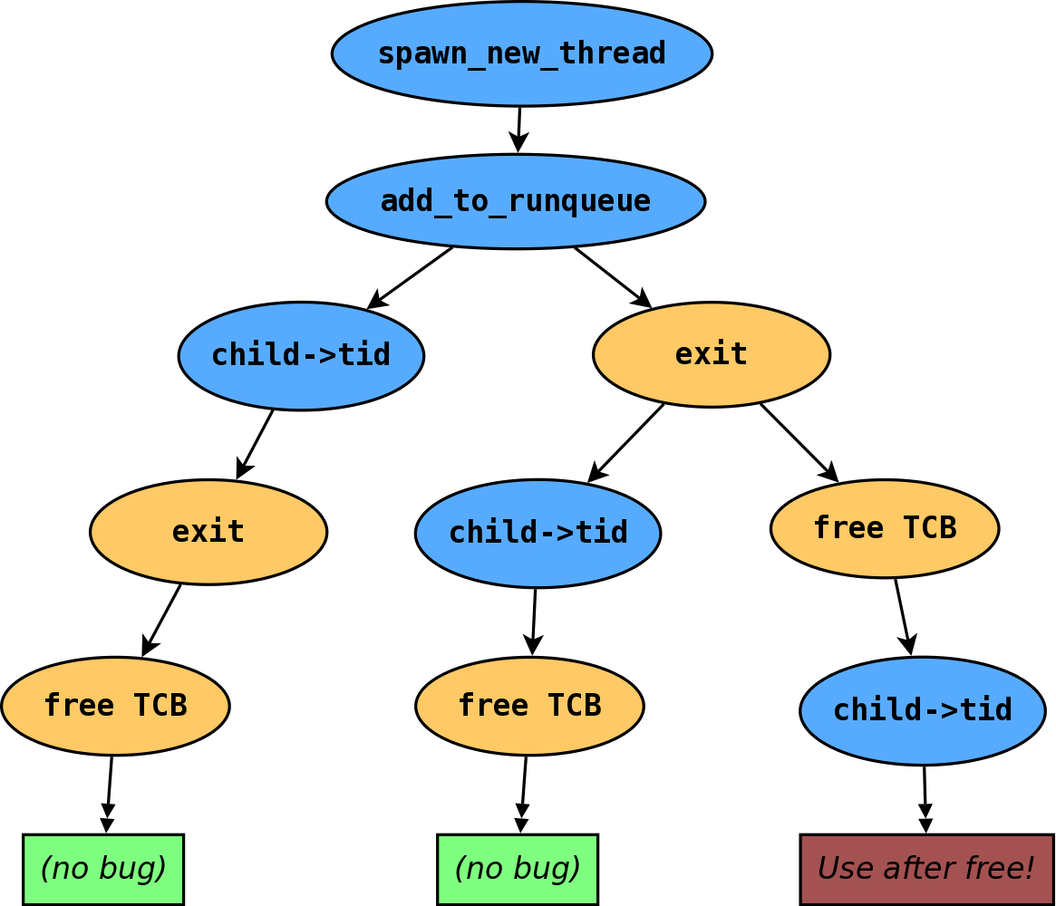
Example - State Space
- Thread 1
- Thread 2

Slide 11
Preemption Points
Concretely, systematic testing asks, “Which preemption points (PPs) are important?”
State space of interleavings is parameterized by PPs.
  Preemption points everywhere: completion infeasible
  Too few preemption points: won't find bugs
Prior work implementations hard-code a fixed set of PPs.
  dBug [Simsa '11]: pthread library calls
  Landslide [Blum '12]: kernel mutex locking/unlocking

Slide 12
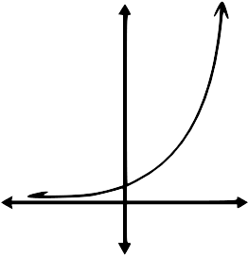
Challenges
Parameters of systematic tests must be kept small.
  Test program length / number of threads
  Number of preemption points used

Slide 13
Coping with Exponential Explosion
Some prior work focuses on improving coverage with...
  Reduction techniques [Flanagan '05, Guo '11]
  Determinizing runtimes [Cui '13]
Other prior systems give up on 100% completion...
  Heuristic exploration ordering (ICB) [Musuvathi '08]
  Random distribution of PPs [Fonseca '14]

Slide 14
Coping with Exponential Explosion
Current systematic testing model not user-friendly.
  Test framework: “I want to use these PPs, but can't predict how long until completion.”
  User: “I have 16 CPUs and 24h to test my program.”
Stress testing offers this... can we offer it too?

Slide 15
Our Technique: Iterative Deepening

Slide 16
Iterative Deepening
Goal: Find the best state space for a given CPU budget.
  User studies with 15-410 (operating systems)
    Students worked best with an iterative process
    “Start small, then add more preemption points”

Slide 17
Iterative Deepening
Goal: Find the best state space for a given CPU budget.
  User studies with 15-410 (operating systems)
    Students worked best with an iterative process
    “Start small, then add more preemption points”
Named after analogous technique in chess AI.
  Chess search is DFS limited by max # of moves (ply).
  AIs repeat DFS, increasing ply, until timeout.
  In systematic testing, “depth” is less straightforward...

Slide 18
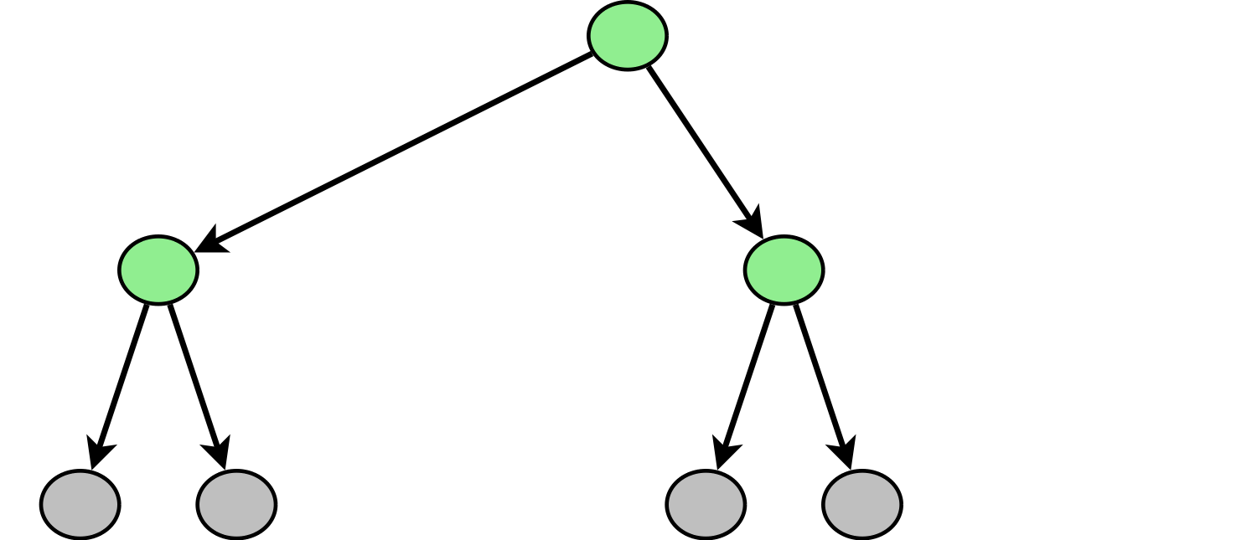
Iterative Deepening
Goal: Find the best state space for a given CPU budget.
  User studies with 15-410 (operating systems)
    Students worked best with an iterative process
    “Start small, then add more preemption points”

Slide 19
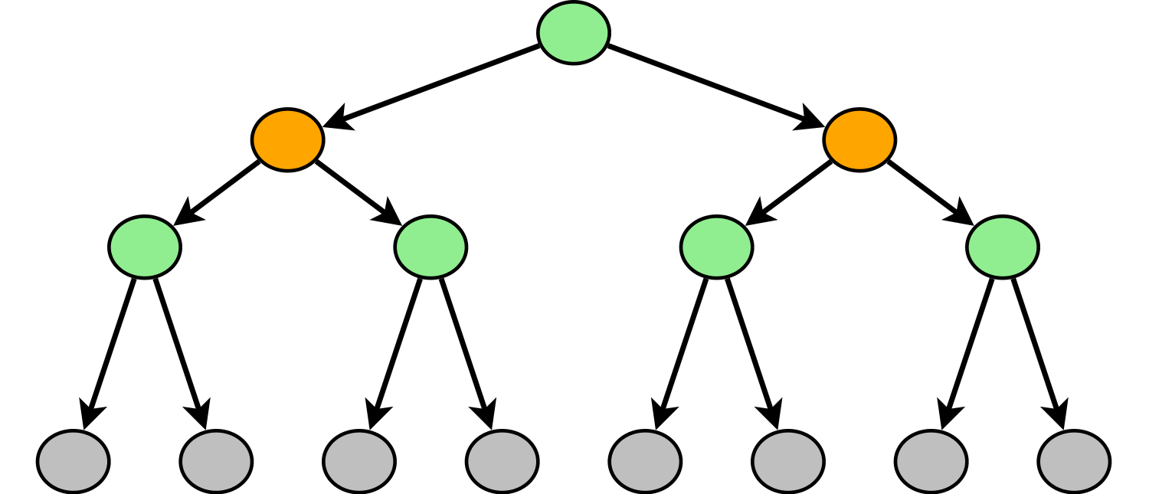
Iterative Deepening
Goal: Find the best state space for a given CPU budget.
  User studies with 15-410 (operating systems)
    Students worked best with an iterative process
    “Start small, then add more preemption points”

Slide 20
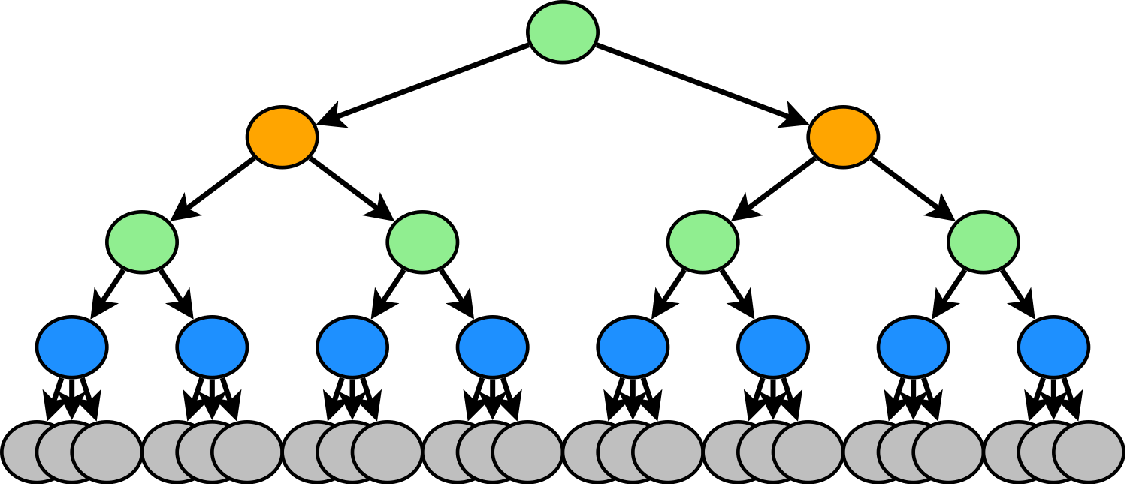
Iterative Deepening
Goal: Find the best state space for a given CPU budget.
  User studies with 15-410 (operating systems)
    Students worked best with an iterative process
    “Start small, then add more preemption points”

Slide 21
Choosing Preemption Points
How do we choose good preemption points?
  Some can be “hardcoded” as before
  Dynamic analysis during run can find new candidates:
    Data races [Savage '97]
    Atomic operations
    Ad-hoc yield (or busy) loops

Slide 22
Choosing Preemption Points
How do we choose good preemption points?
  Some can be “hardcoded” as before
  Dynamic analysis during run can find new candidates:
    Data races [Savage '97]
    Atomic operations
    Ad-hoc yield (or busy) loops
Data race preemption points
  Interleaving threads at suspicious shared accesses
  Solves false-positive problem of single-pass analysis

Slide 23
Choosing Preemption Points
TODO: have a series of picture-only slides here representing the pool of jobs w/ priorities

Slide 24
Iterative Deepening in Landslide
Landslide [Blum '12]: simulator-based, tuned for 15-410
  Data race detection incurs no additional overhead
  Heuristically identifies infinite yield- or busy-loops
  State space estimation guesses total time [Simsa '12]

Slide 25
Iterative Deepening in Landslide
Landslide [Blum '12]: simulator-based, tuned for 15-410
  Data race detection incurs no additional overhead
  Heuristically identifies infinite yield- or busy-loops
  State space estimation guesses total time [Simsa '12]
“Landslide-ID”: wrapper program for Landslide
  Manages work queue of jobs with different PP configs
  Each job is a new state space for Landslide to explore
  Prioritizes which jobs are important / likely to finish
    Based on nature of PPs (data races? mutexes?)
    Based on estimated completion time
  Only two arguments: CPU budget & name of unit test

Slide 26
Evaluation

Slide 27
Conclusion

Slide 28
Future Work
Policies for creating/scheduling jobs within Landslide-ID
  How many new combinations of jobs to create?
  When to suspend jobs when estimates are too high?
Improving quality of state space estimates
  Estimates generally find right order of magnitude...
  High variance depending on exploration ordering
User study with 15-410 students in upcoming semesters
  Evaluate effectiveness as educational/grading tool

Slide 29
Conclusion
Systematic Testing
  Controls scheduling rather than rely on randomness
  More reliable bug-finding than stress testing
  State space depends on preemption points (PPs)
  Completion time is exponential and unpredictable
Systematic testing must be more user-friendly than this!
Iterative deepening in Landslide
  Automatically searches for optimal set of PPs to use
  User need only supply CPU time budget
  Good preliminary results, planning future user study

Slide 30
References
[Godefroid '97]
  Patrice Godefroid. VeriSoft: A Tool for the Automatic Analysis of Concurrent Reactive Software. CAV 1997.
[Savage '97]
  Stefan Savage et al. Eraser: A Dynamic Data Race Detector for Multithreaded Programs. ACM TOCS 1997.
[Flanagan '05]
  Cormac Flanagan and Patrice Godefroid. Dynamic partial-order reduction for model checking software. POPL 2005.
[Musuvathi '08]
  Madanlal Musuvathi et al. Finding and Reproducing Heisenbugs in Concurrent Programs. (a.k.a. the CHESS paper.) OSDI 2008.
[Simsa '11]
  Jirí Simsa, Randy Bryant, Garth A. Gibson: dBug: Systematic Testing of Unmodified Distributed and Multi-threaded Systems. SPIN 2011.

Slide 31
References
[Guo '11]
  Huayang Guo et al. Practical Software Model Checking via Dynamic Interface Reduction. SOSP 2011.
[Blum '12]
  Ben Blum. Landslide: Systematic Dynamic Race Detection in Kernel Space. CMU-CS-12-118. May 2012.
[Simsa '12]
  Jiri Simsa. Runtime Estimation and Resource Allocation for Concurrency Testing. CMU-PDL-12-113. December 2012.
[Cui '13]
  Heming Cui et al. Parrot: A Practical Runtime for Deterministic, Stable, and Reliable Threads. SOSP 2013.
[Fonseca '14]
  Pedro Fonseca et al. SKI: Exposing Kernel Concurrency Bugs through Systematic Schedule Exploration. OSDI 2014.

Slide 32
Related Work
Systematic testing
  MaceMC (NSDI '07) – liveness, random walking
  CHESS (PLDI '07) – iterative context bounding (ICB)
  MoDist (NSDI '09) – network/disk model checking
  dBug (SSV '10/SPIN '11) – dynamic partial order reduction
  SimTester (VEE '12) – interrupt injection, drivers
  Parrot (SOSP '13) – dBug + deterministic userspace scheduler
  SKI (OSDI '14) – randomly-chosen PPs for testing Linux
  SAMC (OSDI '14) – annotated sync primitives, better reduction
Data race detection
  Eraser (TOCS '97) – lock-set tracking, annotations
  DataCollider (OSDI '10) – random sampling, kernel
  RacePro (SOSP '11) – inter-process races

