Slide 1


Multiprotocol Label Switching
Balaji Bharatwaj Manikandan
UID: 117553062

Slide 2


Agenda
What is MPLS
Routing using MPLS
Why is it called MPLS?
When is it used?
Is MPLS a “Private” Network?
Drawbacks of MPLS

Slide 3
What is MPLS
Multiprotocol Label Switching is a routing technique used by organization to speed up networks.
The way it speeds up the networks is by sending the packets through predetermined paths instead of calculating the route for every single packet, every time!
Operates at OSI “2.5”, meaning that it is in-between network layer and data link layer.

Slide 4
Routing with MPLS
Architecture
Packet Structure
Each packet is assigned to a Forwarding Equivalence Class (FEC) that takes a pre-defined path called Label-Switching Paths (LSP).
Packets that has the same FEC takes the same LSP every time. The router doesn’t calculate the route, instead it used the FEC to pass it on to LSP.
The labels for MPLS is added on top of the header of the packet.
The FEC is integrated to the MPLS labels.
The router in the MPLS network doesn’t examine the packet header instead, it reads the MPLS labels and sends the packets on the LSP.

Slide 5
Why it is called MPLS
The routers in the MPLS network can read only MPLS label.
It doesn’t matter for the routers as to how the packets are formatted or structured.
That is the reason they can work with any protocol.
The core rule for the packets transmitted through MPLS is that they should have the MPLS labels for routing.

Slide 6
When MPLS is used?
Is used when Speed and reliability are highly important
Real time application [ near-immediate data delivery ]
Ex: Video and Voice Calls
Usually built on Wide Area Networks (WAN)
But they get expensive
Cloud-based solution are emerging (Cloudflare Magic WAN).

Slide 7
Is MPLS a private “network”?
Each MPLS network is separate for each organization. So it is private in that way
But the data sent through the network is not private (Not Encrypted)
Anyone outside of the organization can see the data
VPN (Virtual Private Network) is used to encrypt the MPLS networks.

Slide 8
Drawbacks of MPLS
Cost
Long Setup Time
Lack of Encryption
MPLS is more expensive than regular internet service.
Even though it doesn’t require special hardware, dedicated network is expensive to setup.
Setting up dedicated paths take a lot of time.
Manual configuration of LSPs is done by a vendor or by the organization itself.
It will also take a lot of time when the organization needs to scale up
MPLS is an un-encrypted network out of the box.
Anyone outside of the organization can read the data as plain text.
Additional encryption setup is required for the security of MPLS (Like using an VPN)

Slide 9
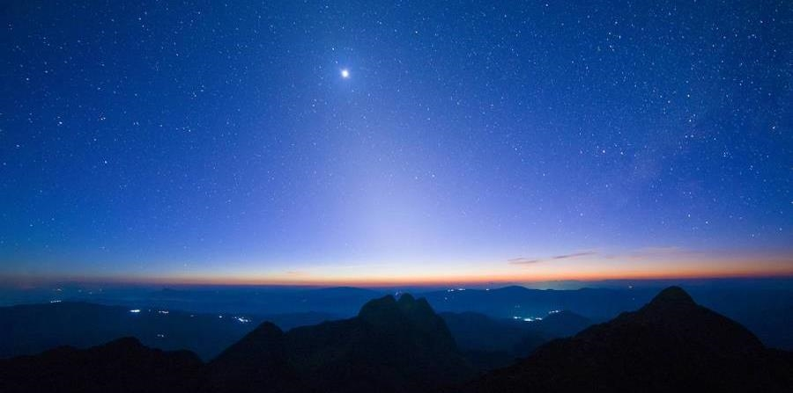

Thank you

Slide 10
Credits
https://www.mushroomnetworks.com/what-is-mpls/ [ MPLS network Image ]
https://www.cloudflare.com/learning/network-layer/what-is-mpls/ [ Information about MPLS ]

