Slide 1

Notes:
Welcome. I am Bryan, from Analytics & Decision Making.
Today: practical ways to use AI in your work, shown with four tools built in this bank.
Questions in the chat any time. I pause after each demo.

Slide 2
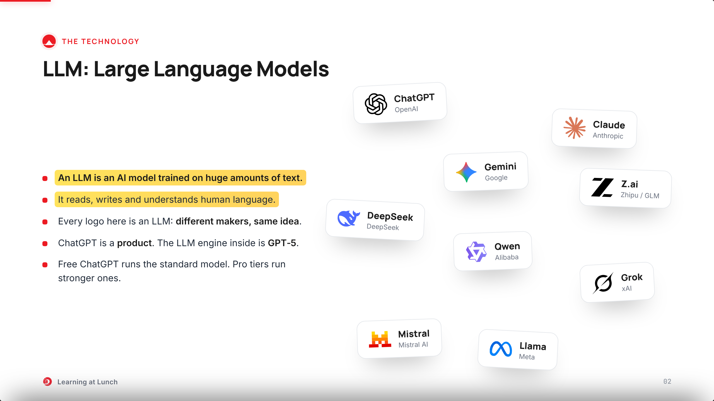
Notes:
LLM = Large Language Model. AI trained on huge amounts of text.
Every logo is an LLM, or a product built on one.
ChatGPT is the app. GPT-5 is the engine inside, like a car and its engine.
Most people use the free, standard model. The paid tiers run stronger ones.
Ask: who used one this week? Most hands go up.

Slide 3
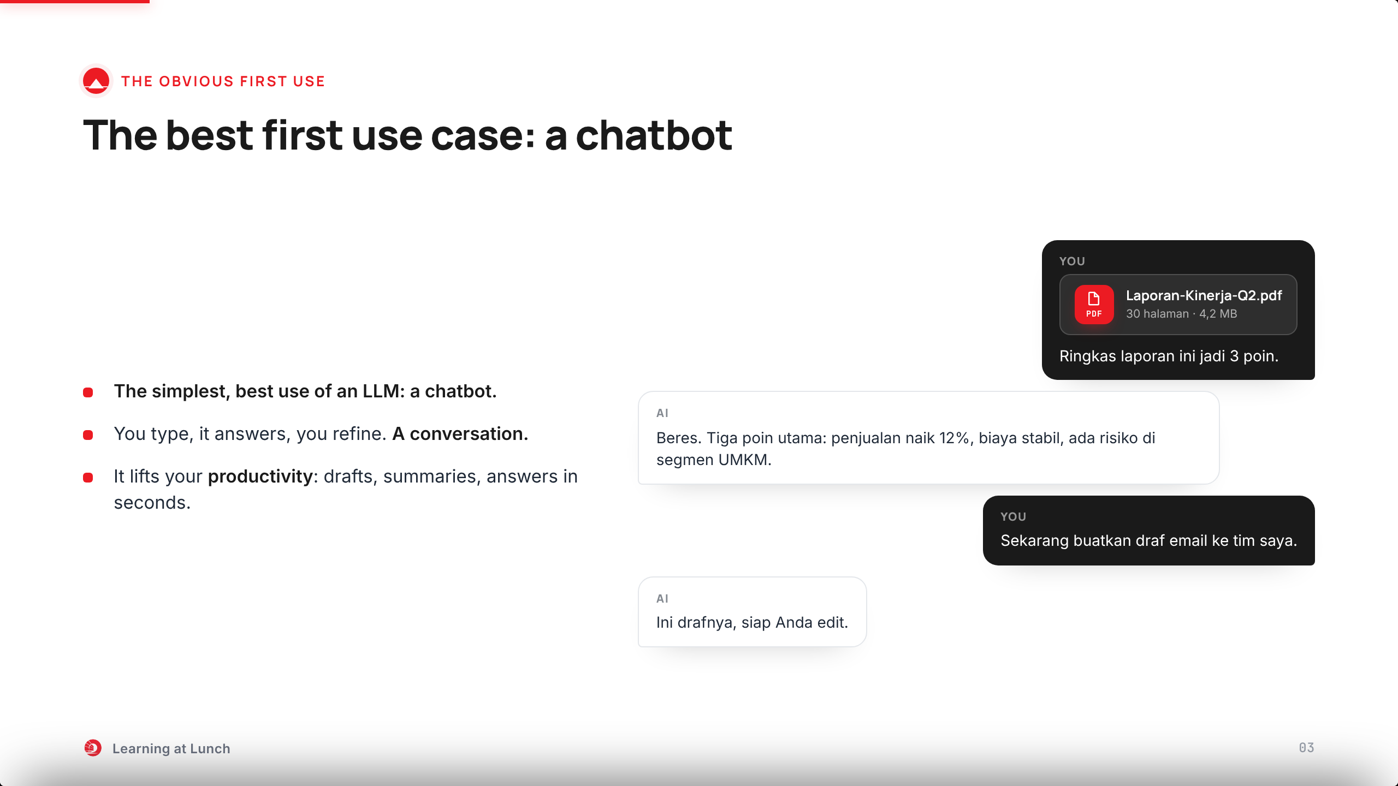
Notes:
One of the best uses of an LLM is also the simplest: a chatbot.
Watch the rhythm on the right. You type, it answers, you refine. A conversation, not a search box.
It lifts your productivity and work efficiency: drafts, summaries, answers in seconds instead of hours.
Later in this session I will show you ours.

Slide 4
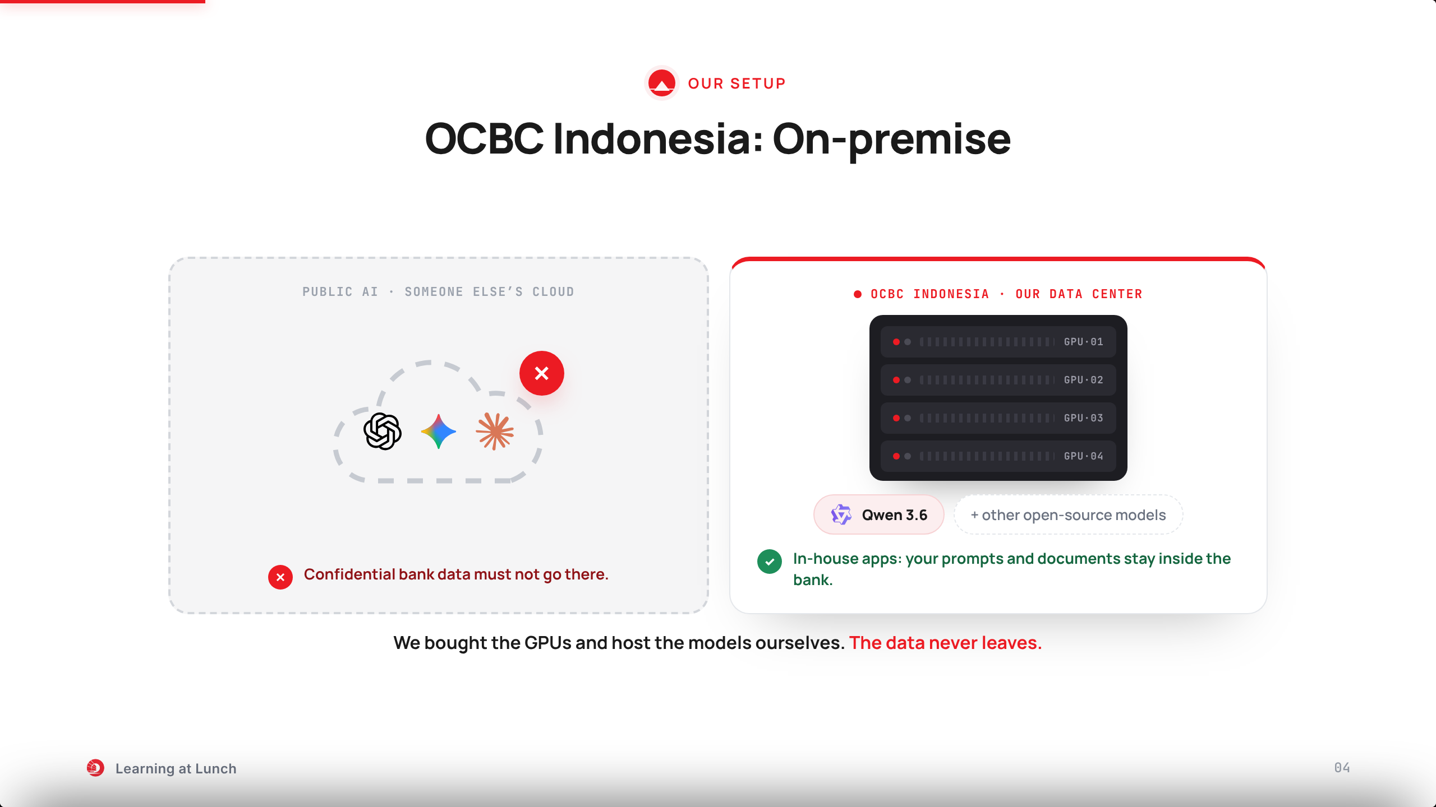
Notes:
Public AI runs in someone else’s cloud. Confidential bank data must not go there.
So OCBC Indonesia went on-premise. We bought GPUs to host multiple open-source models. One of them is Qwen 3.6.
Use the in-house built applications. Your prompts and documents stay inside the bank.
Every demo you will see today runs on this setup.

Slide 5
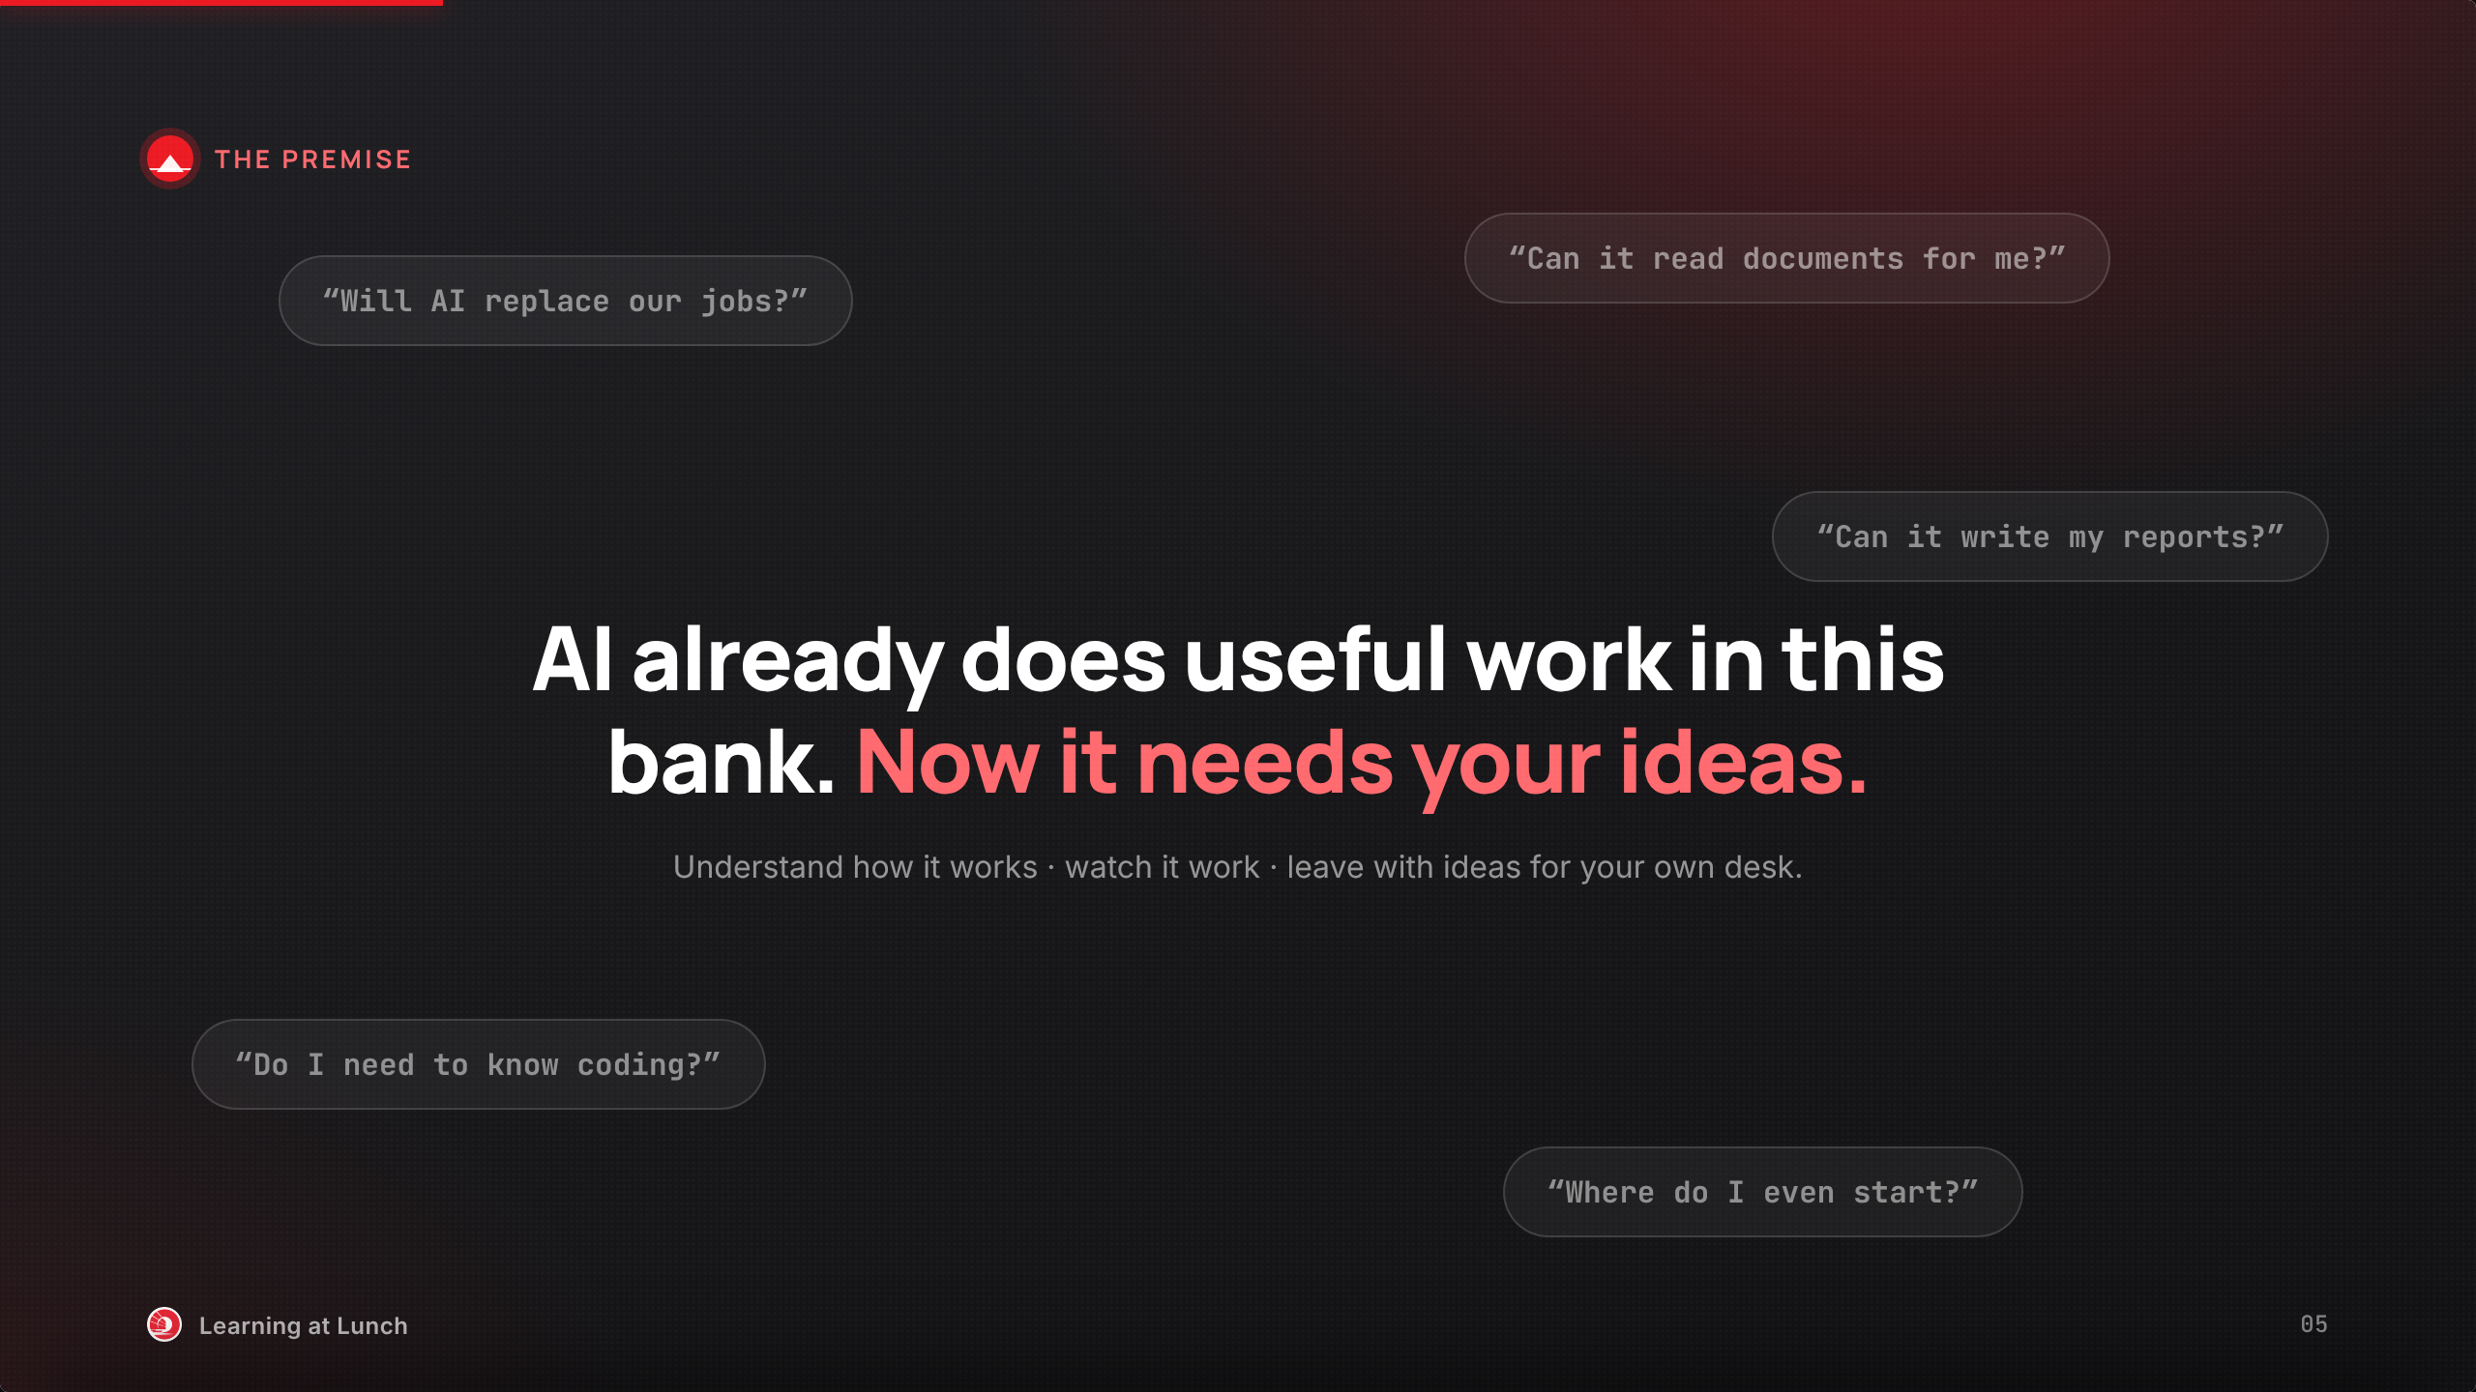
Notes:
Everyone arrives with questions: will it replace us, can it help my work, where do I start?
For us this is not a question. AI already works in this bank.
Goal today: understand it, watch it work, leave with ideas for your desk.

Slide 6
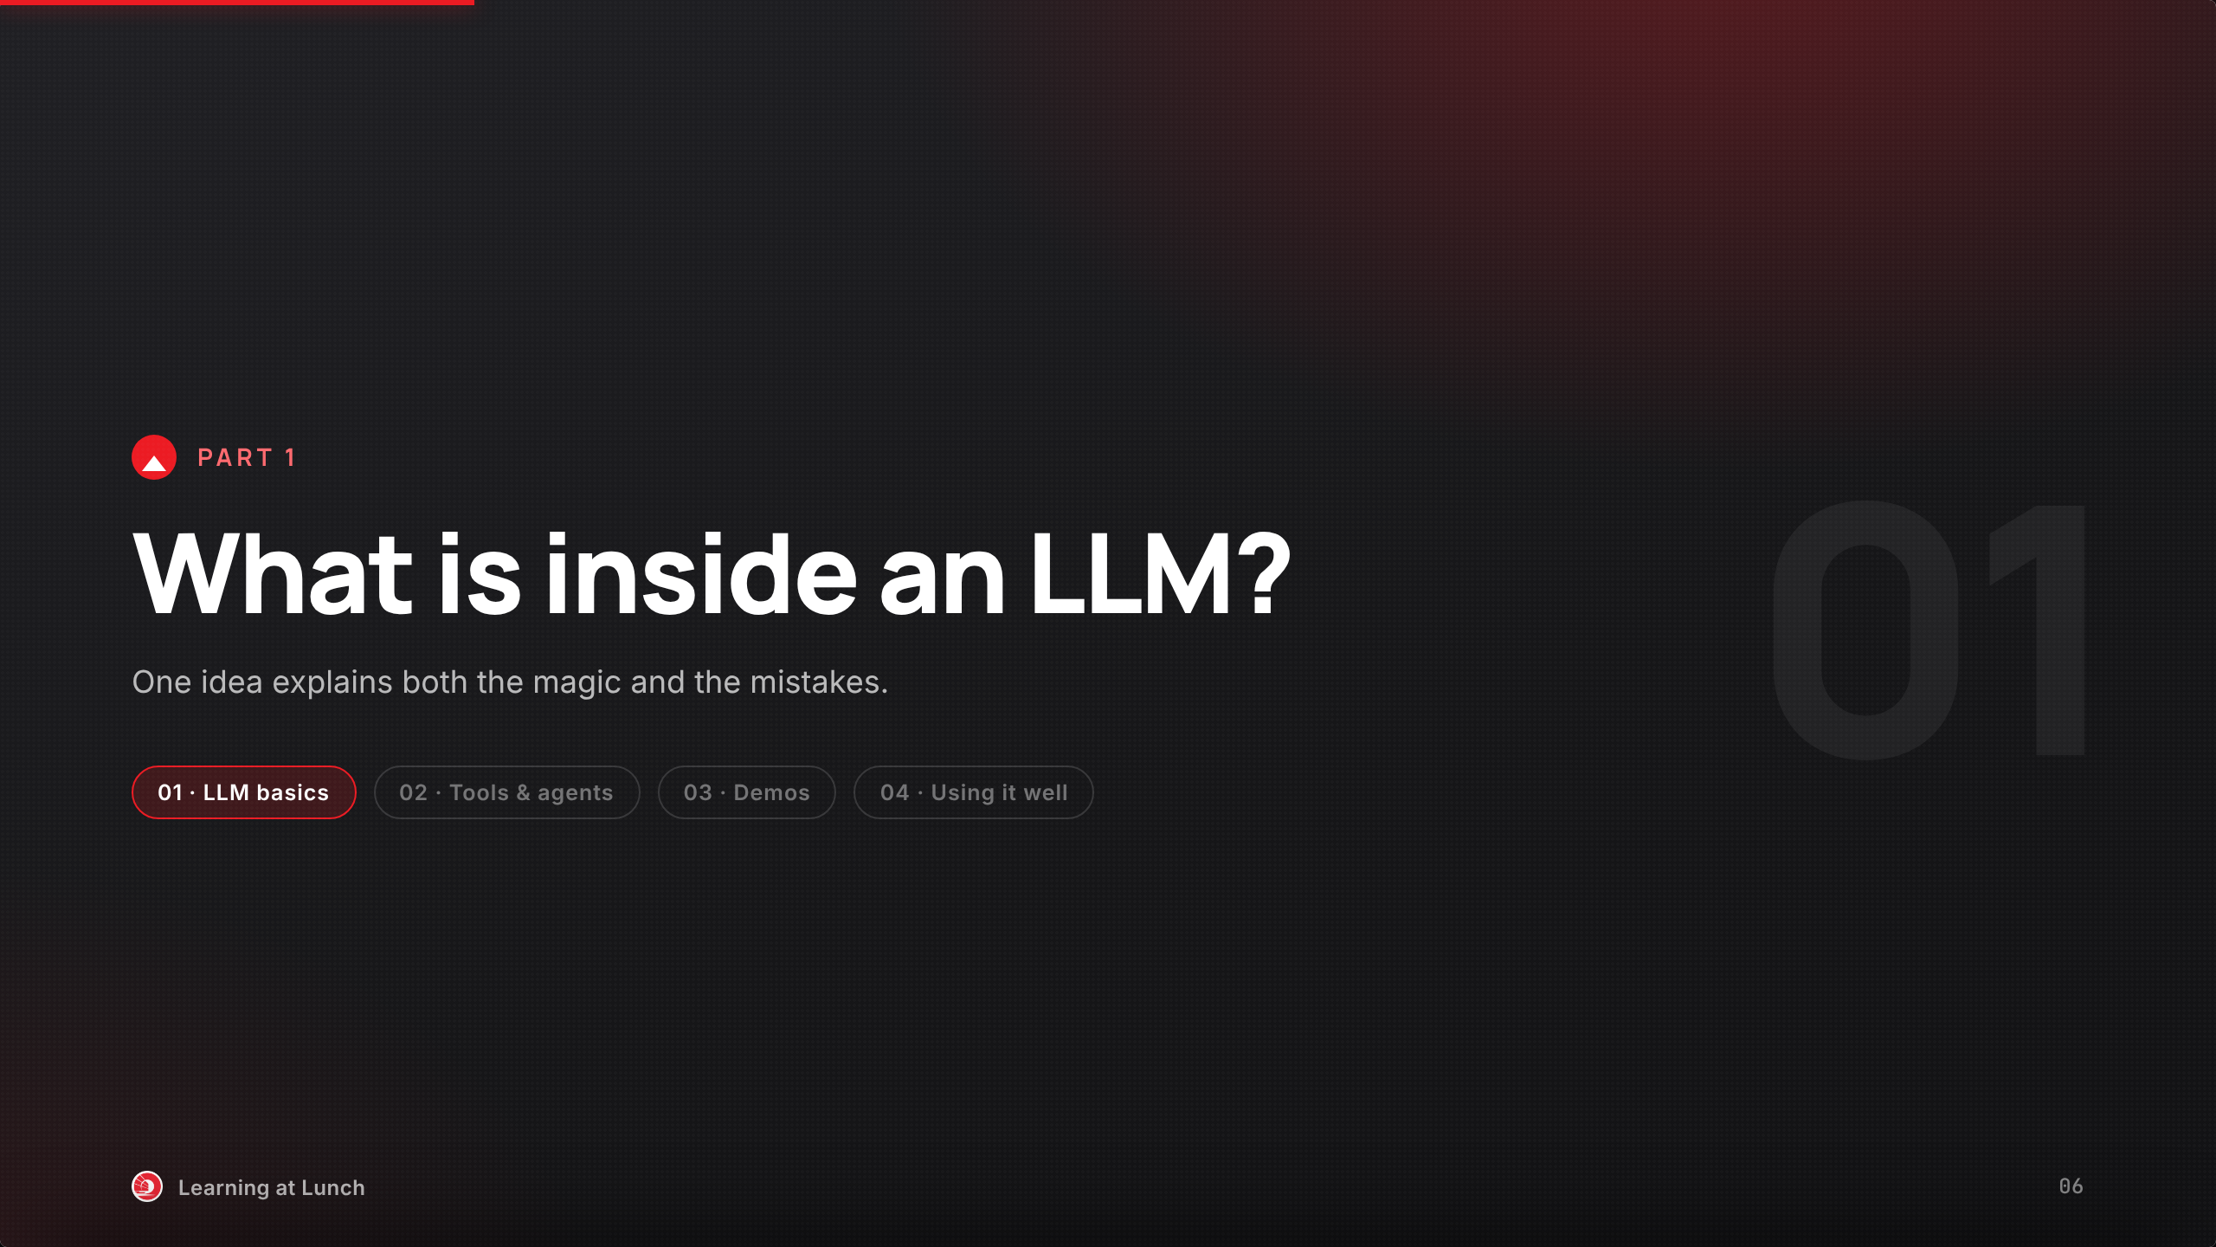
Notes:
Time to open the box.
One idea explains everything: the magic and the mistakes.

Slide 7
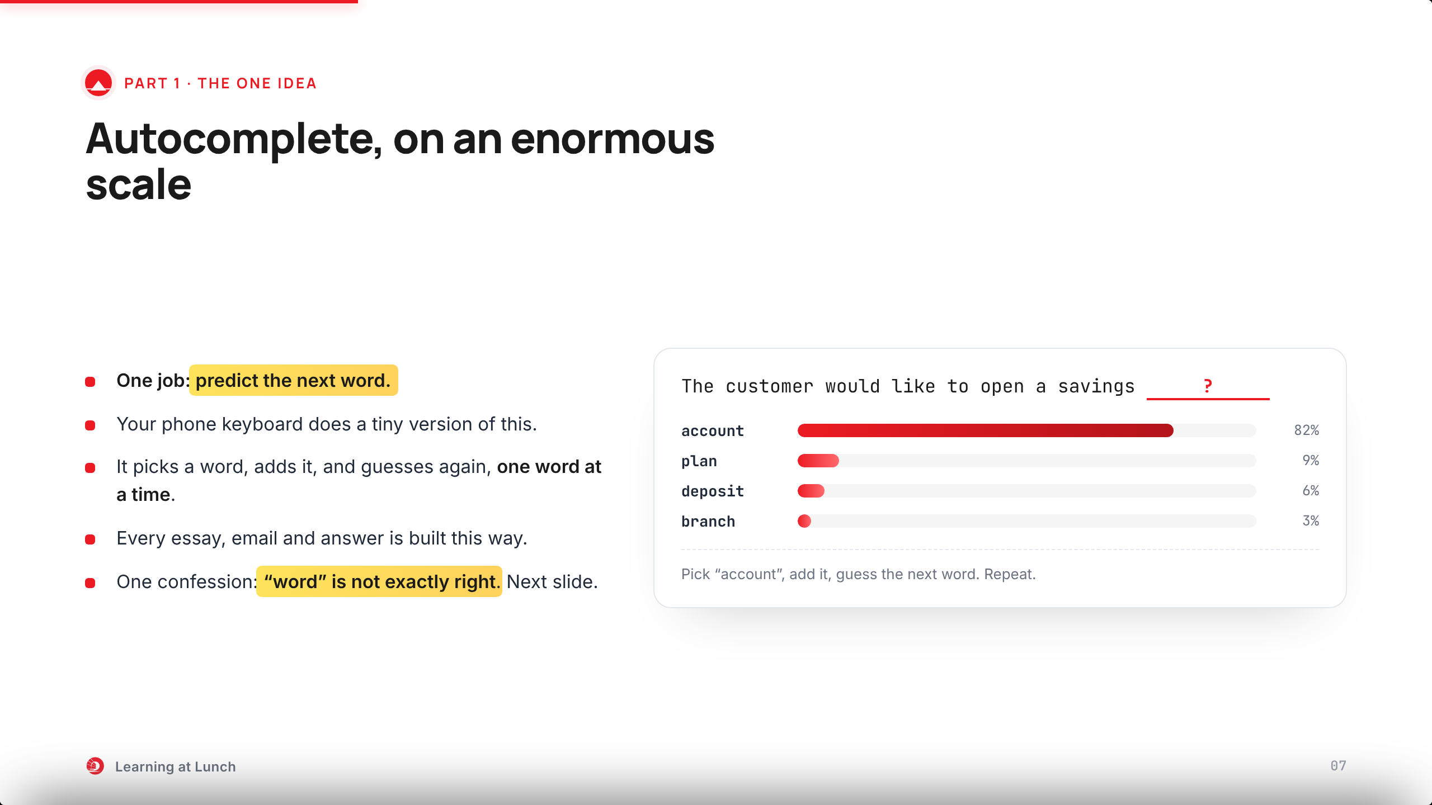
Notes:
An LLM does one thing: guess the next word.
Your phone keyboard is a tiny version of this.
It adds a word, then guesses again, until the answer is done.
Small confession before we move on: word is not exactly the right unit.
Hold this picture. The next slide sharpens it.

Slide 8
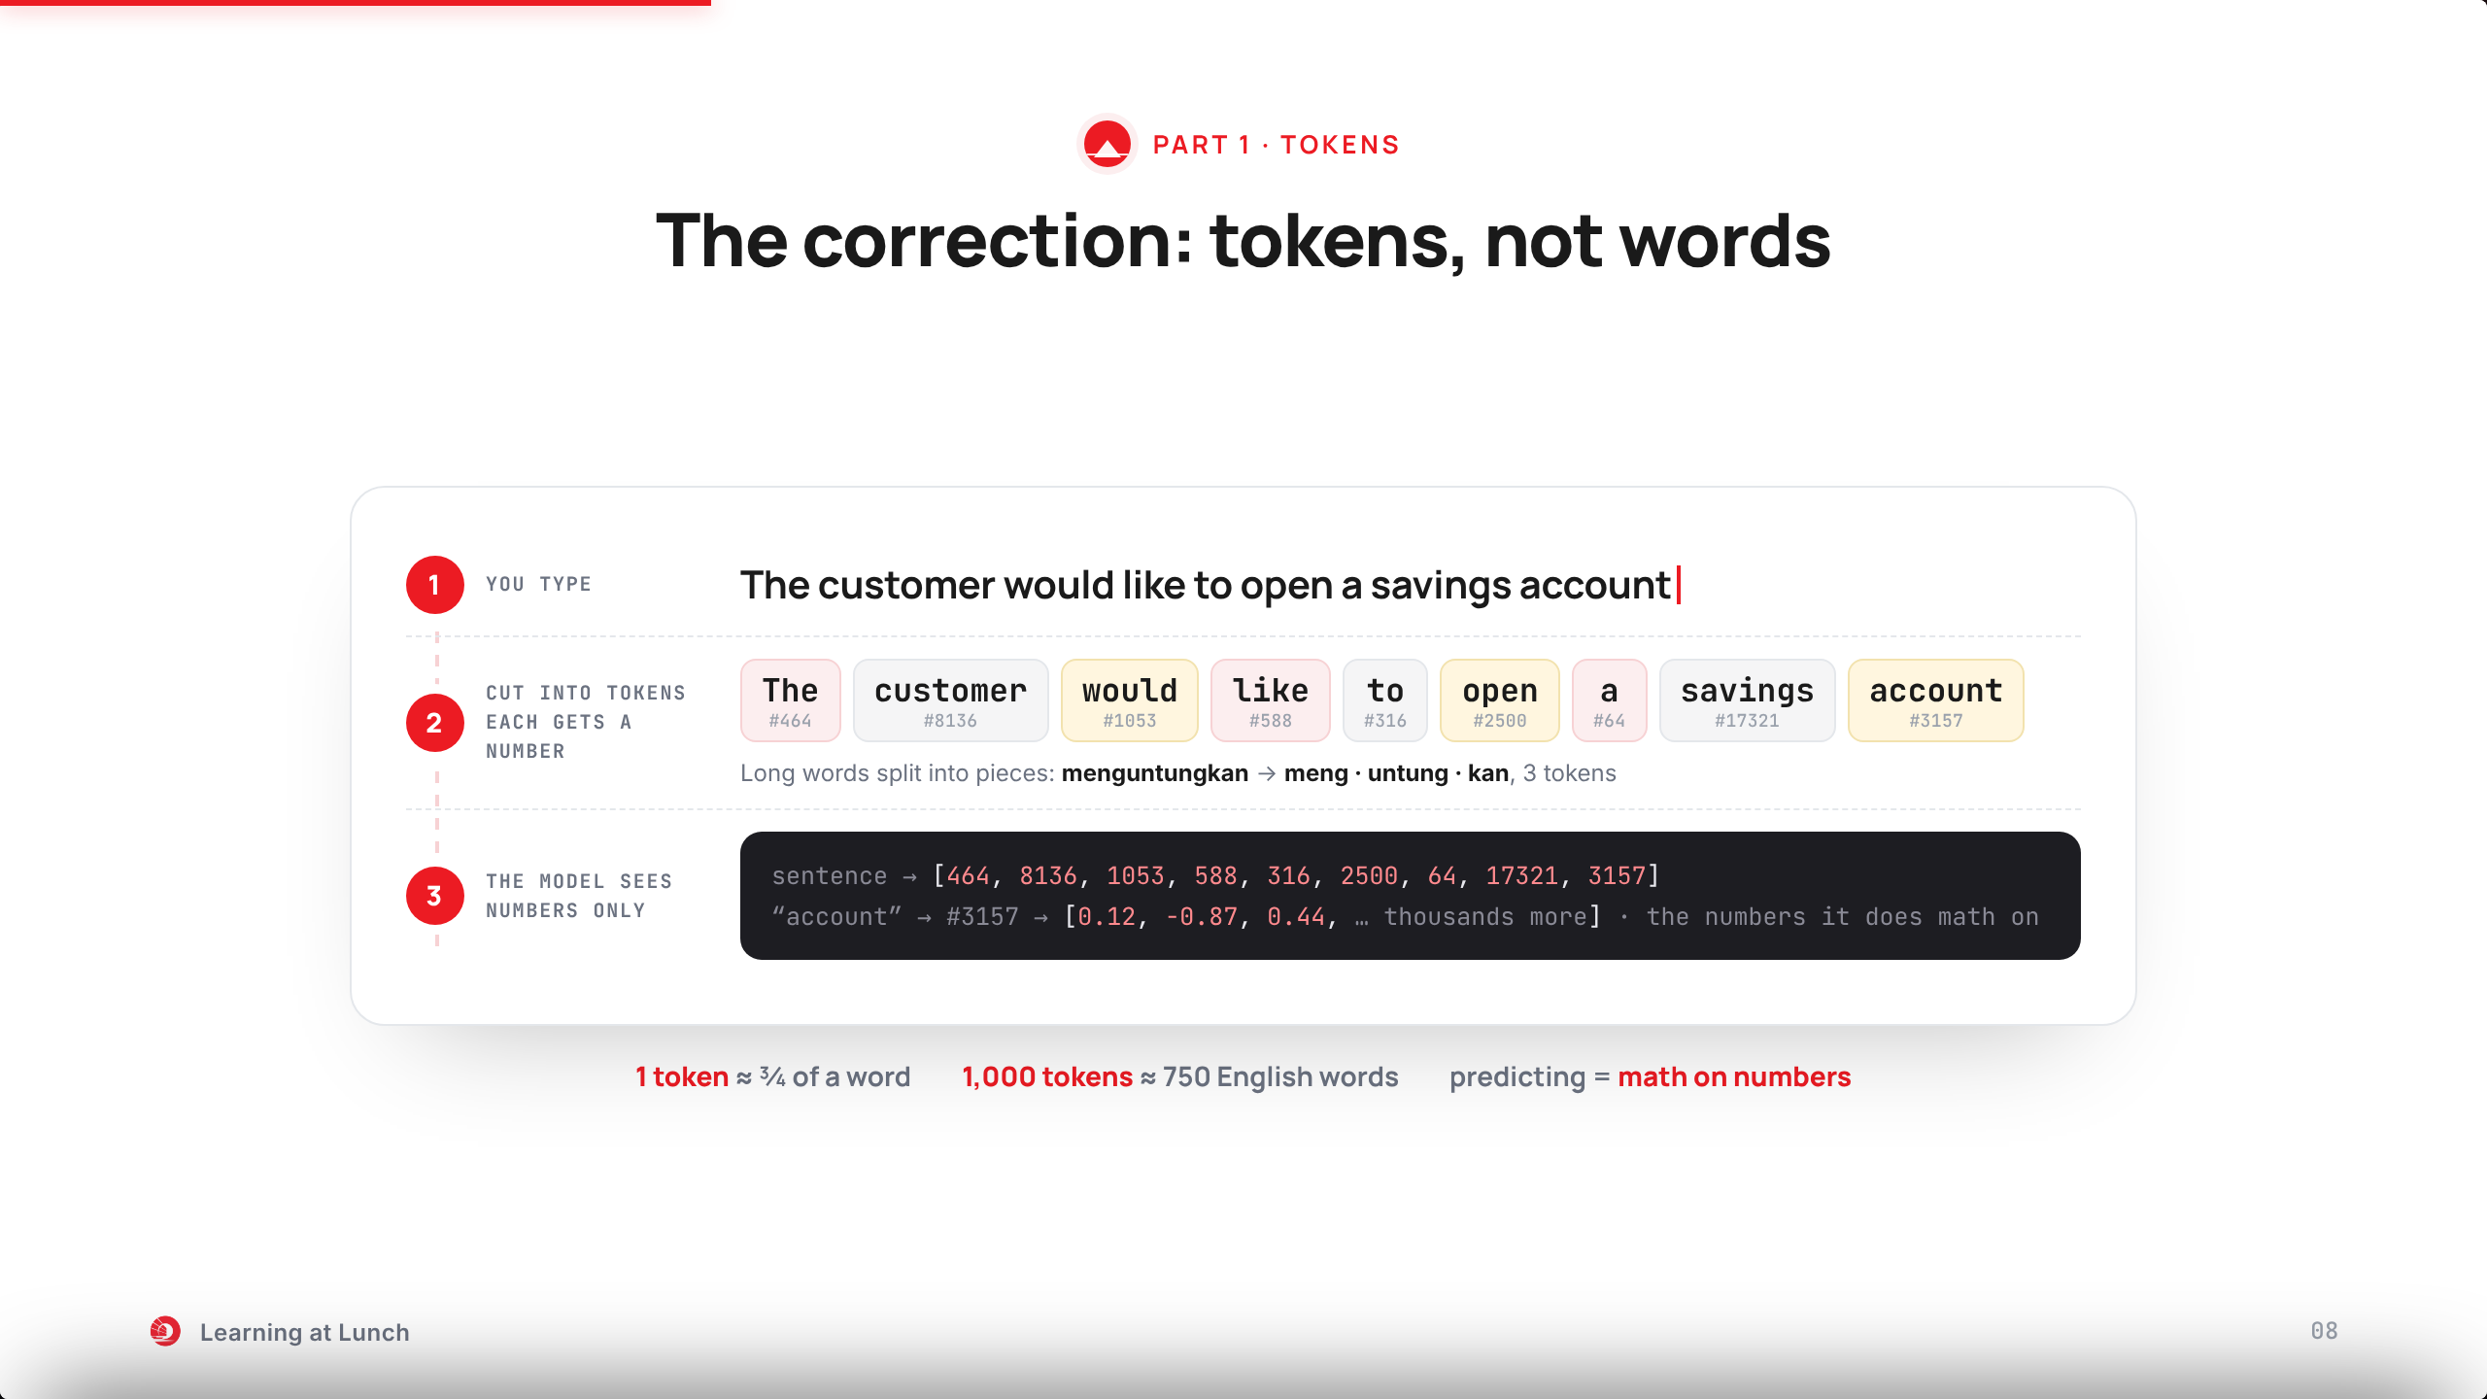
Notes:
On the last slide I kept saying words. Here is the correction: the real unit is the token.
Follow the pipeline. Step one: the sentence you type.
Step two: it gets cut into tokens, numbered pieces from the model’s dictionary of about 100,000 entries. Short word, one piece. A long word like menguntungkan becomes three.
Step three: what the model actually receives. No letters. A list of numbers, and inside, each number becomes thousands of numbers. Predicting is math on those.
Rule of thumb: 1,000 tokens is about 750 English words. Next-word prediction is really next-token prediction.

Slide 9
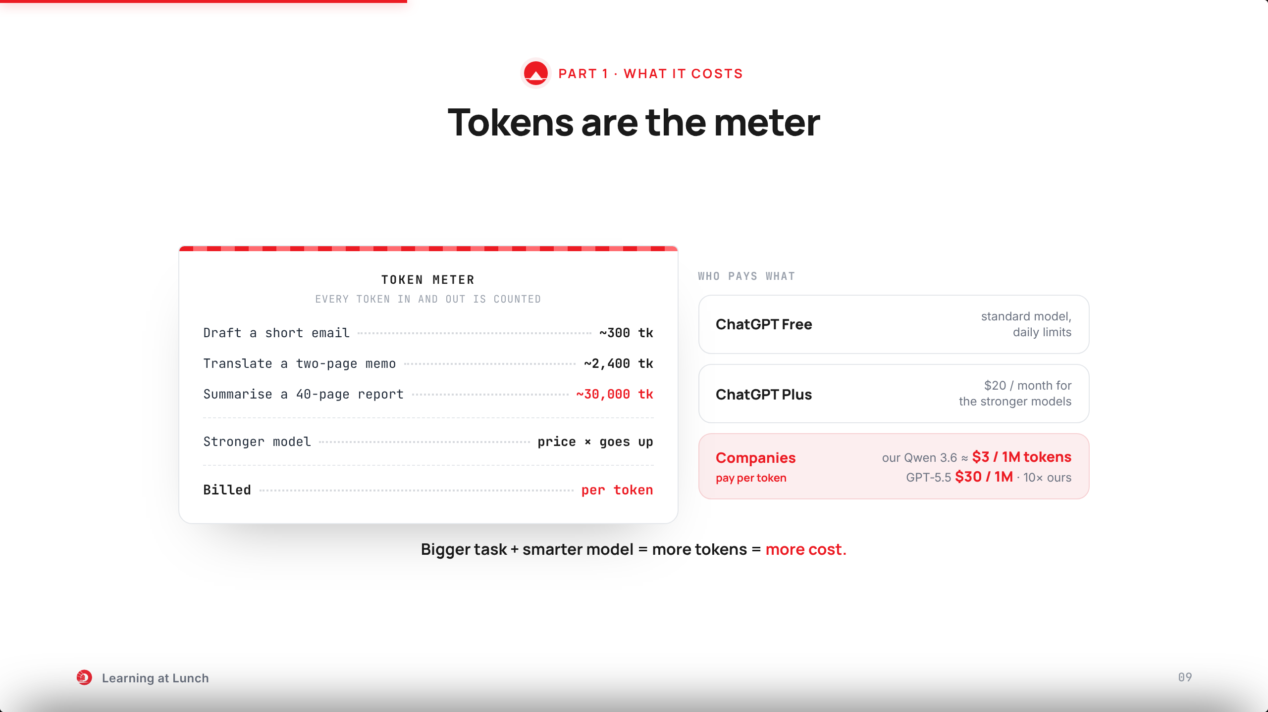
Notes:
Every token in and out gets counted. Tokens are the meter.
Read the receipt: a short email is a few hundred tokens. A 40-page report is tens of thousands.
For consumers it is a subscription: free, or 20 dollars a month for ChatGPT Plus.
For companies it is per token. Our self-hosted Qwen 3.6 works out around 3 dollars per million tokens, mostly the GPU hosting cost. GPT-5.5, the best GPT today, charges 30 dollars per million output tokens. Ten times ours.
That is why the bank sizes the model to the task. Nothing for you to do. Just know AI has a price tag.

Slide 10
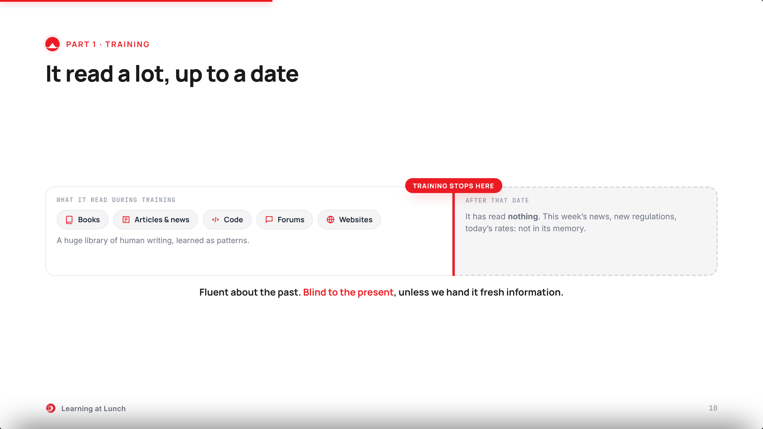
Notes:
It learned by reading books, articles, code and forums. A huge library.
Training stops at a date. After that date, the model has read nothing.
Ask about last week and it may guess. Fluent about the past, blind to the present.
Remember this. Part 2 shows how tools feed it fresh information.

Slide 11
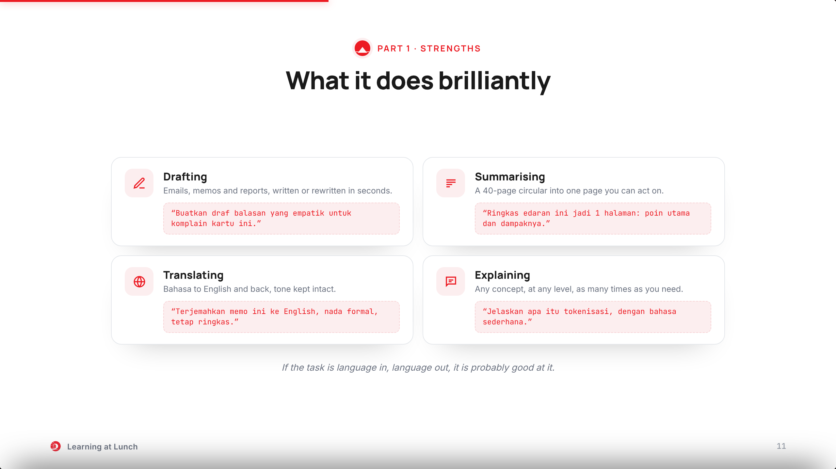
Notes:
Good news first. Anything shaped like language work, it does well.
Four everyday wins: draft, summarise, translate, explain.
Each card carries a starter prompt you can copy this afternoon.
If the task is language in, language out, it is probably good at it.

Slide 12
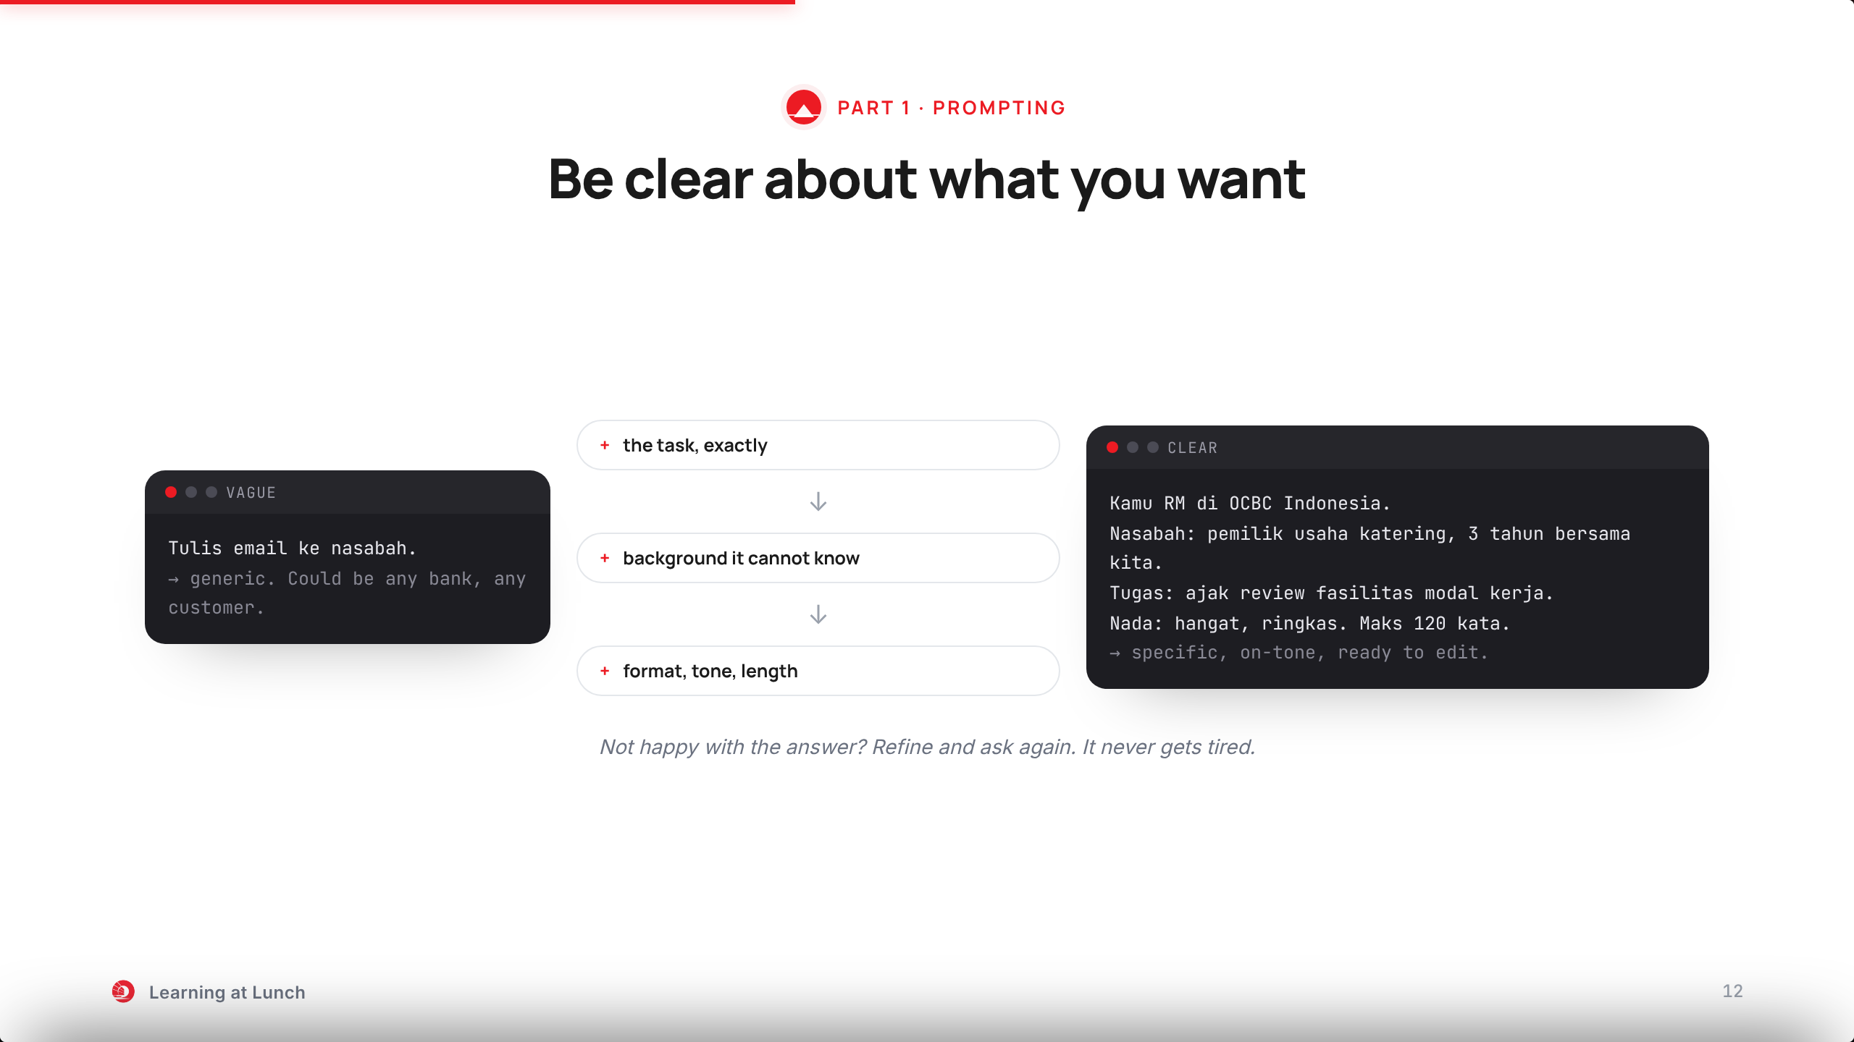
Notes:
Before the tools: how to ask well. Clarity beats everything.
Watch the transformation. The vague prompt becomes a clear one by adding three things.
The task, exactly. The background it cannot know. The format, tone and length.
Not happy with the answer? Refine and ask again. It never gets tired.

Slide 13
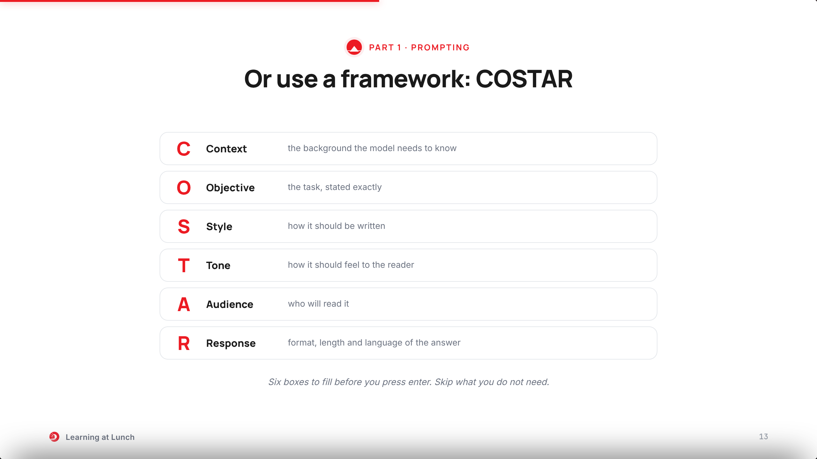
Notes:
Or use a framework. The one I like is COSTAR.
Read it down the left edge: Context, Objective, Style, Tone, Audience, Response.
Six boxes to fill before you press enter. Skip what you do not need.
Next slide: a real one, filled in.

Slide 14
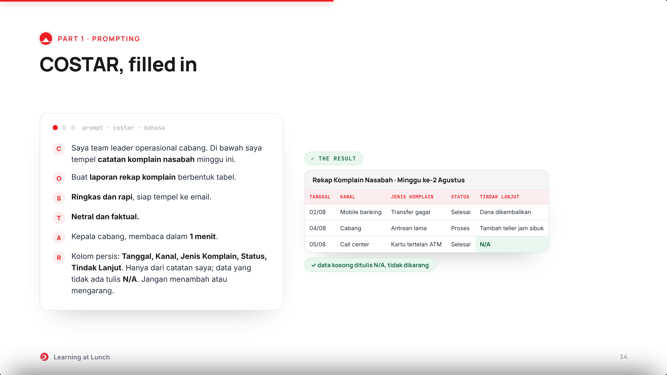
Notes:
New scenario: generating a report. This is where unwanted extras and hallucination hurt, so we fence them in.
The R box does the heavy work: exact columns, only from my notes, N/A for missing data. No adding, no inventing.
Right: the table it produced. Five columns as ordered, and look at the last row: N/A instead of a made-up answer.
Specify the shape and the rules, and you get the report you wanted. Copy this shape.

Slide 15
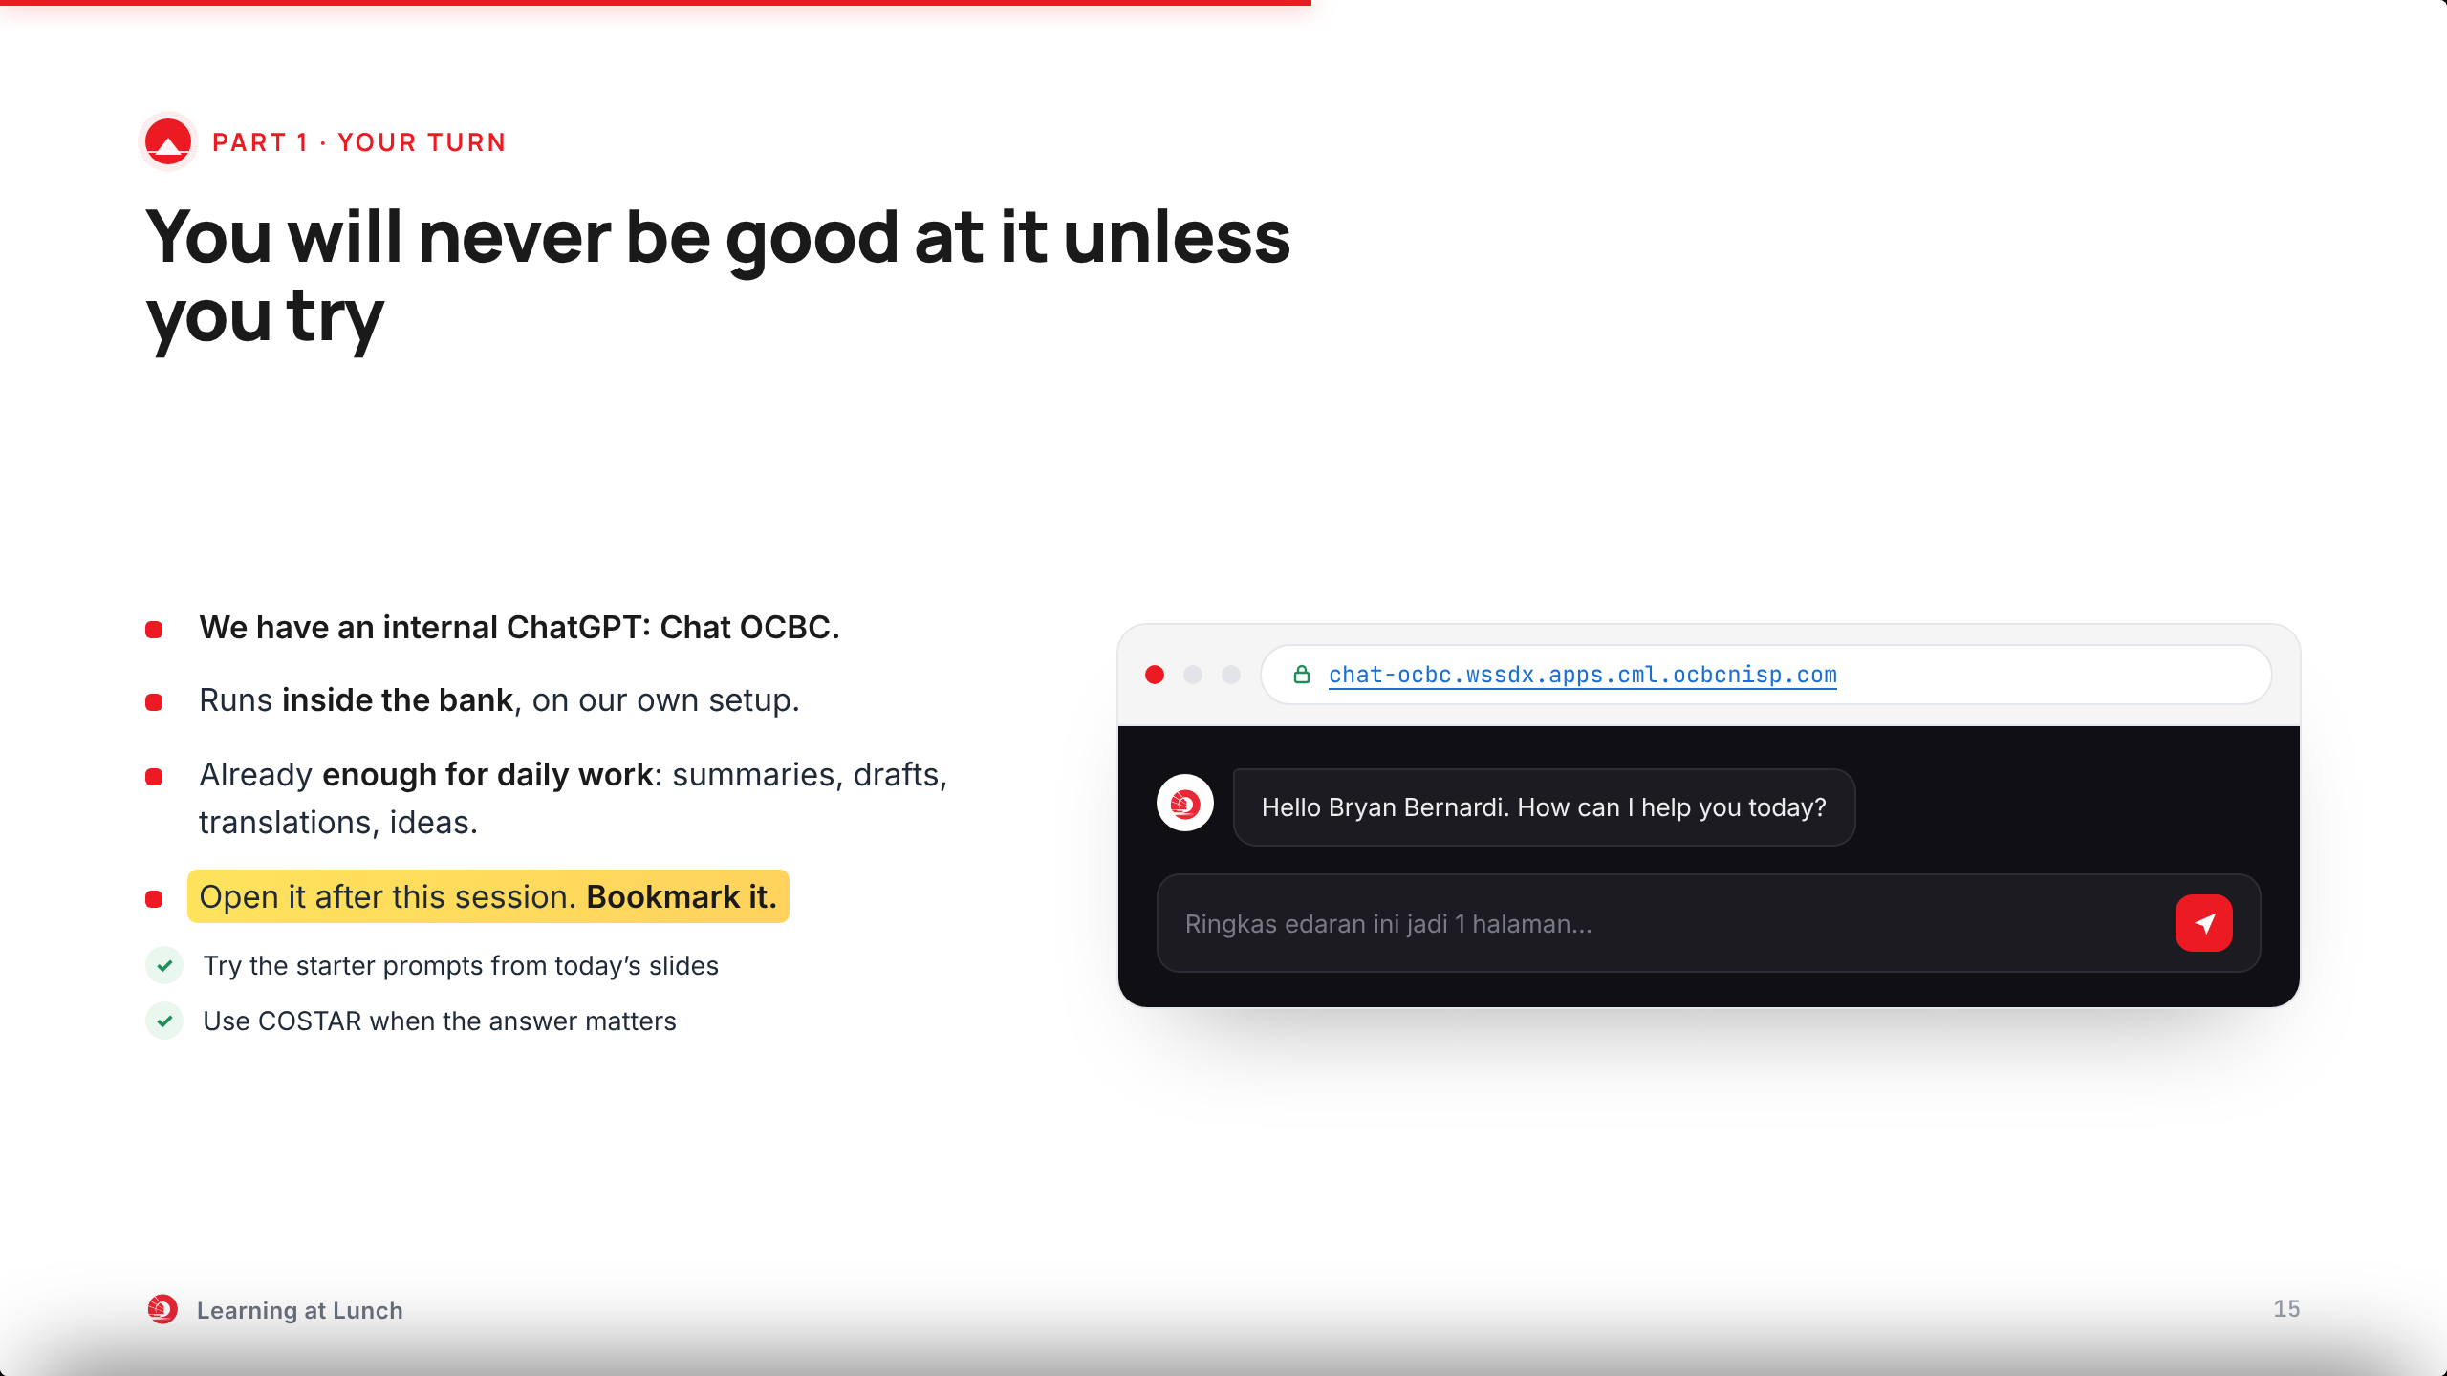
Notes:
One more thing before the tools: practice. You will never be good at this unless you try.
We have our own internal ChatGPT: Chat OCBC. It runs inside the bank, on our Qwen.
For daily work it is already enough: summaries, drafts, translations, explanations, ideas.
Open it after this session. Try the starter prompts from today. Bookmark it: this is your training ground.

Slide 16
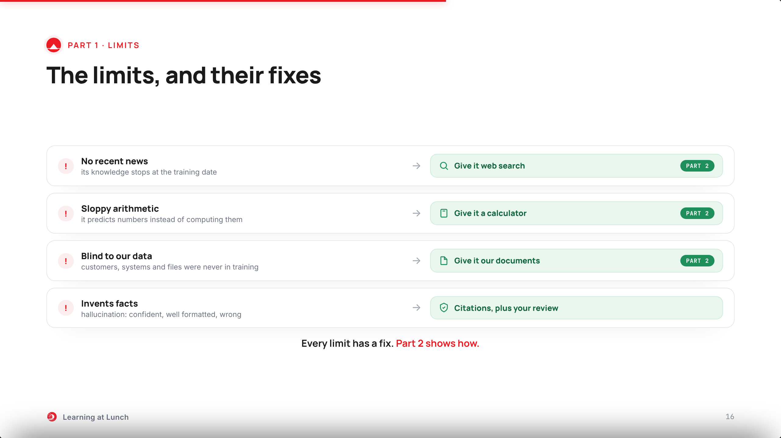
Notes:
Before part two, the honest part: the limits. Four big ones.
No news after its training date. Weak at exact math. Blind to our data. And it can invent facts with confidence, like citing an OJK rule that does not exist.
Key message: every limit has a fix, and most fixes are tools. Web search, a calculator, our documents.
That is Part 2. Let us go.

Slide 17
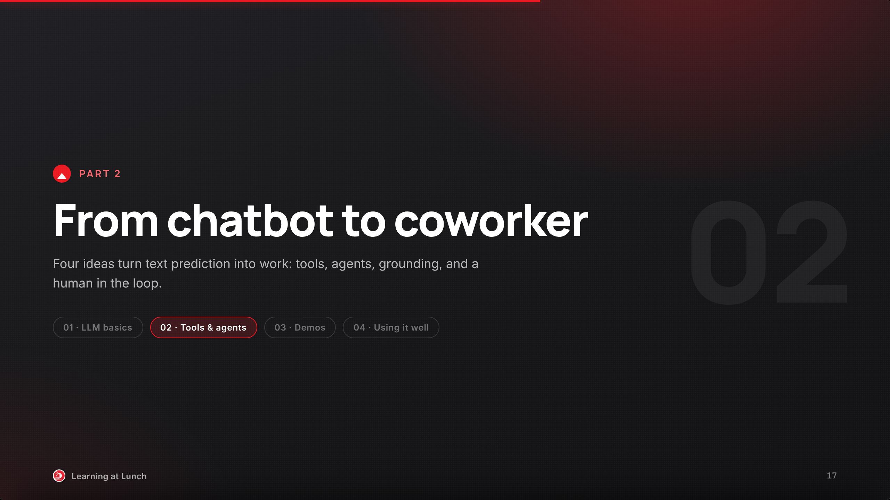
Notes:
Part two: the fixes we promised.
Four ideas: tools, agents, grounding, and a human in the loop.
Two of them you will watch run live in this part.
Every use case in part three runs on them too.

Slide 18
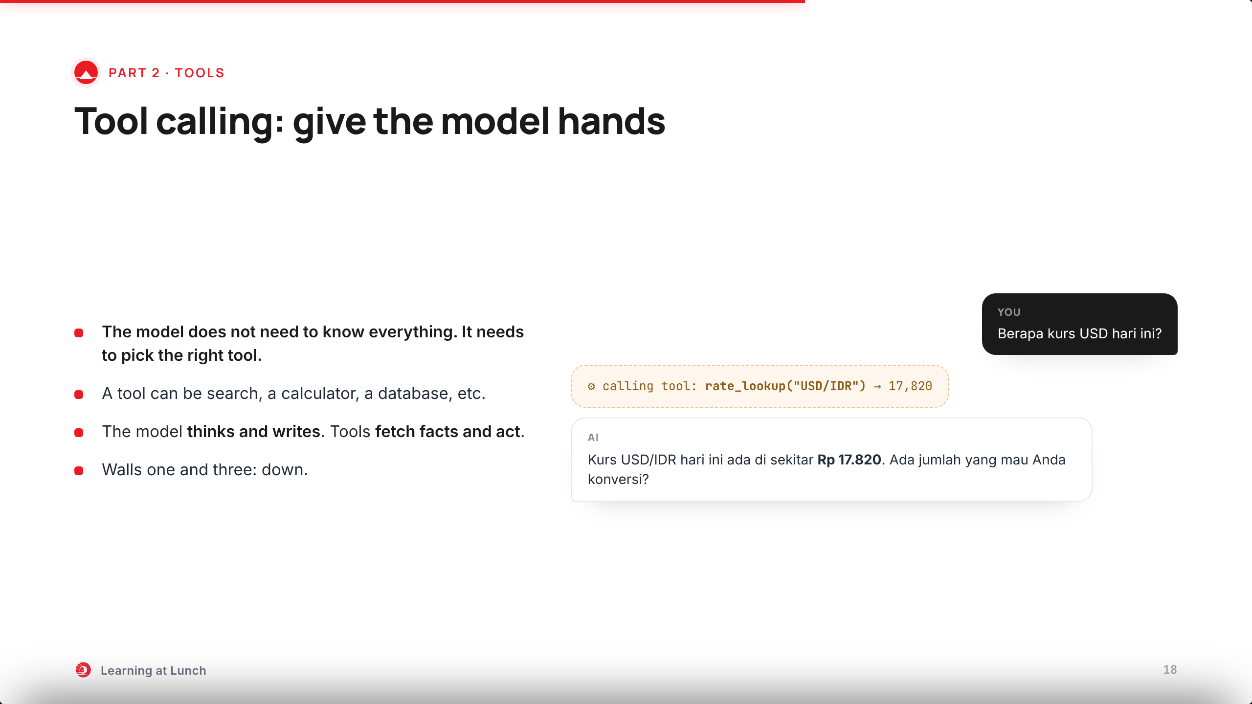
Notes:
Remember the fixes we promised on the limits slide: web search, a calculator, our documents. They are all the same idea: tools.
Ask for the dollar rate. The model knows its training data is stale, so it calls the rate tool and answers with the live number.
The model thinks and writes. Tools fetch facts and act.
This one idea powers every use case coming up.

Slide 19
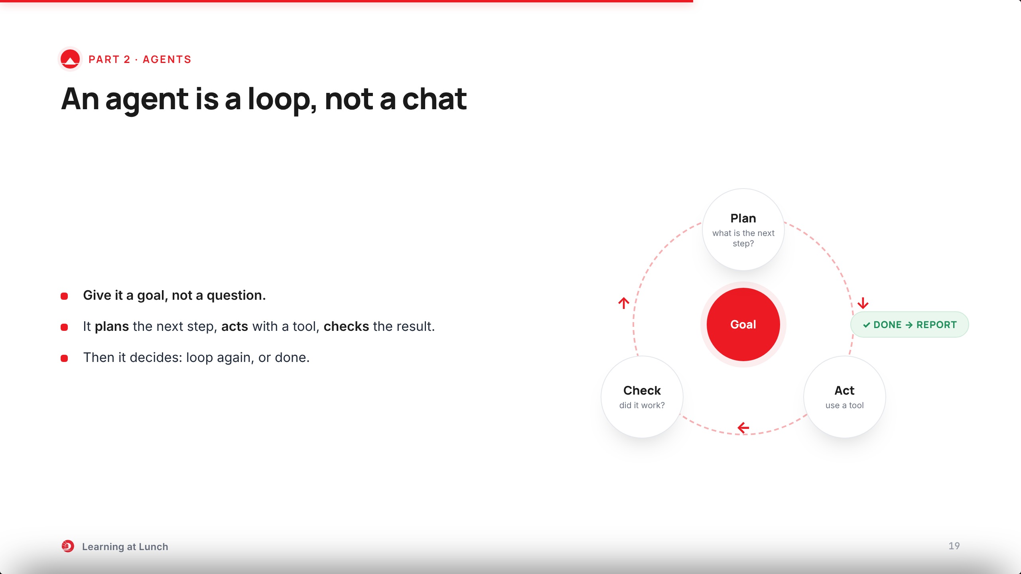
Notes:
An agent is an LLM in a loop: plan, act, check, repeat until done.
You give it a goal, not a question.
Watch it for real on the next slide.

Slide 20
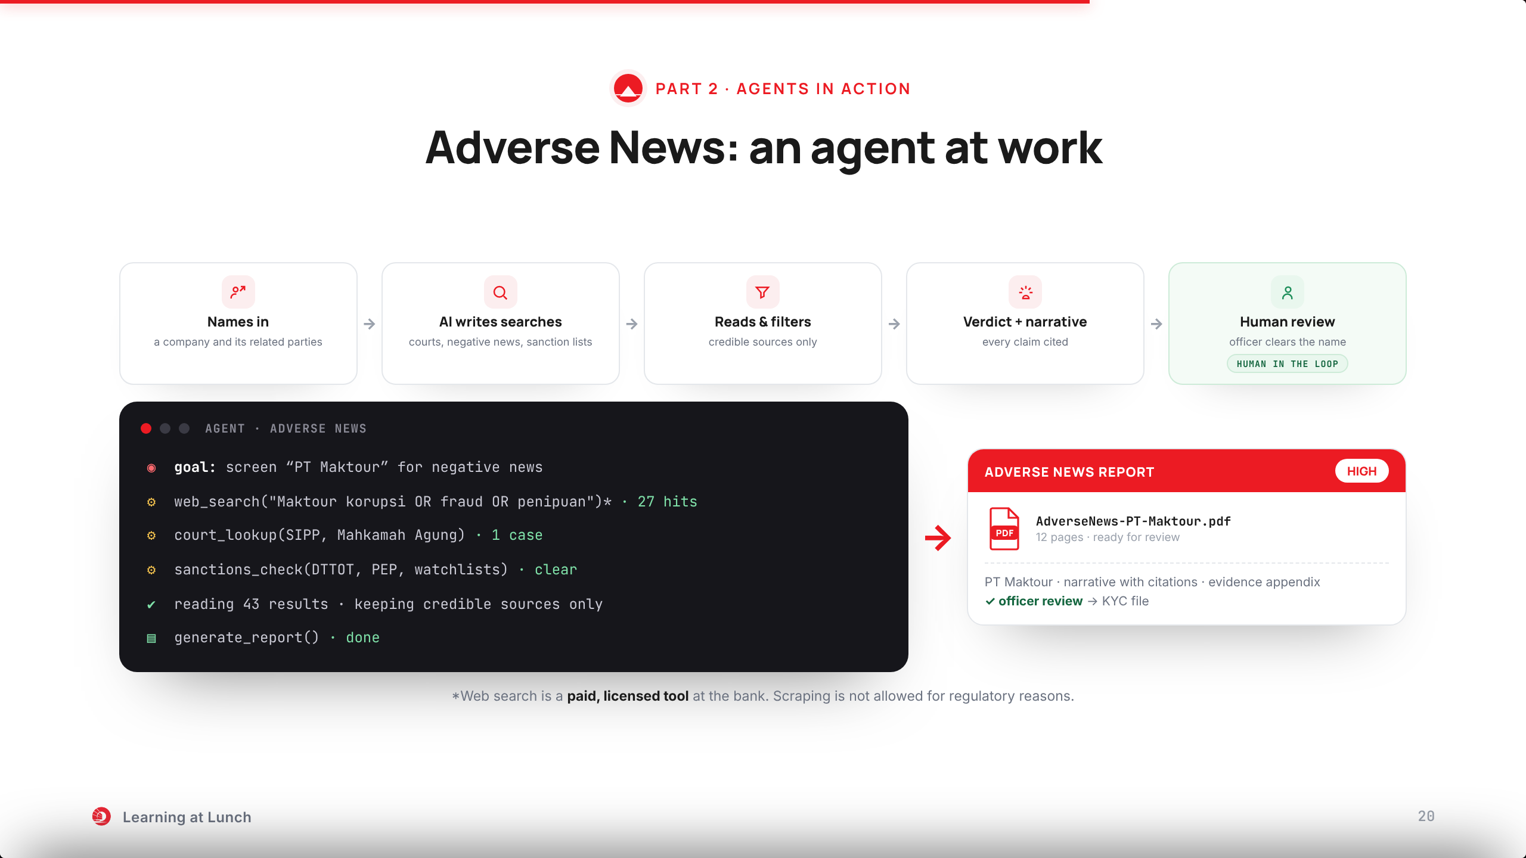
Notes:
Here is the agent loop for real. We added one tool: web search. A paid, licensed tool, because scraping is not allowed for regulatory reasons.
The flow on top: names in, the agent writes its searches, reads and filters, builds a verdict, and a human reviews at the end.
Now watch the console run. It calls the search tool, the court databases, the sanction lists. It reads 43 results and keeps credible sources only.
And when the loop is done, out comes the report: risk verdict, narrative with citations. The officer reviews it and it goes to the KYC file.
That is tool calling plus the loop. One goal in, one report out.

Slide 21
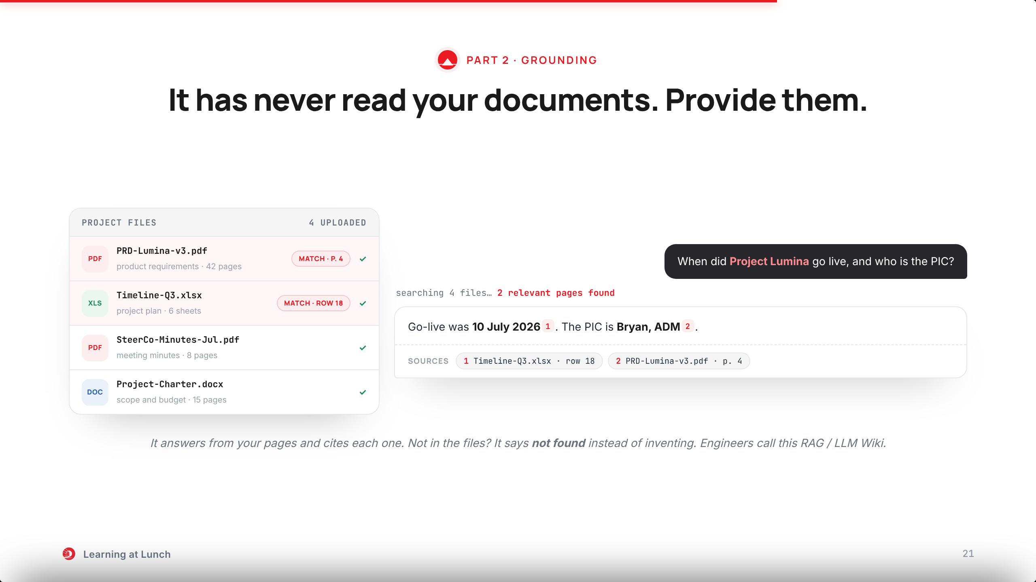
Notes:
Third idea: grounding. The model has never read our documents. So we provide them.
Upload the project files once: the PRD, the timeline, the minutes, the charter.
Then ask about a specific project, in plain words.
Watch the left panel: it finds the two files that matter and ignores the rest.
The answer is written from those pages, and every claim carries a citation you can click and check.
If the answer is not in the files, it says not found. No inventing.
LuminaLM, on the next slide, is exactly this, live in the bank.

Slide 22
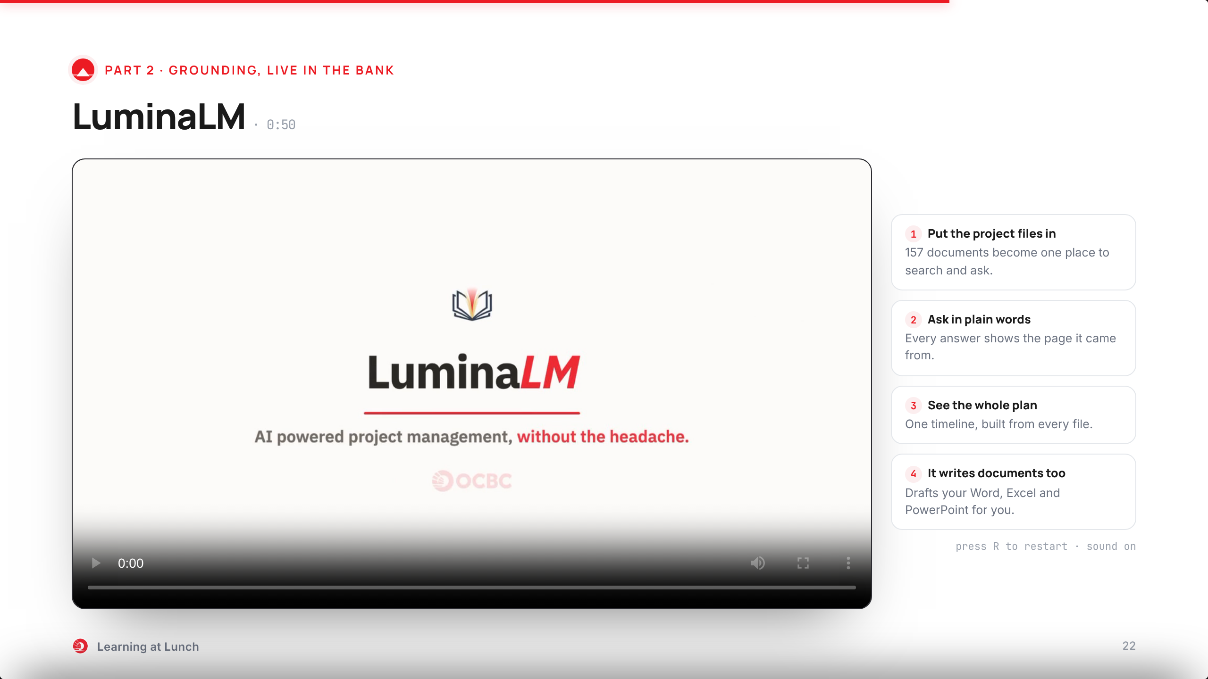
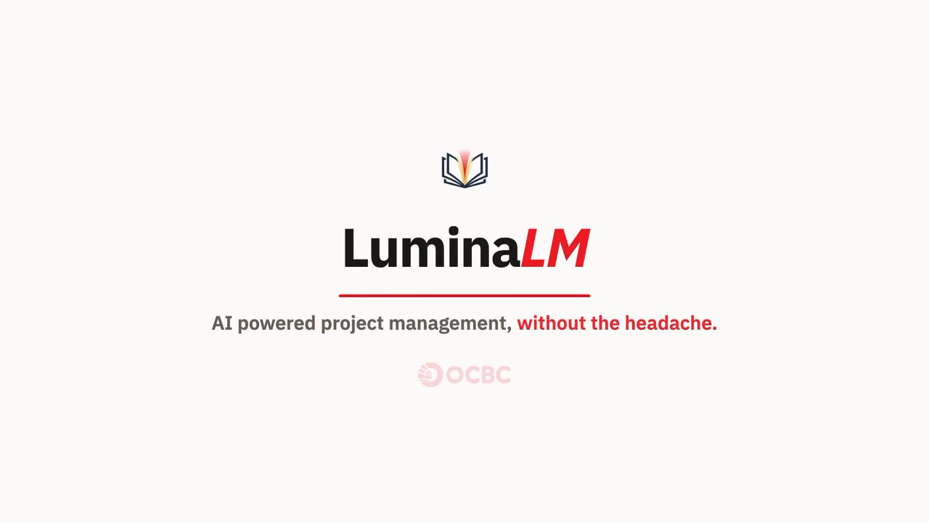
Notes:
And this is grounding live in the bank: LuminaLM, built here.
The pain: one project, 157 documents, and the answer always in a file you did not open.
Put the project files in once. They become one place you can search and ask.
Ask in plain words. Every answer shows the page it came from, exactly like the last slide.
If the answer is not in the files, it says so.
It also drafts documents for you: Word, Excel, PowerPoint.
Think of it as a colleague who read every document and never forgets a page.

Slide 23
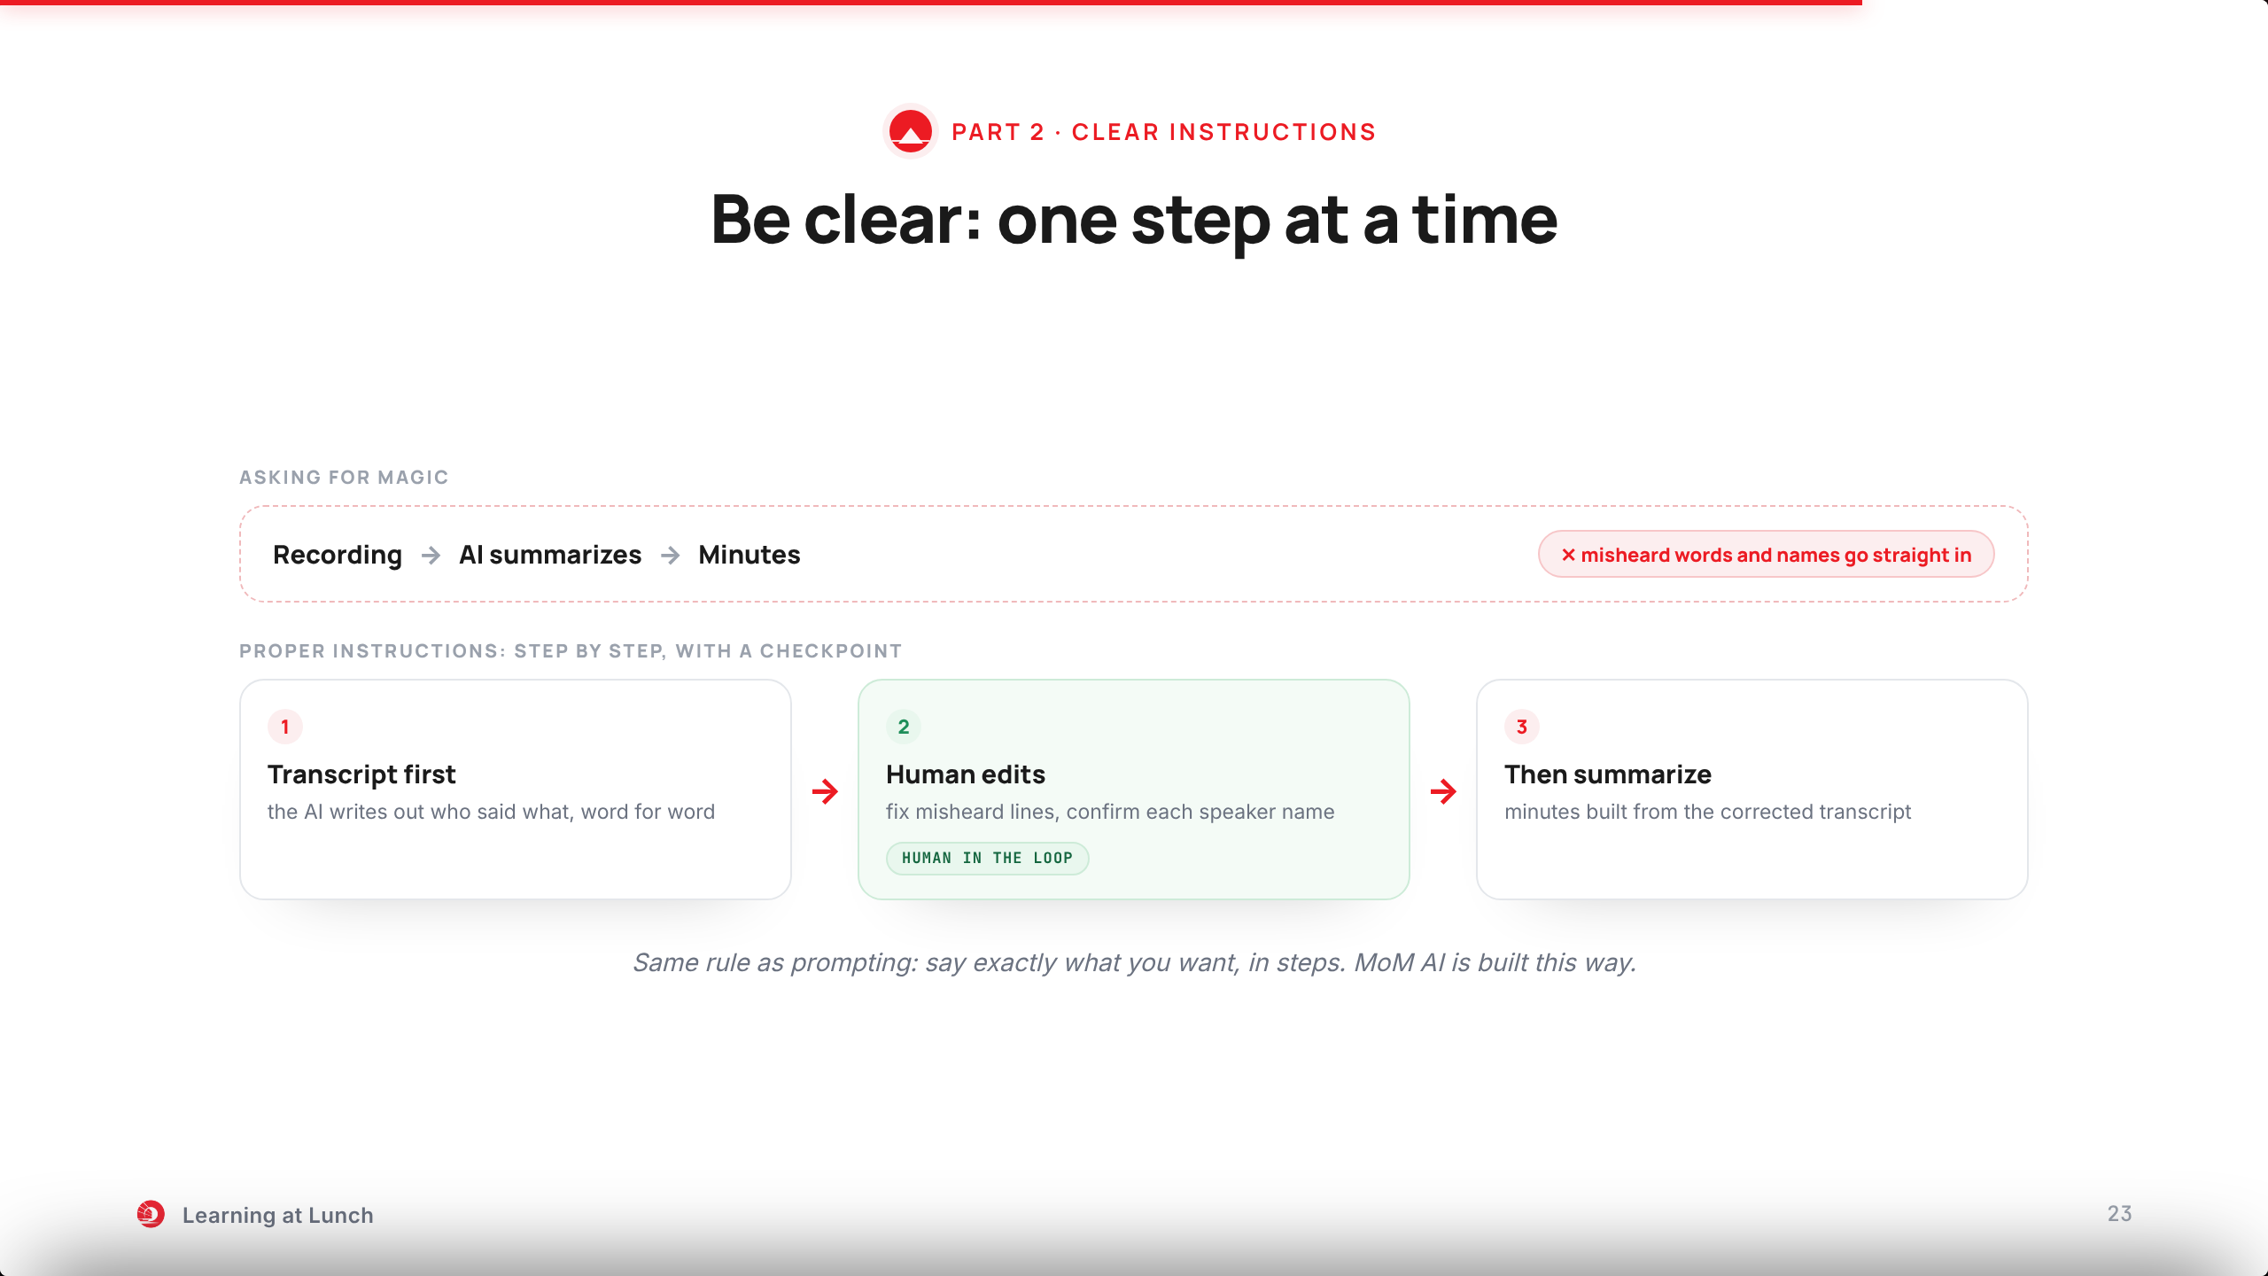
Notes:
Remember slide twelve: be clear about what you want. The same rule applies when AI runs a whole job, doubled.
The tempting way is one jump: recording in, minutes out. But then misheard words and wrong names go straight into the minutes.
So we give the agent proper instructions, step by step.
Step one: transcript first. The AI writes out who said what.
Step two: a human checkpoint. Fix misheard lines, confirm the speaker names.
Step three: only then summarize, from the corrected transcript.
That is exactly how MoM AI is built. Watch it work.

Slide 24
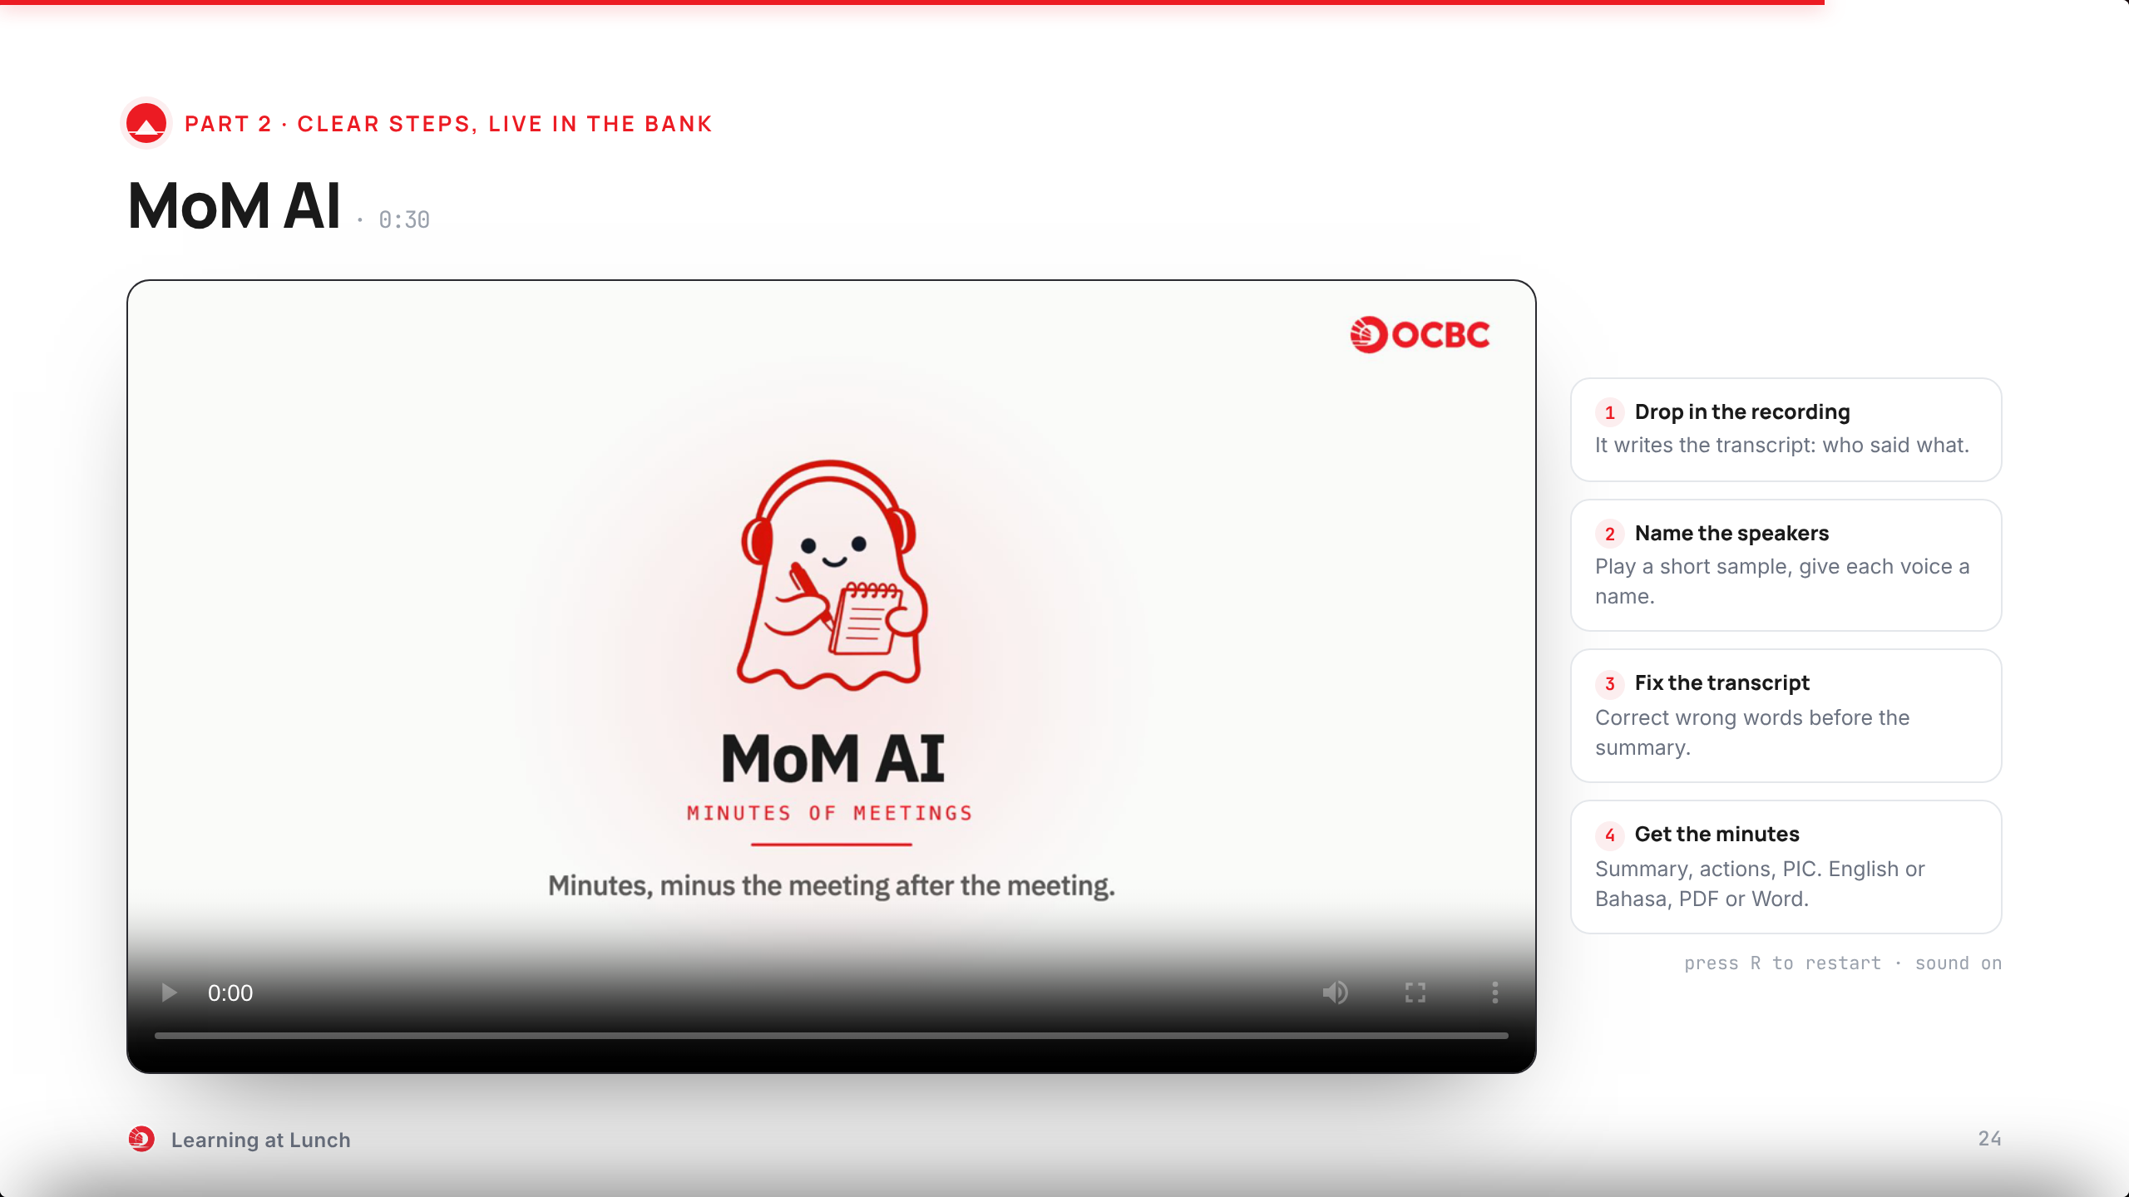
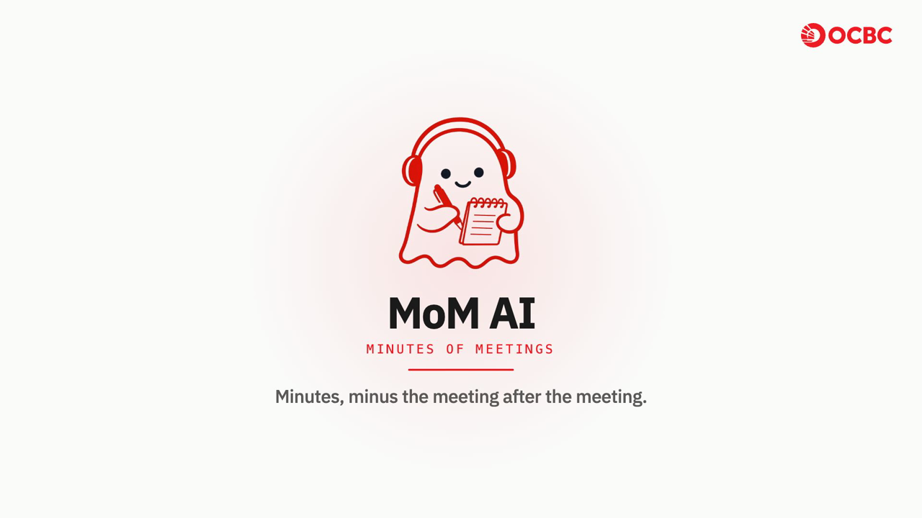
Notes:
This is that pipeline for real: MoM AI, built here.
Drop in the recording. It writes the transcript first: who said what.
Name the speakers from a short sample.
Fix the transcript where it misheard. Only then does it summarize.
Out come the minutes: summary, attendees, actions with a person in charge.
English or Bahasa. Export to PDF or Word.
Thirty minutes of typing becomes five minutes of checking.

Slide 25
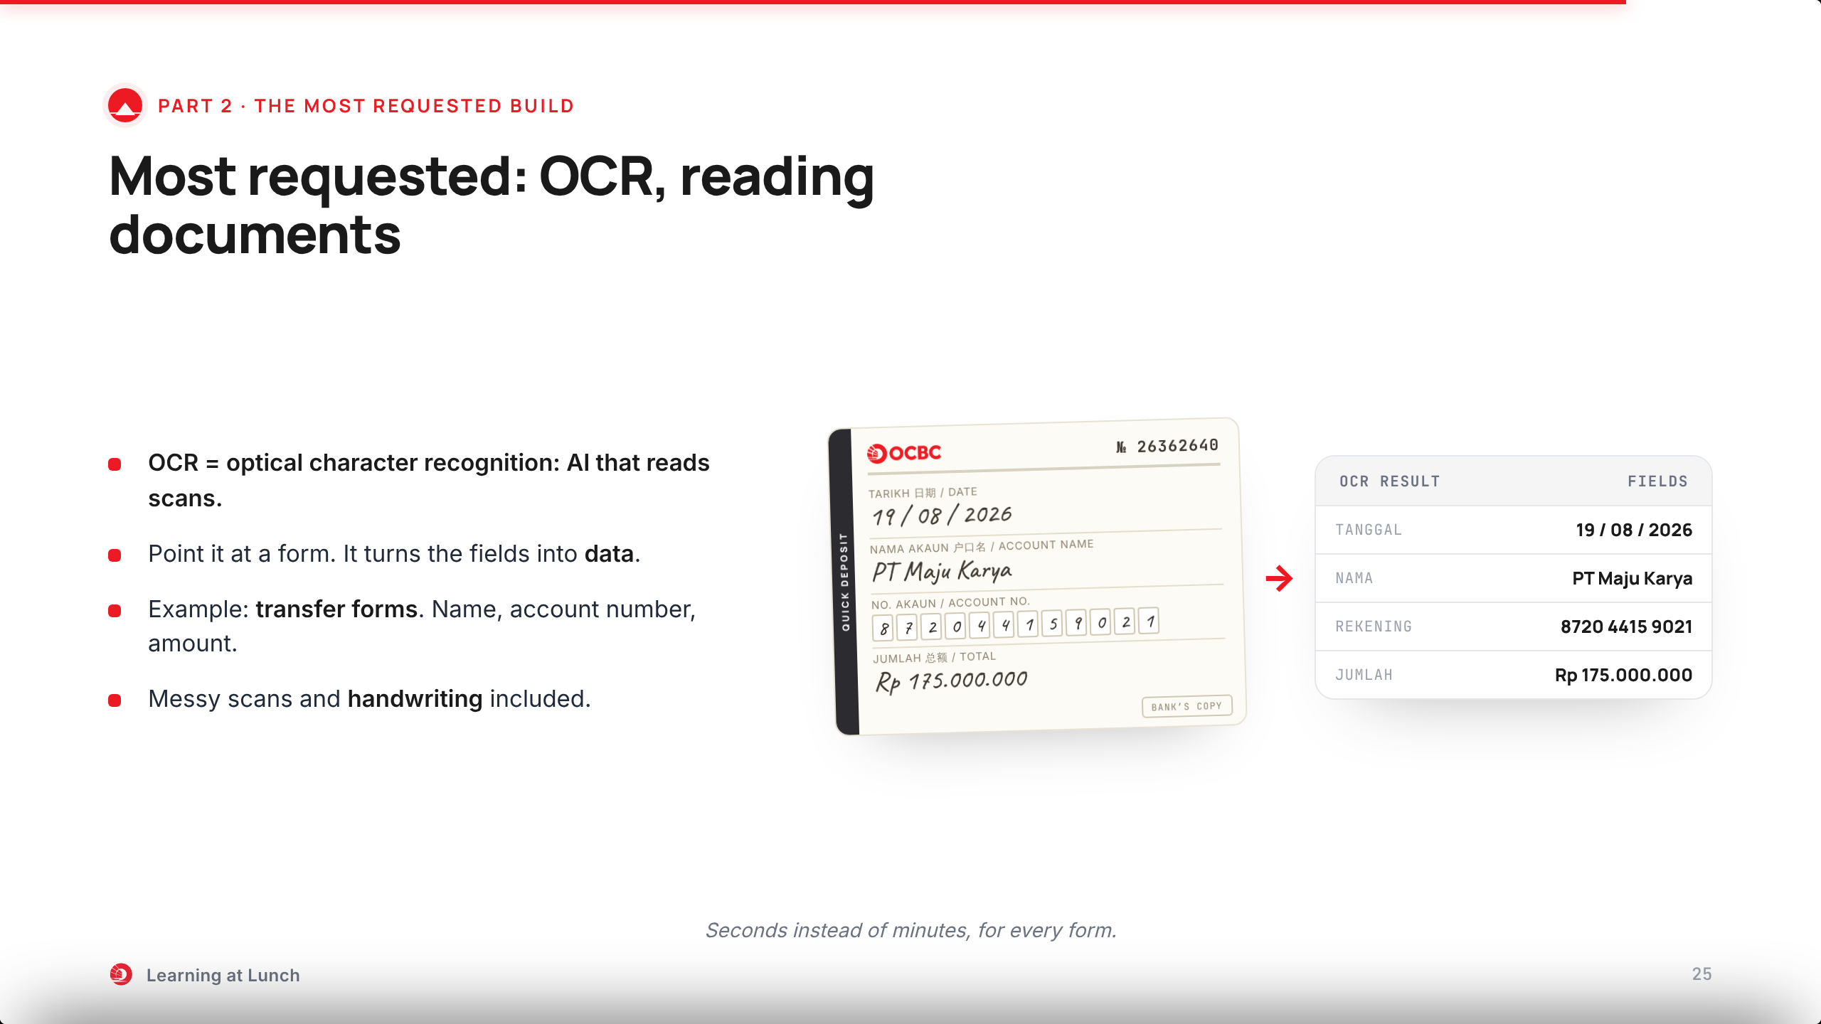
Notes:
One of our most requested projects: OCR, optical character recognition.
Point it at a scanned form and it reads the fields into data.
The example here: a deposit form. Name, account number, amount.
With an LLM behind it, even messy scans and handwriting become structured fields.
Fast. But fast is not the same as right. Hold that thought for the next slide.

Slide 26
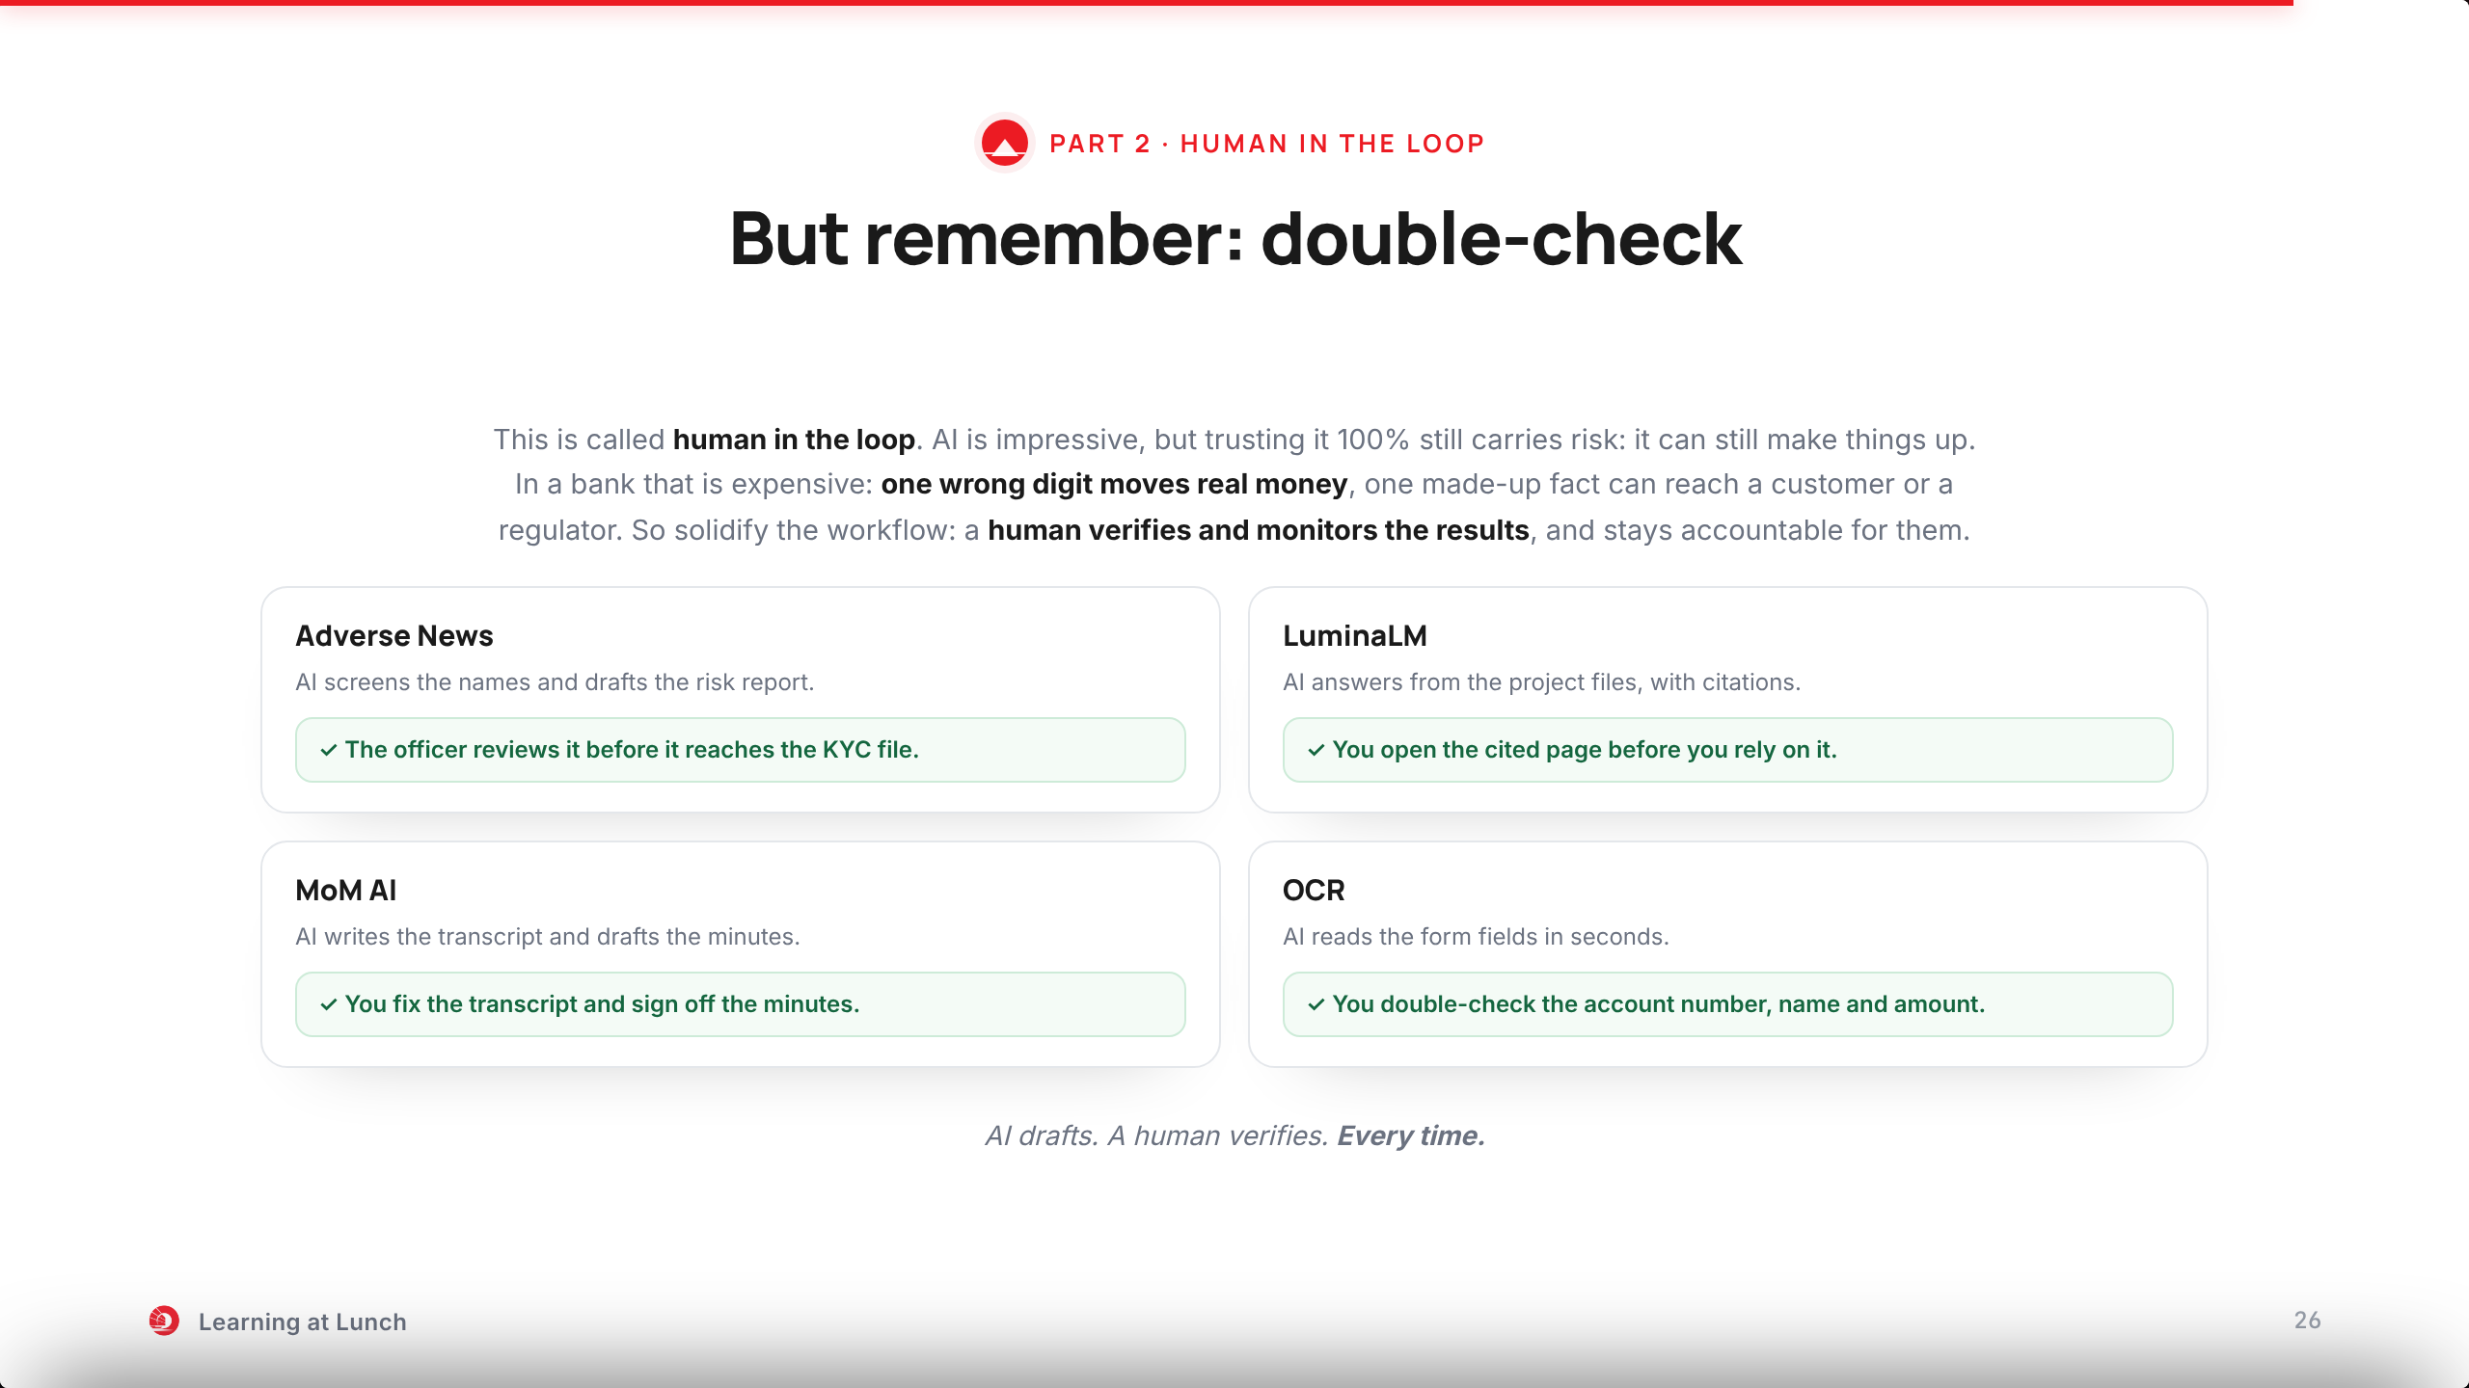
Notes:
But remember: double-check. This is called human in the loop.
AI is impressive, but trusting it one hundred percent still carries risk: it can still make things up with confidence.
Why it is crucial: in a bank a mistake is expensive. One wrong digit moves real money. One made-up fact can reach a customer or a regulator.
So solidify the workflow with a human in the loop: a person verifies and monitors the results, and stays accountable for them.
Every project you just saw has this checkpoint after the AI produces its result.
Adverse News: the officer reviews the report before it reaches the KYC file.
LuminaLM: you open the cited page before you rely on the answer.
MoM AI: you fix the transcript and sign off the minutes.
OCR: before anything moves, double-check the account number, the name, the amount.
AI drafts. A human verifies. Every time.

Slide 27
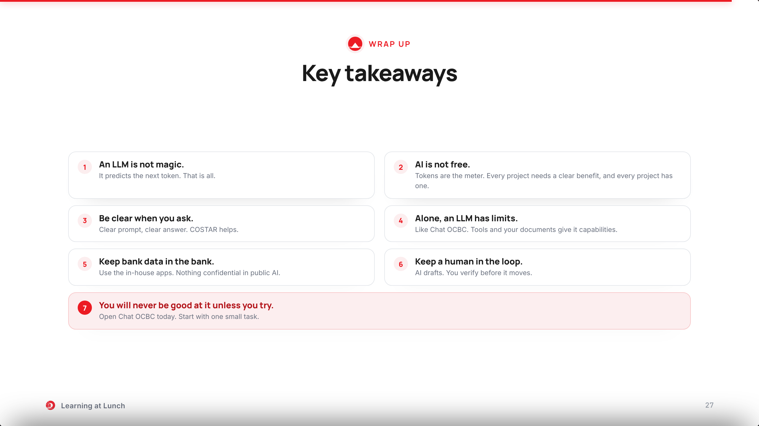
Notes:
Seven things to take home. Ninety seconds.
One: an LLM is not magic. It predicts the next token. That explains both the talents and the mistakes.
Two: AI is not free. Tokens are the meter. That is why every project we build needs a clear benefit, and every project has one.
Three: be clear when you ask. Clear prompt, clear answer. COSTAR helps.
Four: on its own, an LLM has limits, like Chat OCBC. Tools and your documents give it real capabilities.
Five: keep bank data inside the bank. Use the in-house apps.
Six: keep a human in the loop. AI drafts, you verify.
And seven, the one that matters most: you will never be good at it unless you try. Open Chat OCBC today.

Slide 28
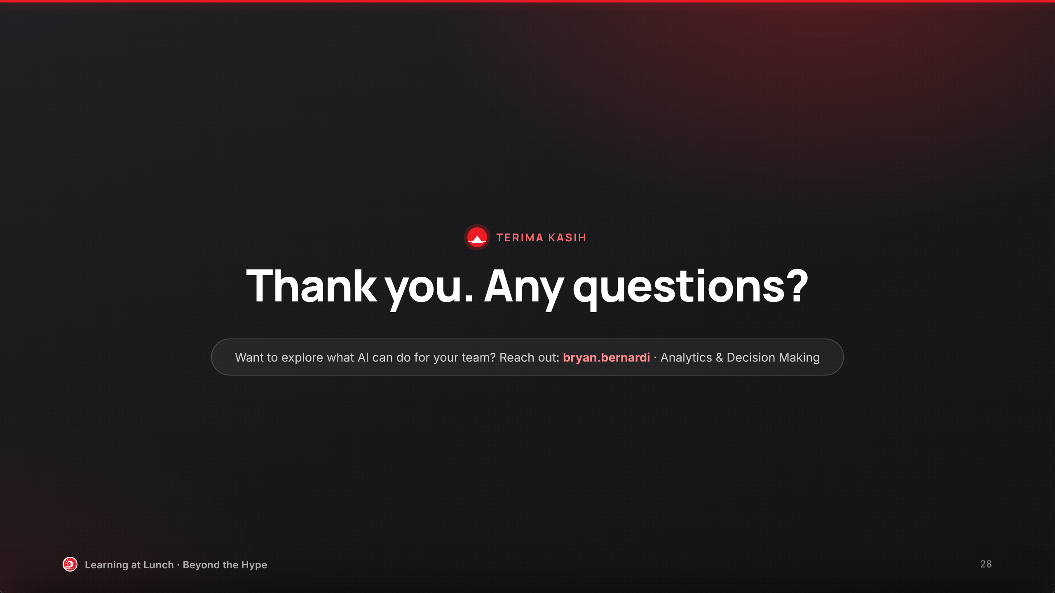
Notes:
Terima kasih. That is the whole story: how an LLM works, and what it already does in this bank.
Any questions? The chat is open too.
And if you want to explore what AI can do for your team, reach out to me: bryan.bernardi. Always happy to talk.

