Slide 1
Mechanical field reconstruction from limited observations
Bahador Bahmani
bb2969@Columbia.edu

Slide 2
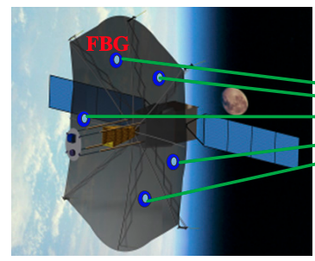

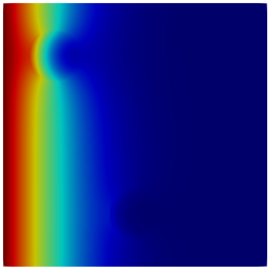
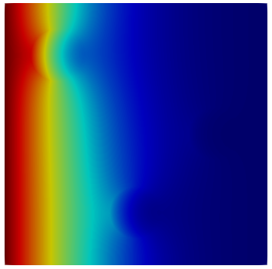

Motivation:
Fact:
Our experimental observations are limited by the number of sensors
Reason:
Cost or manufacture restriction
Efficient Sensor Placement Optimization for Shape Deformation Sensing of Antenna Structures with Fiber Bragg Grating Strain Sensors Jinzhu Zhou
Sometime we have a good prior knowledge about underlying physical phenomena! We know the governing PDE!
We can create many many admissible solutions using numerical solver.
Hypothesis: experimental observation is a linear combination of some of those admissible solutions
Real experiment
Admissible solutions from PDE solver
?

Slide 3
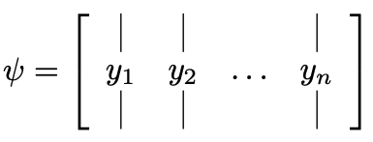
Problem statement:
Hypothesis:
Additional structure: unknown coefficient is sparse
Dictionary of solutions (or an appropriate transformation of admissible solutions)
Measurement matrix
Least square problem
Basis pursuit
LASSO

Slide 4
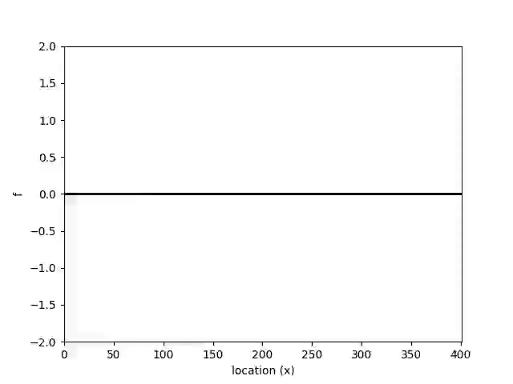
Toy problem 1: data generation
We generate 1000 snapshots for one period

Slide 5
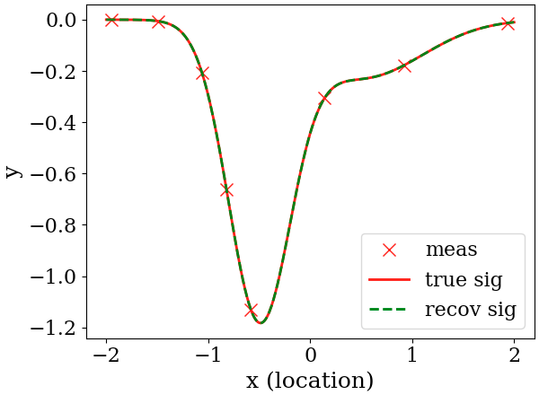
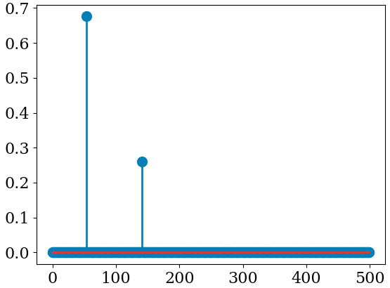
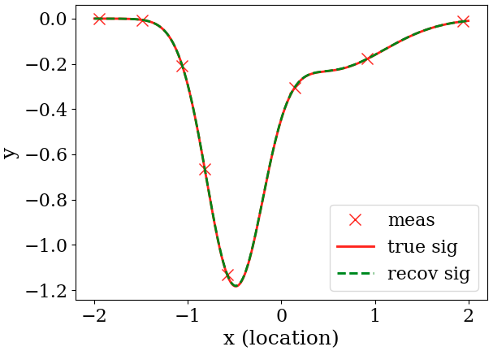
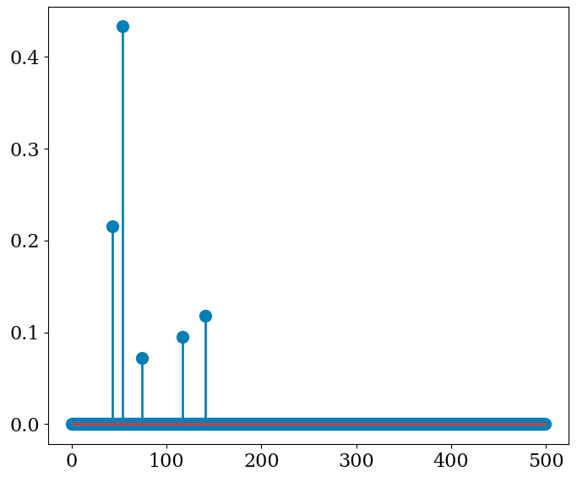
Toy problem 1:
Constructing data:
50% of data is randomly chosen as library
library is temporally normalized: zero mean unitary standard variation
We choose test measurements from data not included in library
Reconstruction error:1.06e-06
Basis pursuit
lambda = .01
Reconstruction error:0.002
LASSO

Slide 6
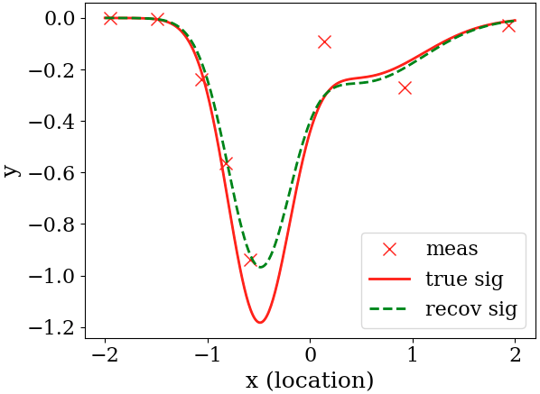
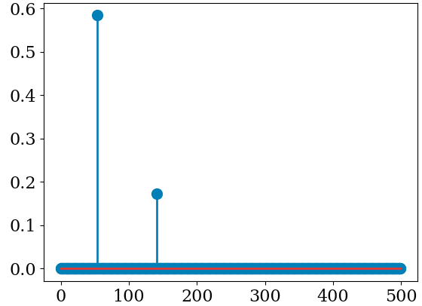
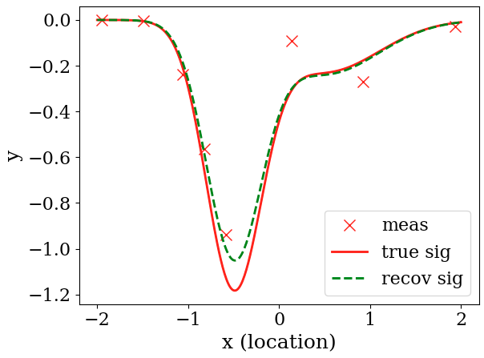
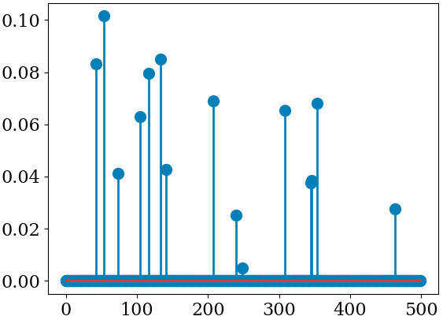
Toy problem 1: noisy measurements
The minimum possible of Epsilon was 0.7
Basis pursuit
Reconstruction Error: 0.17
lambda = 0.005
LASSO
Reconstruction Error: 0.1

Slide 7
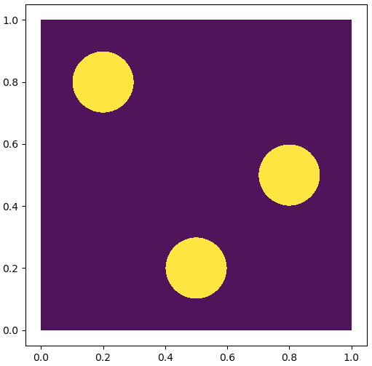
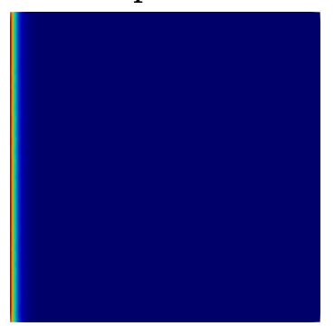
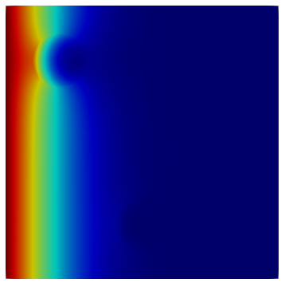
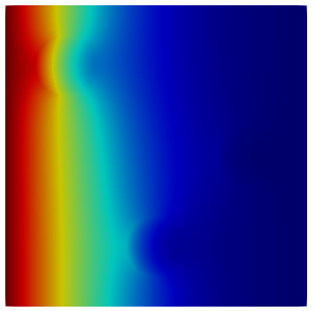
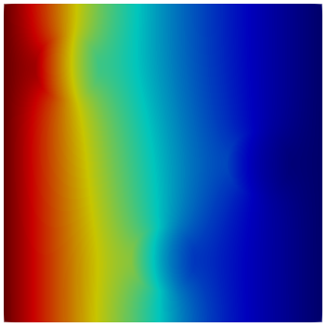
Toy problem 2: heat transfer in heterogenous material
Fixed temperature to 0
Governing equation: parabolic PDE
Fixed temperature to 1
We solve the above problem with finite element solver

Slide 8


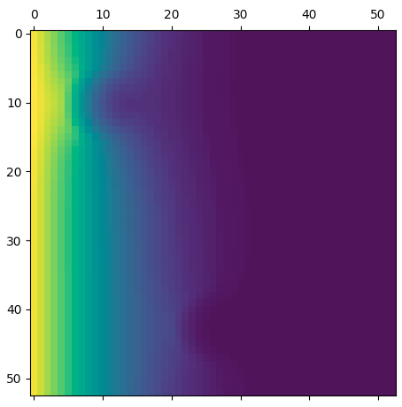
Toy problem 2: Data preparation
0-field solution from FEM
Computational domain has a graph structure
1- we binarized the solution
To be as close as possible to experimental
conditions!
2- Down sampled and crop

Slide 9
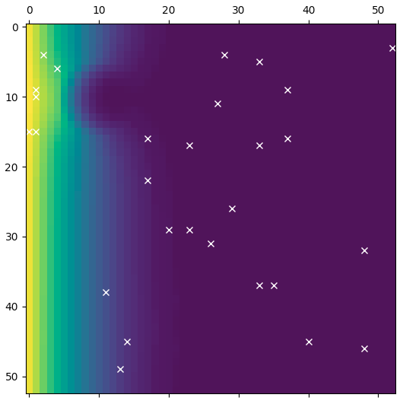
Toy problem 2: Data preparation
we record 300 snapshots from beginning to the steady state condition
240 random snapshots are used to construct the library
For reconstruction we select from those data not presented in the library
Just 2% of measurements

Slide 10
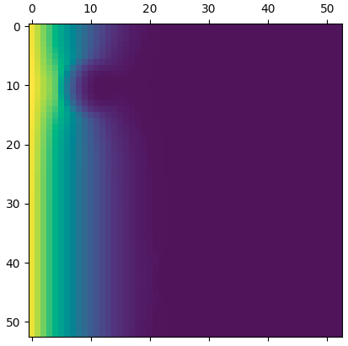
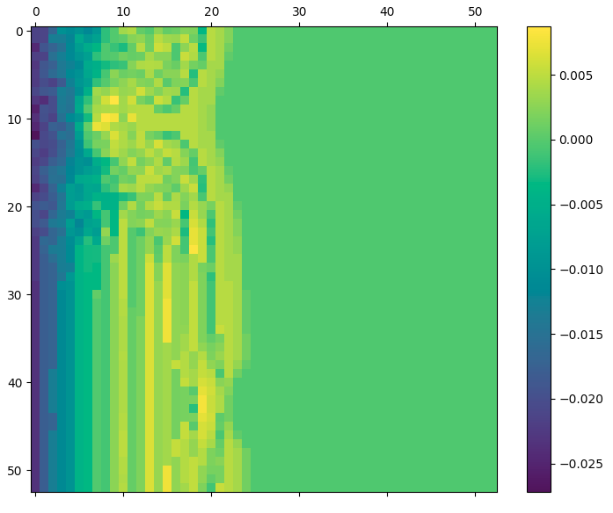
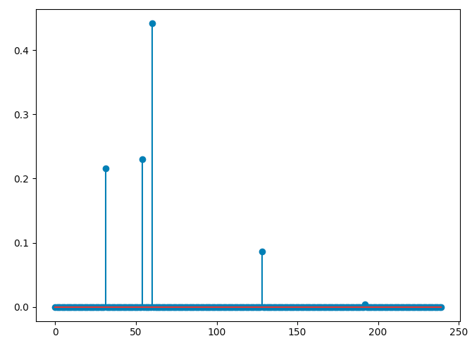
Toy problem 2: LASSO reconstruction without noise
Ground truth
Reconstructed
Error
Recovered atoms

Slide 11
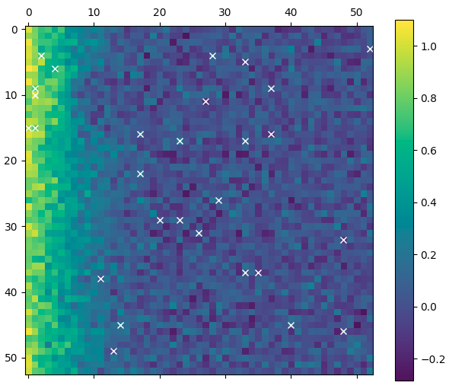
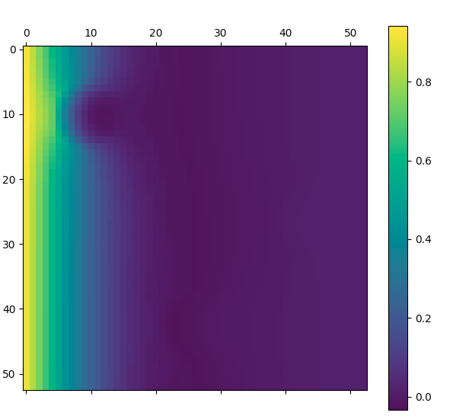
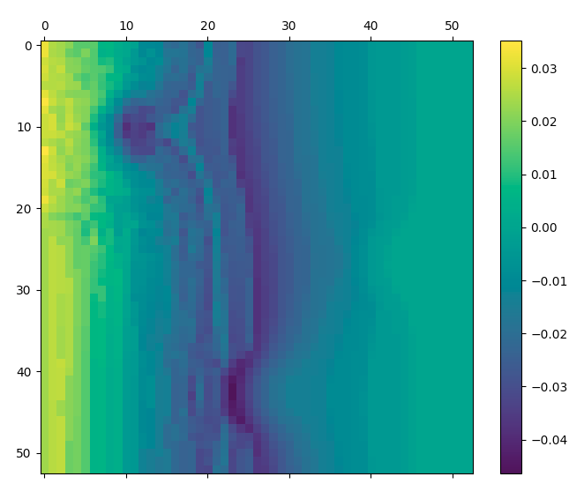
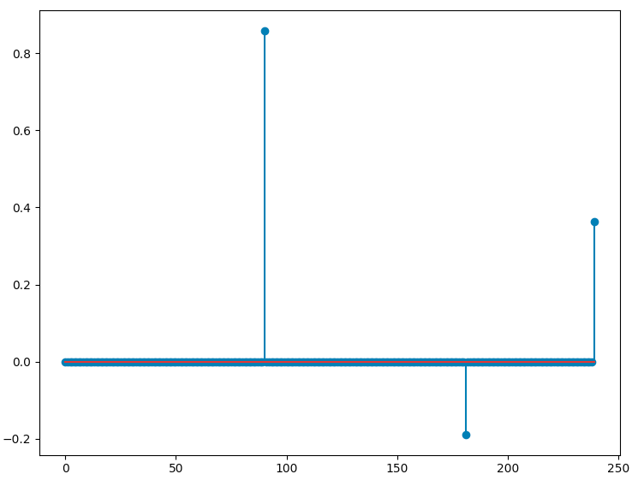
Toy problem 2: LASSO reconstruction without noisy measurement
Noisy measurement
Ground truth
Recovered atoms
Reconstructed
Error

Slide 12
Conclusion:
We empirically show dictionary learning is a reasonable approach for flied reconstruction from
Few measurements even in noisy conditions.
It seems sparse learning can help a lot experimental and computational area of mechanics/material modeling

Slide 13
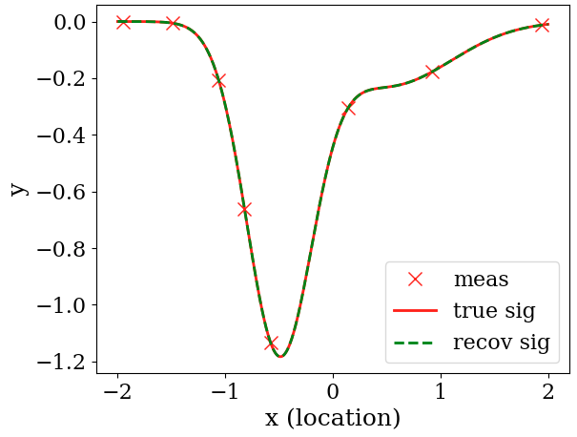
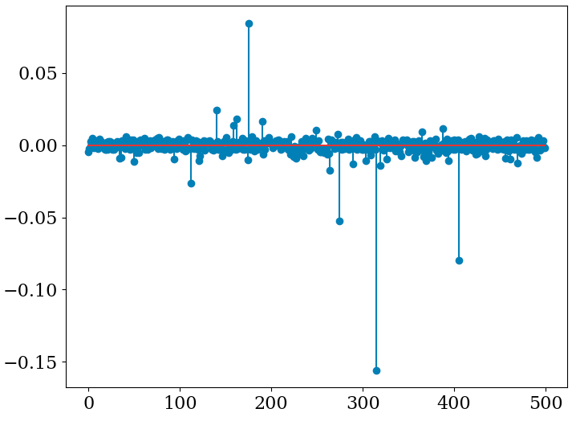
Toy problem 1:
Constructing data:
50% of data is randomly chosen as library
library is temporally normalized: zero mean unitary standard variation
We choose test measurements from data not included in library
Reconstruction error: 5.605518633572185e-15
L2 solution
L1 solution
Reconstruction error:1.0673072250676275e-06
lamda = .01
LASSO solution
Reconstruction error:0.002015971351983264

Slide 14
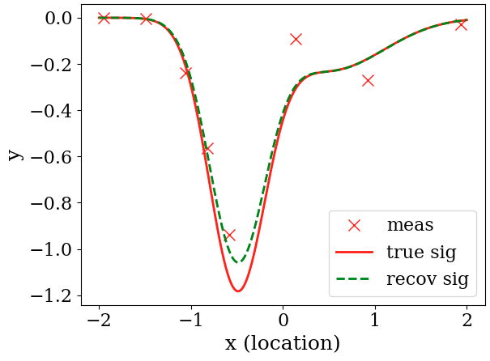
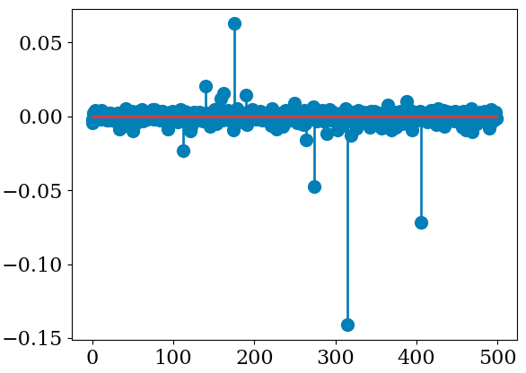
Toy problem 1: noisy measurements
Reconstruction Error: 0.09860999176138388
L2
The minimum possible of Epsilon was 0.7
L1
Reconstruction Error: 0.16966901383199118
lambda = 0.005
LASSO
Reconstruction Error: 0.10372515231840763

