Slide 1

TesseraApp
FINAL PRESENTATION · CPSC 69100 MASTER'S PROJECT
Build or Buy? A Hybrid, Zero-Trust CIAM Platform
Customer identity & access management on Angular 21 and Spring Boot 4 — secure access, by design.
PRESENTERS
ADVISOR
DATE
Robert C. Oliver, Jr. · Travis L. Lester
Prof. Larry Motuzis · Lewis University
2026
Notes:
[TIMING] ~0:30 · running to 0:30 of ~18 min. || Open: 'This is TesseraApp, a full-stack customer and invoice platform I built for my master's project. Today we walk through the system and then demo it live.' Introduce both presenters by name. Keep it to two sentences and move on — don't linger on the title.

Slide 2




TesseraApp
01
THE PROBLEM
Identity is the new perimeter — and the hardest thing to get right.
Stolen credentials are among the most common and slowest-to-contain breaches; the average breach now costs $4.88M.
Commercial CIAM is priced per monthly active user — a tax on the very growth a startup is chasing.
A fully in-house build adds credential friction and loses single sign-on. Neither pole is ideal.
Should an organization build or buy its identity system? TesseraApp is a working answer: a hybrid that does both.
Notes:
[TIMING] ~0:50 · running to ~1:20. || Frame the tension the whole project resolves: rolling your own auth is where most security bugs live, but buying it has its own costs — per-MAU pricing and lost control. Land the build-vs-buy question out loud; don't answer it yet, that's the payoff later.

Slide 3
TesseraApp
02
OBJECTIVES
What we set out to build
1
A production-style authentication core: JWT, refresh-session rotation, MFA, federation.
2
Permission-based role access control with organization scoping.
3
A complete administrative console and user self-service experience.
4
A real business domain — customers & invoices — to secure.
5
Auditability of every security-relevant action.
Notes:
[TIMING] ~0:40 · running to ~2:00. || The five objectives are the scorecard for the rest of the talk. Read them briskly — roughly one breath each — and promise the live demo will show every one of them working.

Slide 4


TesseraApp
03
LITERATURE · THE BUILD-VS-BUY SPECTRUM
Where TesseraApp sits
▶
▶
▶
Managed SaaS
Cloud / Enterprise
Open-source
In-house
Okta · Auth0 — per-MAU
Entra · Cognito · Ping · IBM
Keycloak — self-hosted
TesseraApp — hybrid
Keycloak proves a real market for self-hosted CIAM — control and data ownership, no per-MAU bill.
The gap: sovereign, predictable, production-grade identity at small scale — schools, startups, small business, non-profits.
Notes:
[TIMING] ~0:50 · running to ~2:50. || Position against the landscape left-to-right. Keycloak is the hinge — proof there's a real self-hosted market. TesseraApp sits at the far in-house end, but hybrid. Point at the diagram; do NOT read the vendor list aloud. (Trim this slide first if you're short on time.)

Slide 5



TesseraApp
04
BACKGROUND
Why CIAM, and why hybrid tokens
CIAM vs. traditional IAM: external, self-registering users at internet scale.
Zero-trust: never trust, always verify — every request re-validated, access revocable mid-session.
Stateless JWT scales but can't revoke; stateful sessions revoke but don't scale — TesseraApp uses a hybrid of both.
Notes:
[TIMING] ~0:40 · running to ~3:30. || The core idea in one line: zero-trust needs revocability; pure JWT can't revoke, pure sessions don't scale; a hybrid of both resolves it. Plant this seed — the security-model slides (9–11) pay it off.

Slide 6




TesseraApp
05
REQUIREMENTS · SRS HIGHLIGHTS (IEEE 830)
Scope in one glance
Access
MFA & SSO
Registration, email verification, login, logout, password reset.
Authenticator app (TOTP) + SMS; federated login via OAuth2 / OIDC.
RBAC
Audit & sessions
Seven-role permission control; organization-scoped administration.
Full audit logging; per-device session management.
Notes:
[TIMING] ~0:45 · running to ~4:15. || SRS in one glance — IEEE 830, numbered FR/NFR. Do NOT read every card. Say one line per card, then note that MFA and reuse detection were 'planned' stretch goals that actually shipped.

Slide 7



TesseraApp
06
ARCHITECTURE · THREE TIERS, ONE CONTRACT
A layered, stateless system
▶
▶
Angular 21 SPA
Spring Boot 4 API
MySQL 8
:4200 dev · JWT access + refresh
:8080 · Security 7 · JWT filter + RBAC
db2 · JdbcTemplate + JPA
Described through four architectural views plus scenarios:
Logical
Process
Development
Physical
+ Scenarios
Notes:
[TIMING] ~0:55 · running to ~5:10. || Walk the three-tier diagram left to right: Angular SPA, Spring Boot API, MySQL. Emphasize the API is stateless and only the refresh-session store is intentionally stateful. Name the 4+1 views on the chips.

Slide 8


TesseraApp
07
ANATOMY OF A REQUEST
Seven gates, every request
1 · Network edge / CORS
2 · JWT validity
3 · Brute-force gate
4 · Authentication
5 · URL authority
6 · Method @PreAuthorize
7 · Org scope
Any gate can reject outright; none trusts that the earlier ones did their job.
Every request is audited regardless of outcome — success or failure.
Notes:
[TIMING] ~0:50 · running to ~6:00. || Every request clears seven independent gates in order, none trusting that the earlier ones did their job — that's zero-trust in practice, not a buzzword. End on: every request is audited regardless of outcome.

Slide 9






TesseraApp
08
SECURITY MODEL · THE DIFFERENTIATOR
Stateless to scale, stateful to revoke
Access tokens
Refresh sessions
Reuse detection
Stateless, 30-min, HMAC-512, verified by signature — no DB hit per request.
5-day sliding, server-tracked, rotated on every use .
Replaying an old token revokes the whole family.
MFA
RBAC
Audit
Challenge-bound TOTP + SMS; single-use recovery codes.
Permission strings enforced at URL and method level.
Every security event written to an immutable trail.
Notes:
[TIMING] ~0:50 · running to ~6:50. || This is THE differentiator — slow down here. Stateless to scale, stateful to revoke. Walk each card briefly; the next two slides go deep on JWT and rotation, so don't over-explain yet.

Slide 10



TesseraApp
09
JWT · MINT, VERIFY, TRUST NOTHING TWICE
Two token types, one filter
Access (30 min): embeds the user's authorities — authorization needs no database lookup.
Refresh (5 days): deliberately carries no authorities, so it can never be used as an access token.
CustomAuthFilter checks signature, expiry, and that issued-at > passwordChangedAt — a password change instantly invalidates every token, every device.
Notes:
[TIMING] ~0:50 · running to ~7:40. || Both tokens are HMAC-512. Access carries authorities; refresh carries none — so a refresh token can never authenticate an API call. Land the passwordChangedAt point: one password change instantly invalidates every token, on every device.

Slide 11
TesseraApp
10
REFRESH TOKENS · ROTATE, DETECT, REVOKE
The piece I'm most proud of
▶
▶
▶
Login
Refresh
Replay jti₁
Family revoked
opens family, jti₁
supersede old, insert jti₂
superseded row returns
TOKEN_REUSE_DETECTED
Rotation is deliberately not transactional : the family revocation must commit, then throw — inside a transaction the throw would roll back the revocation, un-punishing the replay it just caught.
Notes:
[TIMING] ~0:50 · running to ~8:30. || Favourite slide — sell it. Family = one device session, rotated on every refresh. A replayed superseded token = theft → revoke the whole family + TOKEN_REUSE_DETECTED. The key design decision is commit-then-throw: never wrap it in a transaction or the throw rolls back the revocation.

Slide 12



TesseraApp
11
AUTHENTICATION · TWO WAYS IN, ONE FRONT DOOR
Every path mints the same JWT
TOTP
SMS
Federated
RFC 6238, in-house; ZXing only rasterizes the QR. Challenge-bound; recovery codes.
Twilio one-time code; TOTP takes precedence when both are enabled.
Google / GitHub / Microsoft via OAuth2 code flow; find-or-create, then our JWT.
Password, TOTP, or a federated provider — all converge on one token-issuance seam , so RBAC, MFA policy, and audit apply identically.
Notes:
[TIMING] ~0:35 · running to ~9:05. || Three ways in, one front door: TOTP in-house (RFC 6238) with challenge tokens, SMS via Twilio, and federated via OAuth2 — all converge on our own JWT. This connects to the federation demo (scenario 4).

Slide 13



TesseraApp
12
AUTHORIZATION · PERMISSION STRINGS, NOT ROLES
Seven roles, fine-grained permissions
One role per user, carrying a comma-separated permission string like READ:USER, UPDATE:CUSTOMER — split into Spring authorities and embedded in the token.
Enforced at both URL and method level (@PreAuthorize) so the two layers can never drift.
A user can never elevate their own role ; reassignment is admin-only and audited. Org admins are scoped to their own organization.
Notes:
[TIMING] ~0:35 · running to ~9:40. || Permission-string based, not naive roles. Ordering of URL matchers matters. Enforced at URL AND method level; no self-elevation; org admins are scoped to their own organization. (Trim this or slide 14 if short.)

Slide 14



TesseraApp
13
AUDIT · WITHOUT CLUTTERING THE REQUEST PATH
Everything is written down
Controllers publish a Spring application event; a separate listener writes the row — logging never sits on the hot path.
The same trail powers a brute-force gate (5 failures / 15 min → generic rejection).
Anti-enumeration across login, registration, and reset — the API never reveals whether an email exists.
Notes:
[TIMING] ~0:35 · running to ~10:15. || Event-driven audit off the hot path: controllers publish an event, a listener writes the row. The same trail powers the brute-force gate and anti-enumeration. Keep it brief.

Slide 15
TesseraApp
14
TECHNOLOGY STACK
Built on current, supported tools
FRONTEND
Angular 21, Bootstrap 5, RxJS
BACKEND
Spring Boot 4, Java 21, Spring Security 7
DATA
MySQL 8 — JdbcTemplate (identity) + JPA (business)
AUTH
JWT (HMAC-512), OAuth2 client, ZXing (TOTP QR), Twilio (SMS)
OPS
Docker (multi-stage), OWASP Dependency-Check, CI/CD → AWS
Notes:
[TIMING] ~0:30 · running to ~10:45. || A 30-second skim — do NOT read the table row by row. Just say 'current, supported tooling top to bottom' and point at the stack.

Slide 16




TesseraApp
15
IMPLEMENTATION HIGHLIGHTS
Engineering decisions that paid off
A single token-issuance seam (SessionService) → every login is a revocable session.
Two persistence strategies by trust boundary: hand-written SQL for identity, JPA for the business domain.
Idempotent schema.sql converges every environment to the same schema.
Angular interceptor with single-flight token refresh — no refresh storms.
Notes:
[TIMING] ~0:30 · running to ~11:15. || Name 3–4 engineering wins you're proud of: the single token seam, two persistence strategies, the idempotent schema, single-flight refresh. Then pivot: 'Now let's see it running.'

Slide 17
TesseraApp
16
LIVE DEMONSTRATION
Let's see it working.
1 · Register → verify → login → 2FA
2 · Admin & RBAC
3 · Customers & invoices
4 · Federated login
SWITCH TO THE RUNNING APP
Notes:
[TIMING] ~0:30 · running to ~11:45. The live-demo block (slides 17–21) is ~4:30 total. || Transition slide: announce the four scenarios and SWITCH TO THE BROWSER now. Have the app already running and logged out. If federation isn't configured, say scenario 4 will be a walkthrough.

Slide 18
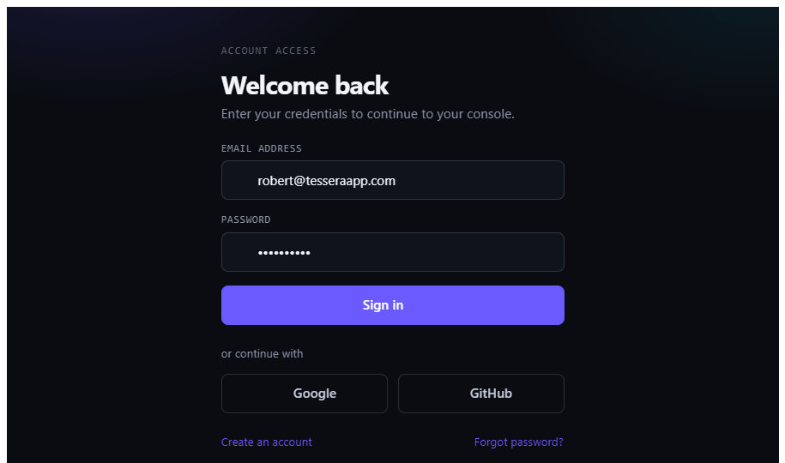
TesseraApp
17
DEMO · SCENARIO 1
The full authentication journey
tesseraapp · /login
Register a new account → account created disabled
Verify via the emailed link → account activated
Log in → authenticator challenge → dashboard
Open Security Center: enroll authenticator, save recovery codes
View active devices → revoke a session
LIVE DEMO
Notes:
[TIMING] ~1:30 · running to ~13:15 — LIVE in the app. || Scenario 1, the full auth journey: register a new account (starts disabled) → verification link → log in → authenticator challenge → dashboard. Then open Security Center, show devices, revoke one, one line on reuse detection. This is the must-succeed segment — do not cut it.

Slide 19
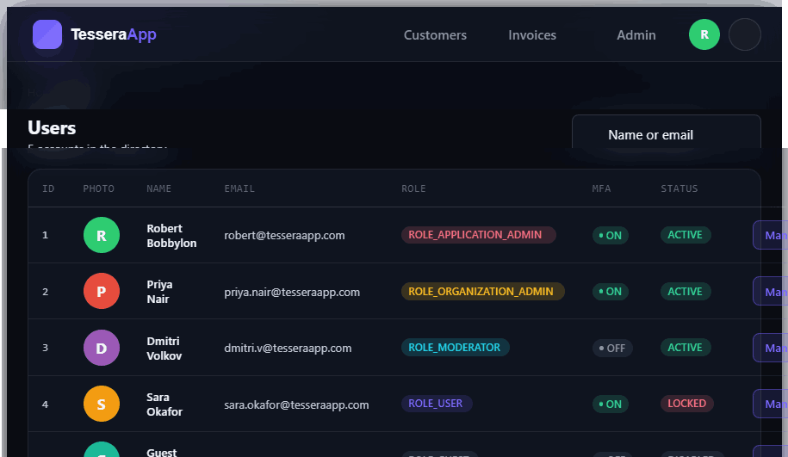
TesseraApp
18
DEMO · SCENARIO 2
Administration & role-based access
tesseraapp · /users
Sign in as eve.admin (ROLE_ADMIN)
Open the user directory; open a user detail
Reassign their role → change appears in their audit log
Show the roles × permissions matrix
Org scoping: an org admin sees only their organization
LIVE DEMO
Notes:
[TIMING] ~1:00 · running to ~14:15 — LIVE. || Scenario 2, admin & RBAC: sign in as eve.admin, open the user directory, reassign a user's role, and show the change land in their audit log. Then mention org scoping — an org admin sees only their own organization, and no one can change their own role.

Slide 20
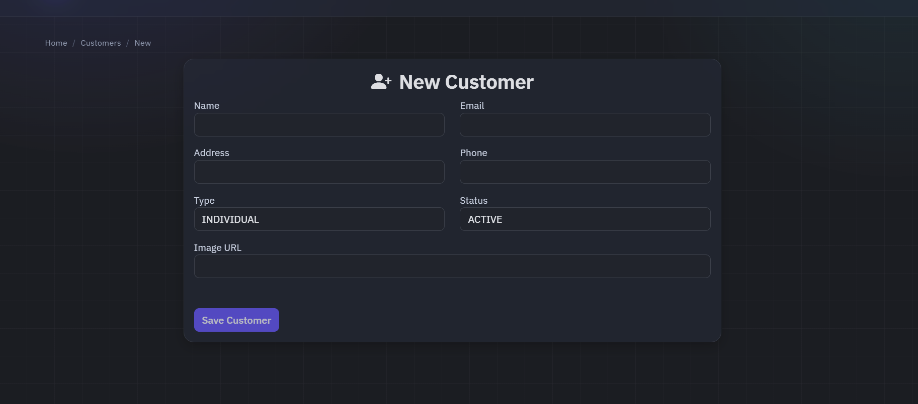
TesseraApp
19
DEMO · SCENARIO 3
Customers & invoices
tesseraapp · /customers/new
Create a customer record
Create an invoice with line items and status
Attach it to the customer
Export customers / invoices to Excel (Apache POI)
LIVE DEMO
Notes:
[TIMING] ~0:45 · running to ~15:00 — LIVE. || Scenario 3, the business domain the identity layer protects: create a customer, create an invoice with line items, export to Excel. Trim this first if you're running long — the security scenarios matter more.

Slide 21
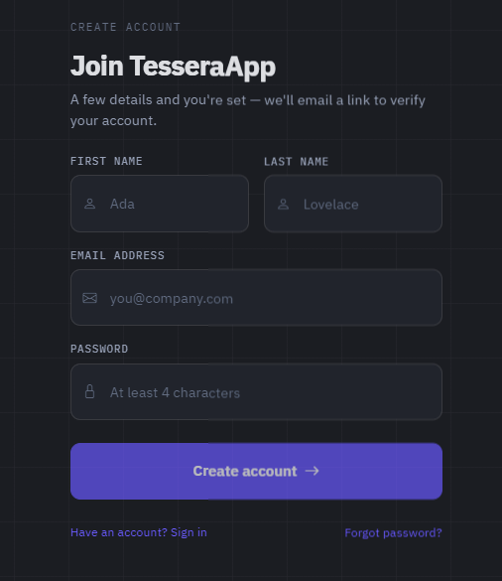
TesseraApp
20
DEMO · SCENARIO 4
Federated login (OAuth2)
tesseraapp · /login
Click Continue with Google / GitHub / Microsoft
Provider redirect → authorization-code exchange
Find-or-create the local user → our own JWT issued
Federated session appears in the device list like an in-house one
LIVE IF PROVIDER CREDENTIALS ARE CONFIGURED
Notes:
[TIMING] ~0:45 · running to ~15:45 — LIVE only if provider credentials are configured. || Scenario 4, federated login: Continue with Google → provider flow → our own JWT; the federated session shows in the device list exactly like an in-house one. If credentials aren't live yet, present this as a short walkthrough/roadmap rather than a live click-through.

Slide 22


TesseraApp
21
RESULTS
Built to spec — and beyond it
7
3
100%
RBAC ROLES ENFORCED
WAYS TO AUTHENTICATE
PRIMARY SCREENS BUILT
Auth + MFA + RBAC + admin + business domain + audit — working end to end.
TOTP MFA and refresh rotation with reuse detection — both were "planned" stretch goals in the SRS and shipped.
Notes:
[TIMING] ~0:40 · running to ~16:25. Back to slides after the demo. || A complete, working system built to the SRS and beyond it. Call out that TOTP MFA and refresh rotation with reuse detection were stretch goals that shipped.

Slide 23



TesseraApp
22
CHALLENGES & LESSONS
What the build taught us
Migration-tool baseline drift → switched to an idempotent schema script.
ORM identifier-quoting pitfalls → explicit column mappings; identity domain kept on hand-written SQL.
Designing reuse detection to commit-then-throw — never roll back the revocation.
Notes:
[TIMING] ~0:40 · running to ~17:05. || What the build taught us — three lessons: migration-tool drift → idempotent schema; ORM identifier-quoting pitfalls → explicit mappings; and designing reuse detection to commit-then-throw.

Slide 24




TesseraApp
23
WHAT'S LEFT — SAID OUT LOUD
Honest gaps, clear next steps
AWS CI/CD
SMS & federation
Multi-stage Docker exists; ship the same image to ECR/ECS/RDS behind TLS with automated deploy.
SMS delivery is stubbed; federation code is complete but needs real provider credentials.
Tests in CI
Hardening
Grow the security/integration suite and run it in the pipeline, not just locally.
Server-side org-scope on analytics/billing; a general rate limiter; env-driven config.
Notes:
[TIMING] ~0:40 · running to ~17:45. || Engineering honesty — name what's left out loud: AWS CI/CD, SMS + federation go-live, tests in CI, and hardening (server-side org-scope, rate limiter, env-driven config). Naming gaps reads as maturity and is what makes the project defensible.

Slide 25



TesseraApp
24
CONCLUSION
A modern CIAM core, end to end
A complete, modern CIAM core on a real application, validated against the SRS.
Hybrid stateless / stateful auth balances scale and control — zero-trust in practice.
Not "build beats buy" — but for the underserved small-scale segment , building in-house is defensible, and we showed it can be built correctly.
Notes:
[TIMING] ~0:40 · running to ~18:25. || Restate the narrow, defensible claim: not 'build beats buy', but for the underserved small-scale segment the market prices out, building in-house is defensible — and we showed it can be built correctly.

Slide 26

TesseraApp
Thank you.
Questions?
PRESENTERS
COURSE
Robert C. Oliver, Jr. · Travis L. Lester
CPSC 69100 · Lewis University
Notes:
[TIMING] ~0:20 · running to ~18:45 (≈ total). || Close: thank the audience and your advisor, invite questions. Then stop talking and let Q&A begin.

