Slide 1

BIKE MS ANALYTICS
TEAM NAME: KDD DEEP LEARNERS UNCC
Analysis Focus: “What occupations were responsible for most of BIKE MS’s fundraising?” Motivation:
To identify occupations where people are more likely to contribute towards Multiple Sclerosis and the trend in involvement over the past years.

Slide 2
DATASET USED:
2013-2017 Bike MS Participants AND 2013-2017 Bike Teams data
Exploratory Data Analysis:
# | Parameter | Analysis Technique | Tools Used
1 | Email Id | Distribution | R
2 | Event Type | Frequency Distribution | R
3 | Occupation | Frequency Distribution | R
4 | Team Division | Binning by Clustering | R
5 | Contribution by Occupation | Time Series Analysis | Tableau, R,

Slide 3
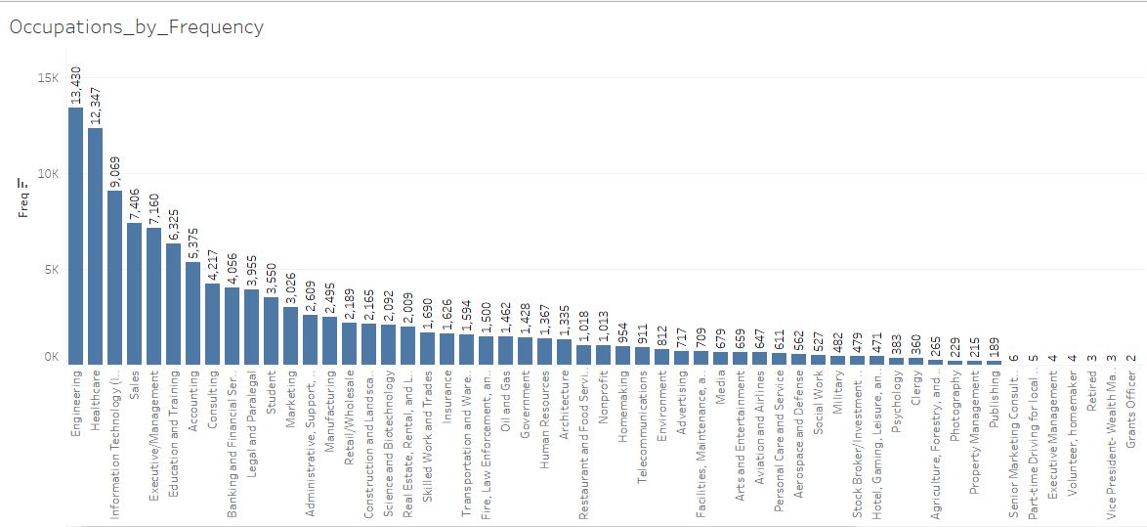
Total Revenue generated by Occupations in 5y sorted by Top 15 Occupations
 | Category | x
1 | Engineering | 14395885.19
2 | Executive/Management | 12609392.65
3 | Healthcare | 9495687.64
4 | Information Technology (IT) | 7606089.71
5 | Sales | 7597209.04
6 | Legal and Paralegal | 6634729.17
7 | Accounting | 5695448.77
8 | Consulting | 5411887.07
9 | Education and Training | 4973761.93
10 | Banking and Financial Services | 4820530.99
11 | Marketing | 3245598.68
12 | Real Estate, Rental, and Leasing | 2971337.83
13 | Science and Biotechnology | 2184393.12
14 | Manufacturing | 2165160.52
15 | Construction and Landscaping | 2096496.36

Slide 4
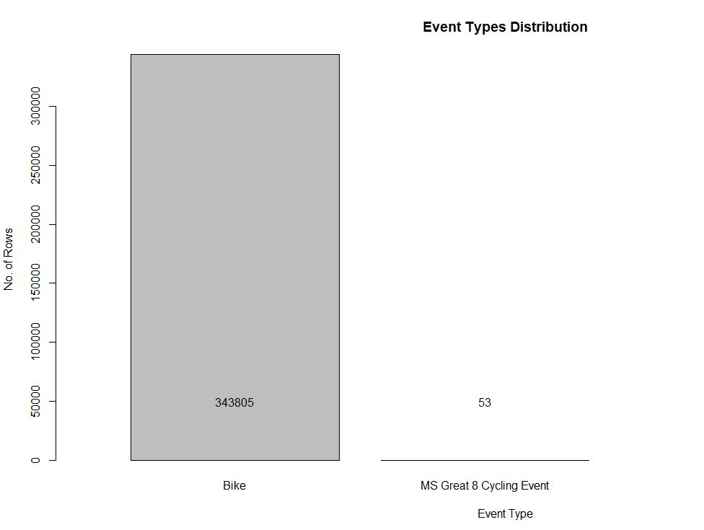
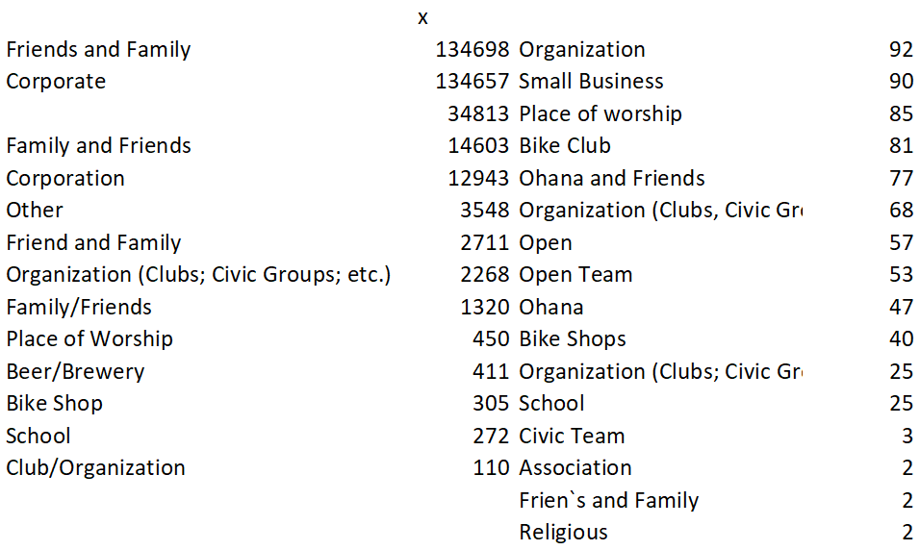
Exploratory Data Analysis
Event Type
Team Division
MS Great 8 event participation numbers are minimal when compared to Bike MS
Most of the teams came from reference through the friends and family compared to other fields.

Slide 5
Exploratory Data Analysis
Occupation Distribution
Outliers
Occupation with frequency less than 10 are omitted considering as outliers.

Slide 6
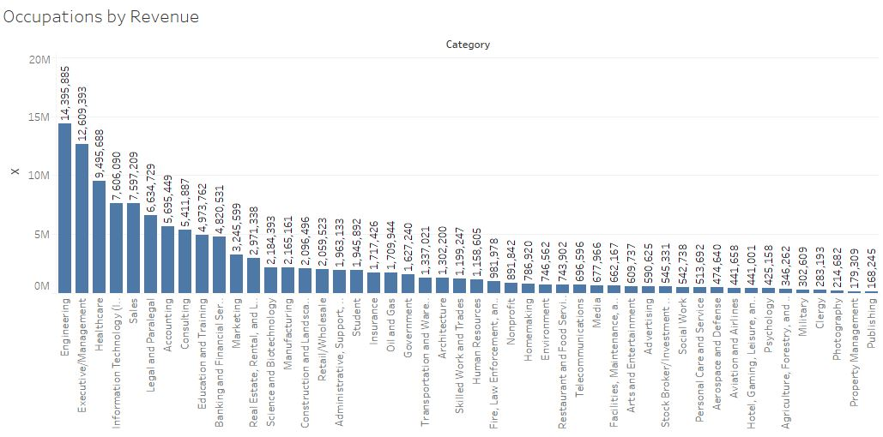
Exploratory Data Analysis - Occupation Distribution by revenue
Occupation | 2014 Rank | 2015 Rank | 2016 Rank | 2017 Rank
Engineering | 1 | 1 | 1 | 1
Executive/Management | 2 | 2 | 2 | 2
Healthcare | 3 | 3 | 3 | 3
Legal and Paralegal | 4 | 6 | 6 | 6
Information Technology (IT) | 5 | 4 | 5 | 5
Sales | 6 | 5 | 4 | 4
Accounting | 7 | 7 | 7 | 7
Consulting | 8 | 8 | 8 | 8
Education and Training | 9 | 9 | 9 | 9
Banking and Financial Services | 10 | 10 | 10 | 10
The graph shows the top performing occupations by revenue.
Contributions by year
Sorted by top 5 occupations

Slide 7
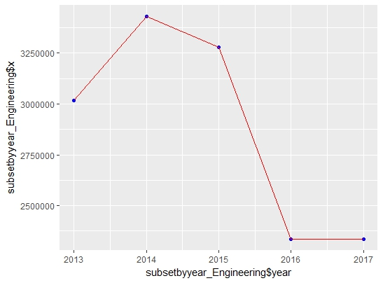
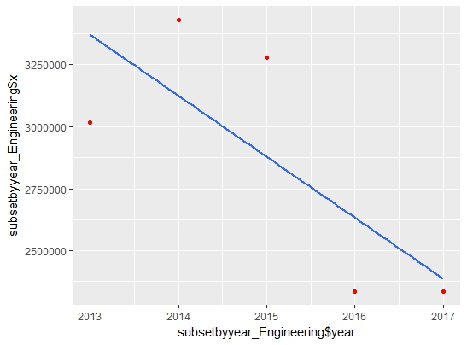
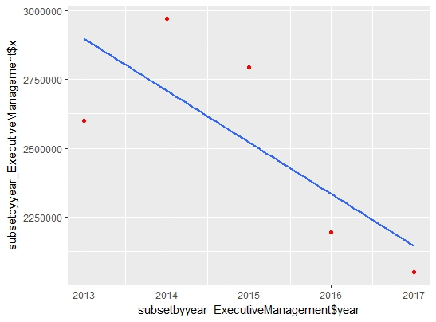
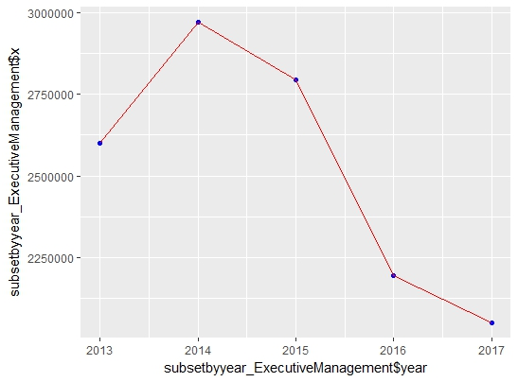
MODELLING – TIME SERIES ANALYSIS
# | Occupation | Aggregated by year map | Linear regression
1 | Engineering
2 | Executive/Management

Slide 8
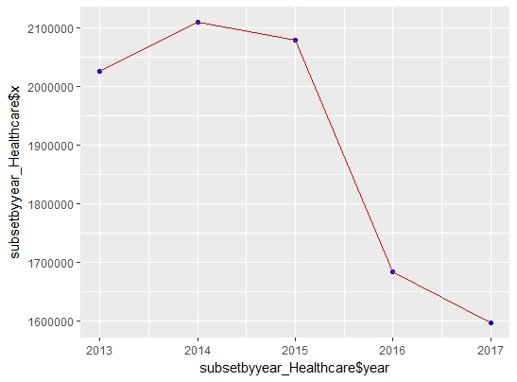
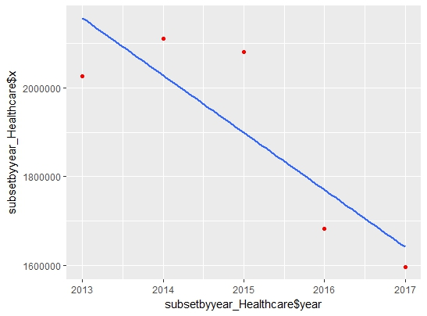
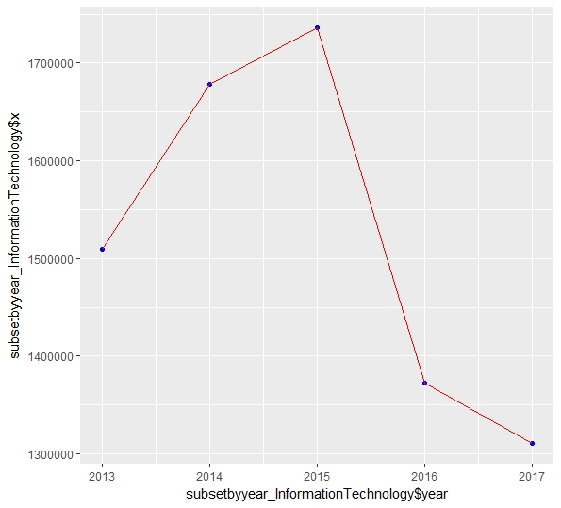
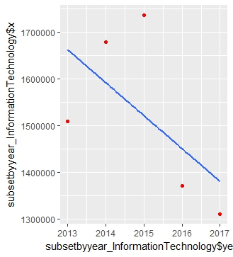
MODELLING – TIME SERIES ANALYSIS
# | Occupation | Aggregated by year map | Linear regression
3 | Health Care
4 | Information Technology

Slide 9
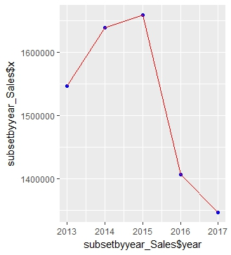
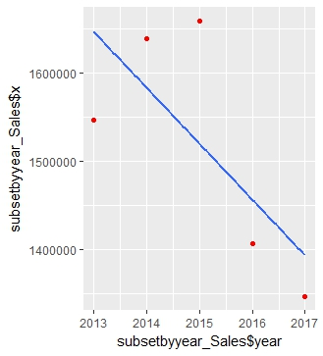
MODELLING – TIME SERIES ANALYSIS
# | Occupation | Aggregated by year map | Linear regression
5 | Sales

Slide 10
PREDICTION RESUTLS
Occupation | Linear regression equation | Year | Predicted Amount
Engineering | Amount = 245701*(Year) - 497966648 | 2018 | 2142030
Executive/management | Amount = 187709*(Year) - 380756779 | 2018 | 1960017
Health care | Amount = 128556 *(Year) - 260940996 | 2018 | 1514988
Information technology | Amount = 70309 *(Year) - 143194401 | 2018 | 1310839
Sales | Amount = 63189 *(Year) - 128845442 | 2018 | 1330040

