Slide 1
Shells and Processes
Bryce Boe
2012/08/08
CS32, Summer 2012 B

Slide 2
Outline
Operating Systems and Linux Review
Shells
Project 1 Part 1 Overview
Processes
Overview for Monday (Sorting Presentations)

Slide 3
OS Review
Operating systems
Manages system resources: cpu, memory, I/O
Types: single/multi-user and single/multi-process
Provides fairness, security

Slide 4
Self Check Questions
What is the primary benefit of a multi-process OS over a single process OS? How is this accomplished?
Explain the difference between multiprogramming and multitasking

Slide 5
Self Check Answers
What is the primary benefit of a multi-process OS over a single process OS? How is this accomplished?
Increased resource utilization (primarily of the CPU) accomplished by scheduling other processes when the currently running process requires I/O

Slide 6
Self Check Answers cont.
Explain the difference between multiprogramming and multitasking
Multiprogramming systems switch the running process when that process requires I/O.
Multitasking systems periodically switch the running process after some (typically minute) period of time

Slide 7
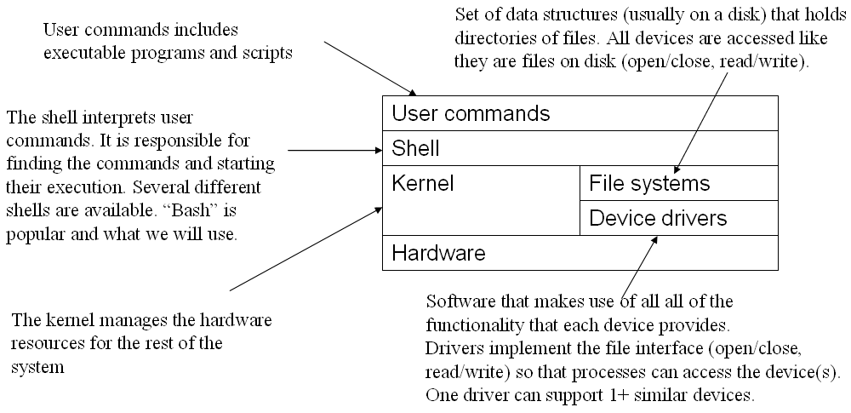
Linux Architecture
Notes:
Image from from Mike Costanzo’s CS32_S12 slides with attribution: Thanks again to Chandra Krintz and Kevin Sanft.

Slide 8
Shells

Slide 9
What is a shell?
A shell is a program that provides the interface between the user and the operating system
Can be used to tell the OS to:
Execute programs (as processes)
Stop, or pause processes
Create, copy, move, remove files
Load or unload device drivers

Slide 10
Types of Shells
Command line shells:
Provide a textual input as the user-interface
Bourne shell (sh), C shell (csh), Bourne-Again shell (bash), cmd.exe
Graphical shells
Provide a point-and-click type interface
Windows shell, Gnome, KDE, Xfce, Xmonad

Slide 11
Login Shell
The shell presented to the user upon login
Typically changeable on Linux via chsh

Slide 12
Configuration Files
Unix shells typically load configuration settings on launch
Bourne shell: ~/.profile
C shell: ~/.login, ~/.cshrc
Bash: ~/.bashrc, ~/.bash_profile
Useful to adjust environment variables such as the PATH
Examples are provided in the reader on page 29 and 30

Slide 13
Unix Shells
Contain built-in commands
cd, eval, exec, exit, pwd, test, umask, unset
Launch external programs
cat, cp, mv, touch, wc
Continue executing until their input stream is closed via <ctrl+d>
External commands are searched for according to the PATH environment variable

Slide 14
Launching shells
Shells can be launched within shells (they’re just applications after-all)
Demo pstree with nested shells
Shells process commands from stdin
Run: echo "echo foo" | sh
Combined with stdin redirection we have the ability to write shell scripts
More on shell scripts in lab1 and project 1

Slide 15
Working with the PATH
The PATH environment variable specifies directories containing executable file
Commands to demo:
echo $PATH
which -a <PROG_NAME>
Bad things can happen with ‘.’ is on the PATH
Shell script wrapper program

Slide 16
Shell meta characters
Support for globbing
Filename expansion using:
* - wildcard to match 0 or more characters
? – wildcard to match exactly one character
[ ] – matches one character if it’s contained in the character list
[0-9A-Za-z] will match a single character if it’s alphanumeric
Home directory substitution via ~

Slide 17
Project 1 Part 1
Automated testing bourne script
Usage: test_it.sh DIRECTORY
Given a directory as input run tests against programs specified by DIRECTORY’s subdirectory names
Individual test inputs are files prefixed with “input_” and should be compared with the corresponding “output_” file

Slide 18
DIRECTORY Hierarchy
test_root/
prog_name/
another_prog_name/
input_test_a
input_test_b
output_test_a
output_test_b
input_a
output_a
Execute: ./test_it.sh test_root

Slide 19
Project 1 Part 1 Demo

Slide 20
Processes (in Linux)
A process is a program in execution
Copied to memory and assigned a process ID (PID)
Multiple processes run simultaneously via multitasking
Processes are created when an existing process makes a fork or clone system call
Processes can have different scheduling priority (nice values in Linux)
Notes:
Some slide contents adapted from Mike Costanzo’s CS32_S12 slides.

Slide 21
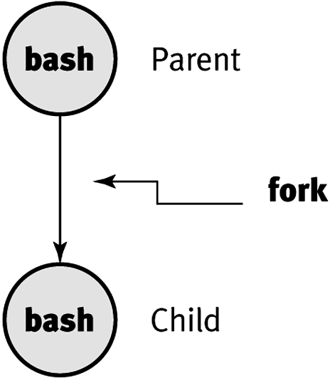
Simple Fork Example
Notes:
Graphic from Mike Costanzo’s CS32_S12 slides.

Slide 22
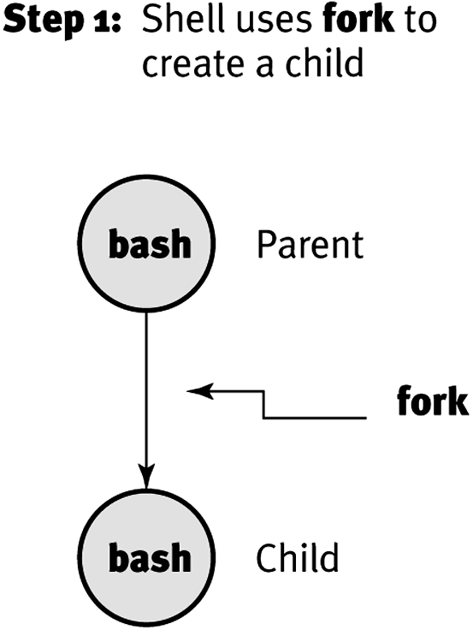
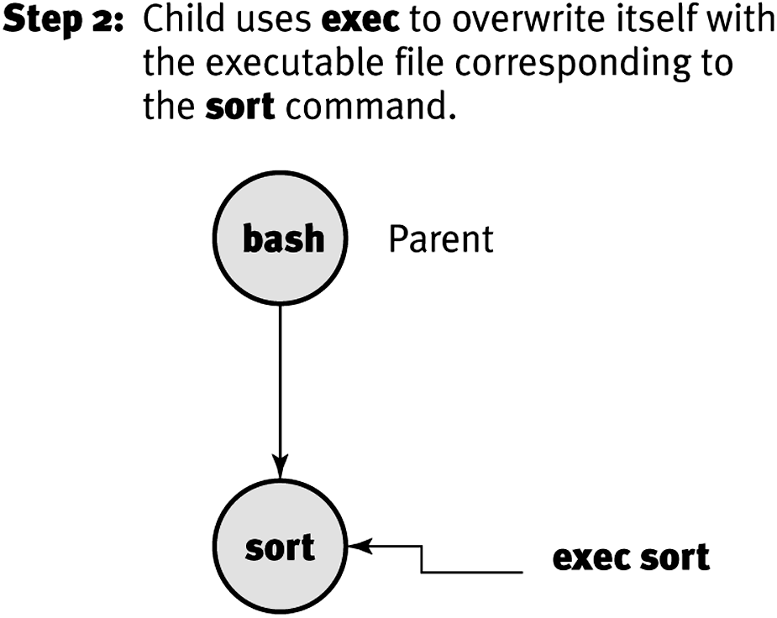
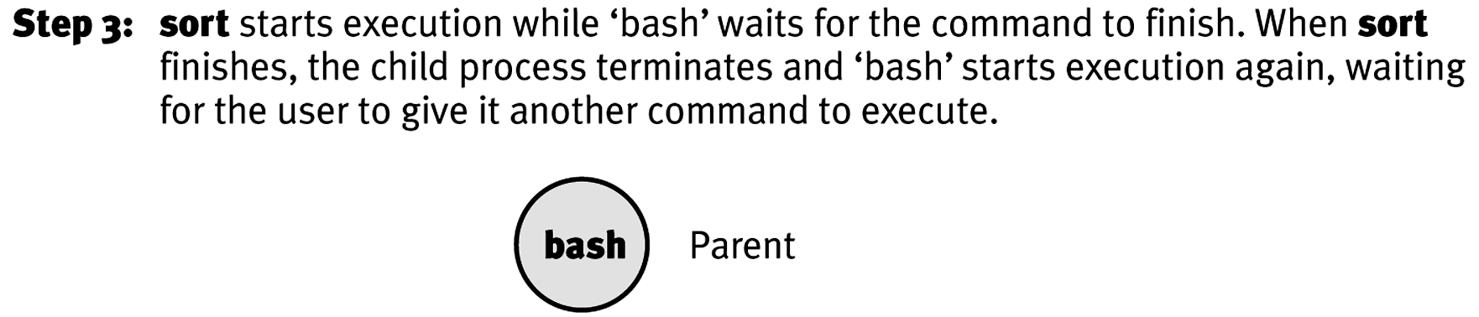
Running sort from bash
Notes:
Graphics from Mike Costanzo’s CS32_S12 slides.

Slide 23
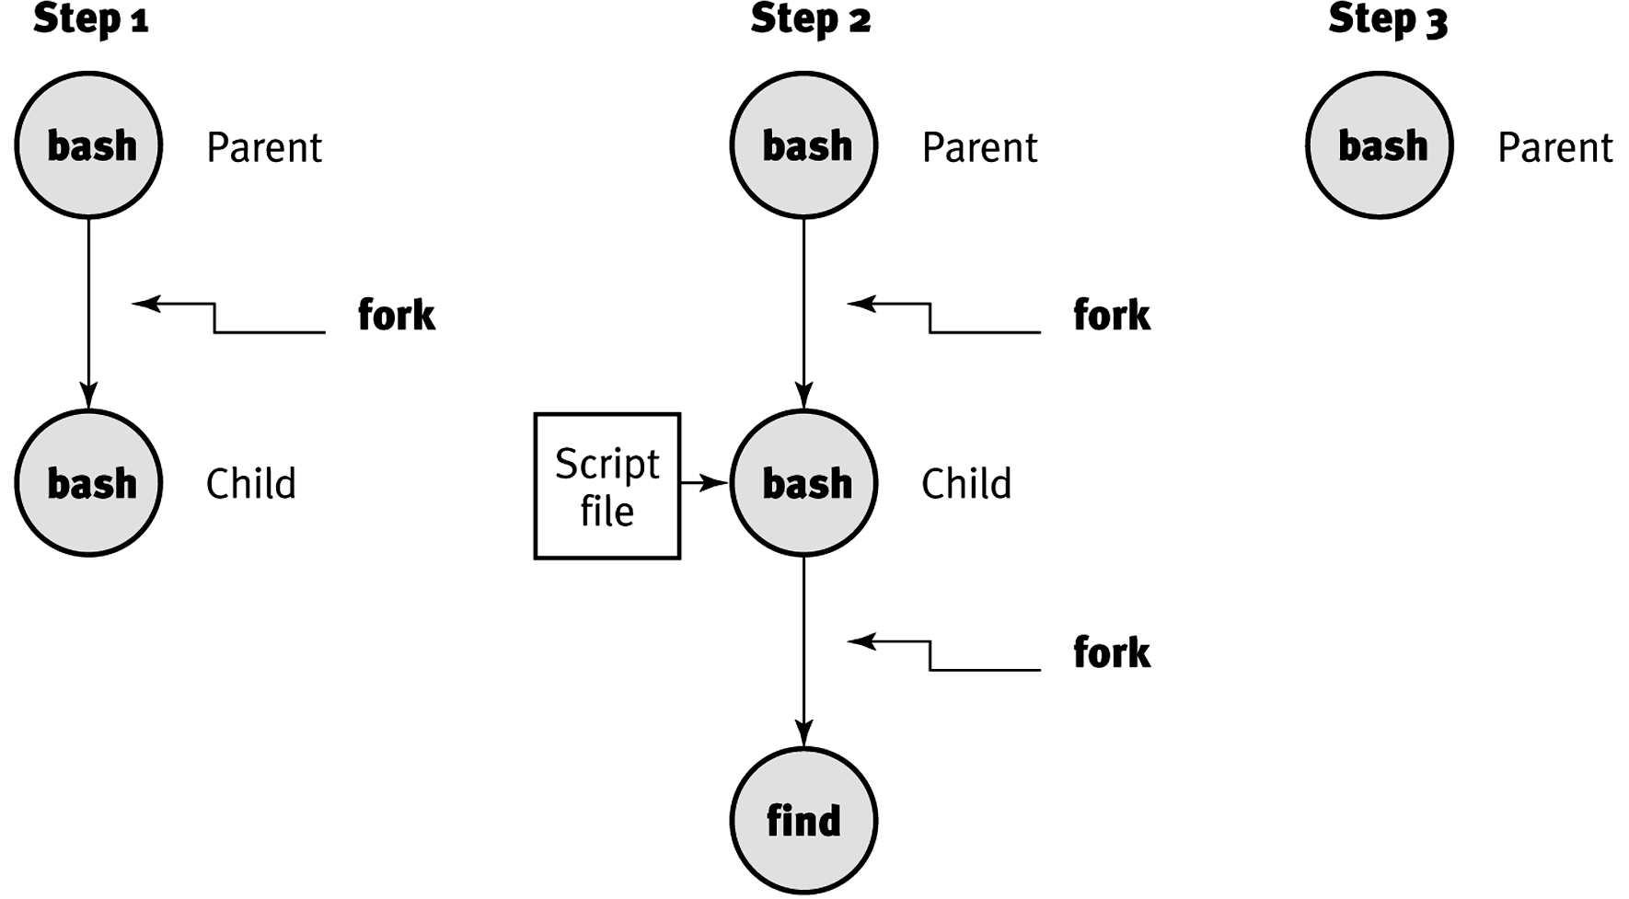
Running a shell script that runs find
exec
Notes:
Graphics from Mike Costanzo’s CS32_S12 slides.

Slide 24
Select Process Attributes
The column names as listed in ps -l output
S – the state of the process
PID – the process id
PPID – the parent process id
UID – process owner’s user id
WCHAN – the event a non-running process is waiting for

Slide 25
Process Hierarchy
init (now systemd) is the root of all processes (PID 1)
The process hierarchy's depth is limited only by available virtual memory
A process may control the execution of any of its descendants
Can suspend or resume it
Can even terminate it completely
By default, terminating a process will terminate all of its descendants too
So terminating the root process will terminate the session
Notes:
Contents adapted from Mike Costanzo’s CS32_S12 slides.

Slide 26
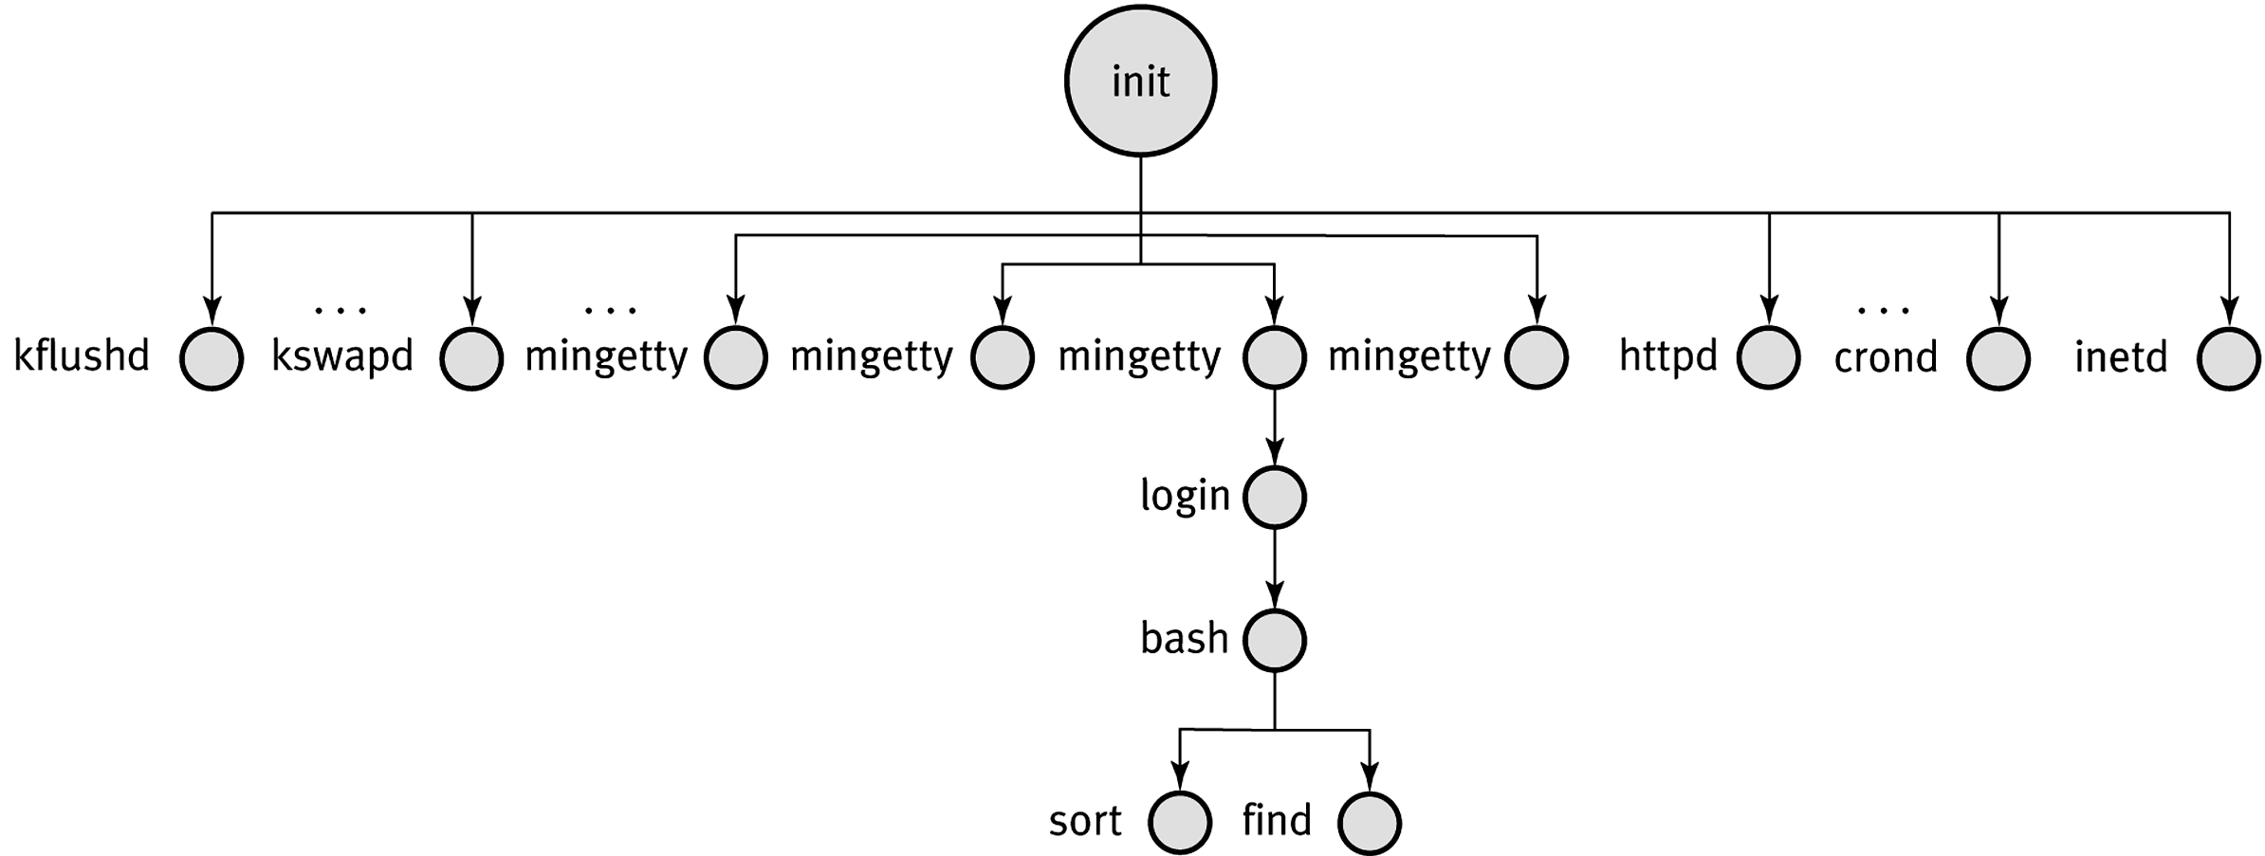
Example Process Hierarchy
Notes:
Graphic from Mike Costanzo’s CS32_S12 slides.

Slide 27
Process States
A process exist in a number of different states
Ready
The process is ready to be scheduled
Running
The process is currently runny
Swapped
Part or all of the process’s memory is on disk
Zombie
The parent of the process no longer exists

Slide 28
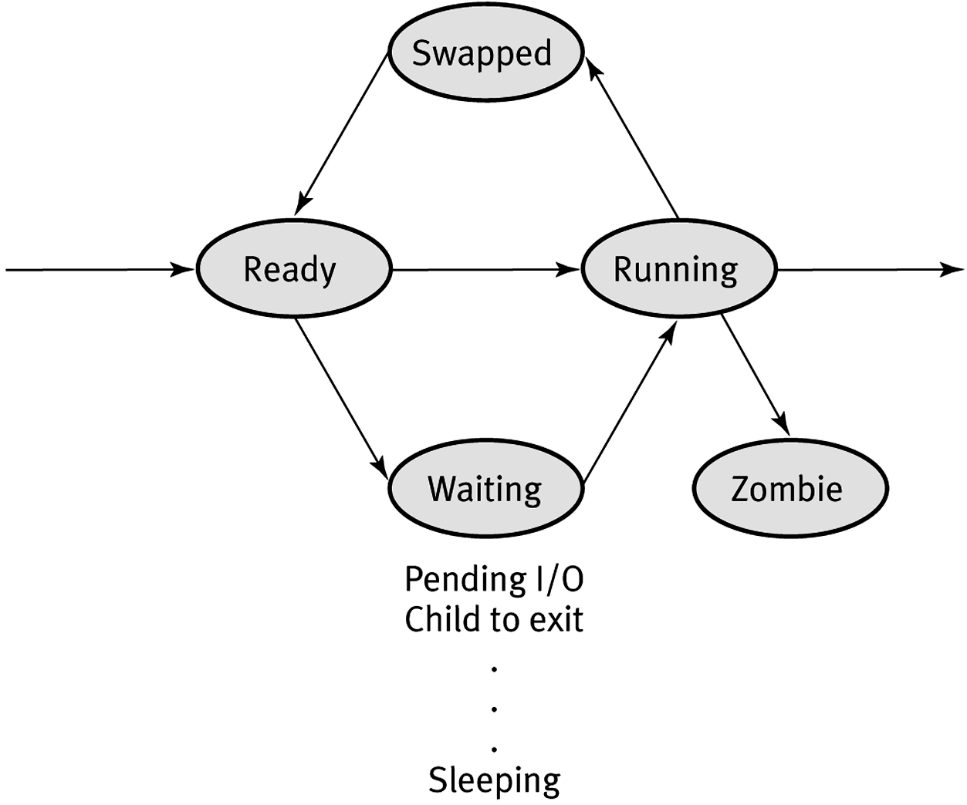
Process States Diagram
Notes:
Graphic from Mike Costanzo’s CS32_S12 slides.

Slide 29
Observing Process States and Hierarchy
ps
Output a snapshot of the running process (many options)
pstree
Output a text-based view of the process hierarchy tree
top
A terminal-based process monitoring program

Slide 30
Process Exit Status
Each process exits with some status 0-255
0 is typically used to indicate success
All other numbers are used to indicate some “error” condition that is application specific
In C/C++ the int return value from the main is the exit status

Slide 31
Processes and the shell
The shell can run processes in the foreground (fg) and the background (bg)
Multiple processes can be run in succession or in parallel via a single command

Slide 32
Foreground and background
The shell normally runs processes in the foreground
Launch a process in the background via &
sleep 500 &
See a list of background processes (jobs) associated with your current shell via
jobs

Slide 33
Background -> foreground
Type: fg (note there must be a background processes running)
You can also explicitly foreground a specific job by number:
fg %3

Slide 34
Foreground -> background
When a process is running, suspend it:
<ctrl> + z
This will bring you back to the terminal
Then run bg to resume the process running in the background
As with the fg command, you can provide an explicit job number:
bg %2

Slide 35
Sequentially executing programs
Separate via ; on the command line
sleep 5; ls; sleep 5; ls
Processes run regardless of previous process’s exit status
Conditionally execute sequentially based on exit status: separate via &&
sleep 5 && ls -l foo && sleep 5 && ls –l
Command stops when a non-zero exit status is returned

Slide 36
Executing programs in parallel
Separate via &, the background process indicator
echo foo & echo bar & echo somethingelse &
If process is running in the background, the command’s exit status will be zero

Slide 37
Mix and match
sleep 5; echo foo& echo bar & ; ls
sleeps 5 seconds
Concurrently runs echo foo, echo bar and ls
Both echo commands run in the background
ls runs in the foreground

Slide 38
For Monday
Prepare 10-15 minute presentation on an assigned sorting algorithm
Provide a number of examples and detail and possible corner cases
1 volunteer will be asked to present each sorting algorithm
If no volunteers, then someone will be picked randomly
Complete instructions will be posted on Piazza sometime before Thursday’s lab

