Slide 1
Heap Sort
Uses a heap, which is a tree-based data type
Steps involved:
  Turn the array into a heap.
  Delete the root from the heap and insert into the array, then reheap. Repeat until sorted.

Slide 2
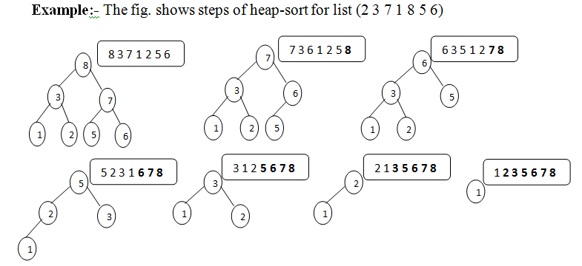
Example 1

Slide 3
Example 2
Heap
[ 2, 4, 8, 5 ]
[ 4, 5, 8 ]
[ 5, 8 ]
[ 8 ]
Array
[ 5, 4, 8, 2 ]
[ 2, ?, ?, ? ]
[ 2, 4, ?, ? ]
[ 2, 4, 5, 8 ]

Slide 4
Efficiency
Heapsort is always O(n log n).
  Building the tree is at least n at most n log n steps.
  The tree has to be reheaped for every node. Reheaping is log n steps, so in total, reheaping takes n log n steps.
  There are a total of 2 * n log n steps
  So time complexity is always O(n log n)

Slide 5
More about performance and speed
Heapsort is an in-place algorithm, so it only needs O(1) memory beyond the items being sorted.
Heapsort's efficiency is often compared with quicksort's.
  Heapsort's worst case performance is much better than quicksort's
  In practice, quicksort is generally faster.
  When a guarantee of speed performance is needed, it is better to use Heapsort.

