Slide 1
Heap Sort
Ameya Damle

Slide 2
The Algorithm
Elements can be sorted by placing the values into a heap and removing them one at a time
Done using balanced binary tree
Time is O(nlogn) with the average case
Worst case is O(nlogn)
Best case is O(n)
Each enter/leave is O(logn) called heapify, and doing n inserts/leaves takes O(nlogn)

Slide 3
Example 1

Slide 4
Special case
Worst Case for heapsort is when tree is complete
Move down to lowest level (height is h) the time it takes is O(h) but since the tree is balanced it is O(logn)
Then to build a heal it is O(n) thus resulting in O(nlogn)
Making it less efficient with a complete tree

Slide 5
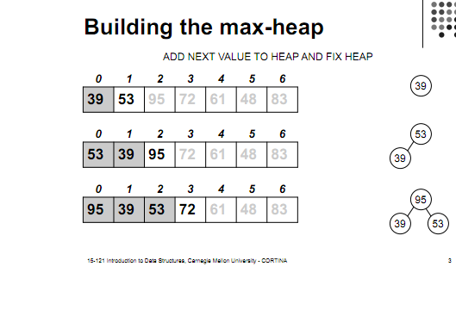
Step by Step run through

Slide 6
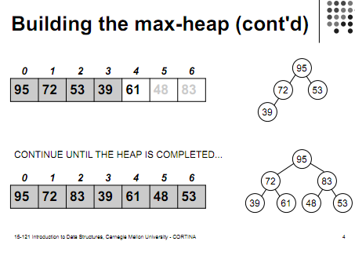

Slide 7
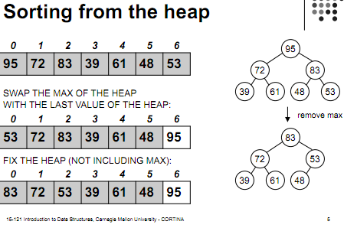

Slide 8
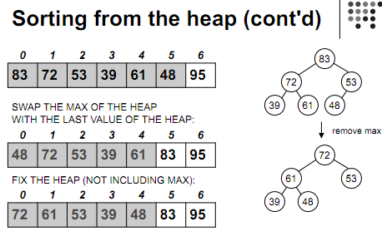

Slide 9
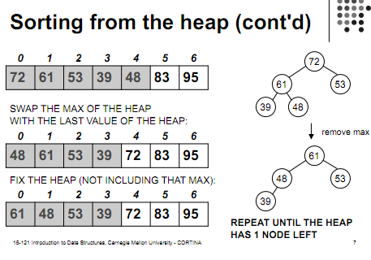

Slide 10
Memory
Heapsort uses no extra memory except for a few local temporary
Quicksort also uses no extra memory and is O(nlogn) at worst but it runs faster than the heapsort

Slide 11
References
http://www.stoimen.com/blog/2012/08/07/computer-algorithms-heap-and-heapsort-data-structure/
http://www.math.ucla.edu/~wittman/10b.1.10w/Lectures/Lec21.pdf
http://pages.cs.wisc.edu/~hasti/cs367-common/readings/Old/fall01/HEAP-SORT.htm
http://www.cs.cmu.edu/~tcortina/15-121sp10/Unit07B.pdf

