Slide 1
Heap Sort Algorithm
Ludim Castillo

Slide 2
How does the algorithm work?
2 step algorithm
1st step
Build heap out of the data
2nd step
Remove the largest element of the heap.
Insert the removed element into the sorted array (the first element removed would be position 0 of the array).
Reconstruct the heap and remove the next largest item, and insert it into the array.
This continues until all objects are removed from the heap, and so the array will be sorted. (depending on min heap or max heap the direction of the sorted elements can vary.

Slide 3

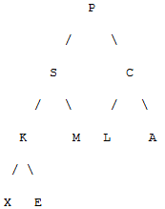
Example 1:
From the following array we will build a heap.
The following is a binary tree of the data.

Slide 4
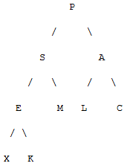
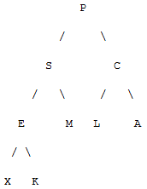
Ex1 continued
Applying a down filter method to get the tree to a smallest value to largest to get a heap, in this case min heap. (from top to bottom with the smallest as the root)

Slide 5
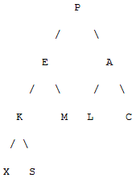
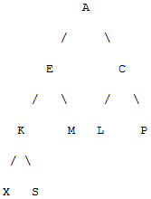
Ex1 continued
We now have a heap. (min heap pointed to by the arrow)

Slide 6
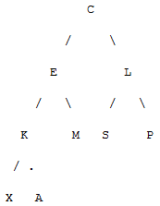
Ex1 continued
-
-
-
-
-
-
-
-
A

Slide 7
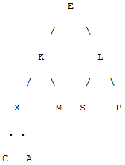
Ex1 continued
-
-
-
-
-
-
-
C
A

Slide 8
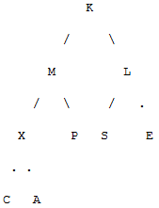
Ex1 continued
-
-
-
-
-
-
E
C
A

Slide 9
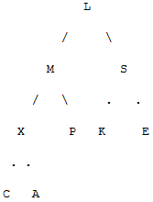
Ex1 continued
-
-
-
-
-
K
E
C
A

Slide 10
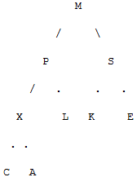
Ex1 continued
-
-
-
-
L
K
E
C
A

Slide 11
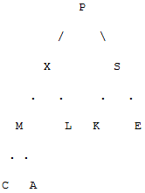
Ex1 continued
-
-
-
M
L
K
E
C
A

Slide 12
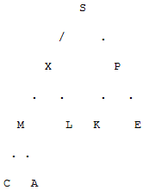
Ex1 continued
-
-
P
M
L
K
E
C
A

Slide 13
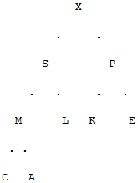
Ex1 continued
-
S
P
M
L
K
E
C
A

Slide 14

Ex1 continued
Only the item X remains in heap so resulting array is sorted

Slide 15
Example 2
The same procedure from example 1 can be used for a max heap. Nothing really different just the direction of the sorting to the array.

Slide 16
Running time
Best Case: O(n)
If all elements are equal building the heap takes O(n). Because removing and adding take O(n).
Average Case: O(n*logn)
Worst Case: O(n*logn)
Because basic heap operation of Heapify runs in O(logn) because it has O(logn) levels. Need to apply Heapify N/2 times, so it takes O(nlogn) to extract each of the elements.

Slide 17
Special cases
More efficient:
If the input is already sorted to some degree then it can come close to O(n) effciency.
Using only one comparison in each siftup run which must be followed by a siftdown for each child
Less efficient
Since the worst case is also the average case, then there can only be more efficient.

Slide 18
The Heapsort algorithm depends on a Binary Heap, either Min or Max could work.
It must be put into a binary tree and then shifted to become a heap, so that a root removal can be used to sort the array.

Slide 19
In-Place runtime
It can run In-Place, but it is not a stable sort because when dealing with the heap equal keys may be changed around in order to result in a sorted array.
The array can be split into two parts the heap and the sorted array. Insertion and root deletion is used to perform the sorting, but the cost is only in the extraction.

Slide 20
References
. "An intuitive Understanding of Heapsort." Stack Overflow. N.p., n.d. Web. 14 Aug 2012. <http://stackoverflow.com/questions/8938375/an-intuitive-understanding-of-heapsort>.
Carlson, David. "Software Design Using C ." Computing and Information Science Department. N.p., June 30, 2012. Web. 14 Aug 2012. <http://cis.stvincent.edu/html/contactUs/index.html>.

