Slide 1
Heapsort
By: Steven Huang

Slide 2
What is a Heapsort?
Heapsort is a comparison-based sorting algorithm to create a sorted array (or list)
Part of the selection sort family
Not a stable sort, but rather an in-place algorithm
In-place algorithm: an algorithm that transforms input using a data structure with a small, constant amount of storage space

Slide 3
How to implement a Heapsort
1. Build a heap out of data
2. Remove root and insert into array
3. Reconstruct heap
4. Repeat steps 2 and 3 until we have an in order array

Slide 4
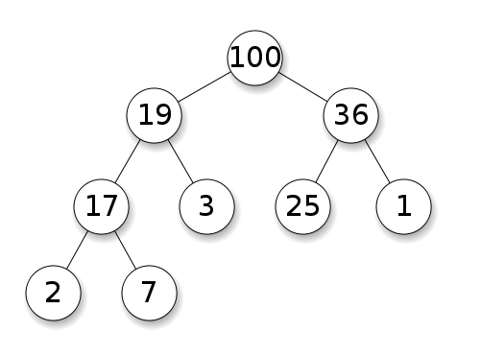
Heaps
What is a Heap?
Example of a binary heap (max)
Specialized tree-based data structure
Satisfies the heap property
The parent node and child node are ordered with the same relationship as every other parent and child node.

Slide 5
How to construct a heap
Choose type of heap
Min Heap
The value of each node is greater than or equal to the value of its parents, with the minimum-value at the root
Max Heap
The value of each node is less than or equal to the value of its parents, with the maximum-value element at the root.

Slide 6
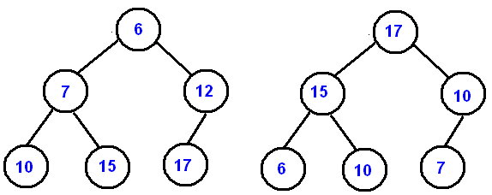
How to construct a heap

Slide 7
How to construct a heap
Inserting elements into the binary tree
0th value of array becomes the root
1st and 2nd value of array become left and right node to the root
3rd and 4th value of array become left and right node to the 1st value node
5th and 6th value of array become left and right node to the 2nd value node…

Slide 8
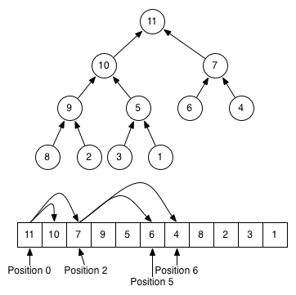
How to construct a heap

Slide 9
How to construct a heap
What if the array is not ordered properly so that each parent node is greater than their children?
When adding elements to the [max] heap, if a new element is larger than its parent, then the parent and child will switch places.
If the child is larger than its grandparent node then first switch the child and parent then switch the child and grandparent

Slide 10
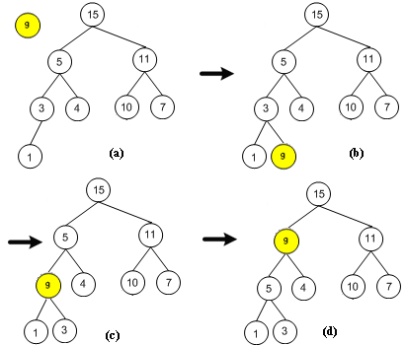
Example

Slide 11
After the heap is built
It is time to sort using the heapsort algorithm
Remove the root (which is the largest element)
Insert into array
Replace it with last element in the heap
Compare new root with children and move to proper place
Repeat until all elements are gone and heap is empty

Slide 12
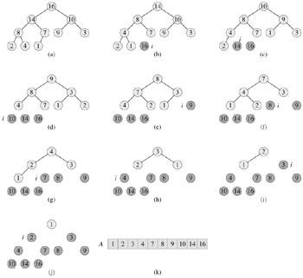
Example of heapsort

Slide 13
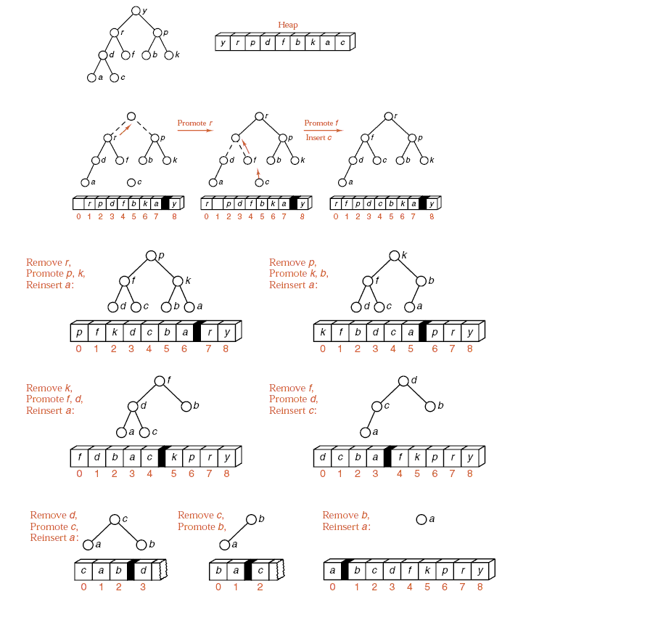

Slide 14
Advantages
The primary advantage of the heap sort is its efficiency.
Execution time efficiceny: O(n log n)
Memory efficieny: O(1)
The heap sort algorithm is not recursive
Heap sort algorithm is in place
In-place algorithm: an algorithm that transforms input using a data structure with a small, constant amount of storage space

Slide 15
Advantages
Best at sorting huge sets of items because it doesn’t use recursion
If the array is partially sorted, Heap Sort generally performs much better than quick sort or merge sort

Slide 16
Disadvantages
Generally slower than quick and merge sorts

