Slide 1
Insertion Sort
David Borden
CS 32

Slide 2
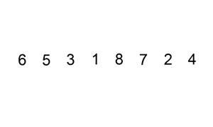
How Insertion Sort Works
Somewhat how humans naturally sort things
( e.g. sorting books by alphabetical order )
http://commons.wikimedia.org/wiki/File:Insertion-sort-example-300px.gif
Author: Swfung8

Slide 3
An element in the array is chosen every run-through of the sort
It is then inserted into the appropriately sorted place
This continues until everything is sorted
Which element is picked to be sorted first is a choice left to the implementer.

Slide 4

Sort { 7, -5, 2, 16, 4 }
"Insertion Sort." INSERTION SORT (Java, C ). N.p., n.d. Web. 13 Aug. 2012. <http://www.algolist.net/Algorithms/Sorting/Insertion_sort>.

Slide 5
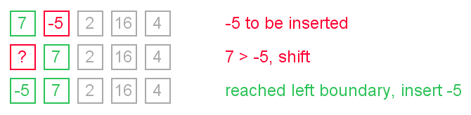
Sort { 7, -5, 2, 16, 4 }

Slide 6
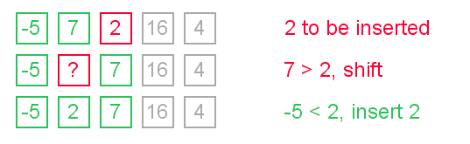
Sort { 7, -5, 2, 16, 4 }

Slide 7
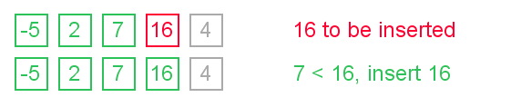
Sort { 7, -5, 2, 16, 4 }

Slide 8
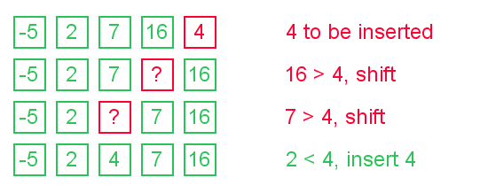
Sort { 7, -5, 2, 16, 4 }

Slide 9

Sort { 7, -5, 2, 16, 4 }

Slide 10
Performance
Average Case: O( n² )
Random list
Worst Case: O( n² )
List in reverse order
Best Case: O ( n )
(Almost) sorted list

Slide 11
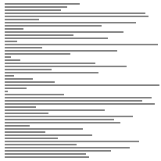
Random Order
http://www.sorting-algorithms.com/insertion-sort
Author: 2007 David R. Martin.

Slide 12

Reverse order
Notice how slow the sorting algorithm works in reverse order
http://www.sorting-algorithms.com/insertion-sort
Author: 2007 David R. Martin.

Slide 13
Properties
Stable: When sorting, elements with equal keys are not taken out of order
Adaptive: When the list is close to sorted, O( n )
Very easy implementation
http://www.sorting-algorithms.com/insertion-sort
Author: 2007 David R. Martin.

Slide 14
In Practice
Used in practice only for small sets of data
It is the fastest sort for a small data set
Better than quicksort at a point
Other sorts sometimes use insert sort
Most efficient when used together
A faster spin-off of the insert sort is the Shell Sort
It is better for Shell Sort to be in a linked list or skip list, but the data structure does not matter for the Insertion Sort

