Slide 1
Insertion Sort
by: Jordan Mash
CS32
Bryce Boe

Slide 2
How does it work?
Essentially the same way you order anything in day to day life.
  Cards
  Straws
  Arrays?
Ex. You have a blackjack hand (two cards) and want to order them?

Slide 3
Order Blackjack hand cont.
1. Look at first card (10 of spades), and put that in the first position.
2. Look at the second card (6 of hearts), and hope the dealer loses compare to first card (10 of spades).
3. Swap with first card since the value is lower.

Slide 4
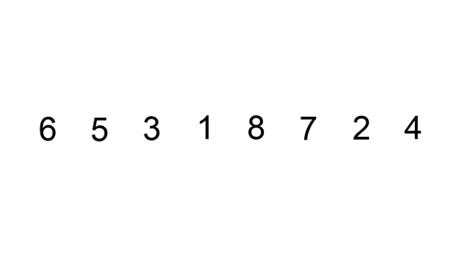
Visual Example

Slide 5
Running Time
Best Case: O(n), or O(1) if only 1 element
Worst Case: O(n^2), if given in reverse order.
Average Case: O(n^2), still a quadratic running time.

Slide 6
Best Times to Use Insertion Sort
When the data sets are relatively small.
  Moderately efficient.
When you want a quick easy implementation.
  Not hard to code Insertion sort.
When data sets are mostly sorted already.
  (1,2,4,6,3,2)

Slide 7
Worst Times to Use Insertion Sort
When the data sets are relatively large.
  Because the running time is quadratic
When data sets are completely unsorted
  Absolute worst case would be reverse ordered. (9,8,7,6,5,4)

Slide 8
Insertion Sort Works in Place
No extra data structures needed. It works off of original data structure that it is fed with and simply swaps the position of the items in the set.
It does not require any extra memory as data sets get larger. Will always require the same amount of memory. M(1) – memory.

Slide 9
Pseudo Code
for i = 0 to n – 1
  j = 1
  while j > 0 and A[j] < A[j – 1]
  swap(A[j], A[j-1])
  j = j - 1

Slide 10
More Resources
If you still don’t quite understand how it all works this youtube video will help clear things up.
  http://www.youtube.com/watch?v=c4BRHC7kTaQ

Slide 11
Resources Used
Bender, Michael A.; Farach-Colton, Martín; Mosteiro, Miguel, Insertion Sort is O(n log n); also http://citeseerx.ist.psu.edu/viewdoc/summary?doi=10.1.1.60.3758; republished? in Theory of Computing Systems Volume 39 Issue 3, June 2006 http://dl.acm.org/citation.cfm?id=1132705
Thomas H. Cormen, Charles E. Leiserson, Ronald L. Rivest, and Clifford Stein. Introduction to Algorithms, Second Edition. MIT Press and McGraw-Hill, 2001. ISBN 0-262-03293-7. Section 2.1: Insertion sort, pp. 15–21.
Donald Knuth. The Art of Computer Programming, Volume 3: Sorting and Searching, Second Edition. Addison-Wesley, 1998. ISBN 0-201-89685-0. Section 5.2.1: Sorting by Insertion, pp. 80–105.
Sedgewick, Robert (1983), Algorithms, Addison-Wesley, ISBN 978-0-201-06672-2, Chapter 8, pp. 95–??

