Slide 1

Merge Sort Algorithm
A pretty decent algorithm

Slide 2
What does it do?
Takes an unsorted list
Splits it into a bunch of tiny, one element lists
Compares each first value of lists and puts them into new list in appropriate order
This process continues until all values are sorted into the SAME list

Slide 3

Example 1: Number list

Slide 4
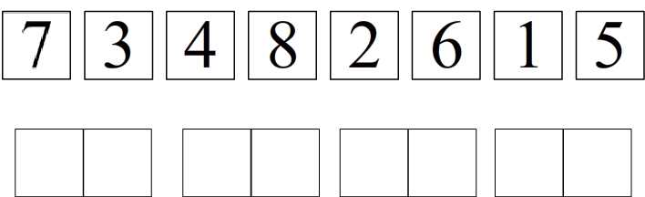
Example 1: Number list

Slide 5
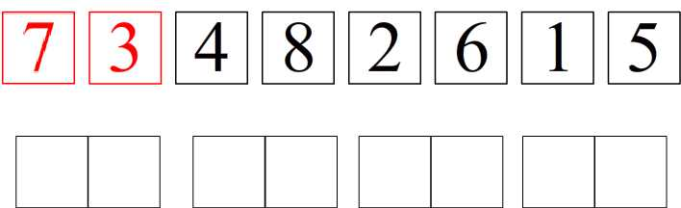
Example 1: Number list

Slide 6
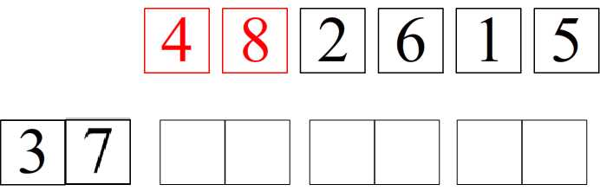
Example 1: Number list

Slide 7
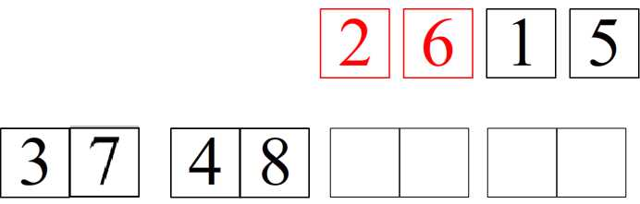
Example 1: Number list

Slide 8
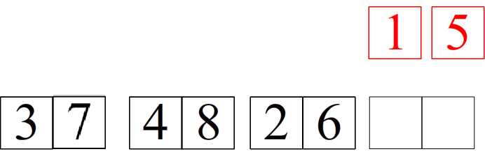
Example 1: Number list

Slide 9

Example 1: Number list

Slide 10
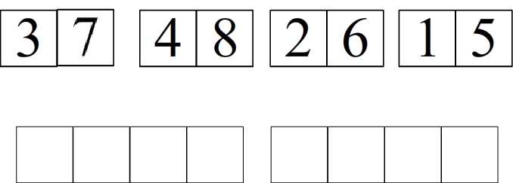
Example 1: Number list

Slide 11
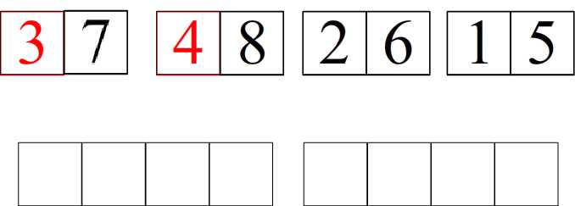
Example 1: Number list

Slide 12
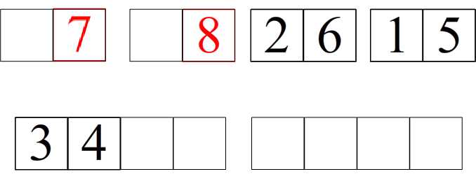
Example 1: Number list

Slide 13
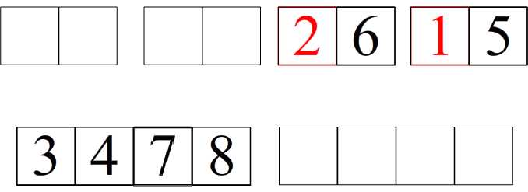
Example 1: Number list

Slide 14
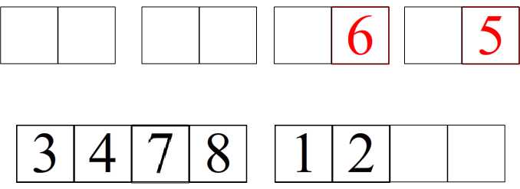
Example 1: Number list

Slide 15
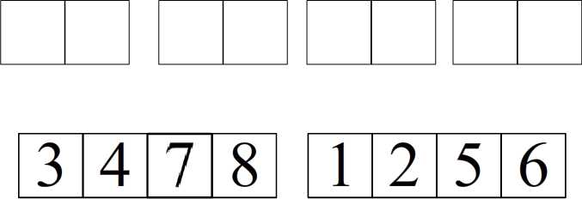
Example 1: Number list

Slide 16
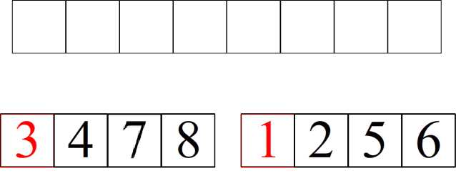
Example 1: Number list

Slide 17
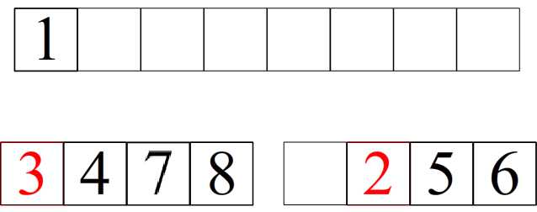
Example 1: Number list

Slide 18
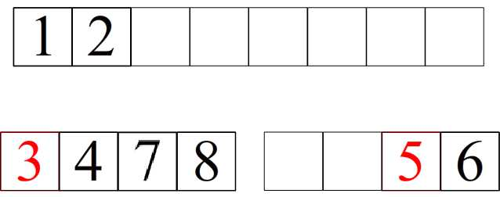
Example 1: Number list

Slide 19
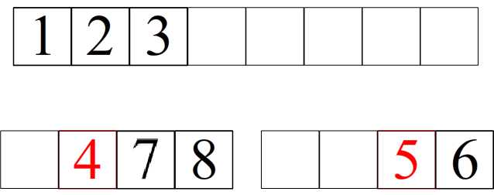
Example 1: Number list

Slide 20
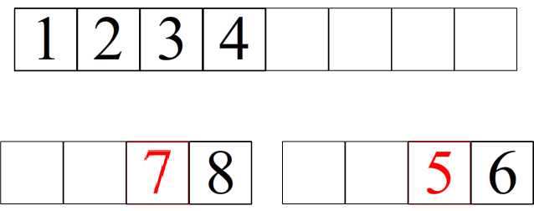
Example 1: Number list

Slide 21
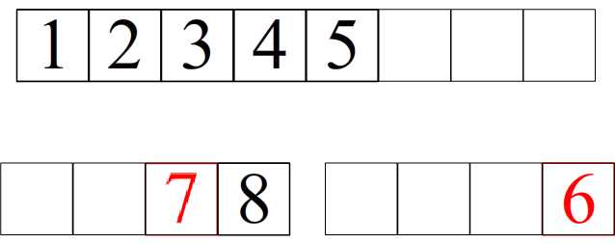
Example 1: Number list

Slide 22
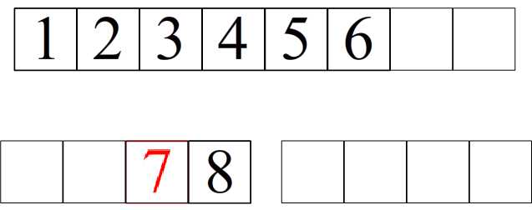
Example 1: Number list

Slide 23
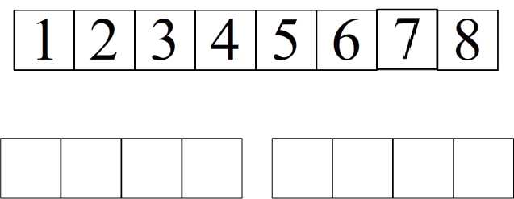
Example 1: Number list

Slide 24

Example 1: Number list

Slide 25
Example 2: Cards
Shishberg
http://www.youtube.com/watch?v=dVaHHwtf8KM
NOT made by me

Slide 26
Running Time
Best Case - O(nlogn)
Average Case – O(nlogn)
Worst Case – O(nlogn)
For all n elements, there are logn comparisons being done.

Slide 27
Running Time
No special cases to make algorithm more or less efficient (in terms of input data)
More efficient when input data structure is linked list (compared to other sorting algorithms)
Less efficient when input structure is more easily accessed (like arrays). At least when compared to other algorithms.

Slide 28
Running Time
With 10 elements, there are 10 comparisons
With 100 elements, there are 200 comparisons
With 1000 elements, there are 3000 comparisons

Slide 29
Pros and Cons
Pros
  Fairly efficient in terms of overall memory used (O(nlogn))
Cons
  Needs to dynamically allocate memory (which is slow)

Slide 30
Pros and Cons
So what does this mean?
While the calculations might take a little while, they probably won't crash your computer.

Slide 31
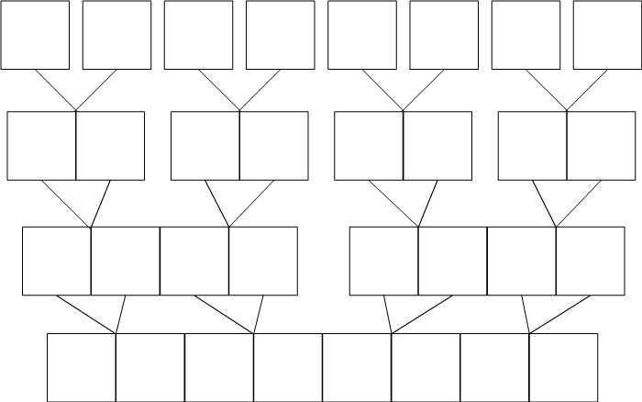
Does Merge Sort need any extra memory/data structures?
Yes

Slide 32
Does Merge Sort need any extra memory/data structures?
Must allocate new memory for subsequent arrays/linked lists
So yes, it does need these things

Slide 33
Thank You

