Slide 1
Merge Sort
Michael Morton

Slide 2
What is Merge Sort?
"Merge sort" is an algorithm that works by breaking an unsorted list of length n into n sublists, and then merges them with their adjacent lists until there is only one, sorted list remaining
It has a complexity of O(n logn)

Slide 3
Example 1:
List of length 4: [5,3,9,6]
List is broken up into 4 lists: [5], [3], [9], [6]
First list is merged with second list: [3,5]
Third list is merged with fourth list: [6,9]
Lists are merged together: [3,5,6,9]

Slide 4
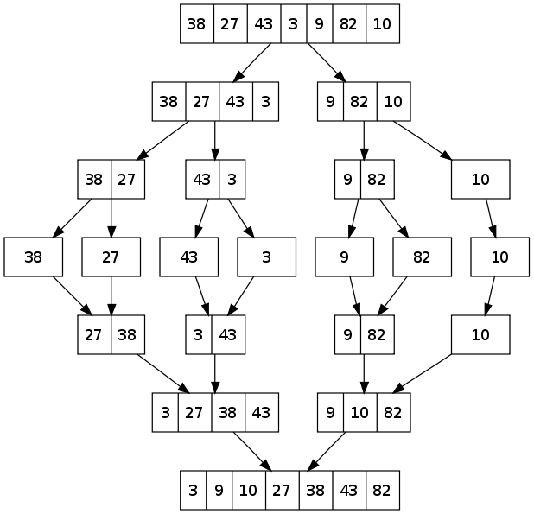
Example 2:
As the length of the list increases, the process becomes far more complex

Slide 5
Running Time
Minimum run time is one run if the list is already in sorted order
In the worst case, complexity is about n(logn)

Slide 6
When is it useful?
Merge sort is useful for its stability in sorting linked lists, and also when random access is more expensive than sequential access (because it requires sequential)

Slide 7
When is it not?
Because it uses sequential rather than random access, it is obviously less useful in a situation that is more able to use random than sequential functions
It cannot be run in place without other accompanying algorithms

Slide 8
Additional Information
The algorithm requires the creation of additional data structures (as many lists as there are elements)
Useful for merging new information into a list of current information

Slide 9
Sources
http://www.sorting-algorithms.com/bubble-sort
http://xlinux.nist.gov/dads//HTML/mergesort.html
http://opendatastructures.org/versions/edition-0.1c/ods-java/node56.html#SECTION001411000000000000000

