Slide 1
Selection Sort Method
Joon Hee Lee
August 12, 2012

Slide 2
What is Selection Sort?

Slide 3
Selection Sort is one of the many sorting algorithms
Known for being a very simple method
Although it is very simple, it has some performance advantages over more complex methods in certain cases

Slide 4
How Does It Work?
Loops through a list and performs these steps :
1st: Finds the lowest value in the list
2nd: Swaps the lowest value with the first value in the list
3rd: Start this process from the second position and repeat

Slide 5
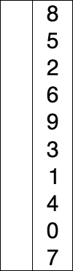
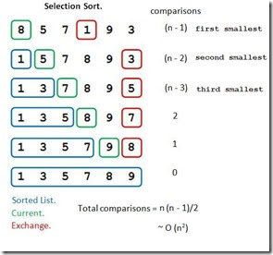
Example: Selection Sort
Credit: http://51051208.blogspot.com/
Credit: http://en.wikipedia.org/wiki/File:Selection-Sort-Animation.gif

Slide 6
Running Time
Has a time complexity of O(n^2)
Worst Case Performance : O(n^2)
Best Case Performance : O(n^2)
Average Case Performance: O(n^2)
Has to locate an item and then swap it.
The more items in a list, the more time it will take.

Slide 7
More/Less Efficient Cases
The Selection Sort method is often times an inefficient method to use as it takes a long time.
Case where it is more efficient:
Selection sort is usually faster with smaller array
Because no additional storage space is required, this method is preferred when you must sort in place or without additional space.
It is much slower when dealing with large arrays as this method has to loops through the entire list many times

Slide 8
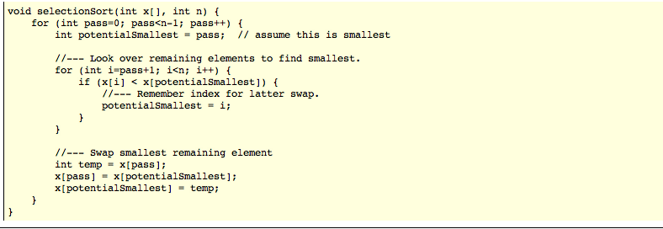
Example Selection Short Code
Source: http://www.fredosaurus.com/notes-cpp/algorithms/sorting/selectionsort.html

