Slide 1
Priority Queues and Heaps
Bryce Boe
2013/11/20
CS24, Fall 2013

Slide 2
Array of Talks
Title: "JUST THE HACKERS YOU NEED"
Location: HFH 1132 (CS conference room)
Time: 3:30 (after class)

Slide 3
Outline
Monday Recap
More Tree Properties
Priority Queue
Heaps

Slide 4
Monday Recap

Slide 5
O(n²) Sorting Algorithms
Bubble sort
Bubble the largest element to the end in each pass
Insertion sort
Insert the next element into the sorted portion of the list
Selection sort
Find the smallest item and put it in its proper location

Slide 6
O(nlog(n)) Sort Algorithms
Merge Sort
Break the problem up until you have 1 or 2 items and put them in order
Merge the sorted lists O(k) where k is the size of the small lists
T(n) = 2T(n/2) + O(n) === O(n*log(n)) (masters theorem)

Slide 7
BST Remove
If the node has no children simply remove it
Parent should point to NULL
If the node has a single child, update its parent to point to its child and remove the node
Recursive helper function should return the pointer to the new node (in addition to the removed value)

Slide 8
Removing a node with two children
Replace the value of the node with the largest value in its left-subtree (right-most descendant on the left hand side)
Make sure to save a copy of the original node to return
Then repeat the remove procedure to remove the node whose value was used in the replacement
Ignore the value of the removed node as it is still in the tree

Slide 9
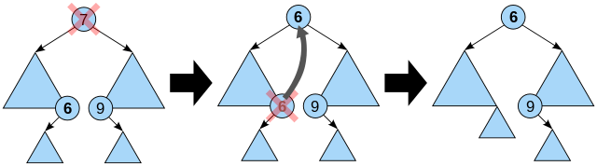
Removing a node with two children

Slide 10
More Tree Properties

Slide 11
Full Binary Tree
Full Binary Tree
A binary tree in which every node has either 0 or 2 children
Complete Binary Tree
A binary tree in which every level is completely filled save for the last where all items must be filled starting with the left-hand-side
Complete trees are always balanced

Slide 12
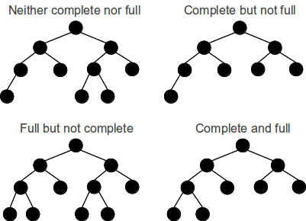
Notes:
Source: http://gsourcecode.files.wordpress.com/2012/02/complete-full-trees1.png

Slide 13
Priority Queue

Slide 14
Priority Queue
Abstract data type with operations similar to the queue
enqueue(item, priority)
Add an item to the queue
dequeue()
Remove the item with highest priority from the queue (undefined order for items with same priority)

Slide 15
Brainstorm
Discuss for a few minutes with those near you:
Attempt to come up with two functionally distinct ways to implement a priority queue as a modification, or combination of the simple structures we’ve learned in this class

Slide 16
Bounded Priority Queue
Simple trick if the number of priorities is bounded
Provide one FIFO queue for each priority
Always look for items starting from the highest queue before proceeding to the next
enqueue: O(1)
dequeue: O(1)

Slide 17
Sorted List Implementation
Use a standard linked-list implementation of a queue
Modify enqueue such that it places the item in the appropriate location in the list according to its priority
enqueue: O(n)
dequeue: O(1)

Slide 18
Tree Implementation
Construct a tree such that its root is always the highest priority
Additionally every subtree has the same property (parent is of equal or higher priority than its children)

Slide 19
HEAP

Slide 20
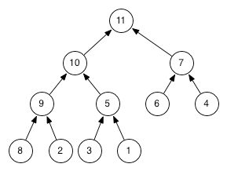
Heap
A complete tree where each node’s parent has a higher or equal priority

Slide 21
Think about it
Are there any trees that can be both a heap and a BST?
Notes:
Yes: 0-node, 1-node, or 2-node tree where the second node is on the left-hand-side
Cannot store on the right-hand side as a BST requires the node to be larger, and the Heap requires the node to be smaller

Slide 22
Heap Insertion (enqueue)
Initially insert item in the next free location (obey the completeness property)
Continue to swap it with its parents until the ordering property is valid (bubble up)
enqueue: O(log(n)) – worst cases traverses up the entire height of the tree

Slide 23
Heap removal (dequeue)
Store the value at the root to return at the end
Swap the last item in the tree with the root
Continually swap the current node with its child of highest priority until it is of higher priority than both children (bubble-down)
dequeue: O(log(n)) – worst cases traverses down the entire height of the tree

Slide 24
Lab 9
Write function to test if array is in heap-order
Arrays are great for storing complete trees
| 11 | 10 | 7 | 9 | 5 | 6 | 4 | 8 | 2 | 3 | 1 |

