Slide 1
Trees, Binary Search Trees, Lab 7, Project 2
Bryce Boe
2013/11/13
CS24, Fall 2013

Slide 2
Outline
Stack/Queue Review
Trees
Binary Search Trees
Lab 7 / Project 2

Slide 3
Stack / Queue Review
Stack operations
push
pop
Queue operations
enqueue
dequeue

Slide 4
Trees

Slide 5
Tree Explained
Data structure composed of nodes (like a linked list)
Each node in a tree can have one or more children (binary tree has at most two children)

Slide 6
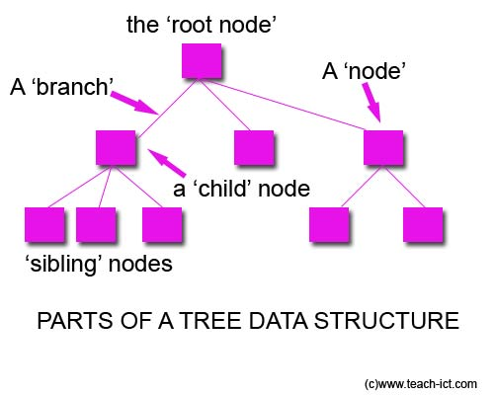
General Tree

Slide 7
Tree Properties
The root is the top-most node of the tree (has no parent)
A node’s parent is the node immediately preceding it (closer to the root)
A node can have at most two children or child nodes
A leaf is a node with no children

Slide 8
More Properties
A node’s ancestors are all nodes preceding it
A node’s descendants all all nodes succeeding it
A subtree is the complete tree starting with a given node and including its descendants

Slide 9
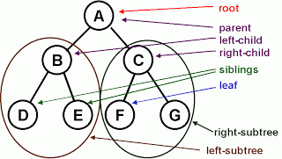
Tree properties

Slide 10
Binary Tree
Each node can have at most two children

Slide 11
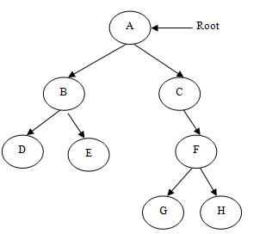
Binary Tree

Slide 12
More Properties
The depth of a node is how far it is away from the root (the root is at depth 0)
The height of a node is the maximum distance to one of its descendent leaf nodes (a leaf node is at height 0)
The height of a tree is the height of the root node

Slide 13
What is the depth of G?
3

Slide 14
What is the depth of D?
2

Slide 15
What is the height of C?
2

Slide 16
What is the height of B?
1

Slide 17
What is the height of the tree?
3

Slide 18
What nodes make up A’s right subtree?

Slide 19
Binary Search TrEES

Slide 20
Binary Search Trees
A tree with the property that the value of all descendants of a node’s left subtree are smaller, and the value of all descendants of a node’s right subtree are larger

Slide 21
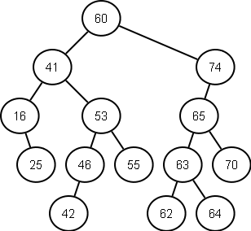
BST Example

Slide 22
BST Operations
insert(item)
Add an item to the BST
remove(item)
Remove an item from the BST
contains(item)
Test whether or not the item is in the tree
What are the running times?

Slide 23
Balanced Tree
A tree is considered balanced if
The height of the left and right subtrees differ by at most 1
The left and right subtrees are balanced

Slide 24
BST Running Times
All operations are O(n) in the worst case
Why?
Assuming a balanced tree (CS130A material):
insert: O(log(n))
delete: O(log(n))
contains: O(log(n))

Slide 25
BST Insert
If empty insert at the root
If smaller than the current node
If no node on left: insert on the left
Otherwise: set the current node to the lhs (repeat)
If larger than the current node
If no node on the right: insert on the right
Otherwise: set the current node to the rhs (repeat)
Otherwise fail the insert (attempt to insert a duplicate node)

Slide 26
BST Contains
If the value is equal SUCCESS!
If the value is smaller, continue down the left subtree
If the value is larger, continue down the right subtree
If the node is a leaf and the value does not match, FAILURE!

Slide 27
BST iterative traversal
ADT items;
items.add(root); // Seed the ADT with the root
while(items.has_stuff() {
Node *cur = items.random_remove();
do_something(cur);
items.add(cur.get_lhs()); // might fail
items.add(cur.get_rhs()); // might fail
}

Slide 28
A look at lab 7 and project 2
Lab 7 requires you to write insert, queue_output and a destructor for a BST
The first part of project 2 requires you to utilize this code to implement a virtual tree

Slide 29
BST Remove
If the node has no children simply remove it
If the node has a single child, update its parent pointer to point to its child and remove the node

Slide 30
Removing a node with two children
Replace the value of the node with the largest value in its left-subtree (right-most descendant on the left hand side)
Then repeat the remove procedure to remove the node whose value was used in the replacement

Slide 31
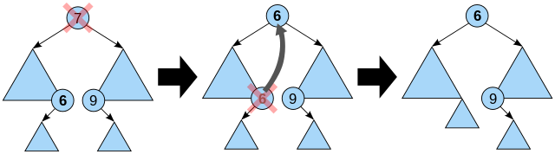
Removing a node with two children

