Slide 1
Recursion
Bryce Boe
2013/11/18
CS24, Fall 2013

Slide 2
Outline
Wednesday Recap
Lab 7 Iterative Solution
Recursion
Binary Tree Traversals
Lab 7 Recursive Solution
Merge Sort
BST Remove

Slide 3
Wednesday Recap

Slide 4
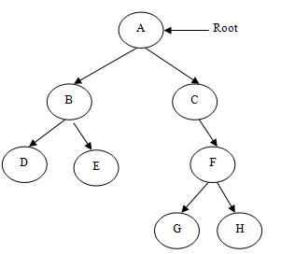
What is the depth of G?
3

Slide 5
What is the height of B?
1

Slide 6
What is the height of the tree?
3

Slide 7
Is the tree balanced?
No

Slide 8
Lab 7 Solution

Slide 9
Recursion

Slide 10
What is recursion?
The process of solving a problem by dividing it into similar subproblems
Examples
Factorial: 5! = 5 * 4! = 5 * 4 * 3!
Length of linked list: L(node) = 1 + L(node->next)
Fibonacci Numbers: F(N) = F(n-1) + F(n-2)

Slide 11
Factorial
Base Case:
F(1) = 1
General Case
F(n) = n * F(n-1)

Slide 12
Factorial
int factorial(n) {
if (n < 1) throw 1; // Error condition
else if (n == 1) // Base Case
return 1;
else // General Case
return n * factorial(n – 1);
}

Slide 13
Linked List Length
Base Case:
Length(last node) = 1
General Case:
Length(node) = 1 + Length(node->next);

Slide 14
Linked List Length (option 1)
int length(Node *n) {
if (n == NULL) // Base Case
return 0;
else // General Case
return 1 + length(n->next);
}

Slide 15
Linked List Length (option 2)
int length(Node *n) {
if (n == NULL) throw 1; // Error condition
else if (n->next == NULL) // Base Case
return 1;
else // General Case
return 1 + length(n->next);
}
What is the size of the simplified activation record?
How much space is required for a list with 8 items?

Slide 16
Fibonacci Numbers
Base Cases:
F(0) = 0
F(1) = 1
General Case:
F(n) = F(n-1) + F(n-2)

Slide 17
Recursion and the Stack Segment
main calls Factorial(3)
main
Factorial(3)
Factorial(2)
Factorial(1)

Slide 18
Recursion question
How many activation records are created when calling Fibonacci(0)?
Fibonacci(1)?
Fibonacci(2)?
Fibonacci(3)?
Fibonacci(4)?
Fibonacci(5)?
1
1
3
5
9
15

Slide 19
BINARY Tree TRAVERSALS

Slide 20
Depth-First Tree Traversals
Can be done iteratively (with a stack) or recursively
Pre-order
Process the node, recurse on left subtree, recurse on right subtree
In-order
Recurse on the left subtree, process the node, recurse on the right subtree
Post-order
Recurse on the left subtree, recurse on the right subtree, process the node

Slide 21
Pre-Order Traversal
A -> B - > D -> E -> C -> F -> G -> H

Slide 22
In-Order Traversal
D -> B -> E -> A -> C -> G -> F -> H

Slide 23
Post-Order Traversal
D -> E -> B -> G -> H -> F -> C -> A

Slide 24
Breadth-first Traversal
Cannot be done recursively
Done iteratively with the help of a queue
You did this in lab 7

Slide 25
Breadth-first (queue lhs before rhs)
A -> B -> C -> D -> E -> F -> G -> H

Slide 26
Question
Which of the traversals will output a sorted version of a binary search tree?
When should you use recursion / iteration?
Most importantly: use what you’re comfortable with
With recursion be careful of stack depth (O(log(n)) memory is okay, O(n) is probably not)
CHALLENGE:
Implement the three depth-first traversals iteratively

Slide 27
Lab 7 recursive solution

Slide 28
Lab 7 Recursive ~BST
template <class T>
void bst_destruct(BinaryNode<T> *node) {
if (node != NULL) {
bst_destruct(node->get_rhs());
bst_destruct(node->get_lhs());
delete node;
}
}
template <class T>
BST<T>::~BST() {
bst_destruct(root);
}
What traversal order is this?
How much memory is required?
Notes:
Traversal is post-order
Memory: O(height of tree) – unbalanced O(n), balanced O(log(n))

Slide 29
Lab 7 Recursive insert
template <class T>
bool BST<T>::insert(T item) {
try {
root = bst_insert(root, item);
return true;
}
catch (int e) {
return false;
}
}

Slide 30
Lab 7 Recursive insert
template <class T>
BinaryNode<T> *bst_insert(BinaryNode<T> *node, T item) {
if (node == NULL)
return new BinaryNode<T>(item, NULL, NULL);
else if (item == node->get_data())
throw 1;
else if (item < node->get_data())
node->set_lhs(bst_insert(node->get_lhs(), item));
else
node->set_rhs(bst_insert(node->get_rhs(), item));
return node;
}
How much memory is required?

Slide 31
Save space by using const references where appropriate
template <class T>
BinaryNode<T> *bst_insert(BinaryNode<T> *node, const T &item) {
if (node == NULL)
return new BinaryNode<T>(item, NULL, NULL);
else if (item == node->get_data())
throw 1;
else if (item < node->get_data())
node->set_lhs(bst_insert(node->get_lhs(), item));
else
node->set_rhs(bst_insert(node->get_rhs(), item));
return node;
}

Slide 32
Merge Sort

Slide 33
O(nlog(n)) Sort Algorithms
Merge Sort
Divide the problem in half until you have 1 or 2 items and put them in order
Merge the two sorted halves
T(n) = 2T(n/2) + O(n) === O(n*log(n))
(masters theorem)

Slide 34
Coding Hint
What’s wrong with the following?
int *tmp = new int[10];
tmp = some_function();
results in a memory leak

Slide 35
BST Removal

Slide 36
Recall
A binary search tree is a tree with the property that the value of all descendants of a node’s left subtree are smaller, and the value of all descendants of a node’s right subtree are larger

Slide 37
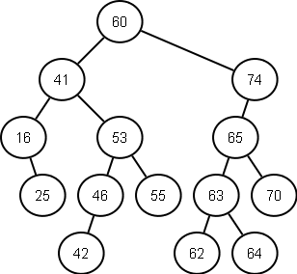
BST Example

Slide 38
BST Remove
If the node has no children simply remove it
If the node has a single child, update its parent pointer to point to its child and remove the node

Slide 39
Removing a node with two children
Replace the value of the node with the largest value in its left-subtree (right-most descendant on the left hand side)
Note you could use the smallest value in the right-subtree (but for consistency please don’t)
Then repeat the remove procedure to remove the node whose value was used in the replacement

Slide 40
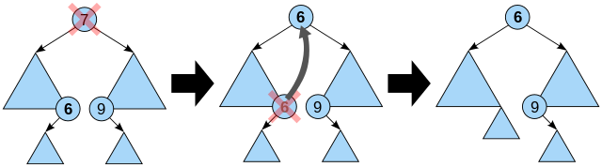
Removing a node with two children

