Slide 1
Trees, Binary Search Trees, Recursion, Project 2
Bryce Boe
2013/08/01
CS24, Summer 2013 C

Slide 2
Outline
Stack/Queue Review
Trees
Recursion
Binary Search Trees
Project 2

Slide 3
Stack / Queue Review
Stack operations
push
pop
Queue operations
enqueue
dequeue

Slide 4
Trees

Slide 5
Tree Explained
Data structure composed of nodes (like a linked list)
Each node in a tree can have one or more children (binary tree has at most two children)

Slide 6
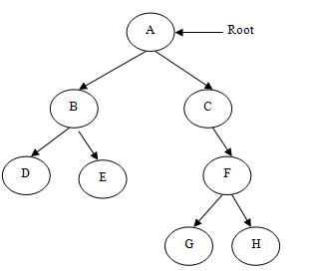
Binary Tree

Slide 7
Tree Properties
The root is the top-most node of the tree (has no parent)
A node’s parent is the node immediately preceding it (closer to the root)
A node can have at most two children or child nodes
A leaf is a node with no children

Slide 8
More Properties
A node’s ancestors are all nodes preceding it
A node’s descendants all all nodes succeeding it
A subtree is the complete tree starting with a given node and including its descendants

Slide 9
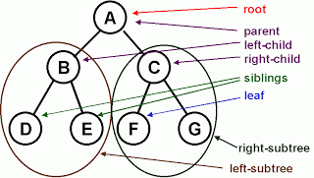
Tree properties

Slide 10
More Properties
The depth of a node is how far it is away from the root (the root is at depth 0)
The height of a node is the maximum distance to one of its descendent leaf nodes (a leaf node is at height 0)
The height of a tree is the height of the root node

Slide 11
What is the depth of G?
3

Slide 12
What is the depth of D?
2

Slide 13
What is the height of C?
2

Slide 14
What is the height of B?
1

Slide 15
What is the height of the tree?
3

Slide 16
What nodes make up A’s right subtree?

Slide 17
Recursion

Slide 18
What is recursion?
The process of solving a problem by dividing it into similar subproblems
Examples
Factorial: 5! = 5 * 4! = 5 * 4 * 3!
Fibonacci Numbers: F(N) = F(n-1) + F(n-2)
Length of linked list: L(node) = 1 + L(node->next)

Slide 19
Factorial
Base Case:
F(1) = 1
General Case
F(n) = n * F(n-1)

Slide 20
Factorial
int factorial(n) {
if (n < 1) throw 1; // Error condition
else if (n == 1) // Base Case
return 1;
else // General Case
return n * factorial(n – 1);
}

Slide 21
Fibonacci Numbers
Base Cases:
F(0) = 0
F(1) = 1
General Case:
F(n) = F(n-1) + F(n-2)

Slide 22
Linked List Length
Base Case:
Length(last node) = 1
General Case:
Length(node) = 1 + Length(node->next);

Slide 23
Linked List Length (option 1)
int length(Node *n) {
if (n == NULL) // Base Case
return 0;
else // General Case
return 1 + length(n->next);
}

Slide 24
Linked List Length (option 2)
int length(Node *n) {
if (n == NULL) throw 1; // Error condition
else if (n->next == NULL) // Base Case
return 1;
else // General Case
return 1 + length(n->next);
}

Slide 25
Recursion and the Stack Segment
main calls Factorial(3)
main
Factorial(3)
Factorial(2)
Factorial(1)

Slide 26
C++ Examples
See
week6/recursion.cpp
week6/trees.cpp

Slide 27
Binary Search TrEES

Slide 28
Binary Search Trees
A tree with the property that the value of all descendants of a node’s left subtree are smaller, and the value of all descendants of a node’s right subtree are larger

Slide 29
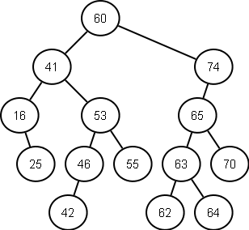
BST Example

Slide 30
BST Operations
insert(item)
Add an item to the BST
remove(item)
Remove an item from the BST
contains(item)
Test whether or not the item is in the tree

Slide 31
BST Running Times
All operations are O(n) in the worst case
Why?
Assuming a balanced tree (CS132 material)
insert: O(log(n))
delete: O(log(n))
contains: O(log(n))

Slide 32
BST Insert
If empty insert at the root
If smaller than the current node
If no node on left: insert on the left
Otherwise: set the current node to the lhs (repeat)
If larger than the current node
If no node on the right: insert on the right
Otherwise: set the current node to the rhs (repeat)

Slide 33
BST Contains
Check the current node for a match
If the value is smaller, check the left subtree
If the value is larger, check the right subtree
If the node is a leaf and the value does not match, return False

Slide 34
BST iterative traversal
ADT items;
items.add(root); // Seed the ADT with the root
while(items.has_stuff() {
Node *cur = items.random_remove();
do_something(cur);
items.add(cur.get_lhs()); // might fail
items.add(cur.get_rhs()); // might fail
}

Slide 35
BST Remove
If the node has no children simply remove it
If the node has a single child, update its parent pointer to point to its child and remove the node

Slide 36
Removing a node with two children
Replace the value of the node with the largest value in its left-subtree (right-most descendant on the left hand side)
Then repeat the remove procedure to remove the node whose value was used in the replacement

Slide 37
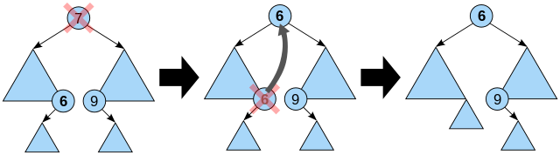
Removing a node with two children

Slide 38
Project 2
Add more functionality to the binary search tree
Implement ~Tree()
Implement remove(item)
Implement sorted_output() // Requires recursion
Implement distance(item_a, item_b);
Possibly implement one or two other functions (will be added later)

