Slide 1
More Binary Search Trees, Project 2
Bryce Boe
2013/08/06
CS24, Summer 2013 C

Slide 2
Outline
Lab 5 Solution
Tree Traversals
More Binary Search Trees
Project 2

Slide 3
Thursday Recap

Slide 4
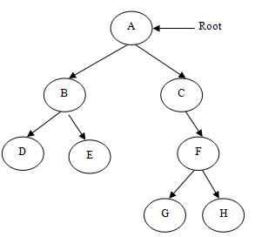
What is the depth of G?
3

Slide 5
What is the height of B?
1

Slide 6
What is the height of the tree?
3

Slide 7
Recursion question
How many activation records are created when calling Fibonacci(0)?
Fibonacci(1)?
Fibonacci(2)?
Fibonacci(3)?
Fibonacci(4)?
Fibonacci(5)?
1
1
3
5
9
15

Slide 8
Lab 5 Solution
Going over in class
Make private request for bst.cpp if you need a 100% working solution

Slide 9
Depth-First Tree Traversals
Can be done iteratively (with a stack) or recursively
Pre-order
Process the node, recurse on left subtree, recurse on right subtree
In-order
Recurse on the left subtree, process the node, recurse on the right subtree
Post-order
Recurse on the left subtree, recurse on the right subtree, process the node

Slide 10
Pre-Order Traversal
A -> B - > D -> E -> C -> F -> G -> H

Slide 11
In-Order Traversal
D -> B -> E -> A -> C -> G -> F -> H

Slide 12
Post-Order Traversal
D -> E -> B -> G -> H -> F -> C -> A

Slide 13
Breadth-first Traversal
Cannot be done recursively
Done iteratively with the help of a queue

Slide 14
Breadth-first (queue lhs before rhs)
A -> B -> C -> D -> E -> F -> G -> H

Slide 15
Question
Which of the traversals will output a sorted version of a binary search tree?

Slide 16
More Binary Search TrEES

Slide 17
Binary Search Trees
Recall
A binary search tree is a tree with the property that the value of all descendants of a node’s left subtree are smaller, and the value of all descendants of a node’s right subtree are larger

Slide 18
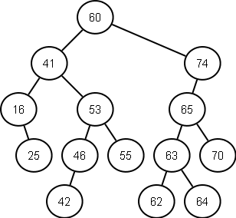
BST Example

Slide 19
BST Operations
insert(item) – done in Lab 5
Add an item to the BST
remove(item) – to complete in project 2
Remove an item from the BST
contains(item) – done in Lab 5
Test whether or not the item is in the tree

Slide 20
BST Remove
If the node has no children simply remove it
If the node has a single child, update its parent pointer to point to its child and remove the node

Slide 21
Removing a node with two children
Replace the value of the node with the largest value in its left-subtree (right-most descendant on the left hand side)
Then repeat the remove procedure to remove the node whose value was used in the replacement

Slide 22
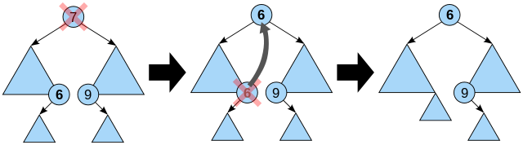
Removing a node with two children

Slide 23
Project 2: Virtual Directory Tree

