Slide 1
Operating Systems
Bryce Boe
2012/08/07
CS32, Summer 2012 B

Slide 2
Outline
HW1 Review
Operating Systems Overview
Linux Software Architecture

Slide 3
HW1 Review
26 submissions, nearly all 14/14
One issue with the grader feedback:
Lack of newlines at the end of the input is hard to detect, this has been corrected
Going forward emailed submissions will not be accepted
atoi v. stringstream example
See str_to_int.cpp

Slide 4
Operating Systems Overview

Slide 5
System Resources
Central Processing Unit (CPU)
Main memory, aka random access memory (RAM)
Input/Output (I/O) devices
Keyboard, mouse, camera
Storage devices, network, printers, display

Slide 6
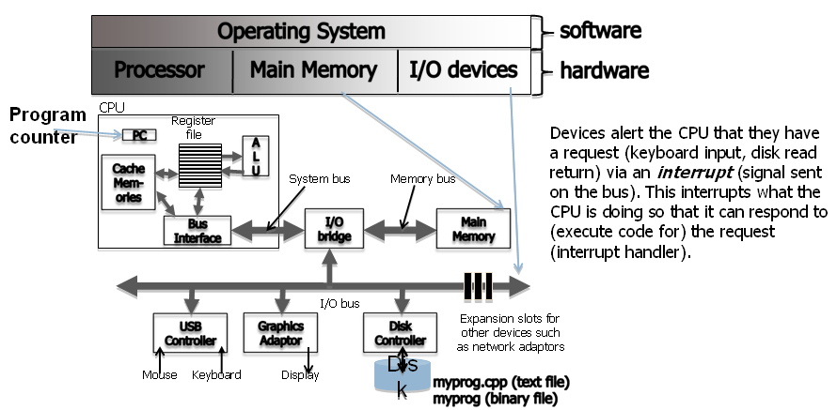
Hardware and the operating system
Notes:
Graphic taken from Mike Costanzo's CS32 slides that had the attribution: Thanks to Chandra Krintz and Kevin Sanft, for this figure and some other parts of these lecture notes.

Slide 7
Brief CPU Processing Overview
Program instructions and data are in memory
Program Counter (PC) register in CPU keeps track of the current instruction location
CPU stores the next few instructions in cache
Some needed data is also cached
Multiple layers of cache can be employed
CPU components typically share the same data width (number of bits)
Registers, Arithmetic logic unit (ALU), buses (wires)
Notes:
Contents adapted from Mike Costanzo’s CS32_S12 slides

Slide 8
Processing Continued
The CPU is dumb
It simply continues executing the next instruction until interrupted
Fetch -> decode -> execute (repeat)
Can only really perform basic arithmetic
Question:
How can we manage these operations and resources effectively?
Notes:
Question adapted from Mike Costanzo’s CS32_S12 slides.
Ponder the lack of an operating system (like old Apple 2 programs)

Slide 9
Answer
By using operating system!

Slide 10
Purpose of the Operating System
Facilitate launching applications
Manage system resources
Provide security
Provide inter-process communication (IPC)
Additionally OS may:
Provide developer libraries
Provide program generation tools
Text editors, compilers

Slide 11
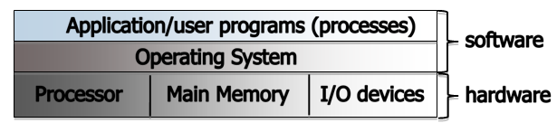
Two ways to consider the OS
Bottom-up view
OS is software that allocates and de-allocates computer resources – efficiently, fairly, orderly and securely
Top-down view
OS is software that isolates us from the complications of hardware resources
In other words, an OS is an application programmer’s and a user’s interface to computer operations
Notes:
Contents adapted from Mike Costanzo’s CS32_S12 slides

Slide 12
Types of Operating Systems
Single User, Single Process
Dos, Windows 3.1
Single User, Multiprocess
Windows 95/98/XP
Multiuser, Multiprocess
Linux, OS X, Windows Server
Requires fairness and and security considerations

Slide 13
Consider device latencies/access times
(all times approximate)
CPU: 3 cycles per ns
L1 Cache: 1 ns (3 CPU cycles)
L2 Cache: 4 ns (12 CPU cycles)
RAM: 80 ns (240 CPU cycles)
SSD: 0.1 ms (300,000 CPU cycles)
HDD: 5 ms (15,000,000 CPU cycles)

Slide 14
Running multiple processes
Multiprogramming
The yielding of the CPU to another process when performing IO
Multitasking (aka timesharing)
The forced yielding of processes at small intervals to give the impression of concurrently running processes

Slide 15
Multiprocessing benefits
Increase CPU throughput
Perform other operations while waiting on I/O
Increase resource utilization
Resources can maintain a queue of tasks so they always have work to complete

Slide 16
Linux Software Architecture

Slide 17
Brief Unix History
AT&T Bell Labs – System V standard
1969-70: Ken Thompson wrote Unix in “B”
1972: Dennis Ritchie developed C – a better B
Unix rewritten in C, 1973
… eventually System V, 1983
UC Berkeley – BSD standard
Started with a copy of System IV, late 1970s
Lots of changes/additions in 1980s
Now FreeBSD
Open source - Linux, since early 1990s
Notes:
Contents copied verbatim from Mike Costanzo’s CS32_S12 slides

Slide 18
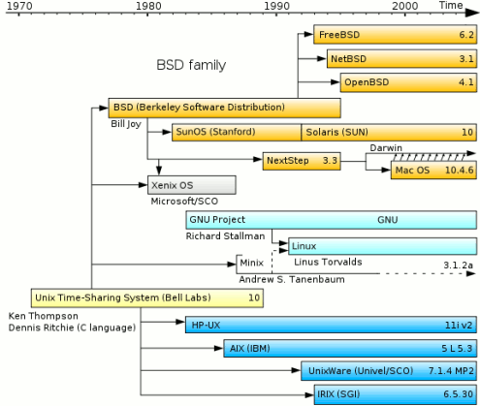
Unix-born operating systems

Slide 19
Unix Philosophy
Small is beautiful
Each program does just one thing
Pipe commands (or use successive functions in C) to accomplish more complicated things
Less typing is best (using 1970s computers)
That’s why so many commands are short (ls, cp, mv, …)
Users/programmers know what they are doing
That’s what makes the brevity sufficient
Means very few restrictions (or safety nets) apply
Notes:
Contents copied verbatim from Mike Costanzo’s CS32_S12 slides

Slide 20
Linux
Started in 1991 by Linus Torvalds
Open Source, GPL
Free to use, modify, distribute
Theoretically allows bugs and security holes to be found faster
Multi-user, Multitasking OS
Support for both command line and graphical user interfaces
Notes:
Contents adapted from Mike Costanzo’s CS32_S12 slides

Slide 21
Linux Distributions
A Linux distribution is a collection of user-level applications and libraries built around the Linux kernel
Well known distributions:
Ubuntu/Debian
CentOS/Fedora/RedHat

Slide 22
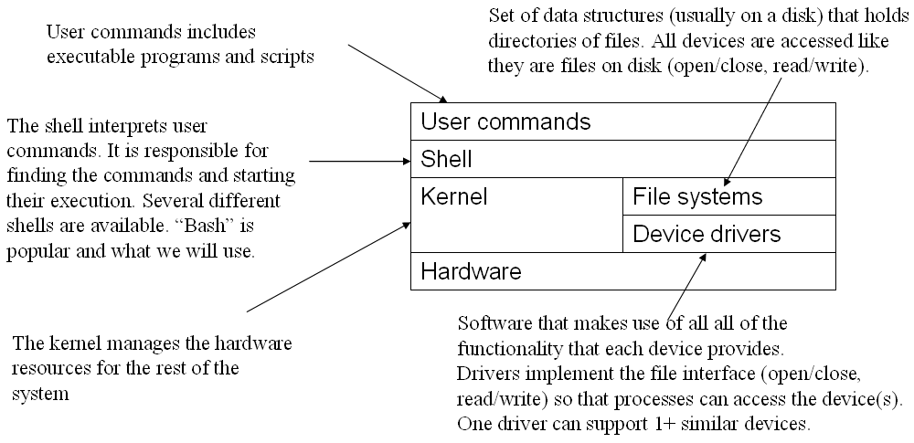
Linux Architecture
Notes:
Image from from Mike Costanzo’s CS32_S12 slides with attribution: Thanks again to Chandra Krintz and Kevin Sanft.

Slide 23
Kernel Services
File management
Permissions and access control
Manages files and folders
Process Management and IPC
Process scheduling
Starting, stopping, suspending, swapping
IPC: pipes, named pipes, sockets

Slide 24
Kernel Services cont.
Memory Management
Address spaces for processes
Provides isolation between processes and the kernel (hopefully)
Manages allocation and de-allocation of memory to processes
Disk scheduling
Mange how processes be given priority to access the disk?

Slide 25
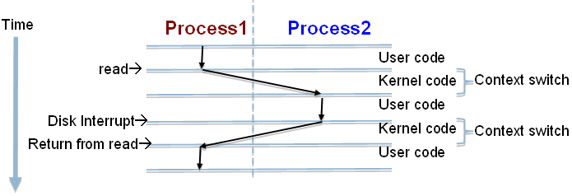
CPU Scheduling
Kernel sends interrupt to a process to give another process a turn to use the CPU
Processes can give up CPU when they don’t need it (e.g. waiting on I/O device)
Notes:
Contents copied verbatim from Mike Costanzo’s CS32_S12 slides

Slide 26
Processes request kernel services
Using system calls (read, write, fork, …)
OOP idea: these are the kernel’s interface
Processes access devices just like files – that’s how they are represented by the kernel, and they occupy places in the file system
Use open, close, read, write, release, seek, …
Or indirectly, by using shell commands or libraries/programs that use system calls
Notes:
Contents copied verbatim from Mike Costanzo’s CS32_S12 slides

Slide 27
A few system calls
open: open a “file”
read: read data from a “file”
write: write data to a “file”
exec: begin executing a new program
fork: start a new process as a copy of the current one

Slide 28
Example Library Function Chain
fclose: posix C close file stream function <stdio.h>
close: unix close file descriptor function <unistd.h>
Invokes the following system call (assembly)
mov ebx, 0 # indicate we want to close fd 0
mov eax, 6 # system call number 6 is close
int 80h # send interrupt 80 for system calls

Slide 29
For tomorrow
Get the reader if you don’t already have it
Finish the first section of the reader “Introduction to operating systems, Unix and shells.”
Begin reading section 3 of the reader “Processes”

