Slide 1
Programs in Memory
Bryce Boe
2012/08/29
CS32, Summer 2012 B

Slide 2
Overview
Project 2 Overview
Inheritance and assignment operator
Virtual Keyword / Polymorphism
Abstract classes
Compilation Process
Programs on Disk and in Memory

Slide 3
Project 2: A semi-simple card game
Turn-based card game where the goal is to eliminate other players by bringing their hp down to zero
Resources (created only once at the start):
Cards
Can have multiple instances of the same card
Player

Slide 4
Classes
Game
Deals cards
Hands control to players in order
Player (abstract)
Has two sets of cards (deck and discard)
Plays cards on other players (or themselves)
Deck (of cards)
Simple AST for holding cards and shuffling
Card
Can attack or heal other players

Slide 5
Relevant Card Interface
virtual void perform_action(from, to, hp)
Called indirectly by player to perform the card’s action on another player
virtual void discard()
Called by player when Card is discarded
virtual int get_hp()
Report the hp this card can attack (negative value) or heal (postive value) with

Slide 6
Relevant Player Interface
virtual void take_turn(const Card& card);
Needs to determine who to play card on.

Slide 7
Your Task
Add additional Cards
ReflectorCard
Heals the attacker while performing the attack
RolloverHPCard
Left over hp can be accumulated and used on later turns
SnowballCard
Becomes stronger each time it is played

Slide 8
Implement Additional Players
AttackWeakest
Always attack the weakest player
???
Undetermined as of yet

Slide 9
Inheritance and Assignment Operator
Often want to call parent’s assignment operator

Slide 10
Virtual Keyword
Allows for late binding, aka dynamic dispatch
Essentially Polymorphism
Associate many meanings to one function

Slide 11
Abstract Classes
Classes can have purely virtual functions (no definition)
A class with purely virtual functions are said to be abstract classes
Cannot directly declare instances of abstract classes
virtual void output() const = 0;

Slide 12
Programs on Disk and Memory

Slide 13
Program building
Have: source code – human readable instructions
Need: machine language program – binary instructions and associated data regions, ready to be executed
clang/gcc does two basic steps: compile, then link
To compile means translate to object code
To link means to combine with other object code (including library code) into an executable program
Notes:
Slide copied verbatim from Mike Costanzo’s cs32s2012 slides with updated clang reference.

Slide 14
Link combines object codes
From multiple source files and/or libraries
e.g., always libc.a
Use -c option with clang/gcc to stop after creating .o file
-bash-4.1$ clang -c mypgm.c ; ls mypgm*
mypgm.c mypgm.o
Is necessary to compile a file without a main function
Later link it to libraries – alone or with other object files:
-bash-4.1$ clang -o mypgm mypgm.o ; ls mypgm*
mypgm mypgm.c mypgm.o
Notes:
Slide copied verbatim from Mike Costanzo’s cs32s2012 slides with updated clang reference.

Slide 15
Compiling: 3 steps with C/C++
First the preprocessor runs
Creates temporary source code with text substitutions as directed
Use clang –E to run it alone – output goes to stdout
Then the source is actually compiled to assembly code
Use clang -S to stop at this step and save code in .s file
Last, assembler produces the object code (machine language)
Notes:
Slide copied verbatim from Mike Costanzo’s cs32s2012 slides with updated clang reference.

Slide 16
Another View
Usually performed by clang/clang++/gcc/g++ in one uninterrupted sequence
Notes:
Slide copied verbatim from Mike Costanzo’s cs32s2012 slides with updated clang reference.

Slide 17
Layout of C/C++ programs
Source code ←
… becomes
Object module →
Notes:
Slide copied verbatim from Mike Costanzo’s cs32s2012 slides.

Slide 18
A sample C program – demo.c
#include <stdio.h>
int a[10]={0,1,2,3,4,5,6,7,8,9};
int b[10];
void main(){
int i;
static int k = 3;
for(i = 0; i < 10; i++) {
printf("%d\n",a[i]);
b[i] = k*a[i];
}
}
Has text section: the machine code
Has initialized global data: a
Uninitialized global data: b
Static data: k
Has a local variable: i
Notes:
Slide copied verbatim from Mike Costanzo’s cs32s2012 slides.

Slide 19
A possible structure of demo.o
Object module contains neither uninitialized data (b), nor any local variables (i)
Notes:
Slide copied verbatim from Mike Costanzo’s cs32s2012 slides.

Slide 20
Linux object file format
\177ELF
.text
…
.rodata
…
.data
…
.bss
…
.symtab
…
.rel.text
…
.rel.data
…
.debug
…
.line
…
Section header table
“ELF” – stands for Executable and Linking Format
A 4-byte magic number followed by a series of named sections
Addresses assume the object file is placed at memory address 0
When multiple object files are linked together, we must update the offsets (relocation)
Tools to read contents: objdump and readelf – not available on all systems
Notes:
Slide copied verbatim from Mike Costanzo’s cs32s2012 slides.

Slide 21
ELF sections
\177ELF
.text
…
.rodata
…
.data
…
.bss
…
.symtab
…
.rel.text
…
.rel.data
…
.debug
…
.line
…
Section header table
.text = machine code (compiled program instructions)
.rodata = read-only data
.data = initialized global variables
.bss = “block storage start” for uninitialized global variables – actually just a placeholder that occupies no space in the object file
.symtab = symbol table with information about functions and global variables defined and referenced in the program
Notes:
Slide copied verbatim from Mike Costanzo’s cs32s2012 slides.

Slide 22
ELF Sections (cont.)
\177ELF
.text
…
.rodata
…
.data
…
.bss
…
.symtab
…
.rel.text
…
.rel.data
…
.debug
…
.line
…
Section header table
.rel.text = list of locations in .text section that need to be modified when linked with other object files
.rel.data = relocation information for global variables referenced but not defined
.debug = debugging symbol table; only created if compiled with -g option
.line = mapping between line numbers in source and machine code in .text; used by debugger programs
Notes:
Slide copied verbatim from Mike Costanzo’s cs32s2012 slides.

Slide 23
Creation of a load module
Interleaved from multiple object modules
Sections must be “relocated”
Addresses relative to beginning of a module
Necessary to translate from beginnings of object modules
When loaded – OS will translate again to absolute addresses
Notes:
Slide copied verbatim from Mike Costanzo’s cs32s2012 slides.

Slide 24
Loading and memory mapping
Includes memory for stack, dynamic data (i.e., free store), and un-initialized global data
Physical memory is shared by multiple programs
Notes:
Slide copied verbatim from Mike Costanzo’s cs32s2012 slides.

Slide 25
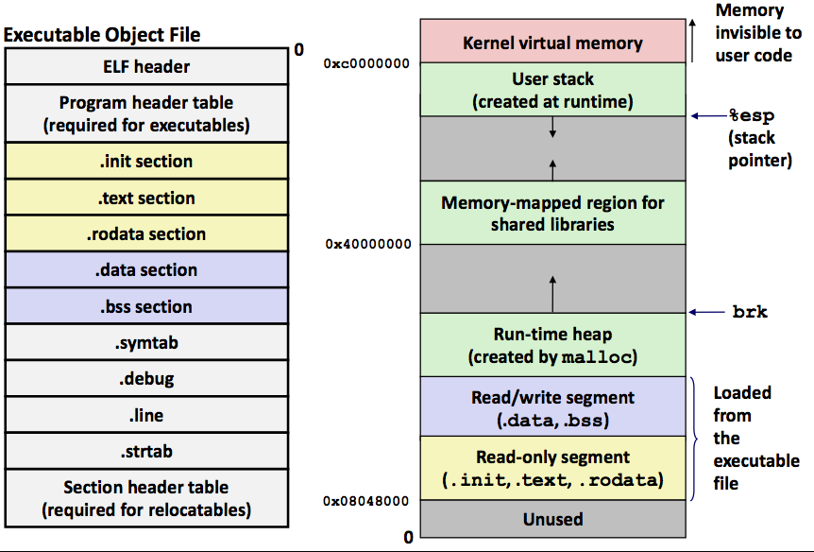
Sections of an executable file
Segments:
Notes:
Slide copied verbatim from Mike Costanzo’s cs32s2012 slides.

