Slide 1
Variables
Bryce Boe
2012/09/05
CS32, Summer 2012 B

Slide 2
Overview
Review of Variable Segment Locations
Variable types and storage

Slide 3
Review
The program’s code is stored in the text segment (it is read-only)
The value(s) of initialized global and static variables are stored in the data segment
The value(s) of uninitialized global and static variables are stored in the bss segment
The value(s) of local variables are stored on the stack
The value(s) of dynamically allocated variables are stored on the heap

Slide 4
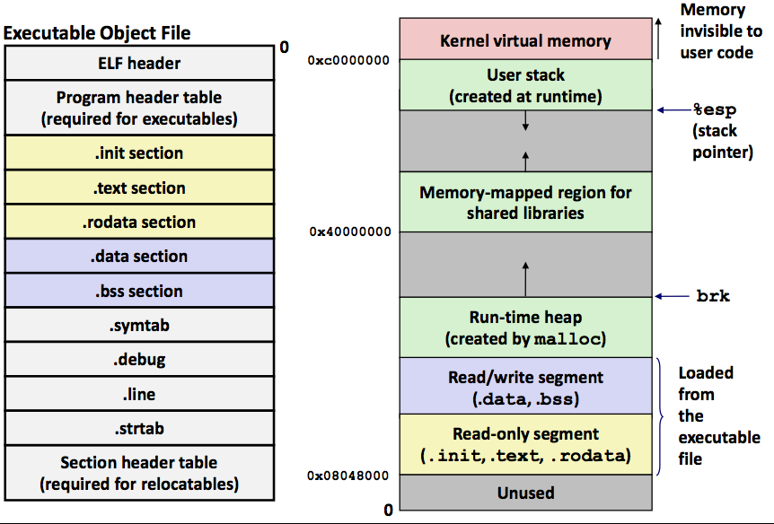
Sections of an executable file
Segments:
Notes:
Slide copied verbatim from Mike Costanzo’s cs32s2012 slides.

Slide 5
Where is all the data stored?
int a1[] = {5, 6, 7, 8, 9};
char msg[] = “hello world”;
int main {
static int call_count = 0;
int i;
return 0;
}

Slide 6
Where is all the data stored?
int a1[5];
char *msg;
int main {
int blah[16];
string *tmp = new string(“some message”);
return 0;
}

Slide 7
Where is all the data stored?
int a1[5];
int main {
Point p;
return 0;
}
class Point {
private:
int a;
int b;
string *name;
};

Slide 8
How do initialized local arrays work?
void main2(int count) {
if (count <= 0) return;
int array[] = {0, 1, 2, 3, 4};
main2(count – 1);
}
int main() {
main2(3);
return 0;
}

Slide 9
Function’s Activation Record
Stores:
Return value
Previous AR’s ebp (base pointer)
Function parameters
Function local variables
1 activation record per function call (allows for recursion)

Slide 10
Why is mixing data and control on the stack not the best idea?
Data
Variable values
Control
Return value
Previous EBP
Buffer overflow example

Slide 11
Variables and objects in memory
'A'
16916 (short big endian)
01000001
01000010
00010100
Variables and data objects are data containers with names
The value of the variable is the code stored in the container
To evaluate a variable is to fetch the code from the container and interpret it properly
To store a value in a variable is to code the value and store the code in the container
The size of a variable is the size of its container
Notes:
Slide copied verbatim from Mike Costanzo’s cs32s2012 slides.

Slide 12
Variable Types and Storage

Slide 13
Overflow is when a data code is larger than the size of its container
e.g., char i; // just 1 byte
int *p = (int*)&i; // legal
*p = 1673579060;
// result if "big endian" storage:
If whole space (X) belongs to this program:
Seems OK if X does not contain important data for rest of the program’s execution
Bad results or crash if important data are overwritten
If all or part of X belongs to another process, the program is terminated by the OS for a memory access violation (i.e., segmentation fault)
Notes:
Slide copied verbatim from Mike Costanzo’s cs32s2012 slides.

Slide 14
More about overflow
Previous slide showed example of "right overflow" – result truncated (also warning)
Compilers handle "left overflow" by truncating too (usually without any warning)
Easily happens: unsigned char i = 255;
i++; // What is the result of this increment?
01000001
010001…
11111111
1
00000000
Notes:
Slide copied verbatim from Mike Costanzo’s cs32s2012 slides.

Slide 15
Placement & padding – word
Compiler places data at word boundaries
e.g., word = 4 bytes
Imagine:
struct {
char a;
int b;
} x;
Classes too
Not like this!
Compilers do it this way
Notes:
Slide copied verbatim from Mike Costanzo’s cs32s2012 slides.

Slide 16
Pointers are data containers too
As its value is a memory address, we say it "points" to a place in memory
It points at just 1 byte, so it must "know" what data type starts at that address
How many bytes?
How to interpret the bits?
Question: What is stored in the 4 bytes at addresses 802340..802343 in the diagram at right?
Continued next slide
Notes:
Slide copied verbatim from Mike Costanzo’s cs32s2012 slides.

Slide 17
What is ?
Could be four chars: ‘A’, ‘B’, ‘C’, ‘D’
Or it could be two shorts: 16961, 17475
All numerical values shown here are for a "little endian" machine (more about endian next slide)
Maybe it’s a long or an int: 1145258561
It could be a floating point number too: 781.035217
Notes:
Slide copied verbatim from Mike Costanzo’s cs32s2012 slides.

Slide 18
Beware: two different byte orders
Matters to actual value of anything but chars
Say: short int x = 1;
On a big endian machine it looks like this:
Some Macs, JVM, TCP/IP "Network Byte Order"
On a little endian machine it looks like this:
Intel, most communication hardware
00000000
00000001
00000001
00000000
Notes:
Slide copied verbatim from Mike Costanzo’s cs32s2012 slides.

