Slide 1
Bubble Sort
The basics of a popular sorting algorithm

Slide 2
How it works
It is a simple sorting algorithm that works by repeatedly stepping through the list to be sorted, comparing each pair of adjacent items and swapping them if they are in the wrong order.
The algorithm starts at the beginning of the data set.
It compares the first two elements, and if the first is greater than the second, it swaps them.

Slide 3

Continued…
The pass through the list is repeated until no swaps are needed, which indicates that the list is sorted.
The algorithm gets its name from the way smaller elements "bubble" to the top of the list.

Slide 4
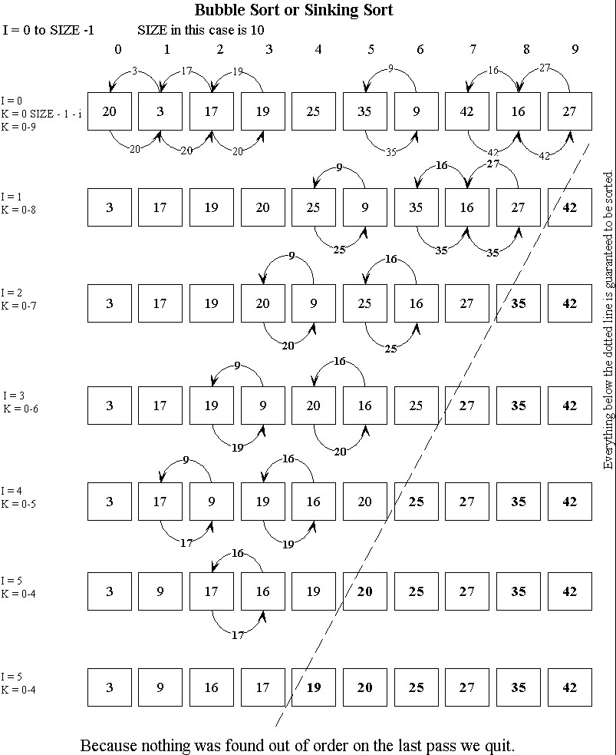

Slide 5
Continued…
Because it only uses comparisons to operate on elements, it is a comparison sort.
Although bubble sort is one of the simplest sorting algorithms to understand and implement, its O(n2) complexity means that its efficiency decreases dramatically on lists of more than a small number of elements.

Slide 6
Performance
Bubble sort has worst-case and average complexity both О(n2), where n is the number of items being sorted.
There exist many sorting algorithms with substantially better worst-case or average complexity of O(n log n). Even other О(n2) sorting algorithms, such as insertion sort, tend to have better performance than bubble sort.
Therefore, bubble sort is not a practical sorting algorithm when n is large.

Slide 7
Continued…
The only significant advantage that bubble sort has over most other implementations, even quicksort, but not insertion sort, is that the ability to detect that the list is sorted is efficiently built into the algorithm.
Performance of bubble sort over an already sorted list (best-case) is O(n).

Slide 8
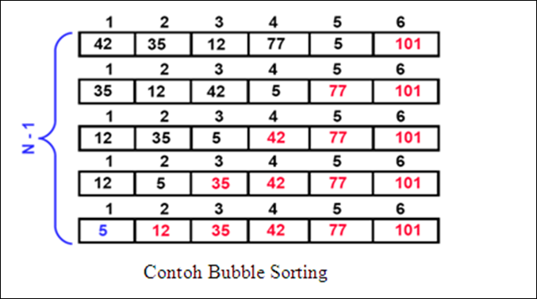
Continued…

Slide 9
Continued…
The positions of the elements in bubble sort will play a large part in determining its performance.
Large elements at the beginning of the list do not pose a problem, as they are quickly swapped. Small elements towards the end, however, move to the beginning extremely slowly.
This has led to these types of elements being named rabbits and turtles.

Slide 10
Examples
Rabbits and Turtles
http://www.algolist.net/Algorithms/Sorting/Bubble_sort

Slide 11
Sources
http://www.cs.duke.edu/~ola/papers/bubble.pdf
https://www.cs.tcd.ie/publications/tech-reports/reports.05/TCD-CS-2005-57.pdf
http://www.algolist.net/Algorithms/Sorting/Bubble_sort

