Slide 1
Insertion Sort
By Daniel Tea

Slide 2
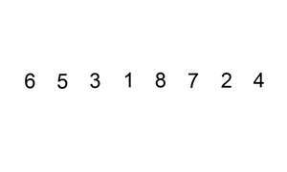
What is Insertion Sort?
Simple sorting algorithm
Builds the final list (or array) one at a time
A type of incremental algorithm

Slide 3
What is Insertion Sort?
Might be how you sort a hand of cards
Empty left hand, cards face down on the ground
Right hand picks it up, and places it in the right order (arbitrary) on your left hand
Input: card you picked up
List = cards on the ground
Output: cards in your left hand

Slide 4
Advantages
Simple
Efficient for small data sets
One of the faster O(n^2) performance algorithms
Does not require extra memory
Low overhead
Best case is O(n)
Nearly sorted input

Slide 5
Disadvantages
Poor performance with large lists
Expensive with many elements
Not as quick as merge sort or quicksort
Worst case is O(n^2)
Input Array/List in reverse order

Slide 6
Insertion Sort Runtimes
Best case: O(n)
Average case: O(n^2)
Worst case: O(n^2)

Slide 7

Cool Animation I Found

Slide 8
So how does it work?
By Insertion, of course!

Slide 9
Insertion Sort Ideas
Each repetition of the sort removes an element from the input data, and shifts it into the correct position of an already sorted list until no input elements remain

Slide 10
Example (Java Implantation)
void insertionSort(int[] arr) {
int i, j, newValue;
for (i = 1; i < arr.length; i++) {
newValue = arr[i];
j = i;
while (j > 0 && arr[j – 1] > newValue) {
arr[j] = arr[j – 1];
j--;
}
arr[j] = newValue;
}
}

Slide 11
Example (C++ Implantation)
void insertionSort(int att[], int length) {
int i, j, tmp;
for (i = 1; i < length; i++) {
j = i;
while (j > 0 && arr[j – 1] > arr[j]) {
tmp = arr[j];
arr[j] = arr[j – 1];
arr[j – 1] = tmp;
j --;
}
}
}

Slide 12
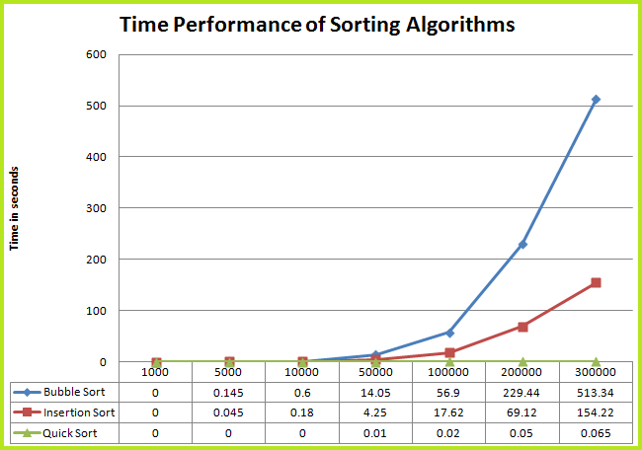
Time Comparison of Quick Sort, Insertion Sort, and Bubble Sort

Slide 13
Sources
http://www.algolist.net/Algorithms/Sorting/Insertion_sort
http://en.wikipedia.org/wiki/Insertion_sort
http://vinayakgarg.wordpress.com/2011/10/25/time-comparison-of-quick-sort-insertion-sort-and-bubble-sort/
http://www.sorting-algorithms.com/insertion-sort

