Slide 1
Merge Sort
A brief look at one of the Earlier sorting algorithms

Slide 2
History of the Merge Sort
Written around 1945
Commonly attributed to renown Hungarian-American mathematician John von Neumann
One of the first sorting styles proposed for computers
Uses divide and conquer principles (recursively breaking down a problem into smaller sub-problems)

Slide 3
What does a merge sort look like?
Graphic courtesy of Wikimedia Commons

Slide 4
So what’s happening exactly?
The data is recursively broken down into smallest possible subset (in this case, an individual number)
The first item in one subset is compared to the first in the next subset
The smaller of the two is placed first in a new set, then the second smallest etc.
Increasingly larger sorted sets are formed until the final, fully sorted list is made by comparing one sorted half of the data to the other sorted half

Slide 5
Let’s try our own merge sort
Here we have the months of the year, except somehow they were placed out of order

Slide 6












First, divide the list into individual months

Slide 7
Now, compare the first two
March comes before November, so March will be added to the new set first and then November second

Slide 8
Now compare the rest of the sets

Slide 9
Compare again
The first item in the first two groups are compared and the earlier month is added to the new set

Slide 10
Round 2
…and then the second item in the first group is compared with the first item of the second group

Slide 11
The newly sorted groups

Slide 12
Compare the first two groups…

Slide 13
Building the new set

Slide 14
And sorted

Slide 15
One final merge sort

Slide 16
Building the final set

Slide 17
Sort complete!

Slide 18
Class Demonstrati0n
Get eight volunteers to stand in a line at the front of the classroom
Have each draw a number out of a hat
Perform a merge sort on the volunteers by comparing their numbers and grouping accordingly
Alternatively, use height for sorting if that can be done without hurting morale

Slide 19
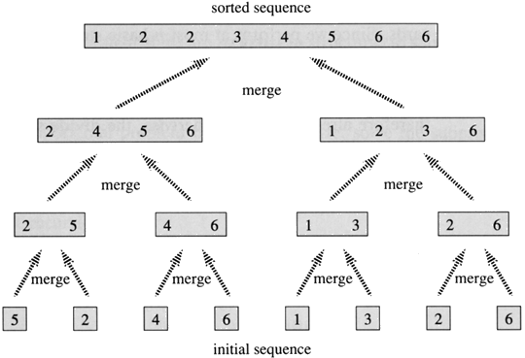
Merge Sorts and Binary Trees
The merge sort algorithm can be visualized using a binary tree, where:
Each leaf node is one piece of data
Going up one level involves one merge process
Image courtesy of Rashid Bin Muhammad at Kent State University

Slide 20
Time Complexity
Best case: O(n)
When values are already sorted
Worst case: O(n log n )
n operations / level * log n + 1 levels
When the data is unsorted/randomly arranged
Average case: O(n log n )
The only stable O(n log n ) sorting algorithm

Slide 21
Memory Requirements
Array implementation
Generally requires a second array to store the merged list
O( n ) extra space
Linked list implementation
Can be done in place by changing list pointers
O( log n ) extra space [for recursion]
Recursive nature of algorithm requires extra memory compared to a non-recursive algorithm

Slide 22
When should you use merge sort?
For linked lists
When wanting to avoid random access to data
If stability is desired
When using extra space is not a concern

Slide 23
References
http://www.cprogramming.com/tutorial/computersciencetheory/mergesort.html
http://www.sorting-algorithms.com/merge-sort
http://www.personal.kent.edu/~rmuhamma/Algorithms/MyAlgorithms/Sorting/mergeSort.htm
http://en.wikipedia.org/wiki/Merge_sort

