Slide 1
Hairball: Lint-inspired Static Analysis of Scratch Projects
Bryce Boe
2013/03/07
University of California Santa Barbara
Notes:
Work done in collaboration with Phillip Conrad, my advisor Diana Franklin, and other colleagues at UCSB

Slide 2
Motivation
Scratch project assessment
is tedious and error prone
takes away from student interaction time
Scratch programming
becomes relatively more difficult to manage as the project size grows
has nearly no tools to check for correctness
Notes:
Removed “is difficult to automate”

Slide 3
Related Work
J. C. Adams and A. R. Webster. What do students learn about programming from game, music video and storytelling projects? SIGCSE 2012.
Q. Burke and Y. B. Kafai. The writers’ workshop for youth programmers: digital storytelling with scratch in middle school classrooms. SIGCSE 2012.
Notes:
Wrote tools to automatically analyze scratch projects.

Slide 4
Background
Assessed four Scratch concepts from a two week summer camp
58 projects across 5 assignments
See tomorrow’s talk:
Assessment of Computer Science Learning in a Scratch-Based Outreach Program
11:30 in Governors 16

Slide 5
Hairball
A Scratch program static analysis tool
Flag items that are potentially incorrect
can be extended through Python plugins
Goals
Provide automated assistance for manual analysis
Warn students about potential mistakes

Slide 6
Methodology
Manual Analysis (intended ground truth)
For each concept, 3 staff members each manually counted and classified instances of the CS concept
Reconciled any discrepancies
Hairball Analysis
Programmed hairball plugins to attempt detect and classify the same instances
Actual Ground Truth
Set of similarly classified instances between manual and hairball, plus the result of a second manual analysis for any discrepancies
Notes:
Hairball is constructed with plugins each checking a CS concept

Slide 7
Instance Classification
Correct
Properly demonstrates the Scratch concept
Semantically incorrect
May appear to work correctly upon execution, but implemented in a non-robust way
Incorrect
Implemented in way that doesn’t work
Incomplete
Missing necessary components
Notes:
Note: We must first detect the _attempt_ at an instance, and then provide one of these classifications

Slide 8
Terminology
False negatives
Instances that are not labeled correct when they in fact are
False Positives
Instances that are labeled correct that are not actually correct

Slide 9
Hairball Plugins

Slide 10
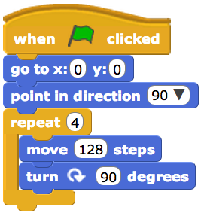
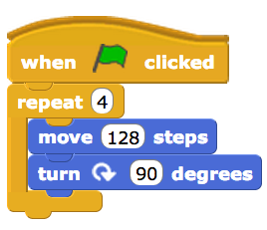
Initialization
Checks that the project initializes attributes that are modified
CORRECT
INCORRECT
Initialization Zone
Notes:
Attributes:
* Position
* Orientation
* Visibility
* etc

Slide 11
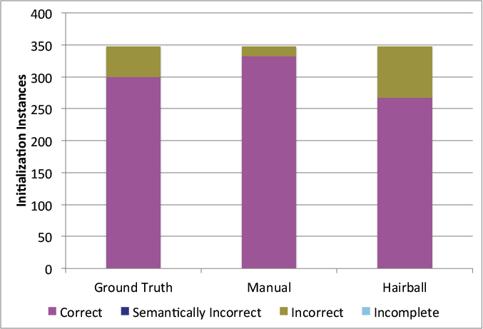
Initialization Evaluation
32 false positives
33 false negatives
Notes:
Total Instances: 348 (6 attributes * 58 projects)
Hairball removed 77% of instances (267) from needing manual analysis

Slide 12
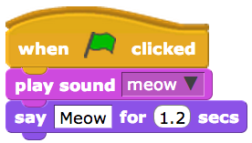
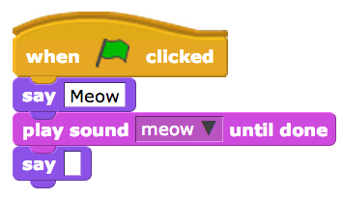
Say and Sound Synchronization
Checks that say bubbles are synchronized with sound files
S. INCORRECT
CORRECT

Slide 13
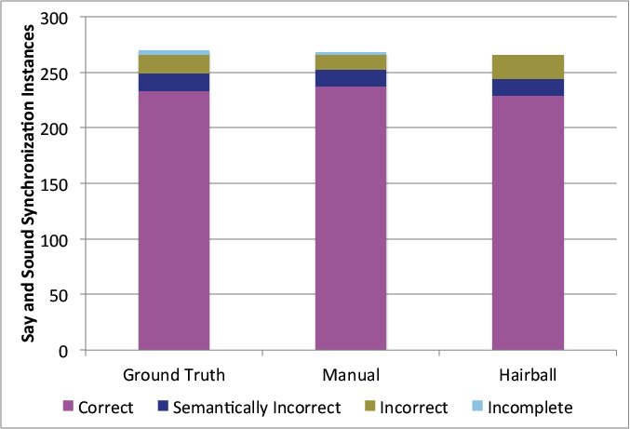
Say and Sound Synchronization Evaluation
2 missing instances
4 missing instances
4 false positives
Notes:
Manual Analysis - 237 correct instances (31 others – 2 missing)
* 4 false positives
Hairball – 229 correct instance (37 others – 4 missing)
* 2 of 4 missing instances were the two “incomplete” instances by manual analysis
* other 2 were due to separation between “say” and “play sound” blocks

Slide 14

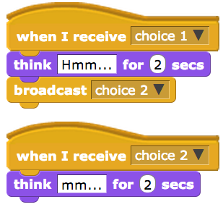
Broadcast and Receive
Checks that each event has matching broadcast and receive blocks and only one broadcast through any one path of a script
Notes:
----- Meeting Notes (3/6/13 10:39) -----
fix animation

Slide 15
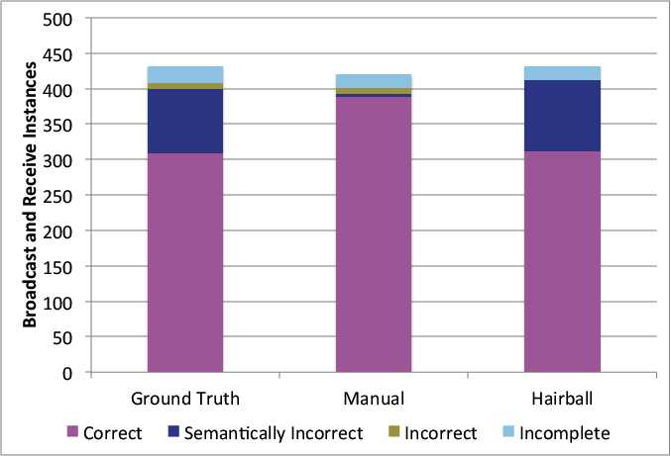
Broadcast and Receive Evaluation
79 false positives
12 missing instances
100% detection
3 false positives
Notes:
Manual analysis – 388 correct (failed to detect 12 instances)
* 79 false positives
Hairball detected 100% of instances (312 correct)
* Zero false negatives
* 3 false positives
Why false positives? -- Manual analysis additionally checked that the desired behavior was produced at run-time
----- Meeting Notes (3/5/13 23:43) -----
switch 100%

Slide 16
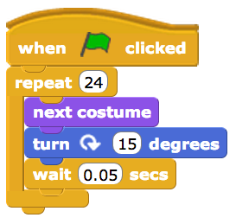
Complex Animation
Checks that a sequence of position and/or orientation changes occur along with costume changes and a delay
Notes:
Necessary components:
* Loop (or sequence, though sequences are listed as semantically incorrect)
* Position or orientation change
* Costume change
* Delay block

Slide 17
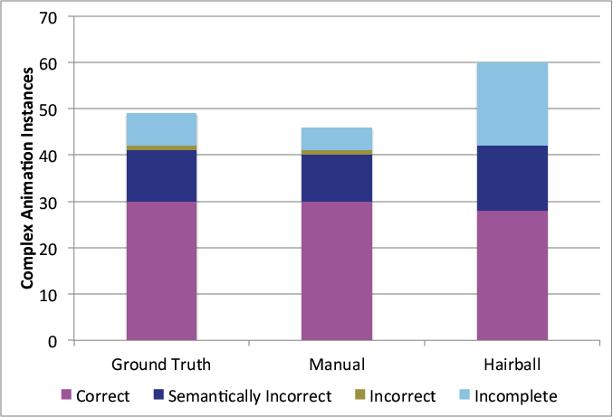
Complex Animation
11 extra instances
3 missing instances
2 false negatives
Notes:
Extra instances detected by hairball are single-item sequences which may or may not have intended to be complex animation
Manual analysis 100% accurate in labeling of 46 detected instances (failed to detect 3)
Hairball – detected 11 instances that were deemed not to be instances
* 28 correct (21 others, with only 2 false negatives)

Slide 18
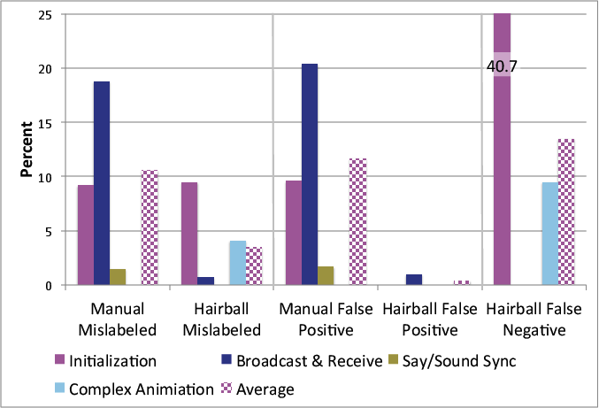
Hairball Summary

Slide 19
Hairball Summary

Slide 20
Hairball Summary
Notes:
There were no manual assessment false negatives.
Complex animation: 2 false negatives out of 21 instances labeled not-correct = 9.5%

Slide 21
Live Demo
http://hairball.herokuapp.com/

Slide 22
Conclusions
Manual assessment is both time-consuming and quite error-prone
Hairball is useful to augment manual analysis (finds things that humans miss)
Hairball is incredibly accurate at detecting correct items

Slide 23
Future Work
Add additional plugins for other sorts of analysis
Test Hairball on a larger set of assignments
(Anyone have Scratch projects they need assessed?)
Measure effectiveness of Hairball as a lint tool

Slide 24
Questions
Contact Information
bboe@cs.ucsb.edu
https://twitter.com/bboe
Links
http://hairball.herokuapp.com/
https://github.com/ucsb-cs-education/hairball
Tomorrow’s talk (11:30 in Governors 16)
“Assessment of Computer Science Learning in a Scratch-Based Outreach Program”

Slide 25
Bonus Slides

Slide 26
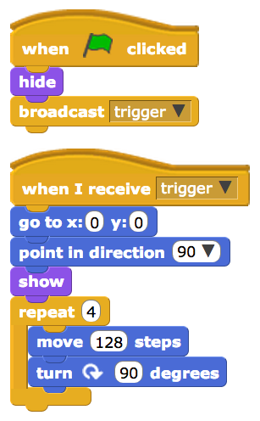
Initialization Check Weakness
Visibility initialization properly detected
Position and orientation initialization does not occur in the initialization zone
Notes:
----- Meeting Notes (3/4/13 22:18) -----
Remove

Slide 27
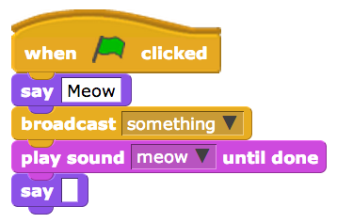
Say Sound Sync Weakness
Blocks between say and sound block
Resulting code may still produce desired effect
Notes:
Semantically incorrect

