Slide 1
CS170 Discussion – 2009-04-24
Bryce Boe

Slide 2
Outline
Announcements
Pair Programming
Project 3 Questions
Partner Assignment

Slide 3
Announcements
Project 3 Deadline extended to Friday March 1 11:59
Late Point Deduction: 1% every 5 minutes
New rules for making patches
http://cs.ucsb.edu/~bboe/dynamic/170_teams#patches

Slide 4
Pair Programming
2 people, 1 computer
Two Roles
Driver – in control of keyboard and thus for the code that get emitted
Observer – watches driver, plans the next steps

Slide 5
Why am I talking about this?
Both members understand all changes, thus get more out of this course
Mutual benefit of shared knowledge and experience

Slide 6
Hand-wavy statistics
~15% less efficient than two independent developers
~15% fewer bugs produced*
Increased enjoyment from of programming
http://collaboration.csc.ncsu.edu/laurie/Papers/XPSardinia.PDF

Slide 7
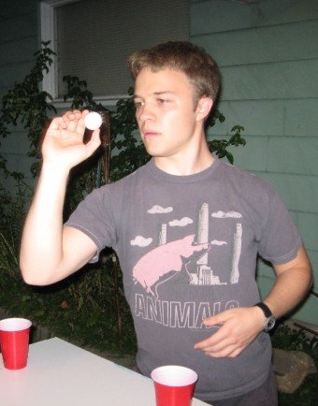
“"It's like twice the brains with half the typing!” - Jeff Browne 1st year Ph.D.

Slide 8
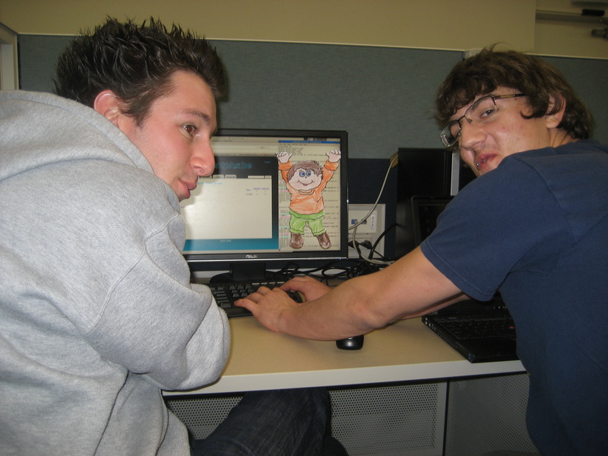

Slide 9
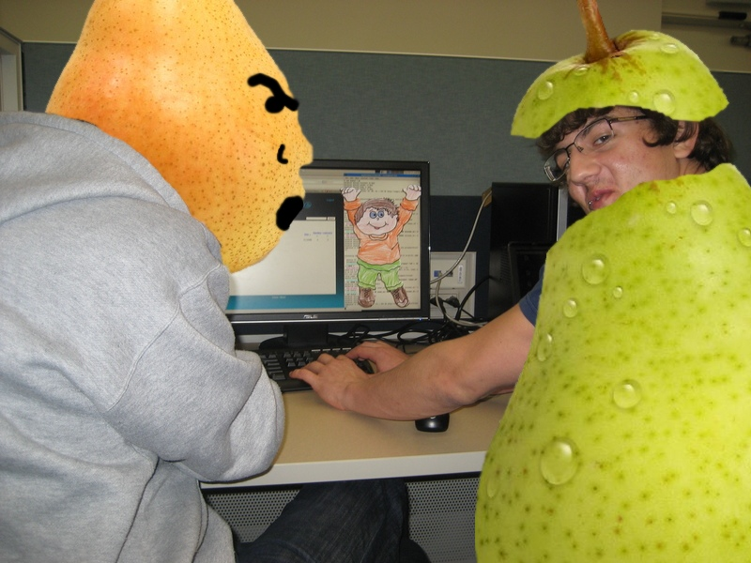

Slide 10
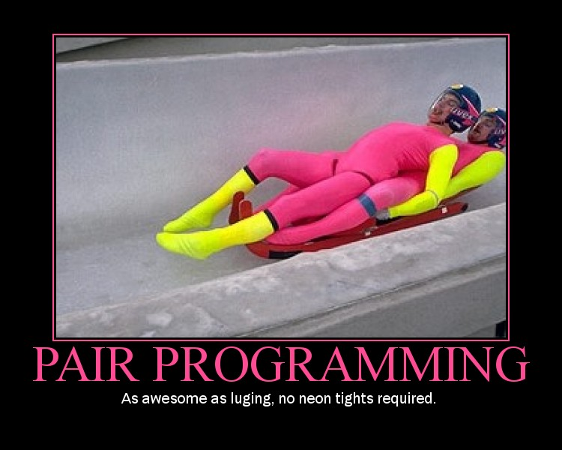
Source: Jonathan Kupferman 1st year MS

Slide 11
Pair Programming Video
http://agile.csc.ncsu.edu/pairlearning/educators.php
Courtesy of North Carolina State University

Slide 12
Project 3 – Realtime processes
A realtime process is one that does not get
Invoked via the syscall: enter_rt(clock_t period)

Slide 13
Notes
Steps in getting message to scheduler
User process makes system call
System call is a wrapper around passing message to the appropriate server
The appropriate server then sends a message to the kernel (kernel call)
The scheduler now has it.
Round-robin scheduling of different priorities

