Slide 1
CS170 Discussion – 2009-05-01
Bryce Boe

Slide 2
9 Days left…
of your favorite class ever
of the best time of you life
of the most you’ve ever worked in your life
to complete project 6
with the coolest TA ever (jk – or am I?)

Slide 3
Project 6 – Immediate Files

Slide 4
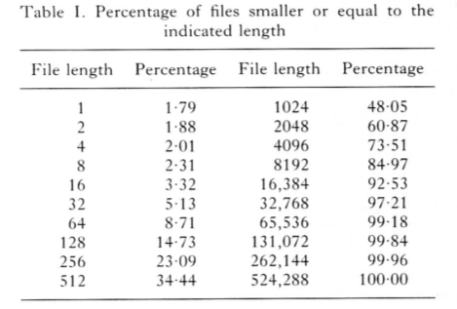
Why?
Mullender, S. J. and Tanenbaum, A. S. 1984. Immediate files. Softw. Pract. Exper. 14, 4 (Jun. 1984), 365-368. DOI= http://dx.doi.org/10.1002/spe.4380140407

Slide 5
Inside Minix

Slide 6
v1, v2, v3 files
v1 files are for older files -- ignore
v2 files are what this version of minix creates
v3 files don’t exist, however there are a few comments about them -- ignore

Slide 7
servers/mfs/inode.h
EXTERN struct inode {
mode_t i_mode; /* file type, protection, etc. */
nlink_t i_nlinks; /* how many links to this file */
uid_t i_uid; /* user id of the file's owner */
gid_t i_gid; /* group number */
off_t i_size; /* current file size in bytes */
time_t i_atime; /* time of last access (V2 only) */
time_t i_mtime; /* when file data last changed */
time_t i_ctime; /* when was inode itself changed */
zone_t i_zone[V2_NR_TZONES]; /* zone numbers */
…
<remainder of struct not saved on disk>
}

Slide 8
include/minix/const.h
Defines constants used by mfs
I_REGULAR – regular file
I_TYPE – mask for file type
Note: These are used in ushorts (2 bytes)
Suggestion: Add an I_IMMEDIATE that fits in ushort and doesn’t conflict with the masks

Slide 9
Constants
I_TYPE 0170000 /* inode type */
I_SYMBOLIC_LINK 0120000 /* symbolic link */
I_REGULAR 0100000 /* regular file */
#define I_BLOCK_SPECIAL 0060000 /* block special file */
#define I_DIRECTORY 0040000 /* file is a directory */
#define I_CHAR_SPECIAL 0020000 /* character special file */
#define I_NAMED_PIPE 0010000 /* named pipe (FIFO) */
#define I_SET_UID_BIT 0004000 /* set effective uid_t */
#define I_SET_GID_BIT 0002000 /* set effective gid_t */
#define ALL_MODES 0006777 /* all bits for u,g,o */
#define RWX_MODES 0000777 /* mode bits for RWX only */
#define R_BIT 0000004 /* Rwx protection bit */
#define W_BIT 0000002 /* rWx protection bit */
#define X_BIT 0000001 /* rwX protection bit */
#define I_NOT_ALLOC 0000000 /* this inode is free */

Slide 10
Adding Files
Set immediate flag whenever a regular file is initially created
Suggestion: Trace all the places where files can be created back to common code.
Hint: Somewhere in servers/mfs/open.c

Slide 11
Deleting Files
When files are deleted typically indirect blocks need to be freed
Skip this step if immediate
Suggestion: As before trace the few places that perform this behavior to the common location
Hint: servers/vfs/link.c

Slide 12
Writing Files
When file size grows beyond 34 bytes switch to “normal” method

Slide 13
Reading Files
If immediate read from inode
If not read as normal

Slide 14
How to start
Step 1: Successfully set immediate bit, and put checks on open/read/write/delete when an immediate file is encountered.
Step 2: Implement the immediate file
Warning: Make regular backups of your minix image, as you might destroy it

