Slide 1
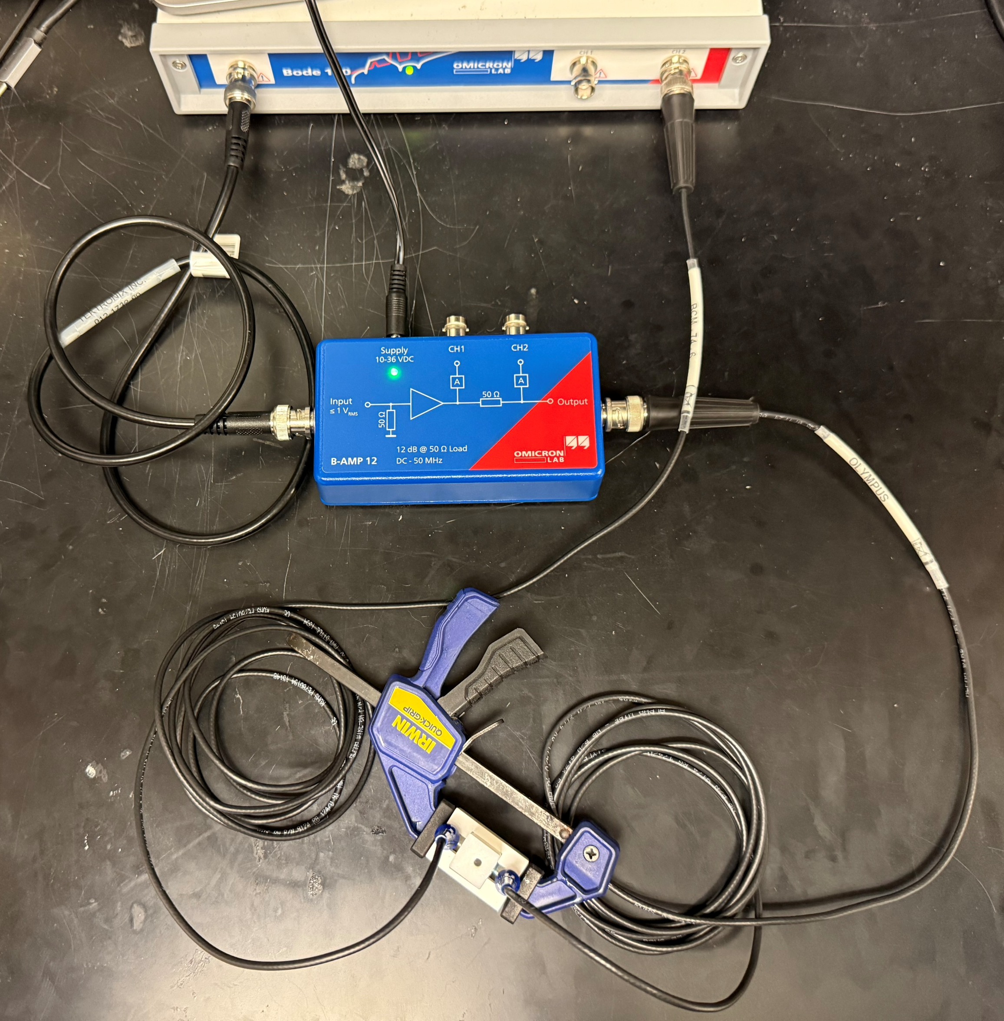
Swept Frequency Acoustic Interferometry (SFAI) Set Up with Omicron Lab’s Bode 100.
Bode 100 Vector Network Analyzer
Controlled through the Bode Analyzer Suite (BAS)
  For automated measurements, BAS is used in conjunction with LabVIEW
Primarily used for SFAI measurements and is particularly suited for testing liquid and gel like materials.
Primary test mode for SFAI is Transmission/Reflection mode.
B-AMP 12
External power amplifier for the Bode 100.
Amplifies the signal by 12dB (= x4)
Sample with Transducers
Transducers must be centered on opposite sides of the sample
Transducers and sample walls must be coupled with the following options:
  Super glue, with both contact surface fully colored with Steadler’s blue Lumocolor permanent marker prior to applying super glue.
    Good for short and long term testing.
    Requires careful cleaning of transducers (and sample if applicable) with Acetone post-testing.
  Echo Shear Wave Couplant, applying an even thin layer on the transducer or material contact surfaces.
    Good for long term testing
    Water-soluble, easily cleaned post-testing

Slide 2
Demo Video:

