Slide 1
DoRA
Weight-Decomposed Low-Rank Adaptation
Improving Low-Rank Adaptation of Large Language Models (LoRA)
Bogdan Baloiu (40156779)

Slide 2
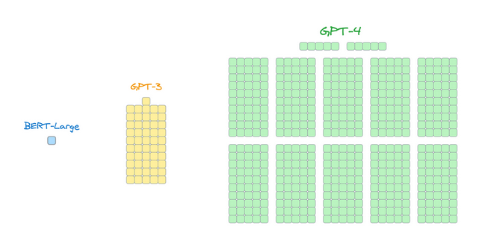
Main Purpose
Save GPU memory
  BERT-base: 110M parameters
  BERT-large: 340M parameter
  GPT-3: 175B parameters
  GPT-4: 1.7T parameters
  [credit] https://www.dailydoseofds.com/implementing-dora-an-improved-lora-from-scratch/

Slide 3
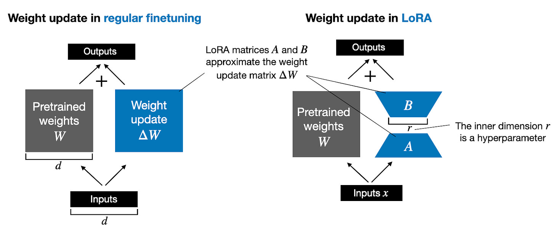
How does it function?
[credit] https://magazine.sebastianraschka.com/p/practical-tips-for-finetuning-llms

Slide 4
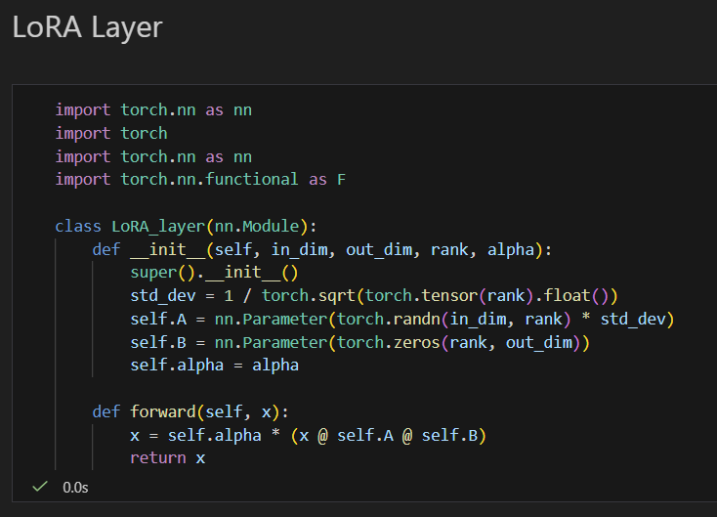
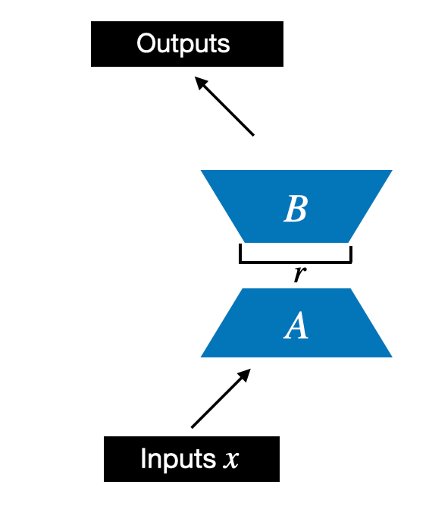
Implementation
[credit] https://magazine.sebastianraschka.com/p/practical-tips-for-finetuning-llms

Slide 5
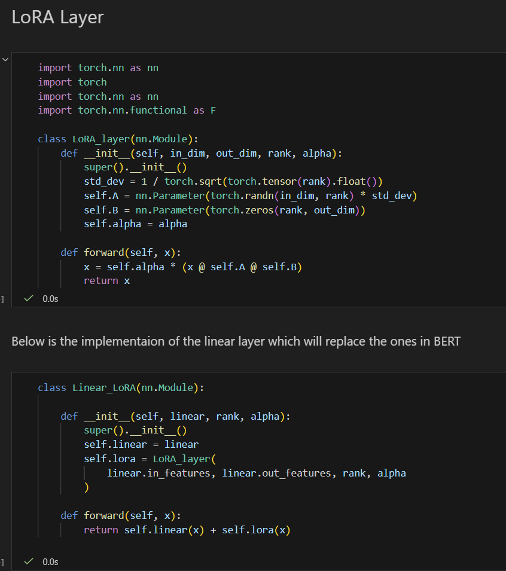
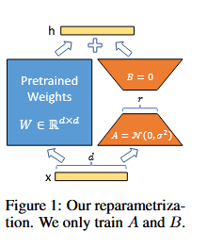
Implementation
[credit] https://arxiv.org/pdf/2106.09685

Slide 6
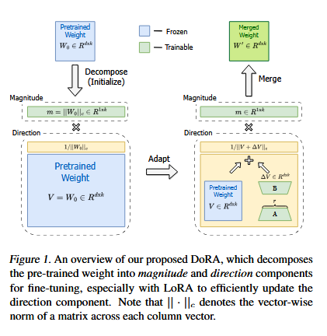
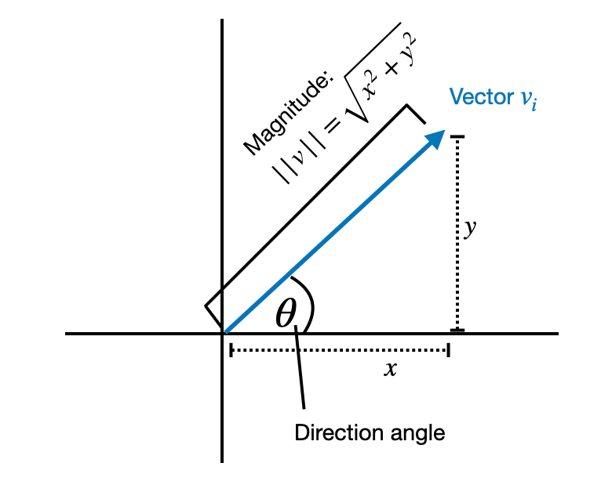
DoRA Main Idea
Decompose pre-trained weight matrix into magnitude vector m and directional matrix v
Apply LoRA to matrix v and train magnitude vector m separately
Decomposition is inspired by the fact that any vector can be represented as the product of its magnitude and its direction
[credit] https://magazine.sebastianraschka.com/p/practical-tips-for-finetuning-llms
[credit] https://arxiv.org/pdf/2402.09353

Slide 7
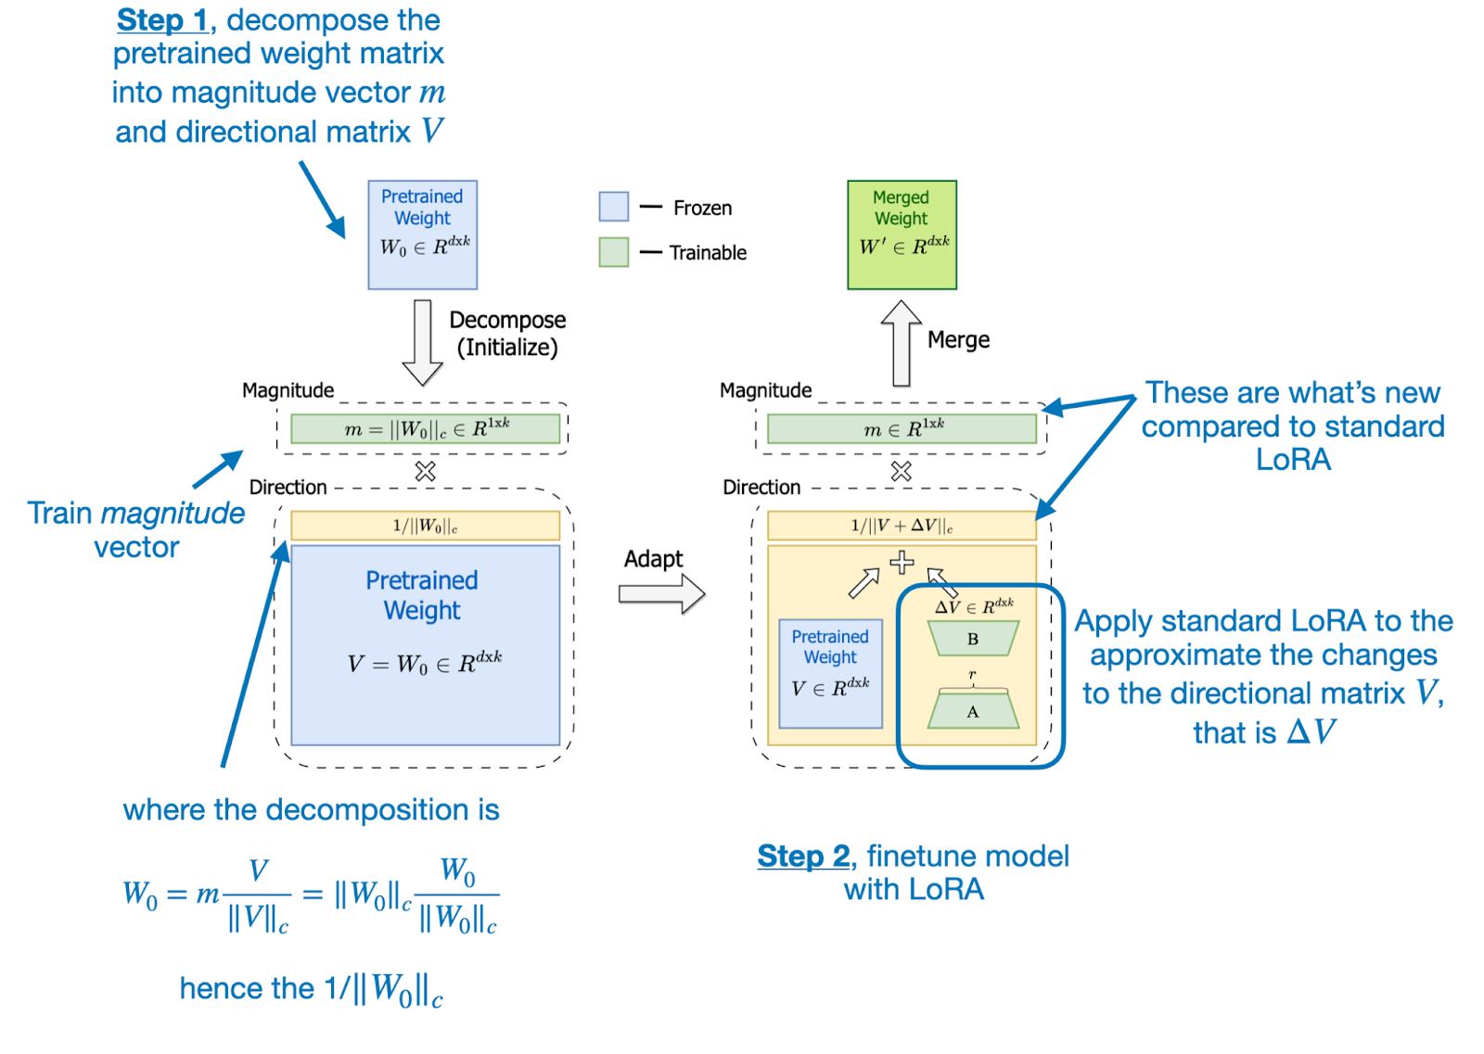
Dora Main Ideas
[credit] https://magazine.sebastianraschka.com/p/practical-tips-for-finetuning-llms

Slide 8
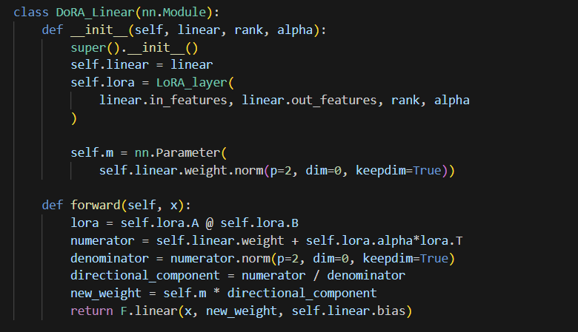



Implementation

Slide 9
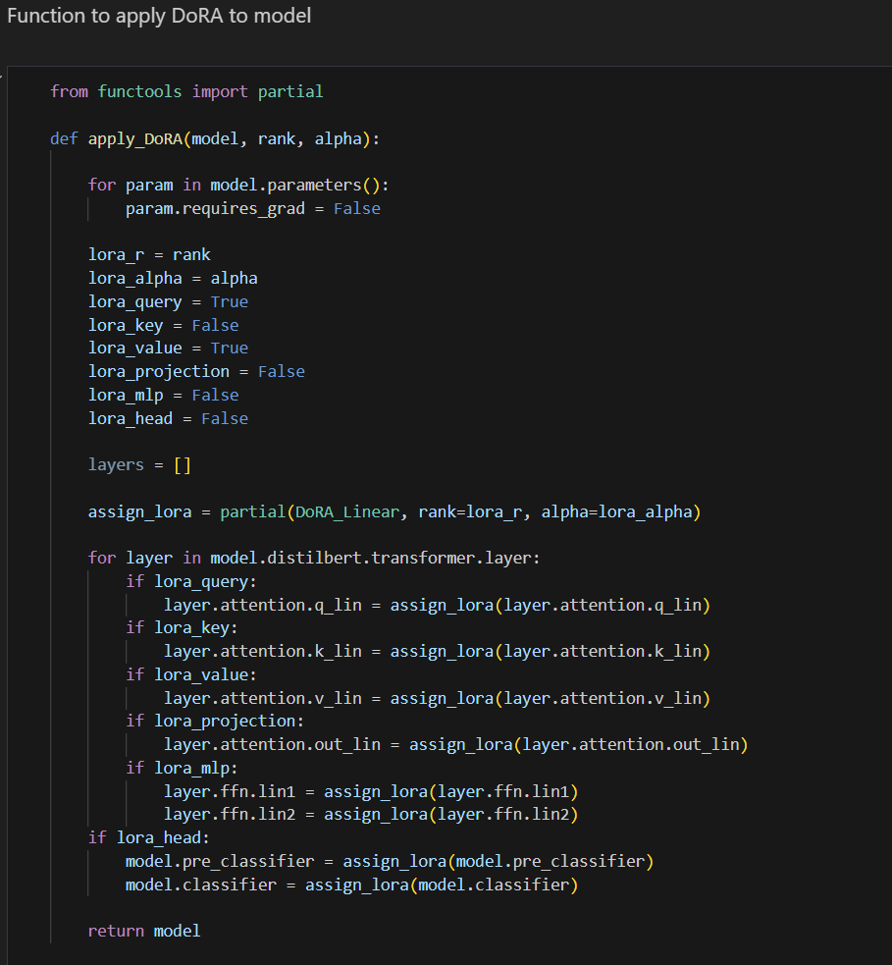
Implementation

Slide 10
Experiments
Using IMDB sentiment analysis dataset ^{[1]}
  Includes at most 30 reviews from any movie
  Contains 50,000 labeled reviews with even categories
  Binary classification (negative or positive review)
  25,000 training set and 25,000 test set
  Used 20% of training for validation
Training DistilBERT with all layers, only the top 2 layers, and only the head
Training DistilBERT using LoRA and DoRA

Slide 11
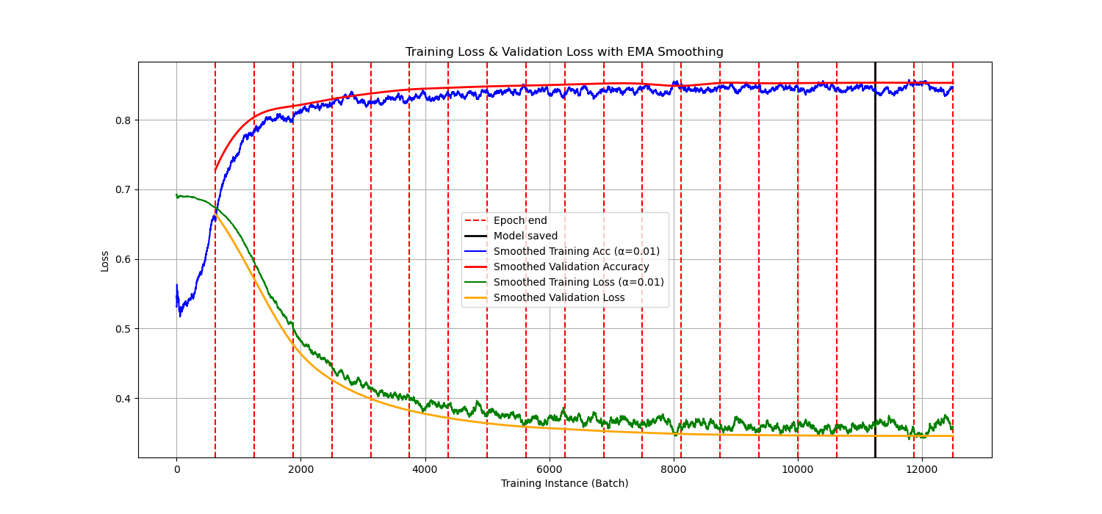
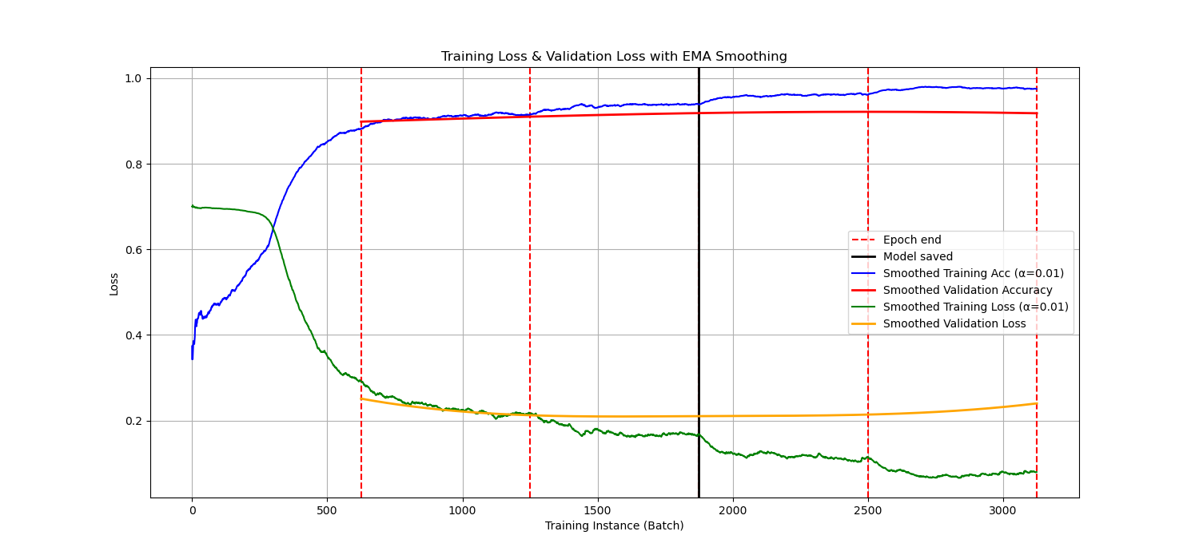
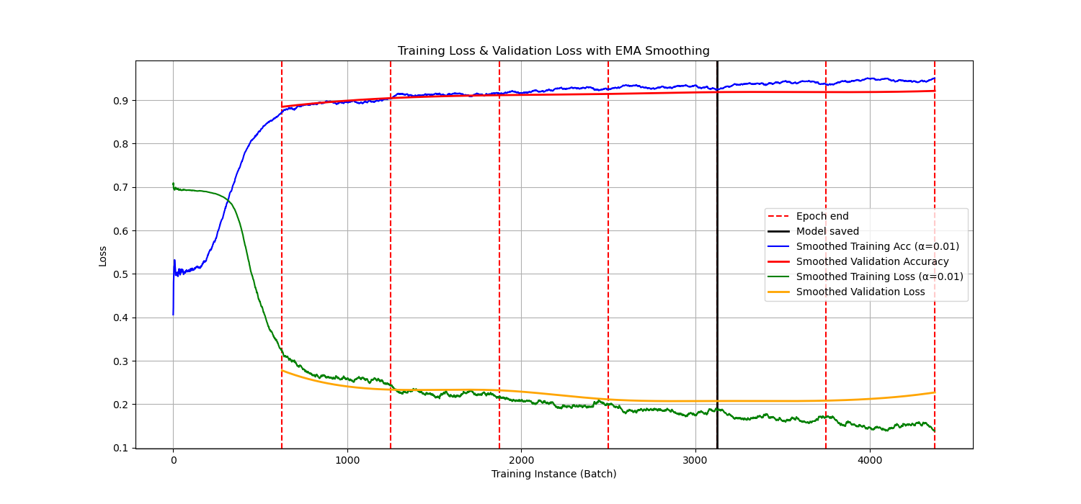
Convergence graphs
DistilBERT with Head Layer Only
DistilBERT with All Layers
DistilBERT with Top 2 Layers

Slide 12
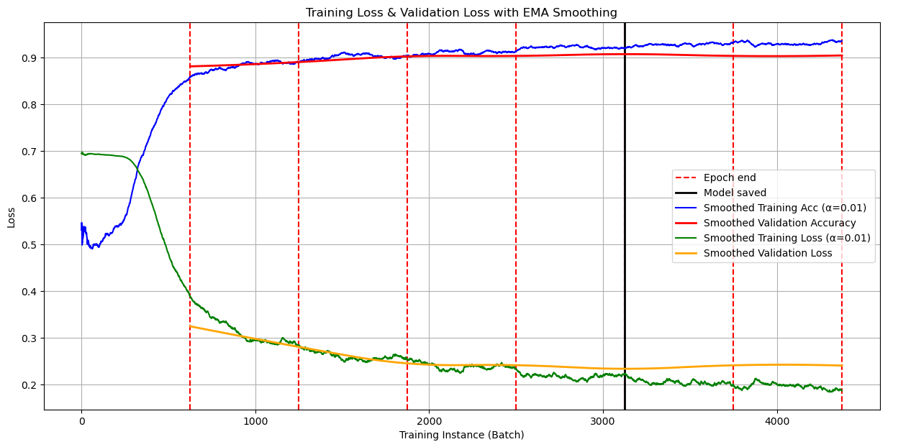
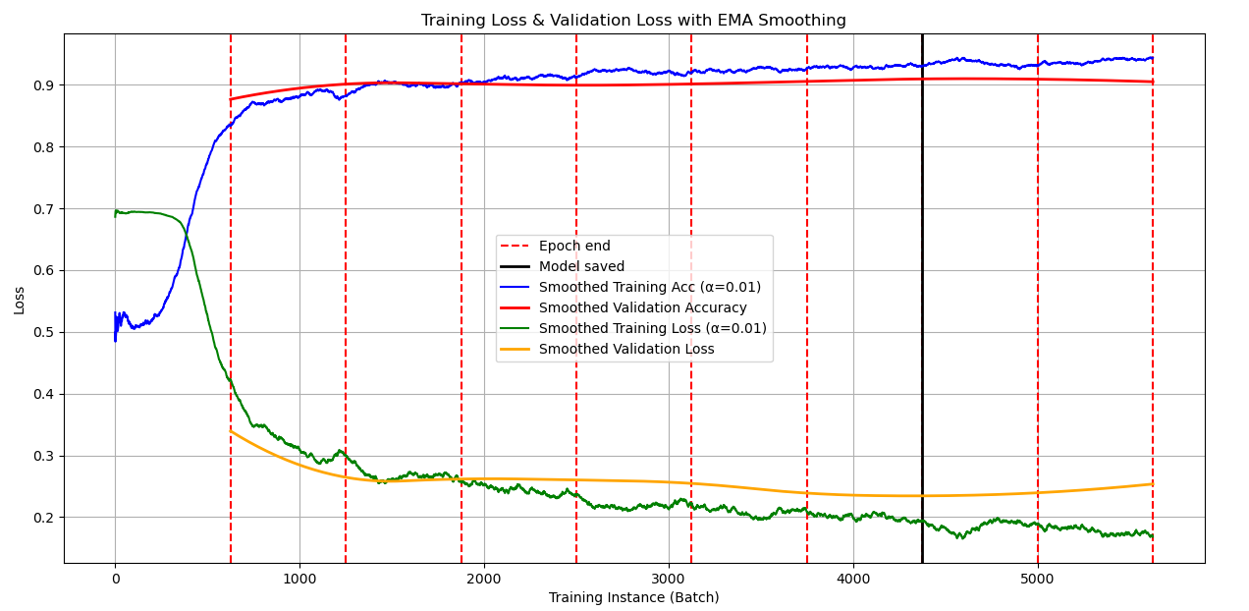
Convergence Graphs
DistilBERT with LoRA
DistilBERT with DoRA

Slide 13
Results
Model | Parameters | % of Parameters Trained | Avg. Time per Epoch | Accuracy | F-1 Measure | Loss
DistilBERT (all weights) | 66,955,010 | 100% | 119.3921 sec | 0.9237 | 0.9237 | 0.2018
DistilBERT (top 2 layers) | 14,767,874 | 22.1% | 64.5824 sec | 0.9230 | 0.9230 | 0.1962
DistilBERT (head only) | 592,130 | 0.88% | 42.2114 sec | 0.8524 | 0.8524 | 0.3456
DistilBERT (DoRA r=8) | 156,672 | 0.23% | 96.9845 sec | 0.9136 | 0.9136 | 0.2271
DistilBERT (LoRA r=8) | 147,456 | 0.22% | 100.5293 sec | 0.9150 | 0.9150 | 0.2241
DistilBERT (Dora r=4) | 82,944 | 0.12% | 96.1715 sec | 0.9146 | 0.9146 | 0.2251

