Slide 1
statistics stuff you should think about
Ben Bolker

Slide 2
outline
experimental design
statistical philosophy
statistical tests & assumptions
analysis platforms

Slide 4
experimental design

Slide 5
the most important thing
Design your experiment well and execute it well: you needn’t worry too much in advance about statistics
Don’t: you’re doomed - statistics can’t save you
randomization, replication, control

Slide 6
randomization
random assignment to treatments
poorer alternative: haphazard assignment (“convenience sampling”)
stratification (i.e., randomize within groups)
related: experimental blinding

Slide 7
replication
how big does your experiment need to be?
power: probability of detecting an effect of a particular size, if one exists
more generally: how much information? what kinds of mistakes? (Gelman et al. 2014)
underpowered studies
failure is likely
cheating is likely
significance filter $→$ biased estimates
overpowered studies waste time, lives, $$$
pseudoreplication (Hurlbert 1984; Davies et al. 2015) confounding sampling units with treatment units

Slide 8
power analysis
need to guess effect size and variability
minimum interesting biological effect size
previous studies
ask your supervisor
OK to simplify design (e.g. ANOVA $→$ $t$-test)
methods
seat-of-the-pants
web calculators
in R
apropos("^power") ## base-R functions library("sos"); findFn("{power analysis}")

Slide 9
power analysis example
With $n=15$ per group, how likely are we to see a clear difference between 10% (control) and 20% (treatment) mortality?
power.prop.test(n=15,p1=0.1,p2=0.2)
## ## Two-sample comparison of proportions power calculation ## ## n = 15 ## p1 = 0.1 ## p2 = 0.2 ## sig.level = 0.05 ## power = 0.1141268 ## alternative = two.sided ## ## NOTE: n is number in *each* group
Uh-oh.

Slide 10
How many samples per group would we need to get power=0.8?
power.prop.test(power=0.8,p1=0.1,p2=0.2,sig.level=0.05)
## ## Two-sample comparison of proportions power calculation ## ## n = 198.9634 ## p1 = 0.1 ## p2 = 0.2 ## sig.level = 0.05 ## power = 0.8 ## alternative = two.sided ## ## NOTE: n is number in *each* group
Uh-oh.

Slide 11
what should we do?

Slide 12
increasing power (control)
increase sample size (ugh)
maximize desired variation (e.g. large doses)
minimize undesired variation
within-subjects designs (paired, randomized-block, crossover)
minimize environmental variation (e.g. environmental chambers; clonal or inbred lines)
isolate desired effects: positive/negative controls (vehicle-only, cage treatments, etc.)
control for variation statistically (e.g. include body size as a covariate)

Slide 13
statistical philosophy

Slide 14
the other most important thing
don’t snoop! (= don’t look at data before deciding how to analyze it) (but do explore your data graphically after deciding on a tentative analysis plan!)
reproducibility crisis: Ioannidis (2005), Simmons et al. (2011)
pre-register; think about what your questions are and how you will test them before you look at your data

Slide 15
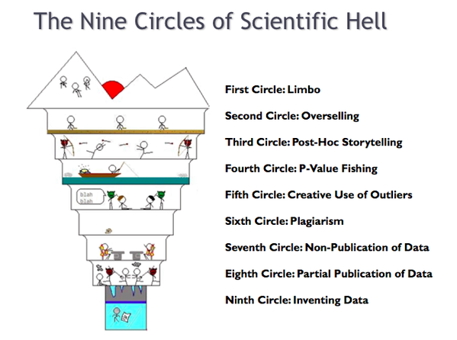
scientific hell

Slide 16
don’t lean on p-values too much
focus on effect sizes/CIs
eschew vacuous hypotheses
don’t accept the null hypothesis
“the difference between significant and non-significant is not significant” (Gelman et al. 2006)
discuss p-values in terms of statistical clarity (Dushoff et al. 2018)

Slide 17
don’t lean on p-values too much
focus on effect sizes/CIs
eschew vacuous hypotheses
don’t accept the null hypothesis
“the difference between significant and non-significant is not significant” (Gelman et al. 2006)
discuss p-values in terms of statistical clarity (Dushoff et al. 2018)

Slide 18
tables vs coefficient plots
1978 automobile data (Chambers et al. 2018)

Slide 19
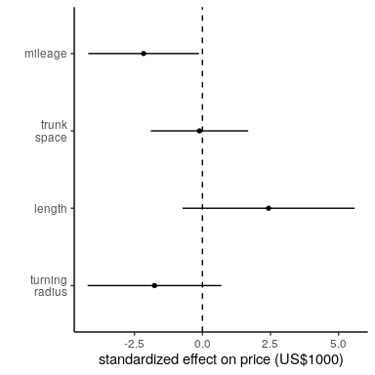
coefficient plot

Slide 20
statistical tests

Slide 21
assumptions
independence (hard to test!)
homogeneity of variance (vs. heteroscedasticity)
linearity
Normality (least important)
outliers; skew; “fat tails” (Student 1927)
distributional assumptions apply to the conditional distribution of the response variable

Slide 22
diagnostics
hypothesis tests are not generally appropriate: they answer the wrong question
graphical diagnostics
residuals plots (linearity, heteroscedasticity)
influence plots (outliers)
Q-Q plots (Normality)
Box-Cox plots (transformations)

Slide 23
(the data set)
## `geom_smooth()` using formula 'y ~ x'

Slide 24
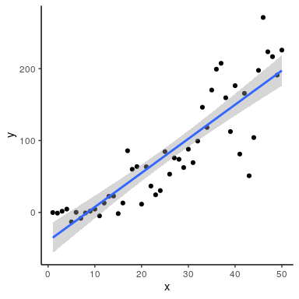

Slide 25
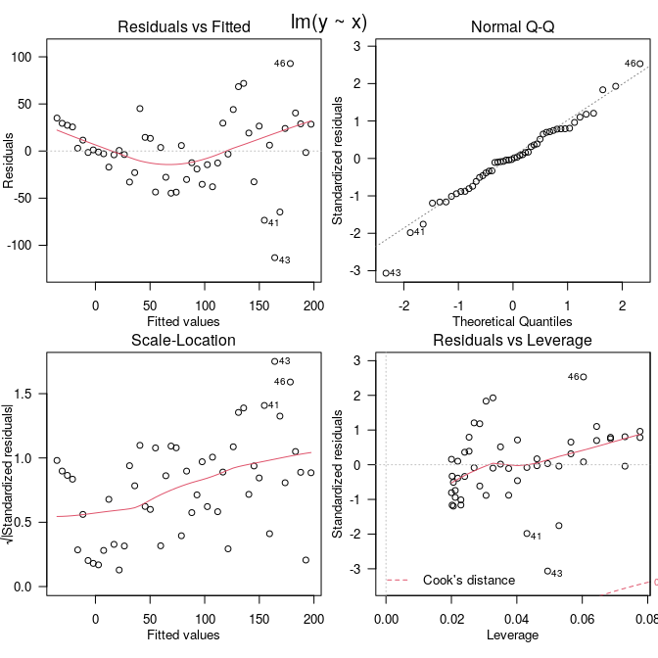
diagnostics

Slide 26
dealing with violations
drop outliers (report both analyses)
transform (e.g. log transform: Box-Cox analysis)
non-parametric (rank-based) tests (e.g. Mann-Whitney-Wilcoxon, Kruskal-Wallis)
relax assumptions/do fancier stats, e.g.
logistic regression (0/1 outcomes)
quadratic regression (nonlinearity)

Slide 27
what should you use?
try to connect scientific & statistical questions
data type
see decision tree or table
if your question doesn’t fit in this tree, think about how much you like statistics …
nonparametric stats
slight loss of power
stronger assumptions than you think
$p$-values only - no effect size

Slide 28
computational platforms

Slide 29
Criteria
simple/weak vs. complex/powerful
GUI vs command-line
default: use what your lab uses

Slide 30
Excel
ubiquitous
open alternatives (Open Office)
data in plain sight
good enough for simple stuff
occasional traps (McCullough et al. 2008)
archive your data as CSV, not XLSX

Slide 31
stats packages
SPSS, JMP, SAS, …
more reliable than Excel
more powerful than Excel
point & click (mostly)

Slide 32
R
powerful; free & open
reproducible: script-based
hardest to learn
R Commander if you need a GUI
great for data manipulation, graphics (once you learn how)
Using this analogy programs like SPSS are busses, easy to use for the standard things, but very frustrating if you want to do something that is not already preprogrammed.
R is a 4-wheel drive SUV (though environmentally friendly) with a bike on the back, a kayak on top, good walking and running shoes in the passenger seat, and mountain climbing and spelunking gear in the back. R can take you anywhere you want to go if you take time to learn how to use the equipment, but that is going to take longer than learning where the bus stops are in SPSS.
Greg Snow, R-help (May 2006)

Slide 33
t-test (R)
x1 = c(1.5,2.5,2.1) x2 = c(1.1,1.4,1.5) t.test(x1,x2)
## ## Welch Two Sample t-test ## ## data: x1 and x2 ## t = 2.226, df = 2.6648, p-value = 0.1236 ## alternative hypothesis: true difference in means is not equal to 0 ## 95 percent confidence interval: ## -0.3759079 1.7759079 ## sample estimates: ## mean of x mean of y ## 2.033333 1.333333

Slide 34
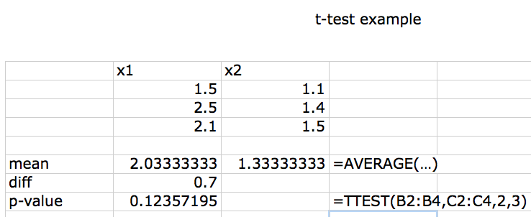
t-test (Excel)

Slide 35
Further resources
Nature web collection, “Statistics for Biologists”
UCLA statistics consulting (many examples in SAS, SPSS, R …)
CrossValidated
bio data lunch
source code for this talk

Slide 36
References
Chambers, JM et al. 2018. Graphical methods for data analysis. Chapman; Hall/CRC.
Davies, GM et al. 2015.. Ecology and Evolution (October). doi:10.1002/ece3.1782. http://onlinelibrary.wiley.com/doi/10.1002/ece3.1782/abstract.
Dushoff, J et al. 2018. (October). https://arxiv.org/abs/1810.06387.
Gelman, A et al. 2014.. Perspectives on Psychological Science 9 (6) (November): 641–651. doi:10.1177/1745691614551642. http://pps.sagepub.com/content/9/6/641.
———. 2006.. The American Statistician 60 (4) (November): 328–331. doi:10.1198/000313006X152649. http://www.tandfonline.com/doi/abs/10.1198/000313006X152649.
Hurlbert, SH. 1984.. Ecological Monographs 54 (2) (June): 187–211. doi:10.2307/1942661. http://www.esajournals.org/doi/abs/10.2307/1942661.
Ioannidis, JPA. 2005.. PLoS Med 2 (8): e124. doi:10.1371/journal.pmed.0020124. http://dx.doi.org/10.1371/journal.pmed.0020124.
McCullough, BD et al. 2008.. Computational Statistics & Data Analysis 52 (10) (June): 4570–4578. doi:10.1016/j.csda.2008.03.004. http://www.sciencedirect.com/science/article/pii/S0167947308001606.
Simmons, JP et al. 2011.. Psychological Science 22 (11) (November): 1359–1366. doi:10.1177/0956797611417632. http://pss.sagepub.com/content/22/11/1359.
Student. 1927.. Biometrika 19 (1/2) (July): 151–164. doi:10.2307/2332181. http://www.jstor.org/stable/2332181.

