Slide 1

Education Inflation & Its Impact
Phase 1
Notes:
NOTE:
To change the image on this slide, select the picture and delete it. Then click the Pictures icon in the placeholder to insert your own image.

Slide 2
Objectives
Visualize in & out state tuition costs in the United States.
Explore the differences in tuition fee growth between in-state and out-of-state students.
Understand how inflation has fluctuated over the past decade.
Determine how closely tuition growth aligns with overall inflation trends.
Draw conclusions from the data analysis and discuss the broader implications on education costs.

Slide 3
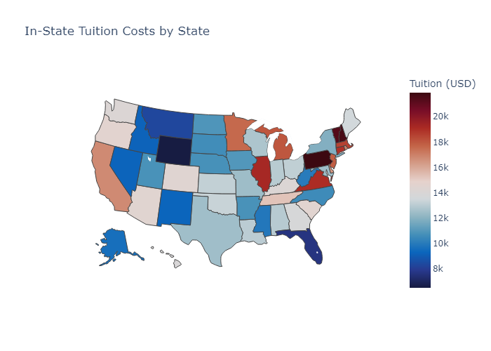
Average In-State Tuition Cost
TOP 5 STATES
Pennsylvania
New Hampshire
Vermont
Illinois
Virginia
BOTTOM 5 STATES
Wyoming
Florida
Montana
Idaho
Nevada

Slide 4
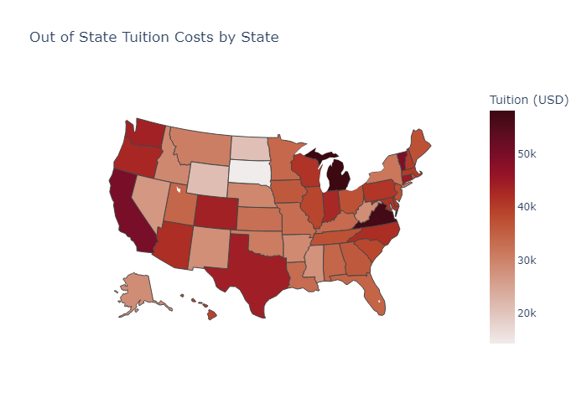
Average Out of State Tuition Cost
TOP 5 STATES
Michigan
Virginia
California
Vermont
Connecticut
BOTTOM 5 STATES
South Dakota
North Dakota
Wyoming
Nevada
Missippi

Slide 5
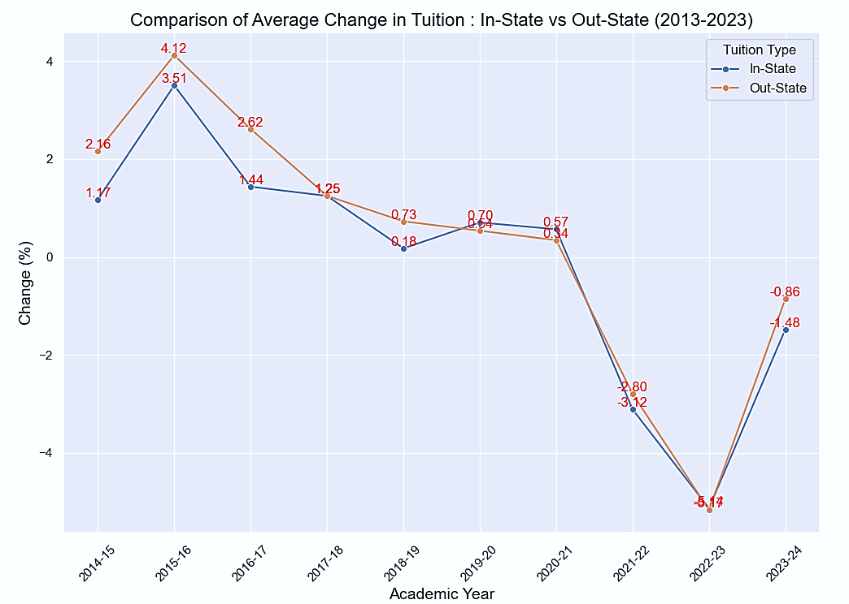
Comparison of In-State vs. Out-State Percent Change
Shows avg. percent change from previous year for both tuition costs.
Similar trends for both tuition types
2015-16 saw the highest increase.
2022-23 recorded the largest drop.
Decline from years 2020 to 2023 decline relates with COVID pandemic.

Slide 6
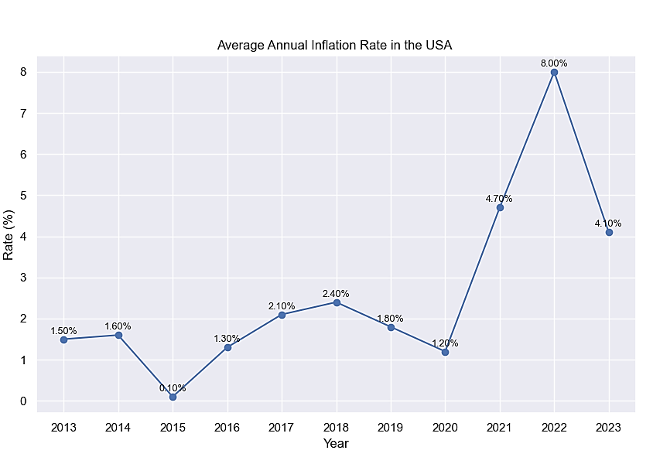
Inflation Rate in the USA
This graph is shows annual average inflation in USA from years 2013 to 2023 from World Bank.
Highest increase in year 2022.
Lowest drop in year 2015.
Lets see if the Inflation data has any relation with the tuition costs.

Slide 7
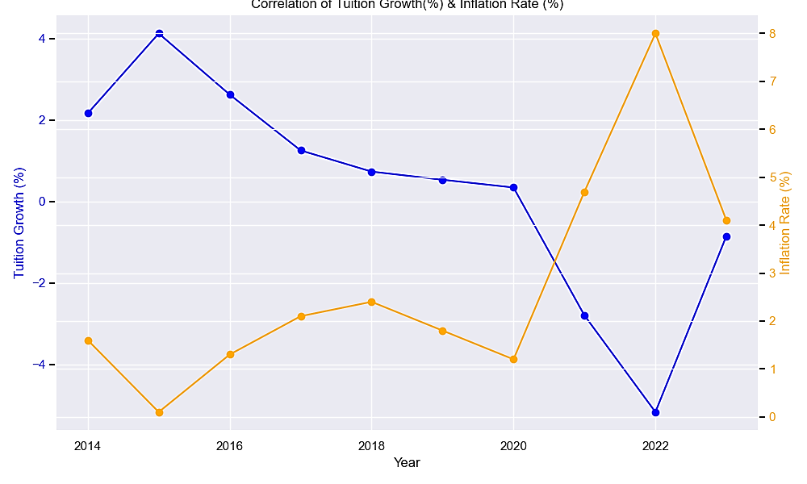
Correlation Between Tuition and Inflation
The correlation coefficient value for Tuition change & annual inflation rate is -0.951.
It shows a strong negative correlation between these variables.
As the inflation rate increases, the tuition costs decreases in a nearly linear fashion, and vice versa.

Slide 8
Conclusions
Northeastern and Western states show consistently higher tuition costs, both for type of students.
Decline in tuition costs from years 2020 to 2023 shows the impact of COVID pandemic.
There is an inverse relation between tuition costs & overall inflation rates in the USA.

Slide 9
Thank You
Any Questions, Comments & Concerns?
Analyzed by Yashesh Darji
Notes:
NOTE:
To change the image on this slide, select the picture and delete it. Then click the Pictures icon in the placeholder to insert your own image.

