Slide 1
House Prices: Advanced Regression Techniques
Machine Learning Project
Brenna Botzheim

Slide 2
Background
Kaggle competition to predict the sale price of houses using the Ames Housing dataset
RMSE is used to evaluate submissions, using the log of predicted and actual values
Goal of the project is to build a model with the highest predictive accuracy (lowest RMSE)

Slide 3
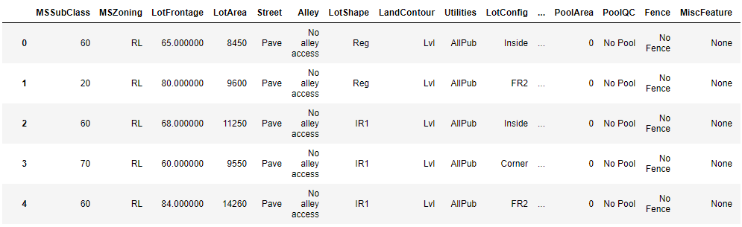
The AMES HOUSING dataset
79 predictive variables describing all aspects of homes sold in Ames, Iowa
A mix of categorical and numerical features
Many highly related variables. For example, 9 variables alone describe different aspects of the house’s basement. Other related variables include garage features, square footage features, etc.

Slide 4
pROCESS
Step 1: Explore Data
Step 2: Round One Data Processing
Step 3: Build Initial Predictive Models, Submit to Kaggle
Step 4: Round Two Data Processing
Step 5: Build Predictive Models again, Build Model Ensembles
Step 6: Final Submission

Slide 5
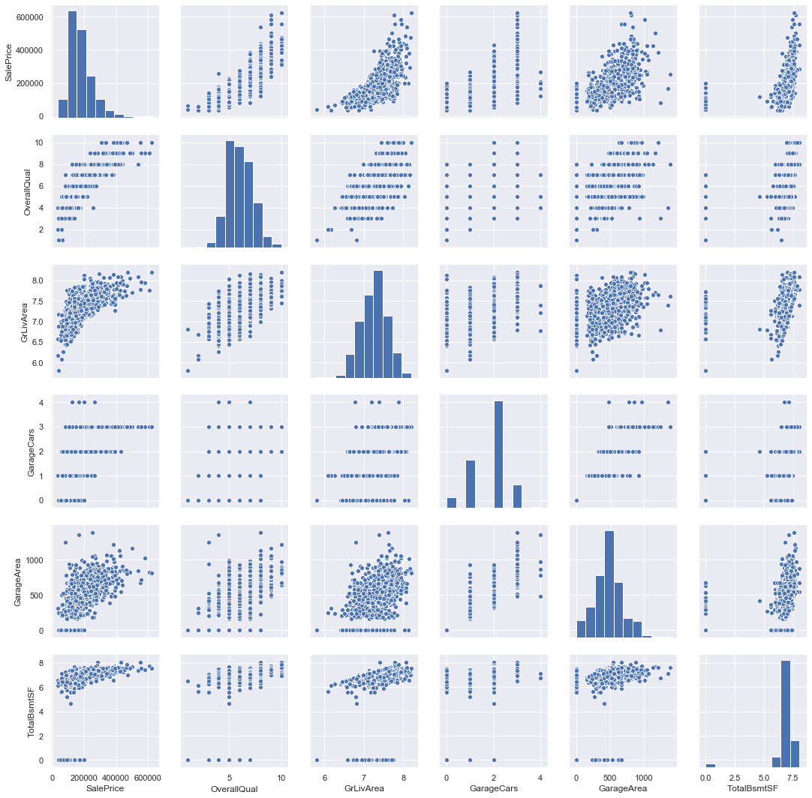
Explore data
Explore relationships between features and the target variable
Find variables with a strong correlation with the target variable
Explore multicollinearity between predictor variables
Opportunities for feature engineering or feature selection
Explore the shape of the data

Slide 6
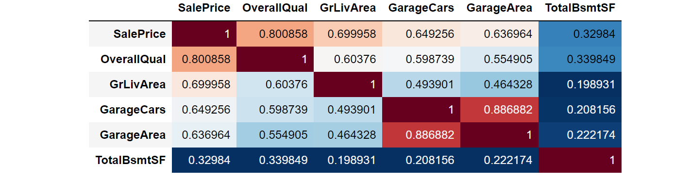
mULTICOLLINEARITY
From the expanded correlation matrix above, we can see that multicollinearity is already evident in this subset of the features.
In general, many of the predictors exhibit some relationship. The features that refer to different aspects of the same house amenities have strong relationships

Slide 7
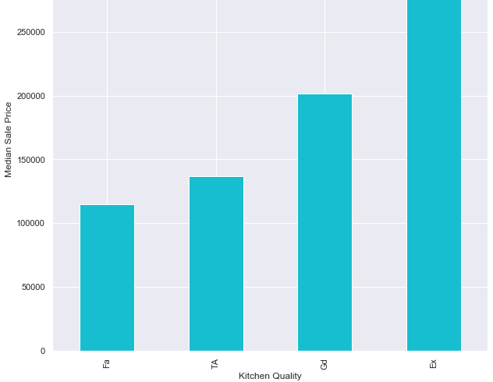
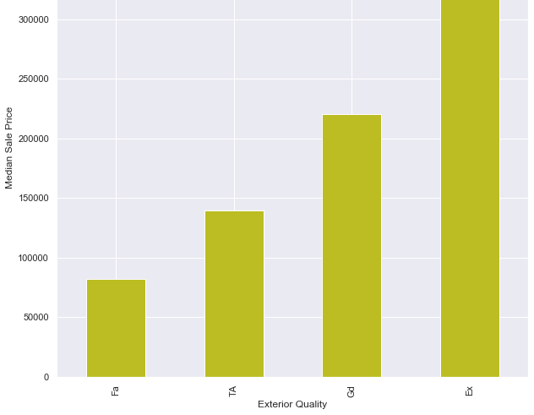
Categorical
Categorical variables were tougher to explore in mass, but made up about half the dataset
Above are two categorical features with the strongest relationship with sale price (as determined by later feature importance exploration in the intermediary models)

Slide 8
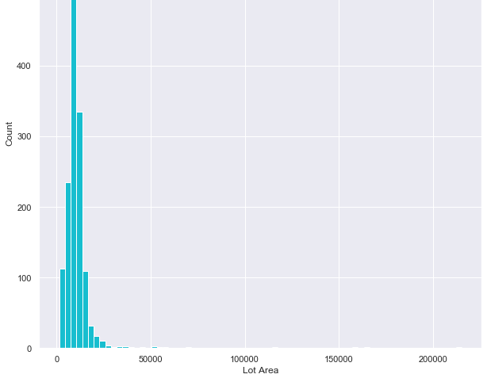
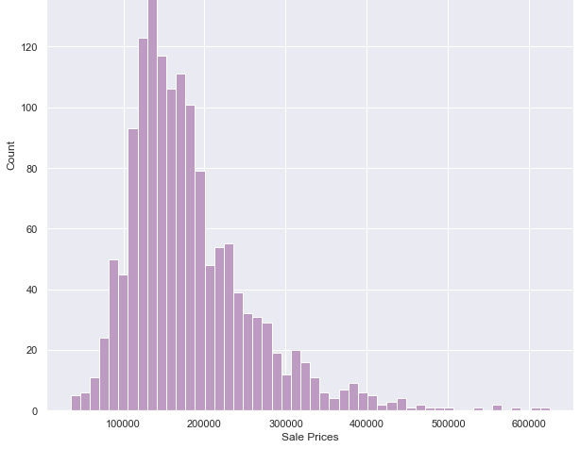
skewedness
A handful of variables had a significant skew to the right, with a long tail for higher values (Predominantly the ‘square footage’ features, but notably the target variable).
The log of the these variables were used so that high values would hopefully cause less of a bias in the models

Slide 9
DATA PRocessing
Feature Engineering / Selection
Handle Missingness
Outliers
Transform Skewed Variables
Categorical Variables: Dummify / Encode

Slide 10
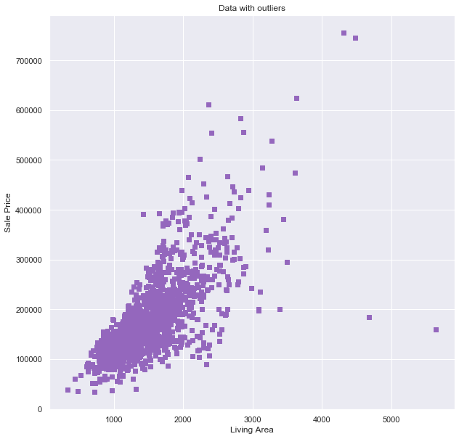
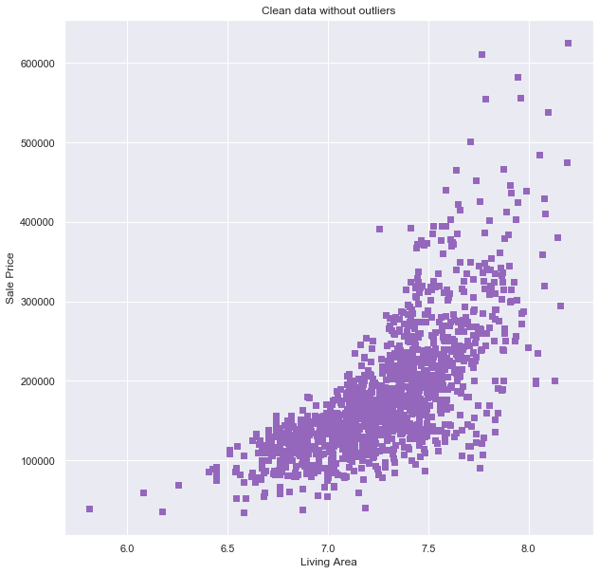
Outliers

Slide 11
Model overview
Linear Models
Tree-based models
MLR
Penalized Regression
Random Forest
Gradient Boosting
XGBoost

Slide 12
Linear regression
Checking the assumptions of MLR confirmed the data did fit a linear regression task
Required dummification: 79 variable turns into 250+
Penalization reduced the effects of multicollinearity on the model
Best performance from ridge regression

Slide 13
Tree based models
Built custom scoring method to use RMSLE as the gridsearch/cv tuning metric
No dummification required
Feature Importance ☺
Marginal improvement in CV results, but vastly improved how robust the models were when testing on new data

Slide 14
Final submission results
Model | CV Test Score | Kaggle Score
Ridge | 0.11465 | 0.15293
Random Forest | 0.13601 | 0.14771
Gradient Boost | 0.10982 | 0.12928
XGBoost | 0.11527 | 0.12599
Average Ensemble | 0.10721 | 0.12758
Stacking Ensemble (XGB meta model) | 0.110714 | 0.13237

Slide 15
Final model
Tuned Paramenters | Value
learning_rate | 0.01
n_estimators | 4600
reg_lambda | 0.9
max_depth | 3
min_child_weight | 3
gamma | 0
subsample | 0.8
colsample_bytree | 0.9
XGBoost had the best performance
Scored in the top 25% percent on Kaggle (placed #1225)

Slide 16
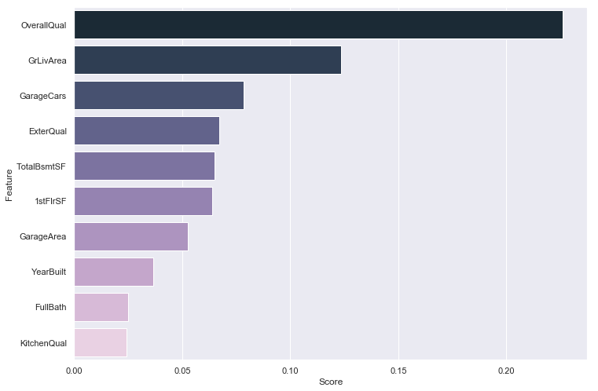
Feature importances

Slide 17
Conclusion / future steps
Diminishing returns on subsequent models, especially on tuning a single model even better
The features with the greatest impact on the final model showed up with the greatest correlation in the initial look at the data
There are a good deal of ways I could see improving my model further

