Slide 1
House Prices: Advanced Regression Techniques
Machine Learning Project
Brenna Botzheim

Slide 2
Background
Kaggle competition to predict the sale price of houses using the Ames Housing dataset
RMSLE is used to evaluate submissions, using the log of predicted and actual target values
Goal of the project is to build a model with the highest predictive accuracy (lowest RMSE)

Slide 3
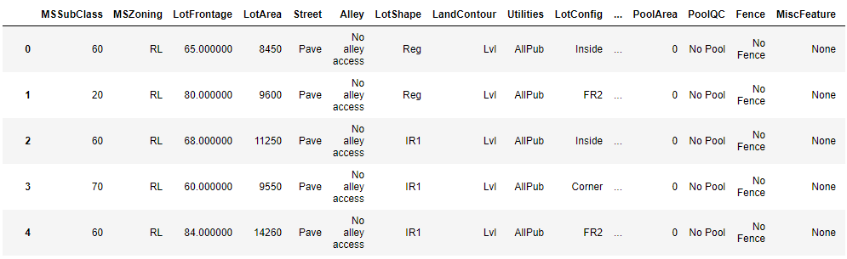
The AMES HOUSING dataset
79 predictive variables describing all aspects of homes sold in Ames, Iowa
A mix of categorical and numerical features
Many highly related variables. For example, 9 variables alone describe different aspects of the house’s basement. Other related variables include garage features, square footage features, etc.

Slide 4
Iterative pROCESS
Step 1: Explore Data
Step 2: Round One Data Processing
Step 3: Build Initial Predictive Models, Submit to Kaggle
Step 4: Round Two Data Processing
Step 5: Build Predictive Models again, Build Model Ensembles
Step 6: Final Submission

Slide 5
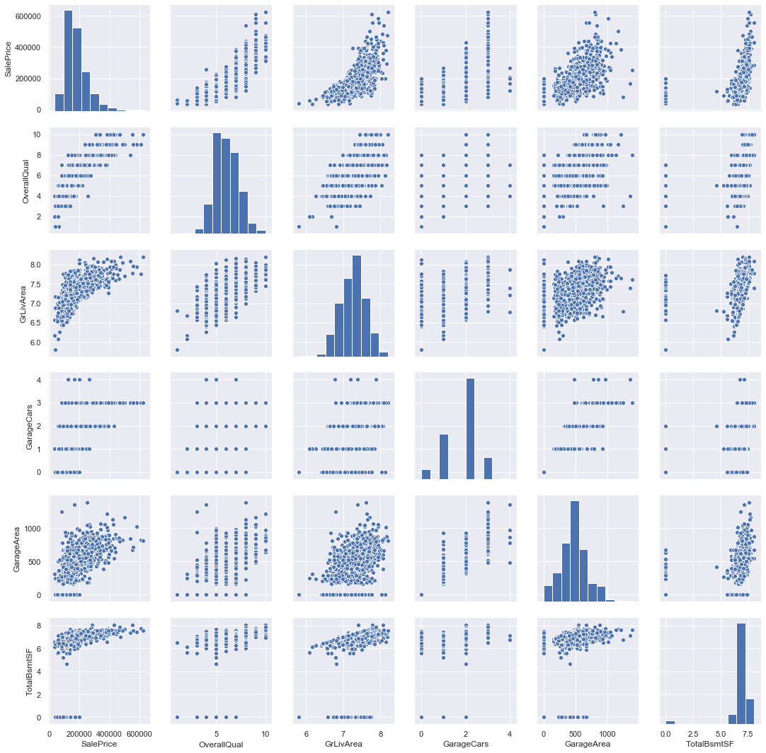
Explore data
Look at relationships between features and the target variable
Find variables with a strong correlation with the target variable
Explore multicollinearity between predictor variables
Opportunities for feature engineering or feature selection
Explore the shape of the data

Slide 6
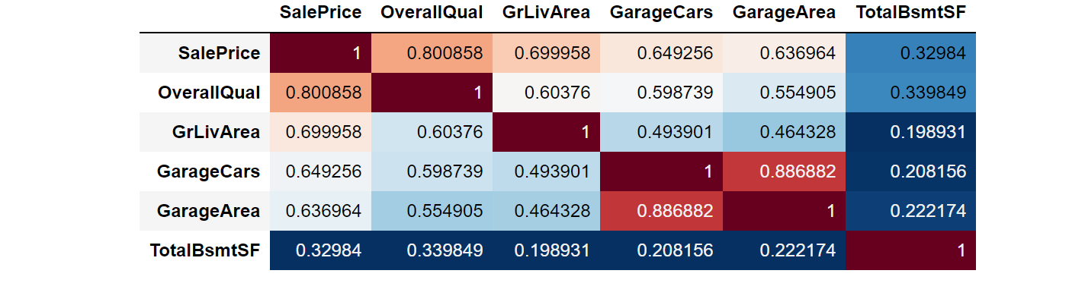
mULTICOLLINEARITY
From the expanded correlation matrix above, we can see that multicollinearity is already evident in this subset of the features.
In general, many of the predictors exhibit some relationship. The features that refer to different aspects of the same house amenities have strong relationships

Slide 7
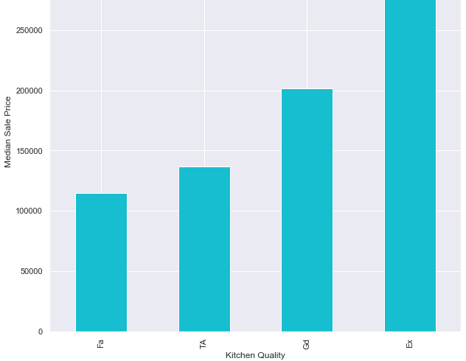
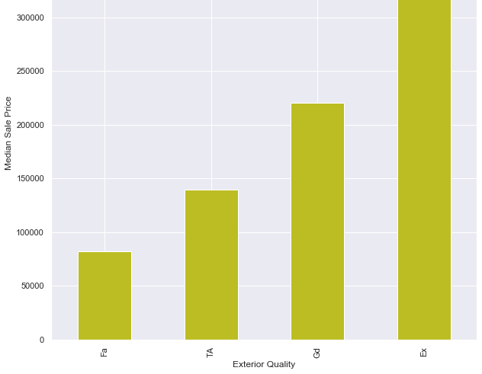
Categorical
Categorical variables were tougher to explore in mass, but made up about half the dataset
These are two categorical features with the strongest relationship with sale price (as determined by later feature importance exploration in the intermediary models)

Slide 8
DATA PRocessing
Feature Engineering / Selection
Handle Missingness
Outliers
Transform Skewed Variables
Categorical Variables: Dummify / Encode

Slide 9
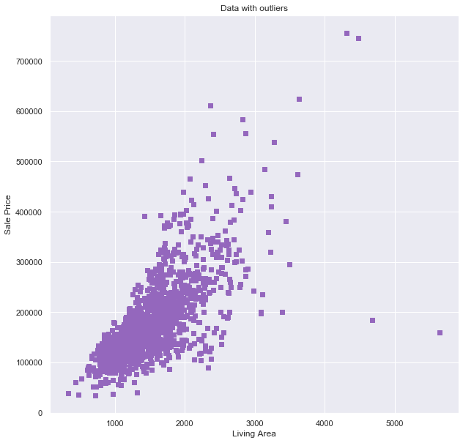
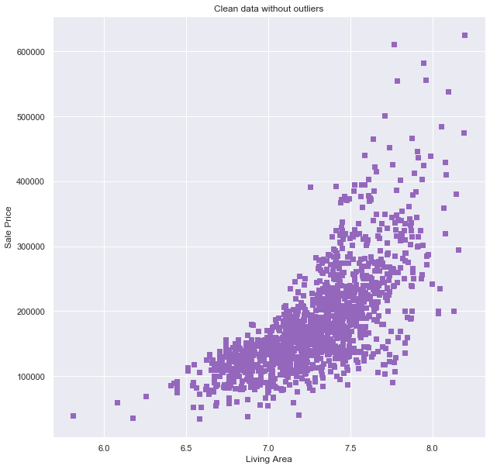
Outliers
Outliers are another source of potential bias in the final models
While processing my data I decided to take an intuition-based approach, and remove very large houses (‘Ground Living Area’ > 4,000) or houses that sold for very high prices (‘SalesPrice’ > 700,000) to reduce bias
This only removed 4 observations from the dataset

Slide 10
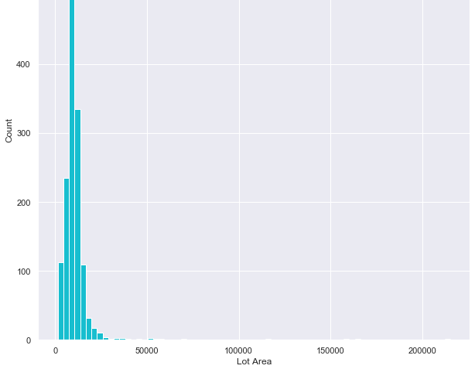
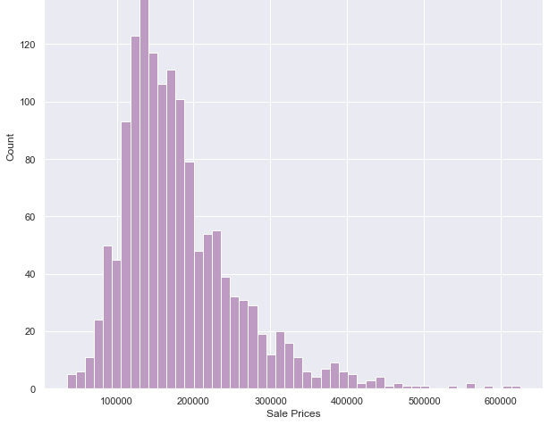
skewedness
A handful of variables had a significant skew to the right, with a long tail for higher values (Predominantly the ‘square footage’ features, but notably the target variable).
The log of these variables were used so that high values would hopefully cause less of a bias in the models

Slide 11
Model overview
Linear Models
Tree-based models
MLR
Penalized Regression
Random Forest
Gradient Boosting
XGBoost

Slide 12
Linear regression
Checking the assumptions of MLR confirmed the data did fit a linear regression task
Required dummification: 79 variable turns into 250+
Penalization reduced the effects of multicollinearity on the model
Best performance from ridge regression

Slide 13
Tree based models
No dummification required
Feature Importance ☺
Built custom scoring method to use RMSLE as the gridsearch/cv tuning metric
Marginal improvement in CV results, but vastly improved how robust the models were when submitting on Kaggle

Slide 14
Final submission results
Model | CV Test Score | Kaggle Score
Ridge | 0.11465 | 0.15293
Random Forest | 0.13601 | 0.14771
Gradient Boost | 0.10982 | 0.12928
XGBoost | 0.11527 | 0.12599
Average Ensemble (Ridge, RF, GBM, XGB) | 0.10721 | 0.12758
Stacking Ensemble (XGB meta model) | 0.110714 | 0.13237
The Average Ensemble model had the best performance on my test set, but it was narrowly outperformed by the XGBoost model on the Kaggle leaderboard. Averaging can help reduce overfitting of any one model.
Stacking Ensemble in theory builds on the different strengths of different models. Its poorer performance suggests to me that the base models may use similar information to predict values.

Slide 15
Final model
Tuned Paramenters | Value
learning_rate | 0.01
n_estimators | 4600
reg_lambda | 0.9
max_depth | 3
min_child_weight | 3
gamma | 0
subsample | 0.8
colsample_bytree | 0.9
XGBoost had the best performance
Utilized lambda regularization parameter (L2 norm) to reduce overfitting
Scored in the top 25% percent on Kaggle (placed #1225)

Slide 16
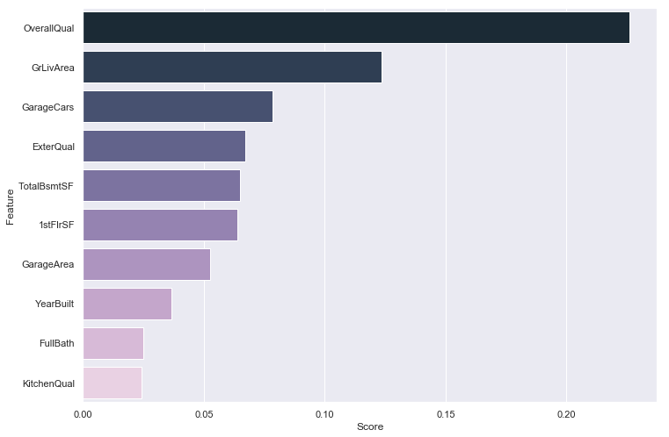
Feature importances
‘Overall Quality’ was the single most important predictor in every model
Other important variables include other quality-related features and size-related features
Most of these variables also showed up with the highest correlation with sale price in the initial data exploration

Slide 17
Conclusion / future steps
Diminishing returns on subsequent models, especially on tuning a single model for better performance
All models performed better on the unseen/set aside test set than on predicting the Kaggle test dataset
Improvements may include more experimenting with how changes in data processing influences model performance.
Additionally, there were more types of models or variations in model ensembling I was interested in applying to this dataset that realistic constraints didn’t allow for.

