Slide 1
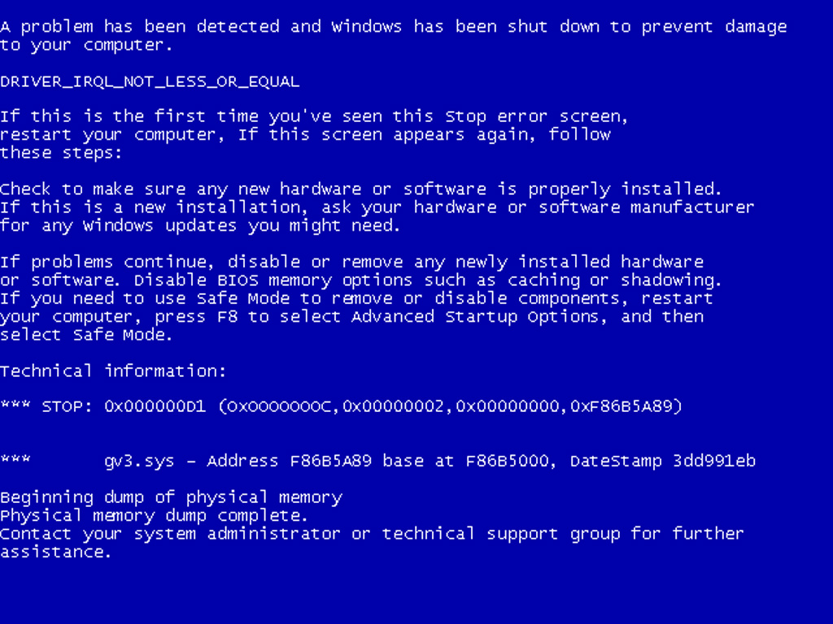

Slide 2
PHP Crawler
<name> Eric Chee </name>
<class> INFO 320 </class>
<grade>4.0</grade>

Slide 3

What does a crawler do?
Downloads the page
Indexes the page
Finds other Links
Depth
A,B,C
<a href=“>

Slide 4
Download Link
Download
Index
Find Links
Depth
<?php
$html = file_get_html(‘www.ericchee.com’);
?>
// $html = “<html><head><body>…”;

Slide 5
Index It
Download
Index
Find Links
Depth
PHP Simple HTML DOM Parser (here)
The jQuery of PHP!
->find(‘’) is basically $(‘’)
EXAMPLES
$html->find(‘h1’);
$html->find(‘p’);
$html->find(‘input[type=”text”]’);
$html->find(‘#ericCheeLovesSEO’);

Slide 6
Index It (cont.)
Download
Index
Find Links
Depth
<?php
include('simple_html_dom.php');
$html = file_get_html(‘www.ericchee.com’);
$header = $html->find(‘h1’, 0)->innertext;
?>
// $header = “Eric Wants a 4.0”;

Slide 7
Find Links
Download
Index
Find Links
Depth
But Grandma!
How do we know what site to parse through next!?
$link = $html->find(a, 0)->href;
// $link = ‘http://ericchee.com/nutchPlease’;

Slide 8
Find Links
Download
Index
Find Links
Depth
<?php
$anchors = $html->find(‘a’);
foreach ($anchors as $anchor){
$href = $anchor->href;
}
?>

Slide 9
Depth
Download
Index
Find Links
Depth
<?php
include('simple_html_dom.php');
$html = file_get_html(‘www.ericchee.com’);
$header = $html->find(‘h1’, 0)->innertext;
$anchors = $html->find(‘a’);
foreach ($anchors as $anchor){
$href = $anchor->href;
}
?>
Download
Index
Find Links

Slide 10
Depth
Download
Index
Find Links
Depth
<?php
include('simple_html_dom.php');
function crawlPage($url, $depth){
$html = file_get_html($url);
$header = $html->find(‘h1’, 0)->innertext;
$anchors = $html->find(‘a’);
foreach ($anchors as $anchor){
$href = $anchor->href;
crawlPage($href, $depth -1);
}
}
?>
Download
Index
Find Links

Slide 11
Where to go from here
Check for:
URL exists
If already seen URLs
Relative URLS
Link Index with Database i.e. MySQL
Link it with Solr
Create Log File

Slide 12
The End
Questions?

