Slide 1
M.Tech. (Online) - Artificial Intelligence
Detecting AI-Generated and Cloned Speech
to Strengthen Voice-Based Authentication in Banking Environments
Midterm Evaluation - Phase 1 + Phase 2 Progress
Rajib Roy | Student No. 24459 | IISc, Bengaluru | M.Tech (AI)
Internal Guide: Dr. Anil Rahate, Wipro Ltd | IISc Mentor: Prof. C. S. Seelamantula
July 2026

Slide 2
OVERVIEW
Agenda
▸ Problem & motivation
▸ Research questions and novelty
▸ Project timeline: Phase 1 → Phase 2 → Phase 3
▸ Phase 1 recap: dataset & feature pipeline
▸ Phase 2: classical ML baselines
▸ Phase 2: feature importance analysis
▸ Phase 2: deep learning models (CNN, CNN-LSTM)
▸ Phase 2: robustness & cross-system generalisation
▸ Consolidated results & key insights
▸ Phase 3 plan & Q&A
Midterm Evaluation — Phase 1 + Phase 2

Slide 3
MOTIVATION
The Problem
Goal
Build and validate an automated pipeline that distinguishes genuine human speech from AI-generated / cloned speech, specifically under banking telephony conditions: short utterances, codec compression, background noise.
▸ Voice authentication is routine in banking IVR / call-centre workflows
▸ Neural TTS & voice cloning can now replicate a voice from a few seconds of audio
▸ Existing voice biometrics were designed against replay attacks - not modern neural TTS
▸ A successful spoof enables fraudulent transfers, identity fraud, social engineering
Midterm Evaluation — Phase 1 + Phase 2

Slide 4
SCOPE
Research Questions
1
Can supervised ML reliably distinguish real vs. AI-synthesised speech, on unseen speakers and unseen TTS systems?
2
Which acoustic/signal-level properties (spectral shape, phase coherence, prosody) most reliably betray synthetic speech?
3
How do detection models hold up under banking telephony conditions - short utterances, G.711 codec, ambient noise?
4
Do deep learning architectures offer a meaningful advantage over classical ML under identical data conditions?
Midterm Evaluation — Phase 1 + Phase 2

Slide 5
WORK PLAN (APPROVED PROPOSAL)
Project Timeline
Phase 1
Jan – Apr 2026
Literature review
Dataset (17,947 utterances)
Feature pipeline
Phase 2
May – Jul 2026
ML baselines
Feature importance
CNN / CNN-LSTM · Robustness experiments
Phase 3
Aug – Dec 2026
SHAP + saliency interpretability
Final evaluation & stats
Thesis writing
COMPLETE
COMPLETE
UPCOMING
We are here: end of Phase 2, entering Phase 3

Slide 6
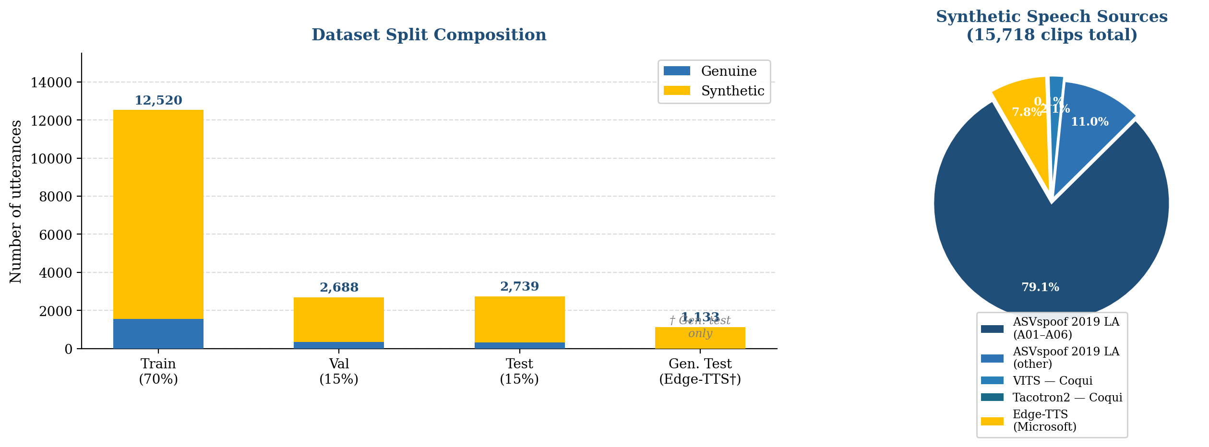
FOUNDATION FOR PHASE 2
Phase 1 Recap: Dataset
▸ 17,947 utterances from 10 sources
Genuine: LibriSpeech test-clean, 2,229 clips, 40 speakers
Synthetic: ASVspoof 2019 LA (6 TTS/VC systems), VITS, Tacotron2, Edge-TTS
▸ 8 kHz + G.711 codec simulation (banking telephony)
▸ 3-8 second utterances (transaction-confirmation length)
▸ Strict speaker- and system-independent splits
▸ Microsoft Edge-TTS held out entirely - unseen-system generalisation test
Midterm Evaluation — Phase 1 + Phase 2

Slide 7
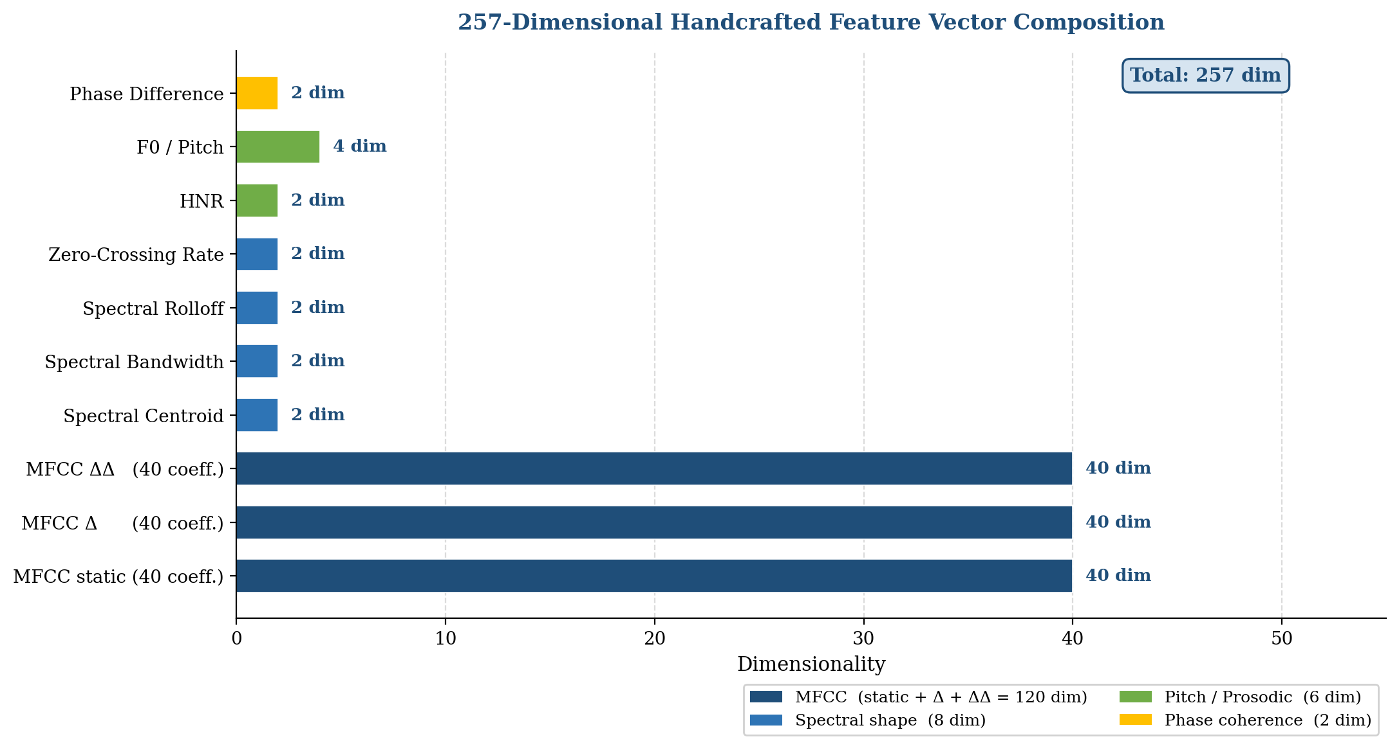
FOUNDATION FOR PHASE 2
Phase 1 Recap: Feature Pipeline
▸ 257-dim handcrafted feature vector (Librosa, 25 ms window / 10 ms hop)
MFCC (40 coeff. × static/Δ/ΔΔ) = 120 dims
Spectral centroid, bandwidth, rolloff, ZCR, HNR, pitch, phase difference
▸ 128-bin log-Mel spectrograms for deep learning models (128×128)
▸ All hyperparameters centralised in config.yaml
▸ diagnose.py validates class balance, NaNs, inter-class separation
Midterm Evaluation — Phase 1 + Phase 2

Slide 8
SVM · RANDOM FOREST · GRADIENT BOOSTING
Phase 2: Classical ML Baselines
Model | Eval. Set | EER ↓ | F1 ↑ | AUC ↑ | Acc. ↑
SVM (RBF) | Test | 0.0083 | 0.9943 | 0.9992 | 0.9912
SVM (RBF) | Gen. test† | 0.0067 | 0.9969 | 0.9987 | 0.9953
Random Forest | Test | 0.0305 | 0.9834 | 0.9956 | 0.9744
Random Forest | Gen. test† | 0.0293 | 0.9854 | 0.9964 | 0.9781
Gradient Boosting | Test | 0.0346 | 0.9820 | 0.9949 | 0.9722
Gradient Boosting | Gen. test† | 0.0311 | 0.9868 | 0.9956 | 0.9801
SVM (RBF kernel, C=10) is the strongest classical baseline. All three models trained with SMOTE + class-weighting inside 5-fold CV.
† Gen. test = held-out Edge-TTS, unseen in training.
Midterm Evaluation — Phase 1 + Phase 2

Slide 9
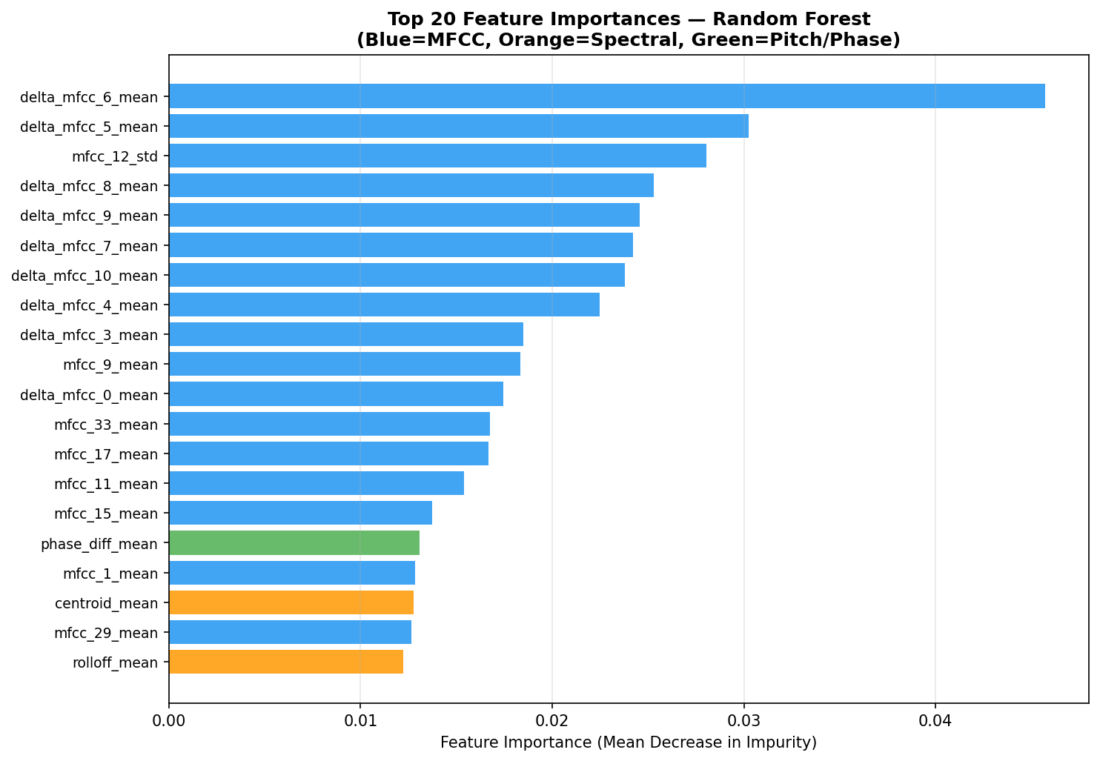
INTERPRETABILITY (RANDOM FOREST)
Phase 2: Feature Importance Analysis
▸ Random Forest importance ranking over the 257-dim feature vector
▸ Delta-MFCC coefficients dominate (delta_mfcc_6_mean, delta_mfcc_5_mean)
TTS vocoders impose smoother, more regular spectral dynamics than natural articulation
▸ phase_diff_mean ranks 16th — validates inclusion of phase-based features
▸ Spectral centroid & rolloff appear as secondary discriminators
Midterm Evaluation — Phase 1 + Phase 2

Slide 10
CNN & CNN-LSTM ON LOG-MEL SPECTROGRAMS
Phase 2: Deep Learning Models
CNN
▸ 4 conv blocks: 32→64→128→256 channels, 3×3 kernel, BatchNorm, ReLU, max-pool
▸ Global average pooling
▸ Classifier: 256→128→2, dropout p=0.5
421,954 parameters
CNN-LSTM
▸ Same conv front-end, frequency-only pooling (preserves time axis)
▸ 2-layer bidirectional LSTM, hidden size 128/direction
▸ Same classifier head — explicitly models temporal prosodic dynamics
1,834,498 parameters
Training: Adam (lr=1e-3), cosine annealing, 50 epochs, weighted cross-entropy, WeightedRandomSampler, mixed precision on RTX 3060 (6.4 GB),
early stopping (patience 10)

Slide 11
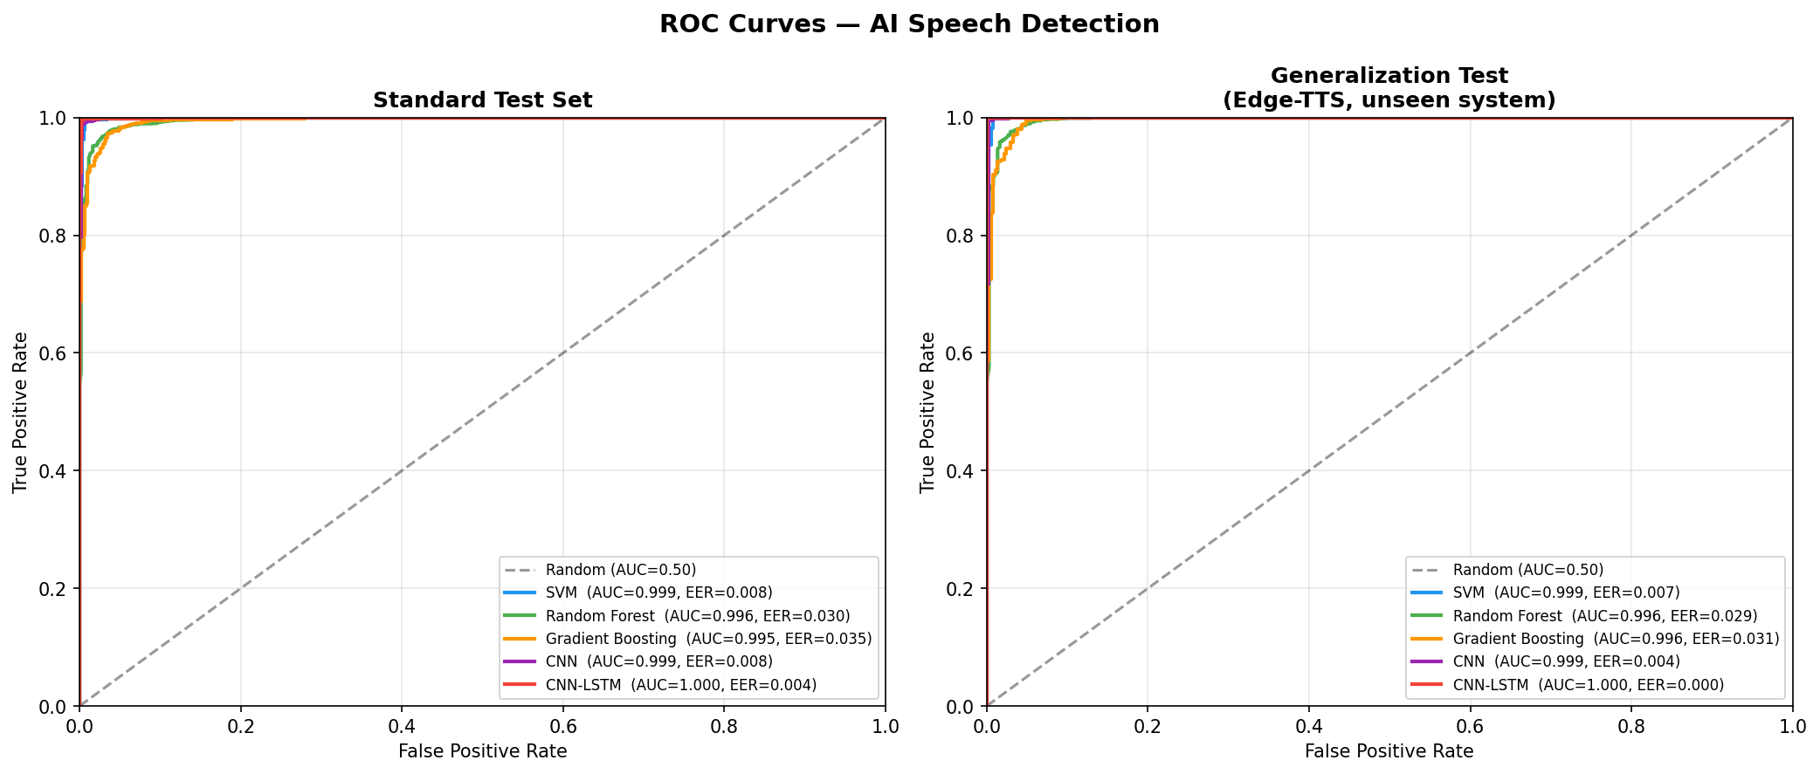
CNN VS. CNN-LSTM
Phase 2: Deep Learning - Convergence
Model | Params | Best Epoch | Val EER | Training Time
CNN | 421,954 | 22 | 0.0154 | ~55 min (RTX 3060)
CNN-LSTM | 1,834,498 | 21 | 0.0092 | ~60 min (RTX 3060)
CNN-LSTM converges faster to a lower validation EER — explicit temporal modelling via the LSTM captures prosodic artefacts that CNN global average pooling discards.
Midterm Evaluation — Phase 1 + Phase 2

Slide 12
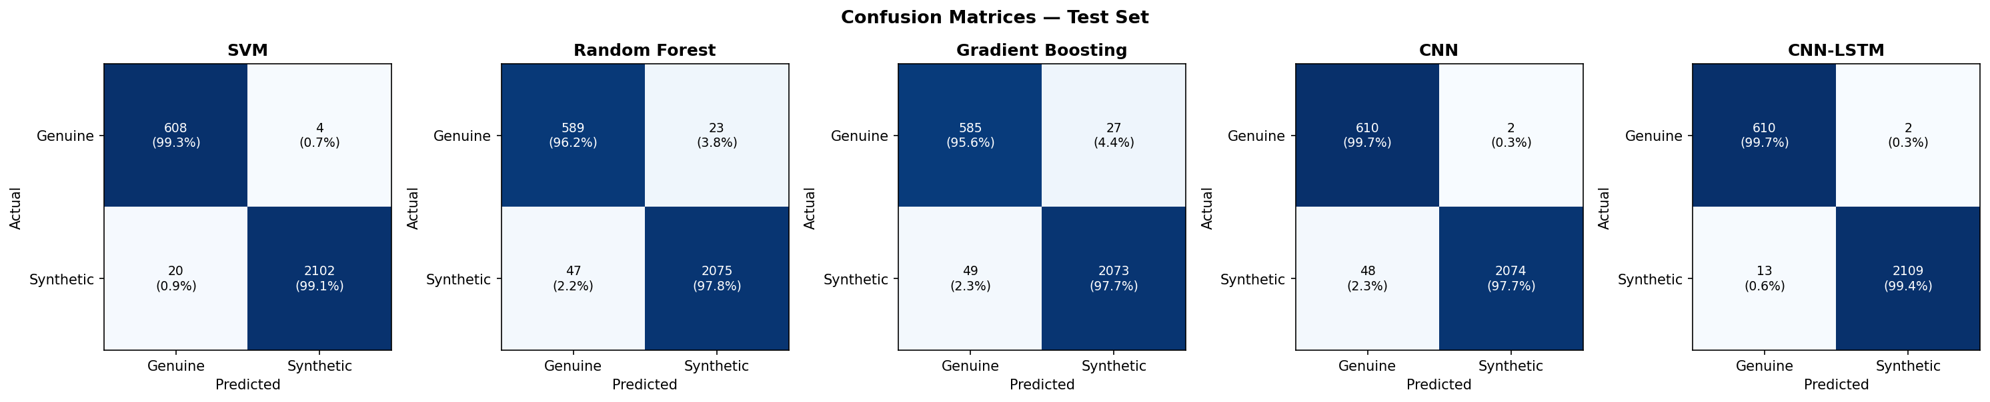
STANDARD TEST SET
Phase 2: Confusion Matrices
CNN and CNN-LSTM produce fewer than 3 false positives and under 50 false negatives per 2,734 test clips.

Slide 13
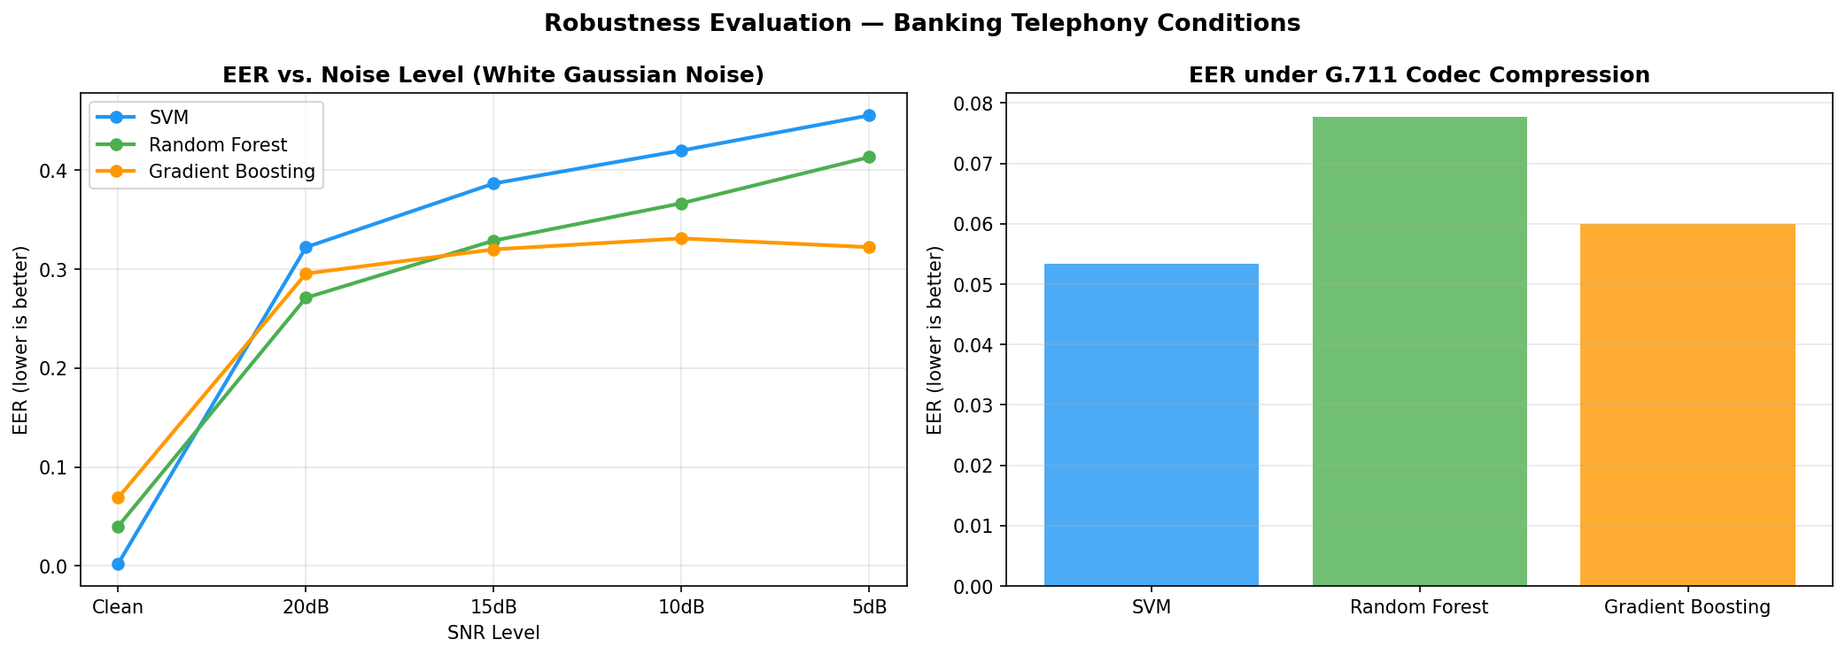
NOISE (SNR) & G.711 CODEC COMPRESSION
Phase 2: Robustness Evaluation
SVM degrades fastest under noise (EER ≈0.45 at 5 dB SNR)
Gradient Boosting is most noise-robust (flattens at ≈0.33 below 15 dB)
G.711 alone degrades all models only to EER 0.05-0.08 → noise is the bigger deployment risk, not codec compression.

Slide 14
FULL COMPARISON ACROSS EVALUATION CONDITIONS
Consolidated Results - All Models
Model | Eval. Set | EER ↓ | F1 ↑ | AUC ↑ | Acc. ↑
SVM | Test | 0.0083 | 0.9943 | 0.9992 | 0.9912
SVM | Gen. test† | 0.0067 | 0.9969 | 0.9987 | 0.9953
Random Forest | Test | 0.0305 | 0.9834 | 0.9956 | 0.9744
Random Forest | Gen. test† | 0.0293 | 0.9854 | 0.9964 | 0.9781
Gradient Boosting | Test | 0.0346 | 0.9820 | 0.9949 | 0.9722
Gradient Boosting | Gen. test† | 0.0311 | 0.9868 | 0.9956 | 0.9801
CNN | Test | 0.0081 | 0.9881 | 0.9993 | 0.9817
CNN | Gen. test† | 0.0036 | 0.9942 | 0.9991 | 0.9914
CNN-LSTM | Test | 0.0035 | 0.9965 | 0.9996 | 0.9945
CNN-LSTM | Gen. test† | 0.0004 | 0.9978 | 1.0000 | 0.9967
CNN-LSTM is best overall (EER 0.0035 test, 0.0004 on unseen Edge-TTS). Every model generalises as well as or better than on the standard test set. † Gen. test = held-out Edge-TTS.
Midterm Evaluation — Phase 1 + Phase 2

Slide 15
WHAT PHASE 2 TAUGHT US
Key Insights
Deep Learning vs. Classical
CNN-LSTM wins overall, but SVM (EER 0.0083) is surprisingly competitive - even beating the plain CNN. The value of deep learning here comes specifically from temporal (LSTM) modelling, not convolution alone.
Generalisation is stronger than expected
Every model does as well or better on the fully unseen Edge-TTS system as on the standard test set - spectral/temporal artefacts appear to be common across neural TTS architectures, not system-specific fingerprints.
Noise > Codec Compression as a risk
G.711 alone only pushes EER to 0.05-0.08. Additive noise pushes classical model EER above 0.3 at low SNR.
Midterm Evaluation — Phase 1 + Phase 2

Slide 16
AUGUST – NOVEMBER 2026
Phase 3 Plan
Task | Timeline | Key Deliverable
Interpretability: SHAP for classical models | Aug 2026 | SHAP summary plots, cross-checked vs. RF importances
Interpretability: gradient saliency (CNN/CNN-LSTM) | Aug - Sep 2026 | Time-frequency saliency maps
Final evaluation & statistical testing | Sep - Oct 2026 | Significance testing between models
Thesis writing & submission | Oct - Nov 2026 | Final report, institute-prescribed format
Midterm Evaluation — Phase 1 + Phase 2

Slide 17
Thank you
Questions & Discussion

